Slide 1
Travel evidence | decision snapshot
Queried 2026-10-24 04:30 UTC • USD • 1 adult/room • 11/28–12/2/2026
CONDITIONAL FIRST CHOICE
Chicago • 24 attendees • DCA–ORD nonstop • 4 nights
Known/estimated base: $31,399.68
+ 5% reserve: $32,969.66
20% airfare stress: $34,330.46
Not quoted (entered $0, not free):
venue • provided meals • breaks • breakfast confirmation • group rate delta
Approval blocked until written quotes and hotel quality evidence are obtained.
Screenshots are genuine public search pages. Fares change and are single-traveler snapshots; no booking, group inventory, credentials, or approval is represented.

Slide 2
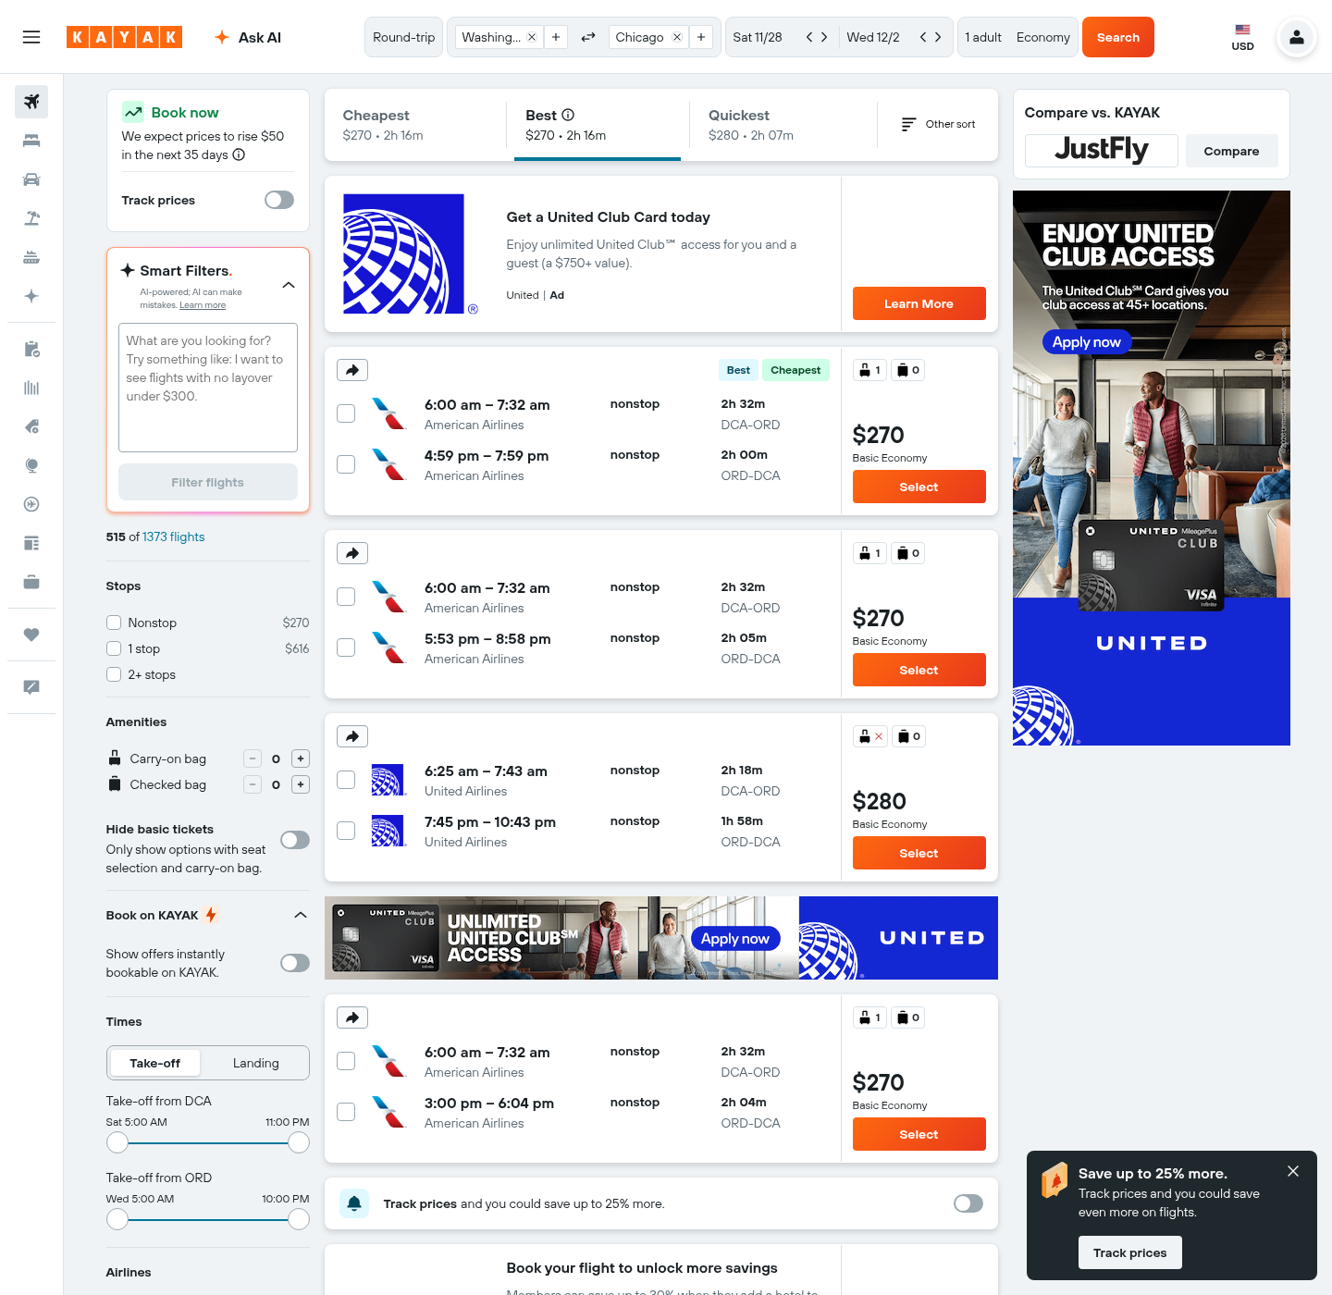
Chicago | actual airfare search screenshot
https://www.kayak.com/flights/DCA-ORD/2026-11-28/2026-12-02?sort=bestflight_a • queried 2026-10-24 04:30 UTC
Budgeted itinerary
DCA 06:00–ORD 07:32 nonstop
ORD 16:59–DCA 19:59 nonstop
American Airlines • $270.00 round trip
Fare class shown on page; baggage/seat and refund/change terms not fully displayed—reconfirm.
Hotel cards on the same dated results page were used for preliminary comparison:
Staybridge Suites Chicago—Glenview by IHG: $134.00/night; 8.5/10
Hampton Inn & Suites Chicago/Hoffman Estates: $96.00/night; 8.1/10
Breakfast, room type, taxes/fees, cancellation, review count and recent issue detail were not displayed: not admitted.

Slide 3
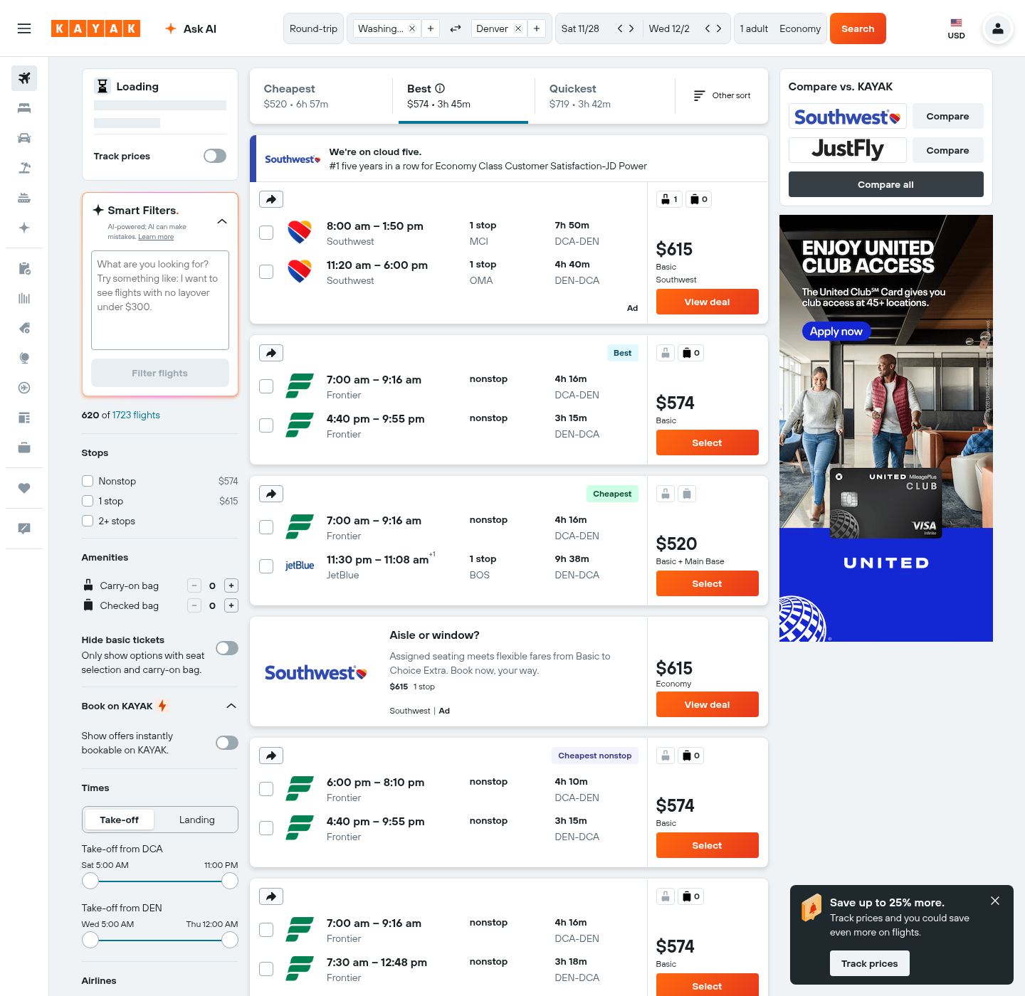
Denver | actual airfare search screenshot
https://www.kayak.com/flights/DCA-DEN/2026-11-28/2026-12-02?sort=bestflight_a • queried 2026-10-24 04:30 UTC
Budgeted itinerary
DCA 07:00–DEN 09:16 nonstop
DEN 16:40–DCA 21:55 nonstop
Frontier • $574.00 round trip
Fare class shown on page; baggage/seat and refund/change terms not fully displayed—reconfirm.
Hotel cards on the same dated results page were used for preliminary comparison:
Staybridge Suites Denver Downtown by IHG: $103.00/night; 8.3/10
Hyatt House Denver/Downtown: $116.00/night; 8.7/10
Breakfast, room type, taxes/fees, cancellation, review count and recent issue detail were not displayed: not admitted.

Slide 4
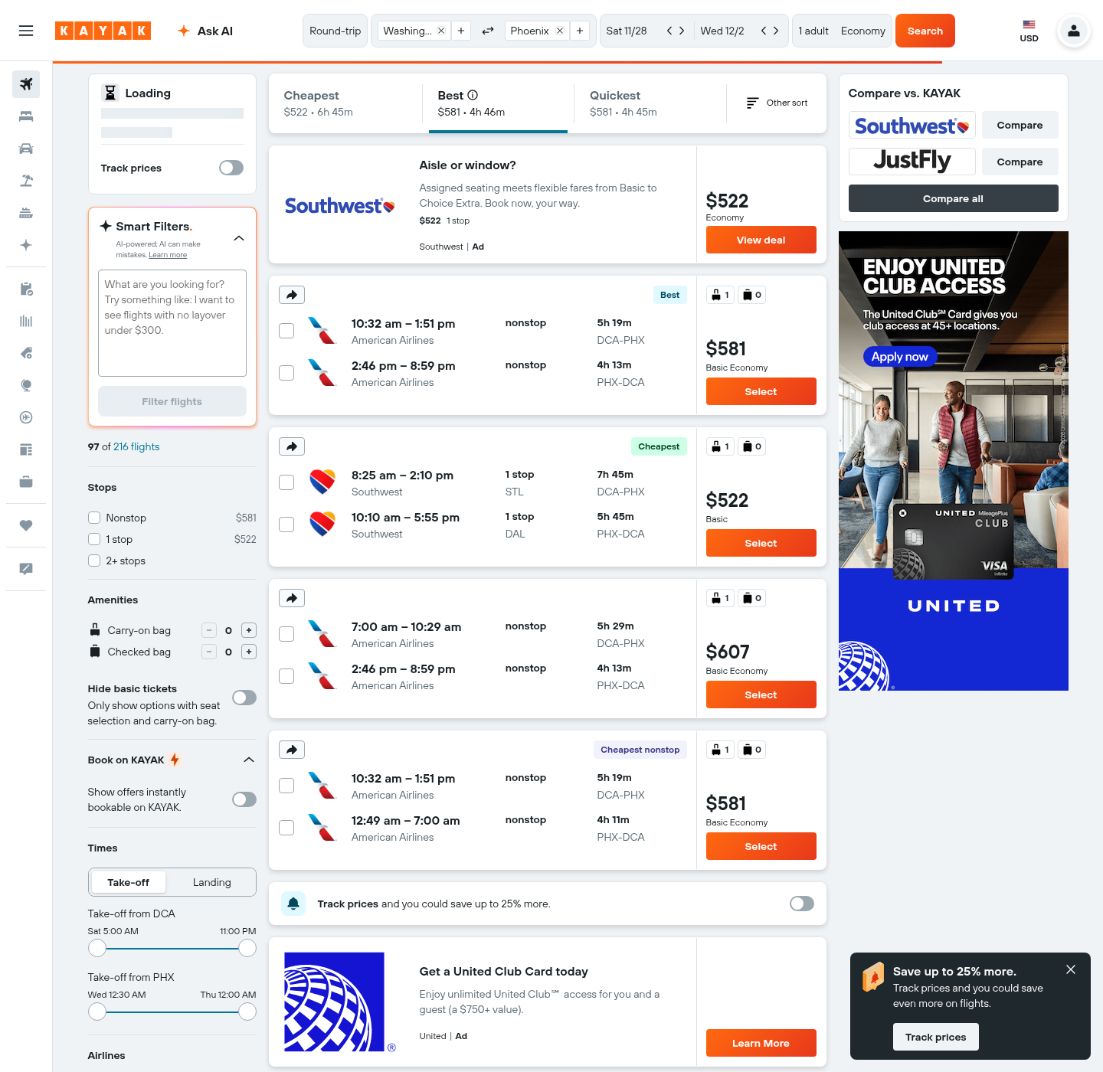
Phoenix | actual airfare search screenshot
https://www.kayak.com/flights/DCA-PHX/2026-11-28/2026-12-02?sort=bestflight_a • queried 2026-10-24 04:30 UTC
Budgeted itinerary
DCA 10:32–PHX 13:51 nonstop
PHX 14:46–DCA 20:59 nonstop
American Airlines • $581.00 round trip
Fare class shown on page; baggage/seat and refund/change terms not fully displayed—reconfirm.
Hotel cards on the same dated results page were used for preliminary comparison:
La Quinta Inn & Suites by Wyndham Phoenix Chandler: $100.00/night; 8.3/10
Radisson Hotel Phoenix Airport: $118.00/night; 8.0/10
Breakfast, room type, taxes/fees, cancellation, review count and recent issue detail were not displayed: not admitted.

Slide 5
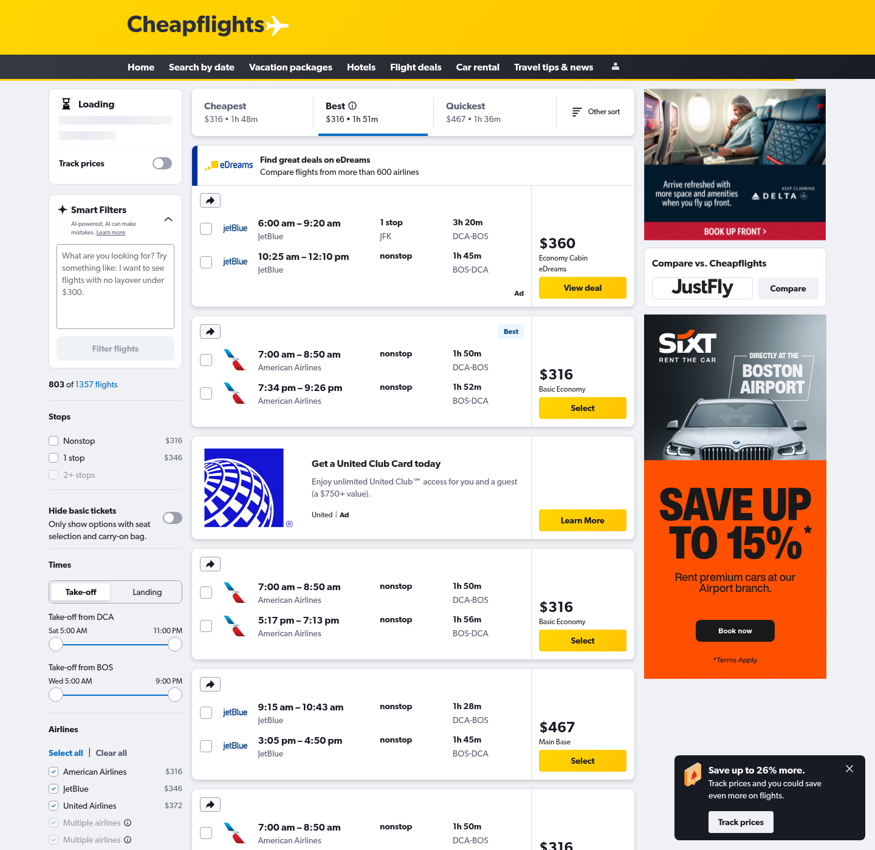
Boston | actual airfare search screenshot
https://www.cheapflights.com/flight-search/DCA-BOS/2026-11-28/2026-12-02?sort=bestflight_a • queried 2026-10-24 04:30 UTC
Budgeted itinerary
DCA 07:00–BOS 08:50 nonstop
BOS 17:17–DCA 19:13 nonstop
American Airlines • $316.00 round trip
Fare class shown on page; baggage/seat and refund/change terms not fully displayed—reconfirm.
Hotel cards on the same dated results page were used for preliminary comparison:
Studio Allston Hotel: $155.50/night; 8.2/10
DoubleTree by Hilton Boston-Downtown: $165.50/night; 8.4/10
Breakfast, room type, taxes/fees, cancellation, review count and recent issue detail were not displayed: not admitted.

Slide 6
Hotel quote comparison and evidence gaps
Public dated cards on flight-result pages; 1 room / 1 adult / 4 nights; group inventory unconfirmed
Chicago: Staybridge Suites Chicago—Glenview by IHG — $134.00/night, 8.5/10 | Hampton Inn & Suites Chicago/Hoffman Estates — $96.00/night, 8.1/10
Denver: Staybridge Suites Denver Downtown by IHG — $103.00/night, 8.3/10 | Hyatt House Denver/Downtown — $116.00/night, 8.7/10
Phoenix: La Quinta Inn & Suites by Wyndham Phoenix Chandler — $100.00/night, 8.3/10 | Radisson Hotel Phoenix Airport — $118.00/night, 8.0/10
Boston: Studio Allston Hotel — $155.50/night, 8.2/10 | DoubleTree by Hilton Boston-Downtown — $165.50/night, 8.4/10
Uniform admission rule: ≥8.0/10, ≥100 reviews, and no unresolved recent pattern involving cleanliness, nighttime noise, or maintenance. The result cards did not show review counts or the required recent-review evidence. They also did not show breakfast, room type, tax/mandatory-fee basis, or cancellation terms. Therefore every hotel remains a candidate—not a qualified recommendation—until procurement captures complete evidence.

Slide 7

Seattle | excluded pending re-quote
DCA–SEA, 11/28–12/2/2026 • search attempts queried 2026-10-24
Kayak, Cheapflights and Priceline searches returned human-verification challenges in this environment. No fare or hotel amount was extracted or invented.
Budget cells remain $0 only as “not quoted” inputs; Options labels the city NO QUOTE. Seattle cannot compete until new complete screenshots are obtained.

Slide 8
Policy and rate evidence
Supplied frozen/validated files; see workbook Sources for exact file names and applicability
FTR 301-74.1–.5: minimize total costs, consider alternatives, compare lodging adequacy, fees, meeting space, equipment, convenience and travel distance; document rationale.
FTR 301-74.21 / 301-11.18: deduct government/registration meals; no deduction for light refreshments. FTR 301-11.17: complimentary hotel breakfast does not reduce M&IE. FTR 301-11.27: lodging taxes are separate and limited to tax on reimbursable lodging. FTR 301-11.101: first/last travel days at 75%.
FY2027 lodging caps: Chicago $232 (Nov)/$148 (Dec); Denver $170; Phoenix $165; Boston $213; Seattle $188. M&IE: Phoenix $86; others $92.
RD Instruction 2036-A official 2024-07-19 version was requested but USDA access returned HTTP 403 in this environment. No clause was invented; retrieval and policy-office verification are approval blockers.

