Slide 1
Dataset Distillation
Tian-Shuang Wu
Tutor：Shen-Huan Lyu
tianshuangwu@hhu.edu.cn
2025/4/7

Slide 2
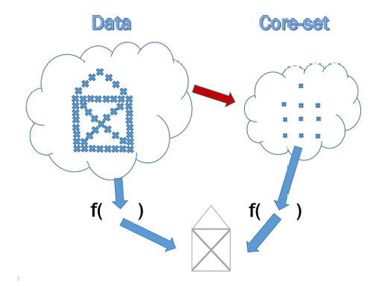
Background
Problem:
massive data pose a significant threat to training efficient and data storage
Method:
before dataset distillation(DD),
Core-set selection
a few
high-information data

Slide 3
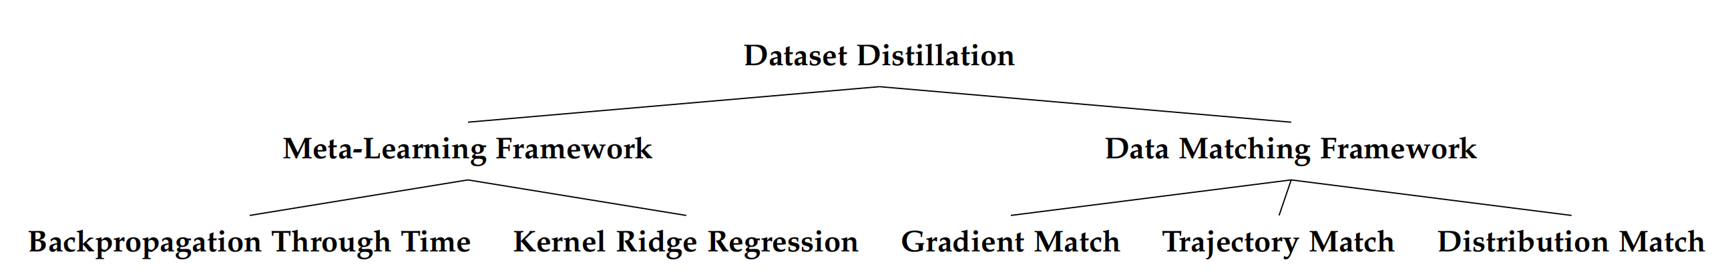

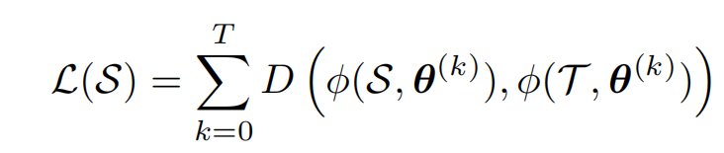

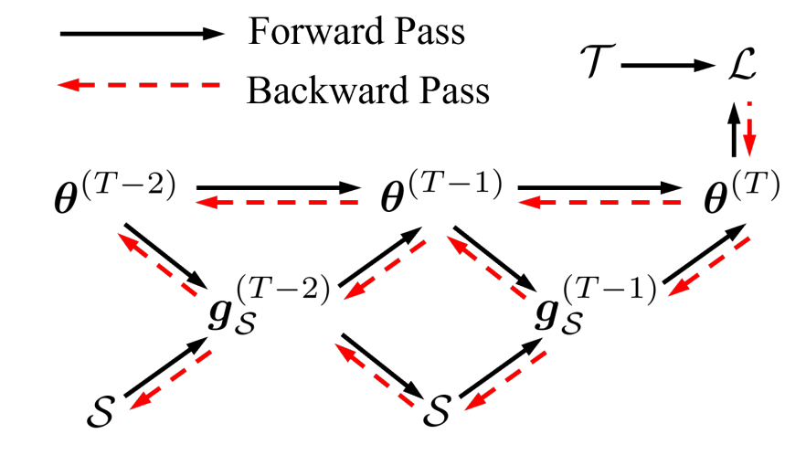
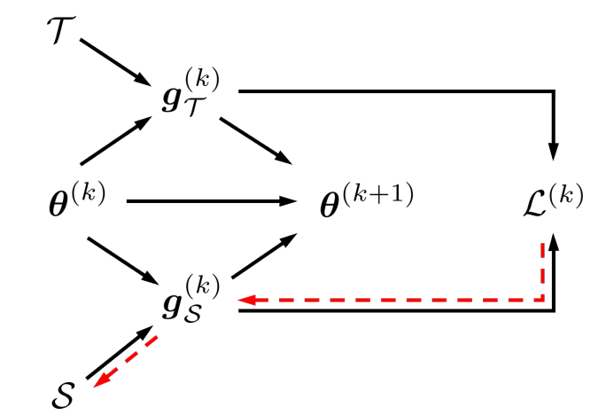
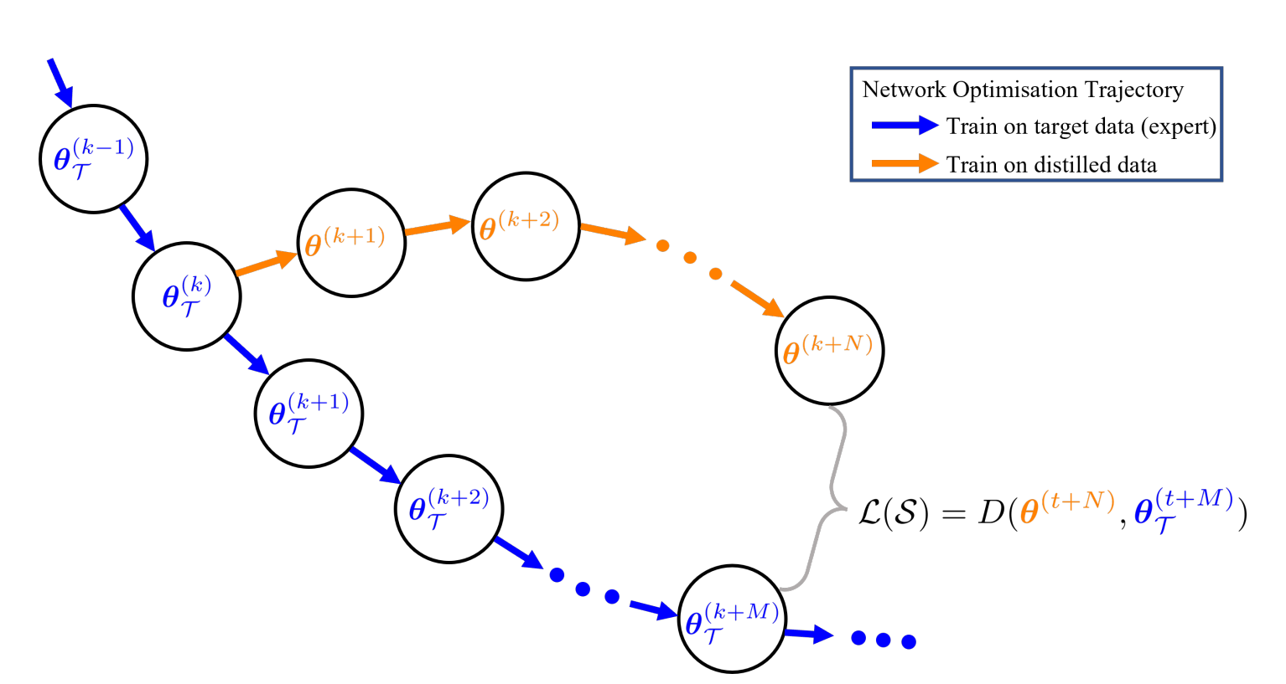
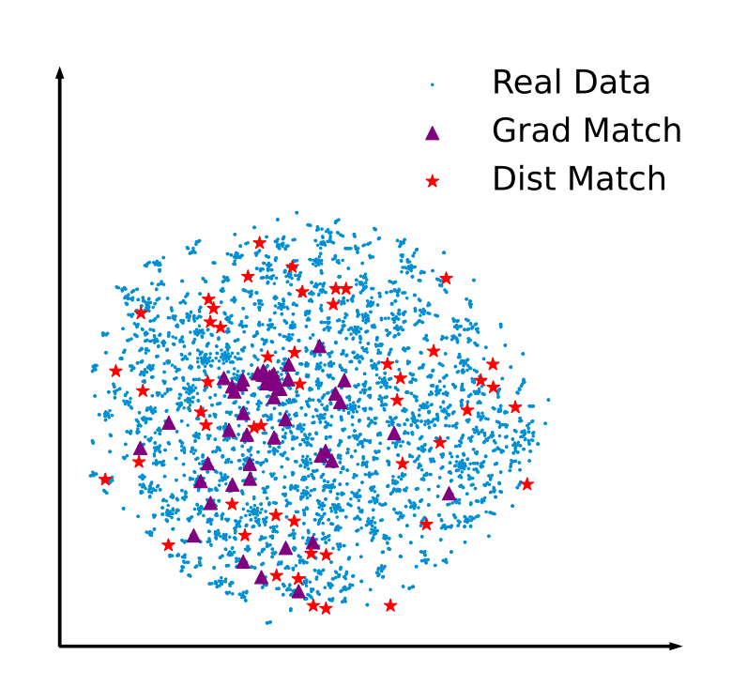
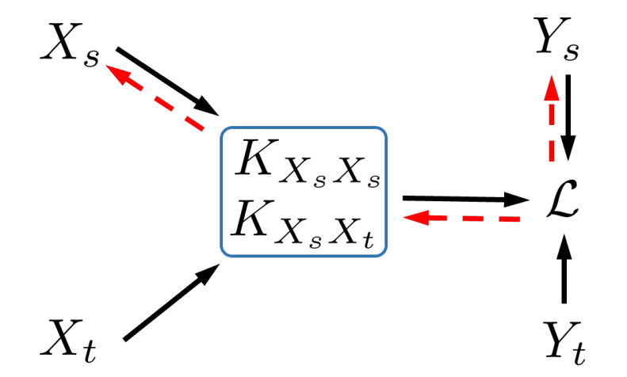
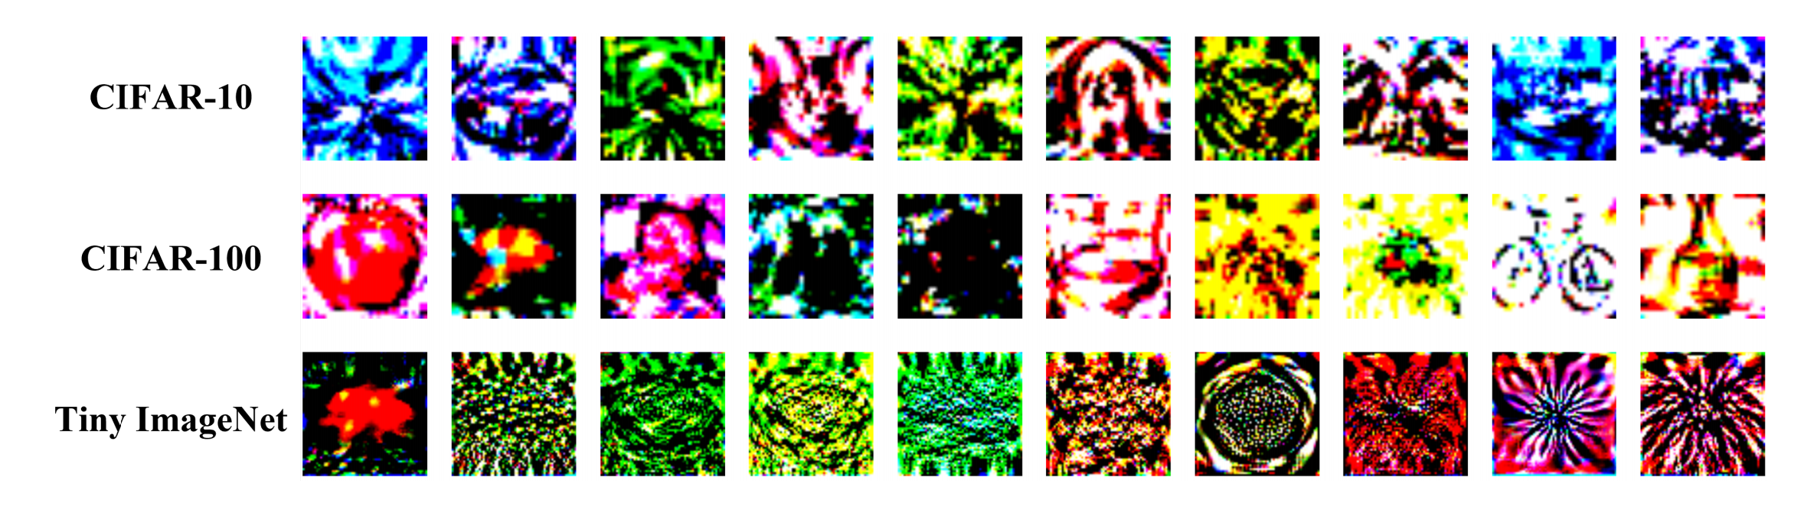
Dataset Distillation

Slide 4
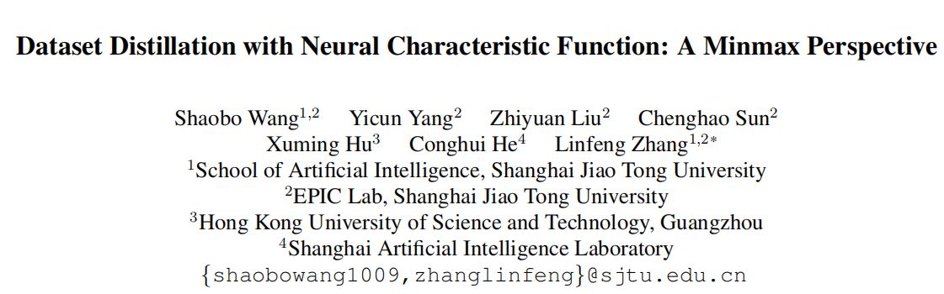
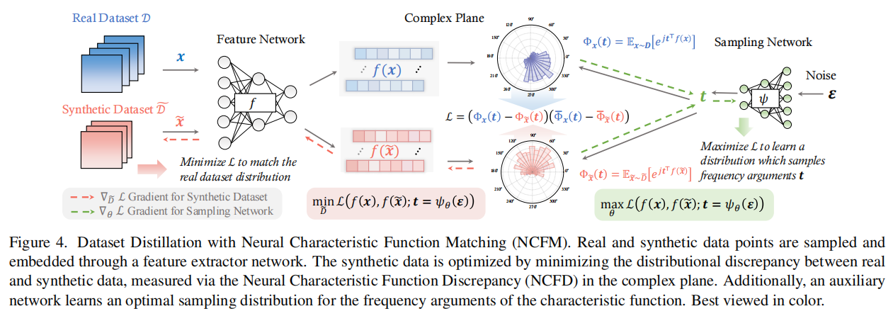
Neural Characteristic Function Discrepancy (NCFD)
Notes:
图

Slide 5
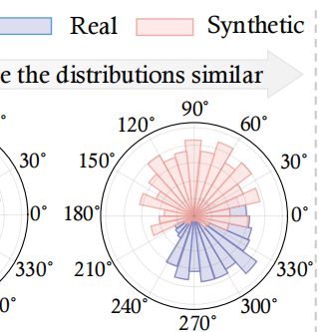
Dataset Distillation with Neural Characteristic Function: A Minmax Perspective
Target of data distillation:
reducing data requirements in deep learning
Problem:
Popular Distribution Matching (DM) -based methods:
Mean Square Error(MSE)
directly matches pixel-level or patch-level information without capturing the semantic structures embedded in high dimensional manifolds
Maximum Mean Discrepancy(MDD)
aligning moments alone does not guarantee full distributional matching

Slide 6

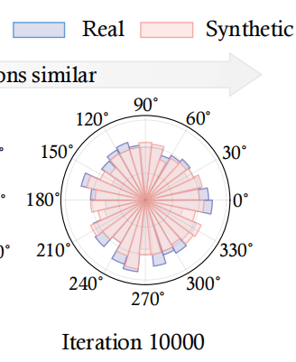
Neural Characteristic Function Discrepancy (NCFD)
Method (Solution):
Minmax Framework:
Neural Characteristic Function Matching(NCFM):
Characteristic Function (CF): Uniqueness
Sampling Strategy for NCFD: ψ → t
Distribution Matching with NCFD

Slide 7
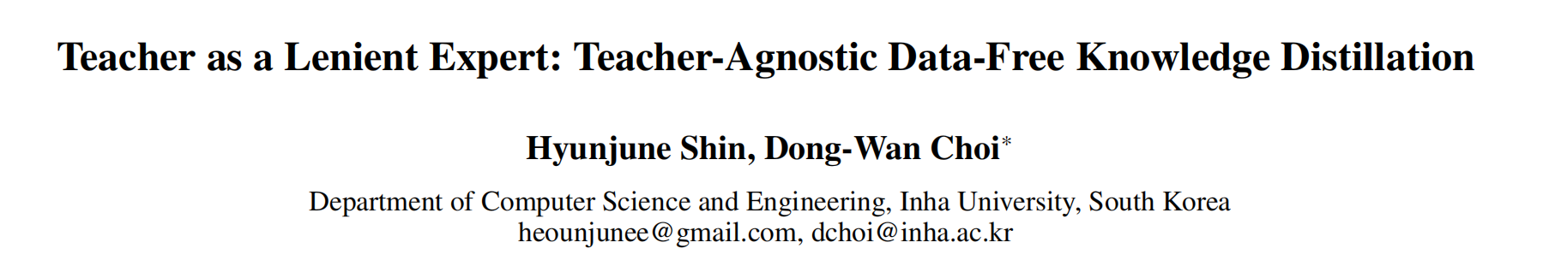
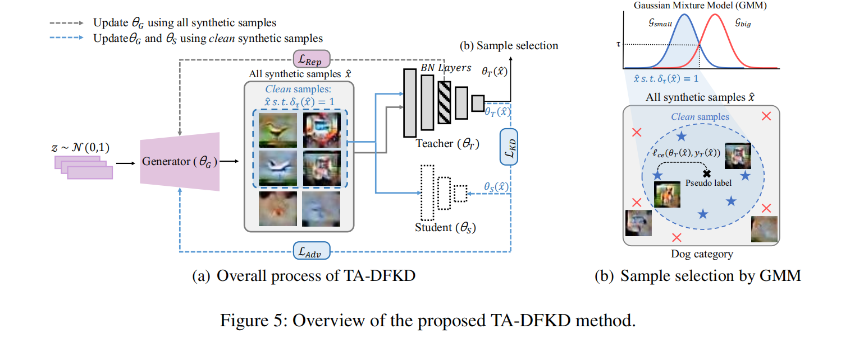
Teacher Agnostic Data-Free Knowledge Distillation (TA-DFKD)

Slide 8
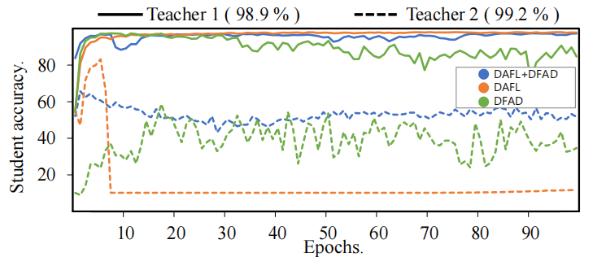
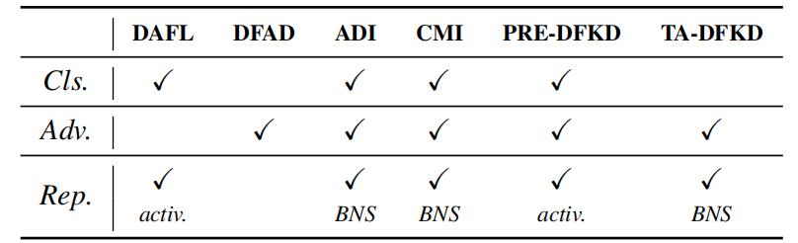
Teacher Agnostic Data-Free Knowledge Distillation (TA-DFKD)
Target of Data-Free Knowledge Distillation:
distill pre-trained knowledge through the assistance of a generator, without the use of original data samples.
Problem:
existing DFKD methods are quite sensitive to different teacher models
class-prior loss
adversarial loss
representation loss

Slide 9
Teacher Agnostic Data-Free Knowledge Distillation (TA-DFKD)
Method (Solution):
Generator Loss Without Class-Prior
Quality Control via Sample Selection:
Evaluated by the confidence of the teacher model
Gaussian Mixture Model (GMM)
Using high-quality samples to train the student model

Slide 10
Thank you for your
listening and guidance

