Slide 1
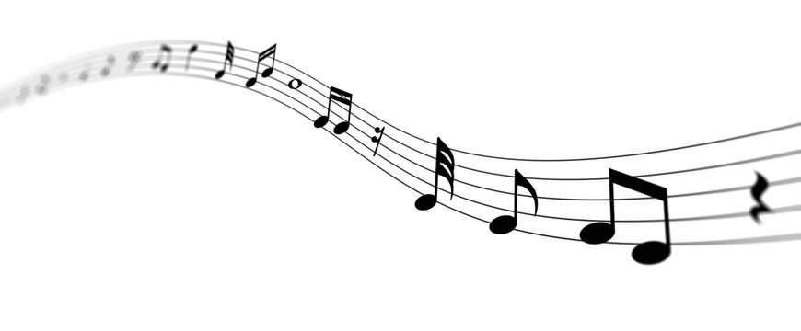
WHAT IS MUSICALITY?
ALYVIA ZOROYA, BRENDAN LAN, & NATALIE DONATO

Slide 2
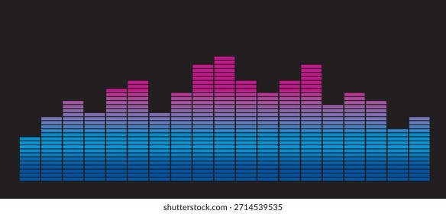
OVERVIEW
01
WHAT IS MUSIC?
02
RHYTHM AND PITCH
03
TEST YOUR SKILLS!
04
DATA ANALYSIS
05
PAPER DISCUSSION

Slide 3
WHAT COUNTS
AS MUSIC?

Slide 4
























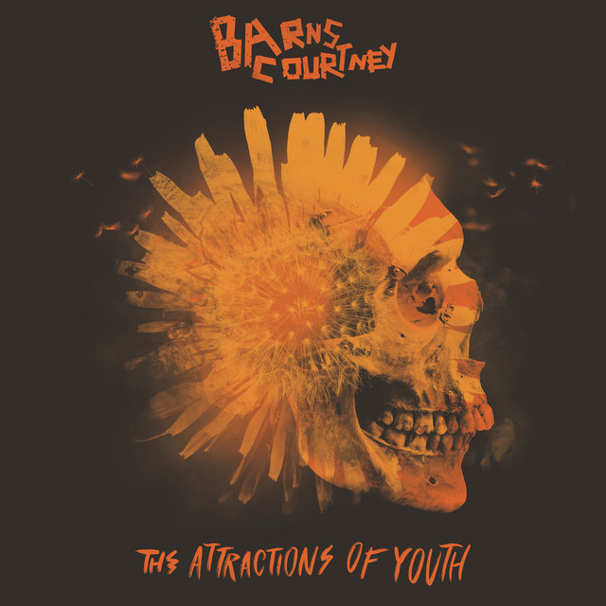





BRENDAN
NATALIE
LYV

Slide 5
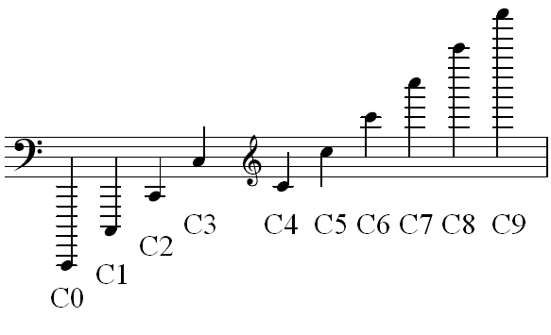
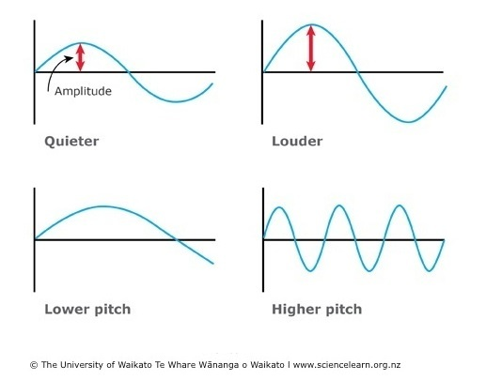
PITCH
UP AN OCTAVE = ~2x FREQUENCY
The quality that makes it possible to judge sounds as "higher" and "lower" in the sense associated with musical melodies
HIGHER PITCH
LOWER PITCH

Slide 6

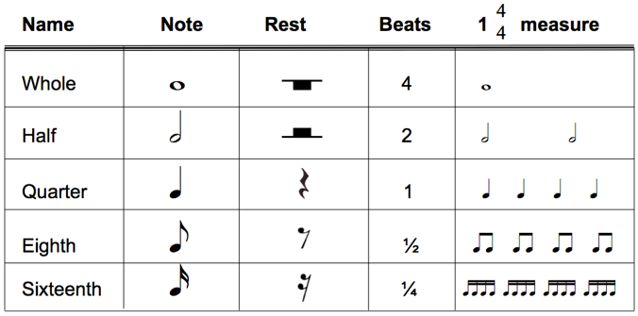
RHYTHM
The placement of sounds in time forming regular, repeated patterns

Slide 7
Slower, distinct events
Faster, indistinguishable events
RHYTHM
PITCH
MUSIC = ~40-240 BPM
60 bpm = 1 Hz
INDISTINGUISHABLE FROM TONE
~480-600 bpm (8 – 10 Hz)
"CONCERT A"
440 Hz (or 26,400 bpm)

Slide 8

Rhythm, you have it or you don't, that's a fallacy /
I'm in them, every sproutin' tree, every child of peace
-
“Clint Eastwood”, 2021

Slide 9
TEST YOUR SKILLS!
Distorted Tunes Test
  https://www.nidcd.nih.gov/tunestest/take-distorted-tunes-test
  Determine whether the tune is played in the correct pitch
  Record your score
PITCH
Got Rhythm?
  https://www.concerthotels.com/got-rhythm
  Tap your space key to the beat of the rhythm
  Take the test three times and record each score on the spreadsheet under Trial 1, Trial 2, and Trial 3.
RHYTHM

Slide 10
Record your scores on the Excel Sheet!
If you have musical training, answer a 1, and if not, answer 0.
Musical training counts as a year or more of consistent practice in a musical instrument(s) including physical, digital, or vocal.

Slide 11
DATA EXPEDITION
Download and open your templates!
Homework questions in a word document
Code in an R Markdown document
Live Coding to Begin Shortly...

Slide 12
DATA EXPEDITION
Develop your hypotheses for these questions:
(write them in your homework document)
Does practice improve rhythm?
2. Is there a relationship between rhythm and pitch?
3. Can we predict who has musical experience from their rhythm/pitch scores?

Slide 13
PAPER DISCUSSION
Liu et al. 2023
What:
is the context?
did they actually do?
are their claims?
do you think is actually supported?
are the logical next steps?
Naguib et al. 2008
Pinelli et al., 2024
Drake & Palmer 2000

Slide 14
WHAT COUNTS
AS MUSIC?

