Slide 1


Advanced Algorithm Assignment 9
12032189 Yuxi Liu

Slide 2

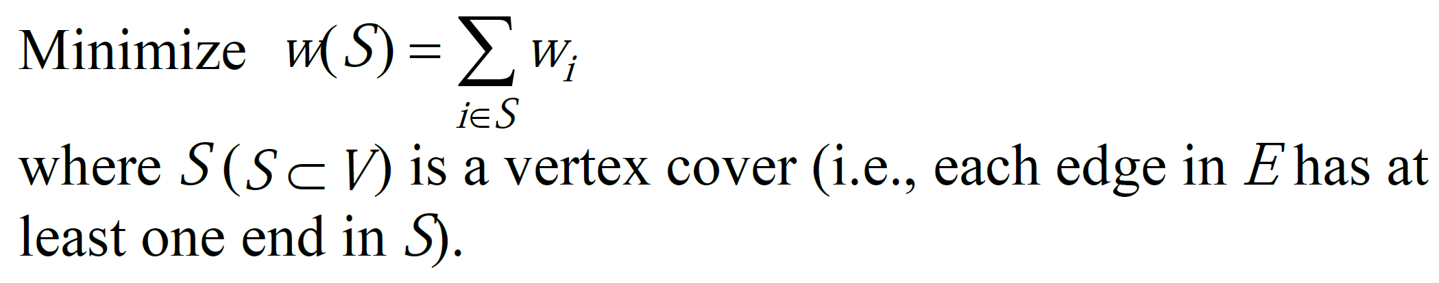









Exercise 9
(b) Generate a simple example of the LP problem
$$x_{2}$$
4
Problem background: Vertex Cover Problem
$$e_{1}$$
$$e_{3}$$
$$e_{4}$$
3
5
3
$$e_{2}$$
$$e_{5}$$
$$x_{1}$$
$$x_{4}$$
$$x_{3}$$
Go futher: we change this problem to a Linear Programming (LP) from Integer Programming.
(d) Find or generate a larger example of the LP problem
Generate method:
Set N as the number of vertices
Set w as the Probability of generating an edge between any two vertices

Slide 3




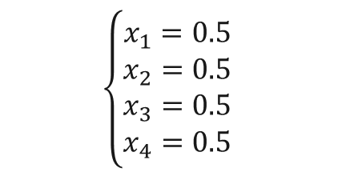








Exercise 9
(c) Simple example by using linprog (matlab)
Minimize $z=$ 3$x_{1}$ + 4$x_{2}$ + 3$x_{3}$ + 5$x_{4}$
$$x_{2}$$
Subject to
$x_{1}$ + $x_{2}$ $≥1$
$x_{1}$ + $x_{4}$ $≥1$
$x_{2}$ + $x_{4}$ $≥1$
$x_{2}$ + $x_{3}$ $≥1$
$x_{3}$ + $x_{4}$ $≥1$
4
$$e_{1}$$
$$e_{3}$$
$$e_{4}$$
Optimal solution: $z=7.5$
3
5
3
$$e_{2}$$
$$e_{5}$$
$$\left\{\begin{aligned}x_{1}=0.5 \\ x_{2}=0.5 \\ x_{3}=0.5 \\ x_{4}=0.5 \end{aligned}\right.$$
$$x_{1}$$
$$x_{4}$$
$$x_{3}$$

Slide 4
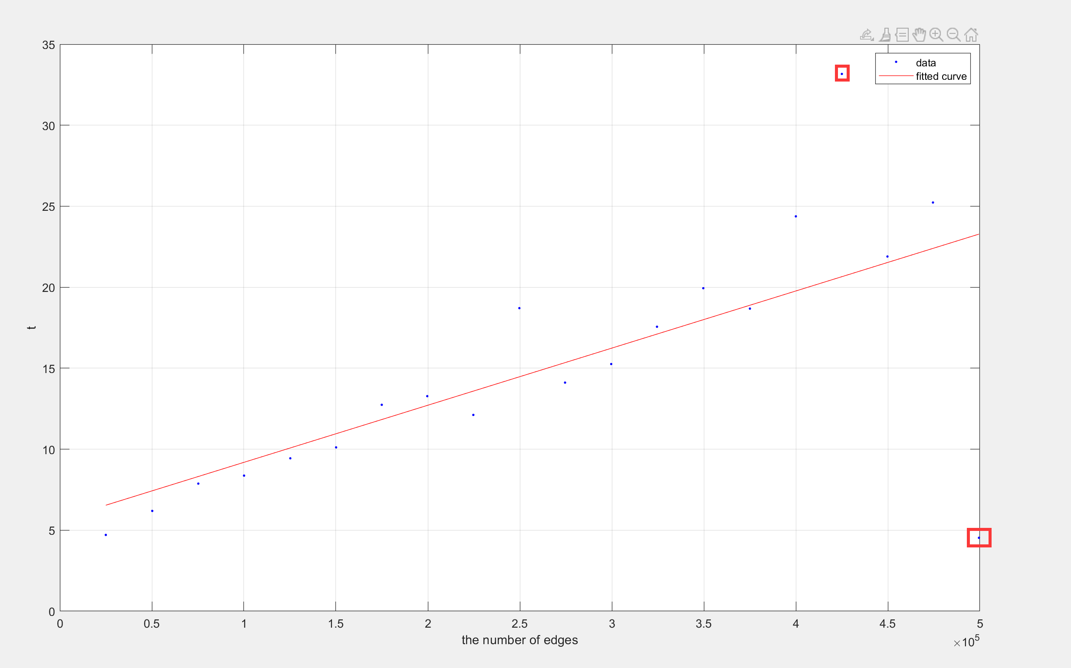
Exercise 9
(e) Forecast execution time by using linprog (matlab)
Fully connect
Total number of edges(Restrictions) v.s. execution time

Slide 5
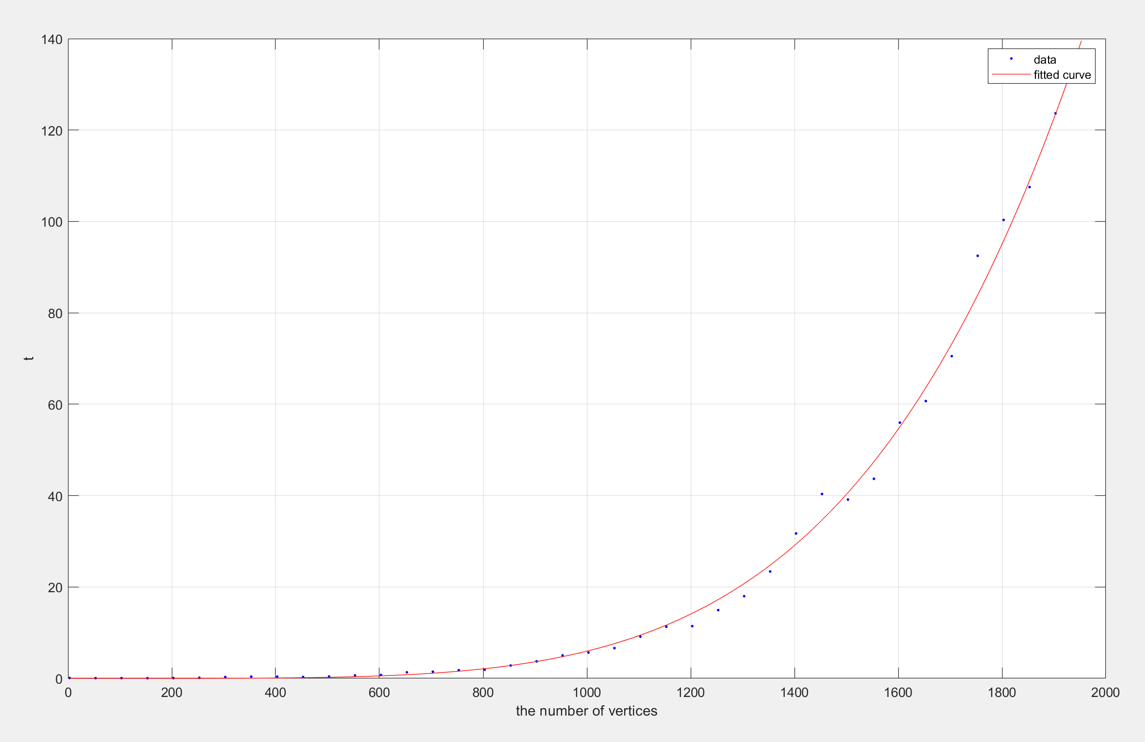
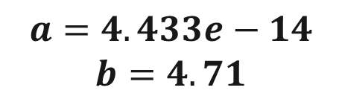

Exercise 9
(e) Forecast execution time by using linprog (matlab)
$$y=ax^{b}$$
$$a=4.433e−14$$
$$b=4.71$$
Total number of variables | Execution time (s)
10000 | 306688
100000 | 15728877544
1000000 | 806673390621805
Total number of vertices(variables) v.s. execution time

Slide 6
Exercise 9
(e) Other software may be can solve LP problem with 1,000,000 variables
Lingo
IBM ILOG Cplex
Gurobi
FICO Xpress
MOSEK

Slide 7
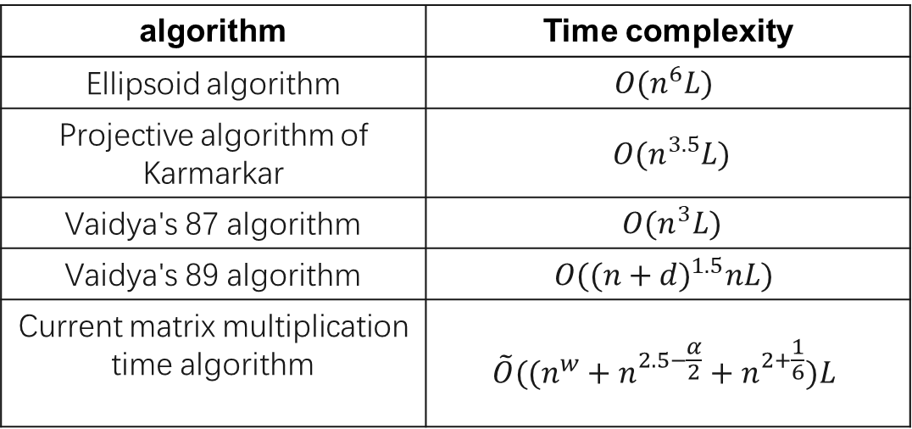
Exercise 9
Appendix. Time complexity of different algorithms for LP problem
n variables
L input bits
algorithm | Time complexity
Ellipsoid algorithm | $$O(n^{6}L)$$
Projective algorithm of Karmarkar | $O(n^{3.5}L)$
Vaidya's 87 algorithm | $O(n^{3}L)$
Vaidya's 89 algorithm | $$O({(n+d)}^{1.5}nL)$$
Current matrix multiplication time algorithm | $$\tilde{O}((n^{w}+n^{2.5−\frac{α}{2}}+n^{2+\frac{1}{6}})L$$

Slide 8

THANK YOU

