Slide 1
Advanced Algorithm Assignment 1 Nearest Neighbor Greedy Method
12032793
Haorui Guo

Slide 2
Outline
Requirement
Demonstrate the search behavior of the nearest neighbor greedy algorithms using example of 10 cities and calculate the Solution Quality
Influence Factor
Examples

Slide 3
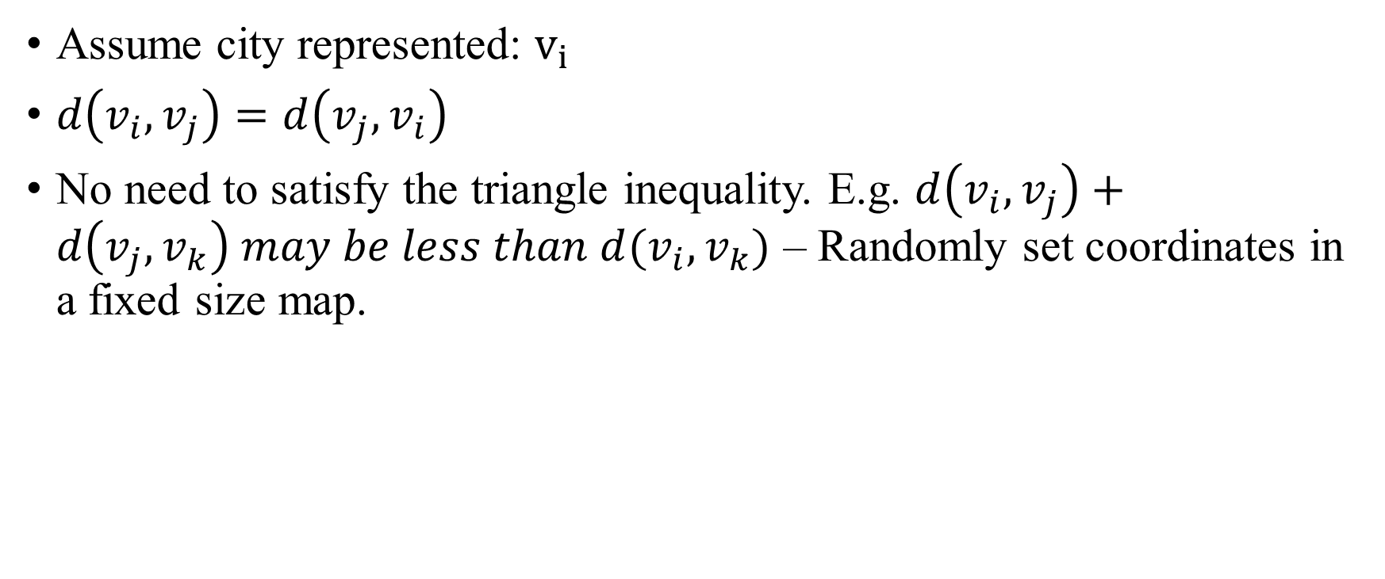
TSP Assumption
Assume city represented: $v_{i}$
$d\left(v_{i},v_{j}\right)=d\left(v_{j},v_{i}\right)$
No need to satisfy the triangle inequality. E.g. $d\left(v_{i},v_{j}\right)+d\left(v_{j},v_{k}\right) may be less than d(v_{i},v_{k})$ – Randomly set coordinates in a fixed size map.

Slide 4

Solution Quality
$$Solution Quality=\frac{Obtained Tour Length}{Optimal Tour Length}$$
Where $Optimal Tour Length$ will be found by brute iteration with O(n!)

Slide 5
Influence Factor
Starting Point
Whether walk the node walked?
Whether the middle road enough fast?

Slide 6
Influence Factor
10
C
NNA each points:
A->D->C->D->B->A: 9+7+7+14+11=46
B->A->D->C->D->B: 11+9+7+7+14=48
C->D->A->B->D->C: 7+9+11+14+7=48
D->C->A->B->D: 7+10+11+14=42
A
9
7
Walk repeated city
11
D
14
B
10
C
NNA each points:
A->D->C->D->A->B->A: 1+7+7+1+11+11=38
B->A->D->C->D->A->B: 11+1+7+7+1+11=38
C->D->A->B->A->D->C: 7+1+11+11+1+7=38
D->A->C->D->A->B->A->D:1+10+7+1+11+11+1=43
A
1
7
11
D
14
B
Middle road short enough

Slide 7
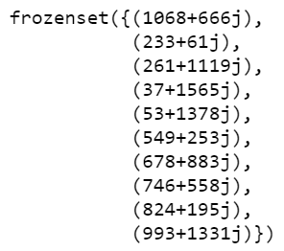
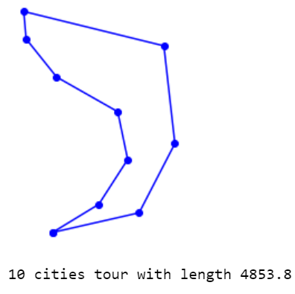
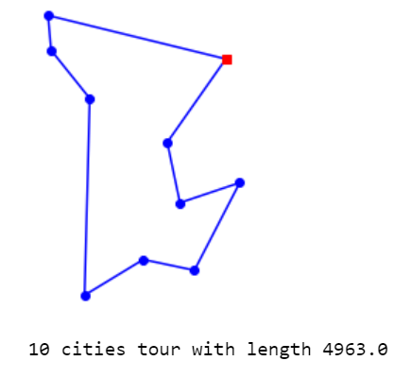

Example – different starting point
Choose 10 city coordinate randomly in a 1200*1800 map.
Best path got from brute iterative -- O(n!)
Best path got from NNA iterative -- O($n^{2}$)

Slide 8
Example – different starting point
Performance between different starting points
 | Tour Length | Solution Quality
Best Path | 4853.8 | 1
NNA_1 | 5268.3 | 1.085397
NNA_2 | 5496.4 | 1.132391
NNA_3 | 5550.9 | 1.143619
NNA_4 | 5268.3 | 1.085397
NNA_5 | 5333.6 | 1.09885
NNA_6 | 4963.0 | 1.022498
NNA_7 | 5485.4 | 1.130125
NNA_8 | 5440.1 | 1.120792
NNA_9 | 5316.2 | 1.095266
NNA_10 | 5316.2 | 1.095266

