Slide 1
Advanced Algorithm Assignment 4 Center Selection Problem
12032189
Yuxi Liu

Slide 2
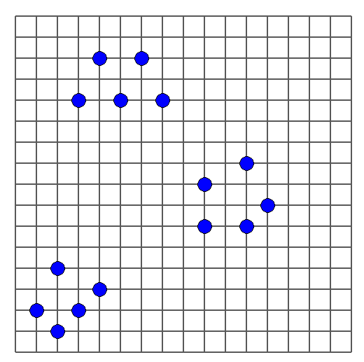
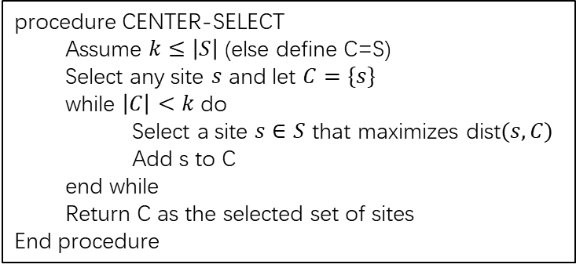
Exercise 4-1
In the k-means algorithm, we can start with (i) using an initial partition {S1, S2, ..., Sk} or with (ii) using initial centers {c1, c2, ..., ck}. Design a good initialization method for k-means algorithm for (i) and also for (ii).
Initial site
Greedy-Center-Selection
procedure CENTER-SELECT
Assume $k≤\left|S\right|$ (else define C=S)
Select any site $s$ and let $C=\{s\}$
while $\left|C\right|<k$ do
Select a site $s∈S$ that maximizes dist$(s,C)$
Add s to C
end while
Return C as the selected set of sites
End procedure

Slide 3
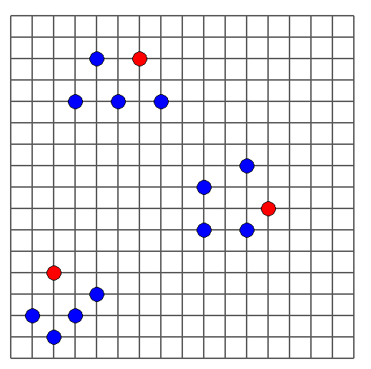
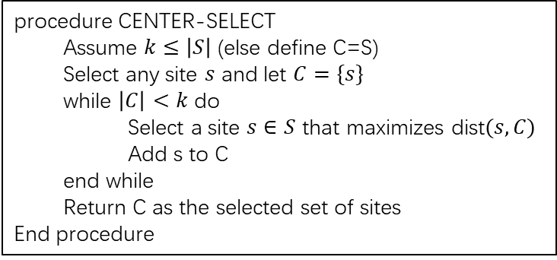
initial centers selection algorithm
In the k-means algorithm, we can start with (i) using an initial partition {S1, S2, ..., Sk} or with (ii) using initial centers {c1, c2, ..., ck}. Design a good initialization method for k-means algorithm for (i) and also for (ii).
Initial center
Initial site
Greedy-Center-Selection
procedure CENTER-SELECT
Assume $k≤\left|S\right|$ (else define C=S)
Select any site $s$ and let $C=\{s\}$
while $\left|C\right|<k$ do
Select a site $s∈S$ that maximizes dist$(s,C)$
Add s to C
end while
Return C as the selected set of sites
End procedure
First Site

Slide 4
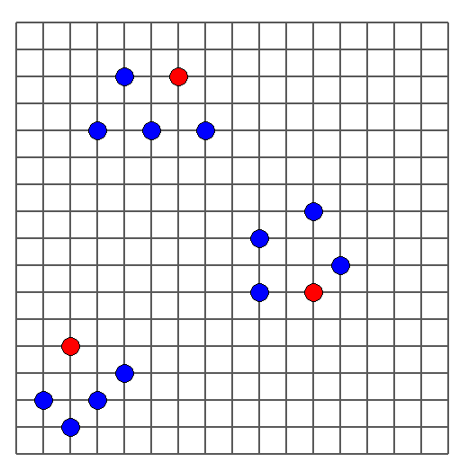

initial centers selection algorithm
Initial center
Initial site
Final center
$$r\left(C\right)=r(C^{∗})≈2.154$$

Slide 5
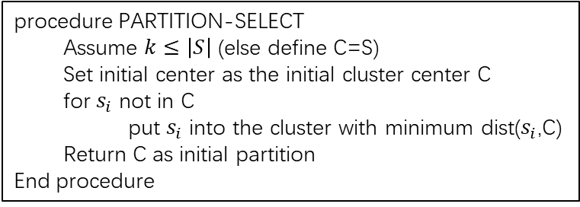
initial partition selection algorithm
Initial center
Assume that we have N sites and divide them into K clusters. We calculate the distance between each site and these initial center. And partition the site by minimum distance.
Initial site
procedure PARTITION-SELECT
Assume $k≤\left|S\right|$ (else define C=S)
Set initial center as the initial cluster center C
for $s_{i}$ not in C
put $s_{i}$ into the cluster with minimum dist($s_{i}$,C)
Return C as initial partition
End procedure
First Site

Slide 6
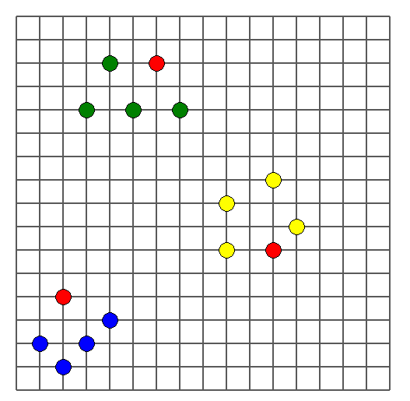
initial partition selection algorithm
Initial center
Initial partition1
Initial partition2
Initial partition3
Final result
$$r\left(C\right)=r(C^{∗})≈2.154$$
First Site

Slide 7
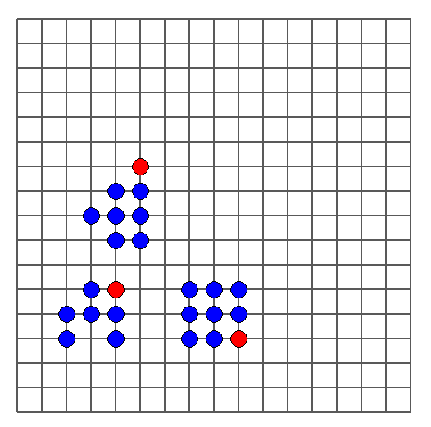
initial partition selection algorithm
Hard case：
First Site

Slide 8
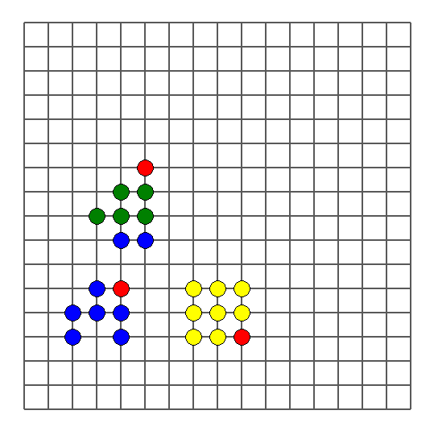

initial partition selection algorithm
Hard case：
Initial center
Initial partition1
Initial partition2
Initial partition3
Current result

Slide 9
Thank you

