Slide 1
Advanced Algorithm Assignment 4 Center Selection Problem
12032189
Yuxi Liu

Slide 2
context
Exercise 3-1
Exercise 3-2

Slide 3
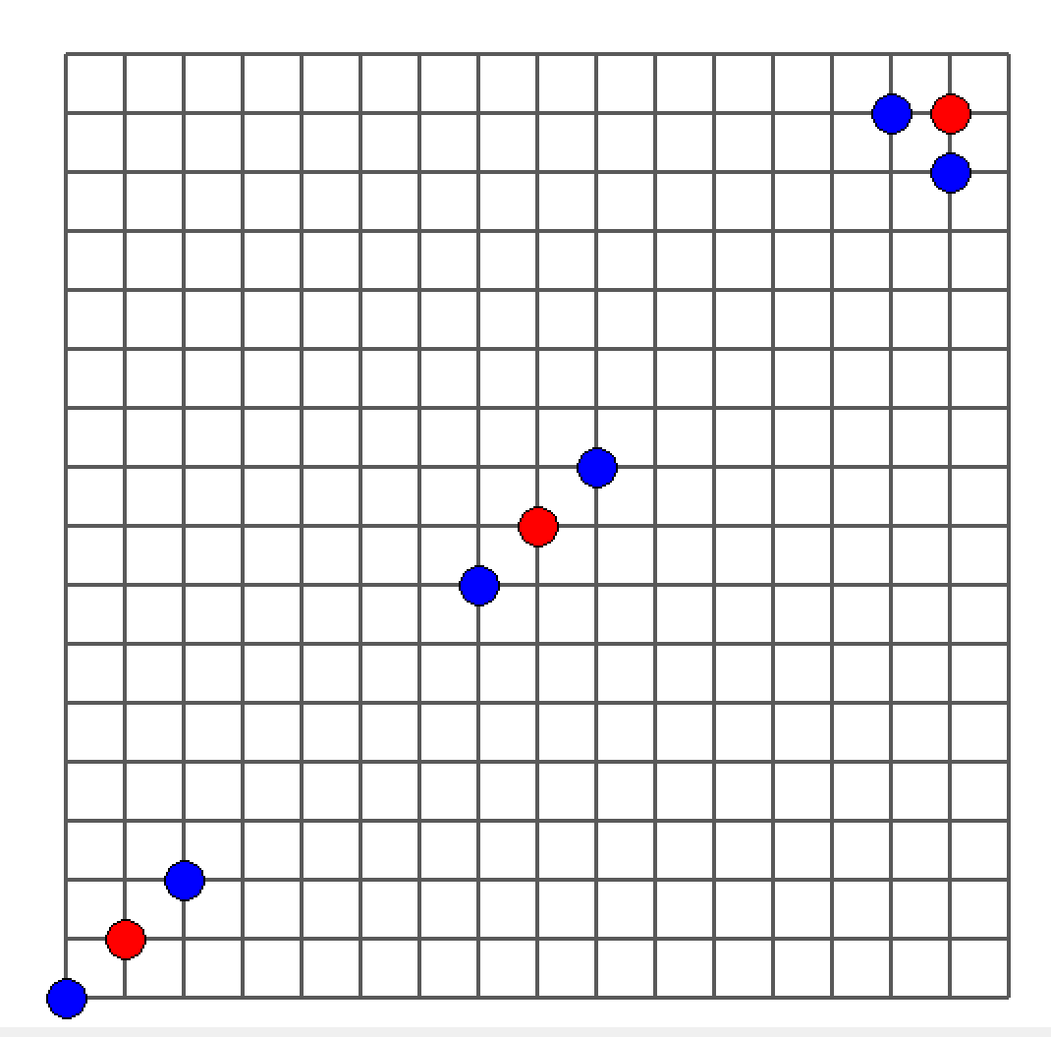
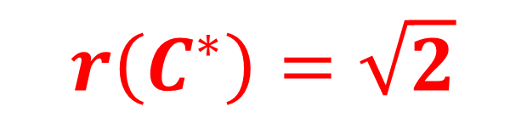
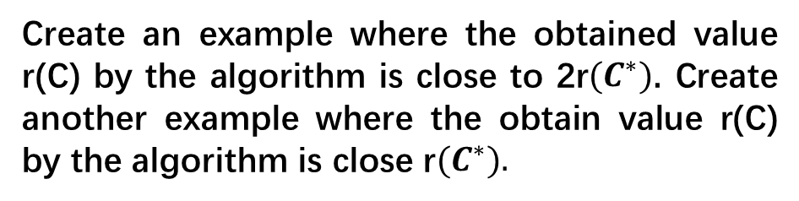
Exercise 3-1
Optimal condition:
Create an example where the obtained value r(C) by the algorithm is close to 2r${(C}^{∗})$. Create another example where the obtain value r(C) by the algorithm is close r${(C}^{∗}).$
$$r\left(C^{∗}\right)=\sqrt{2}$$

Slide 4
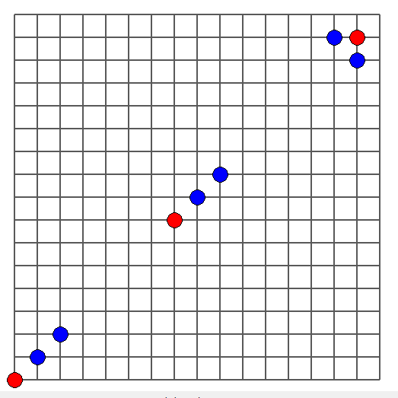
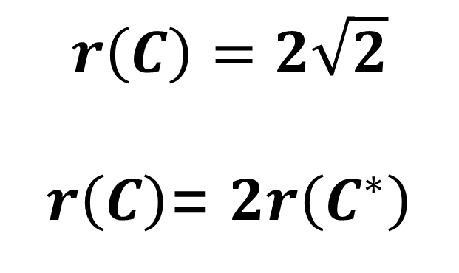
Exercise 3-1
Center Selection Algorithm:
$$r\left(C\right)=2\sqrt{2}$$
$r\left(C\right)$= $2r\left(C^{∗}\right)$
Start point

Slide 5
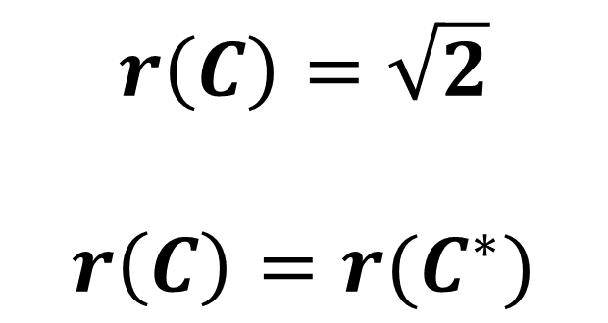
Exercise 3-1
Center Selection Algorithm:
$$r\left(C\right)=\sqrt{2}$$
$$r\left(C\right)=r(C^{∗})$$
Start point

Slide 6
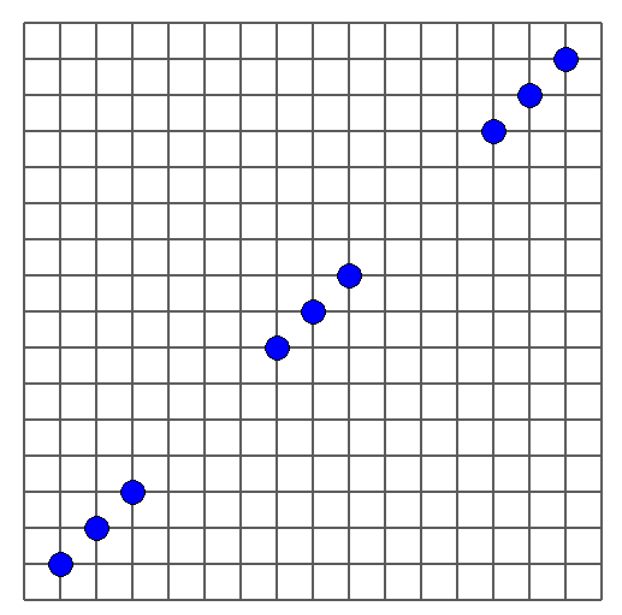
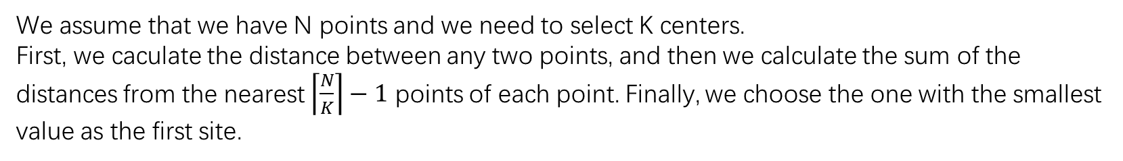

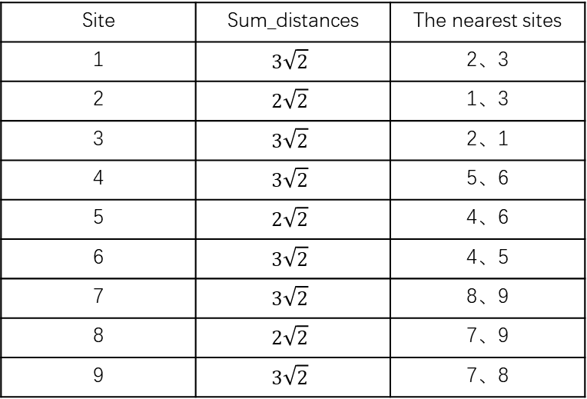
Exercise 3-2
We assume that we have N points and we need to select K centers.
First, we caculate the distance between any two points, and then we calculate the sum of the distances from the nearest $\left\lceil \frac{N}{K}\right\rceil −1$ points of each point. Finally, we choose the one with the smallest value as the first site.
9
$$\left\lceil \frac{N}{K}\right\rceil −1=2$$
8
Site | Sum_distances | The nearest sites
1 | $$3\sqrt{2}$$ | 2、3
2 | $$2\sqrt{2}$$ | 1、3
3 | $$3\sqrt{2}$$ | 2、1
4 | $$3\sqrt{2}$$ | 5、6
5 | $$2\sqrt{2}$$ | 4、6
6 | $$3\sqrt{2}$$ | 4、5
7 | $$3\sqrt{2}$$ | 8、9
8 | $$2\sqrt{2}$$ | 7、9
9 | $$3\sqrt{2}$$ | 7、8
7
6
5
4
3
2
1

Slide 7
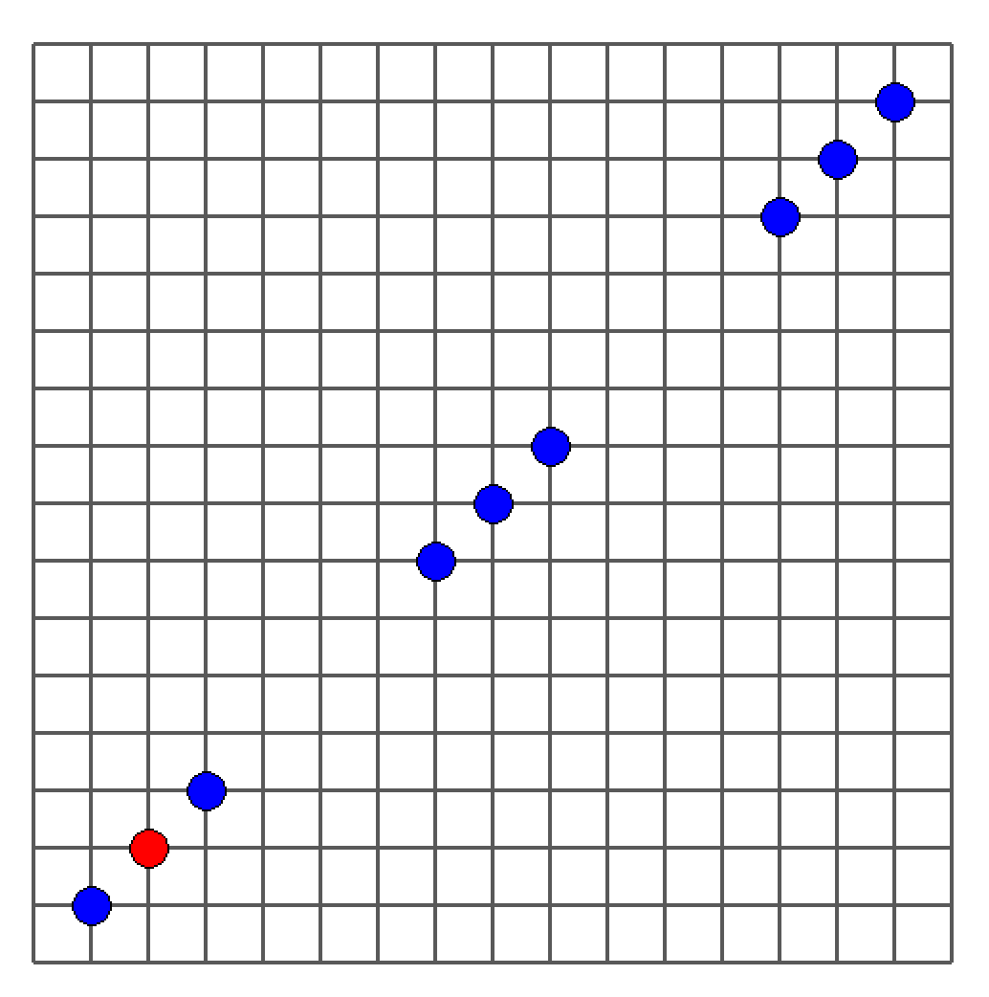
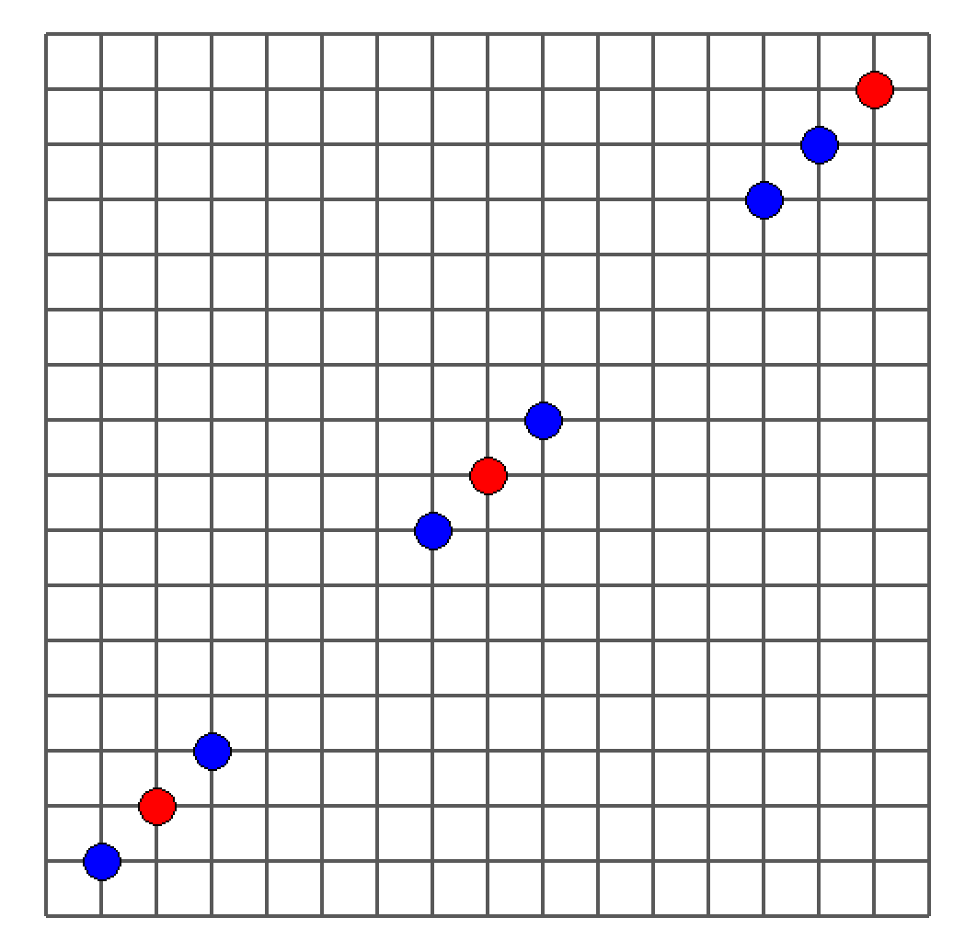
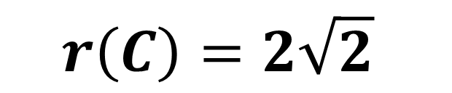
Exercise 3-2
9
9
8
8
7
7
6
6
5
5
4
4
3
3
2
2
1
1
$$r\left(C\right)=2\sqrt{2}$$

Slide 8
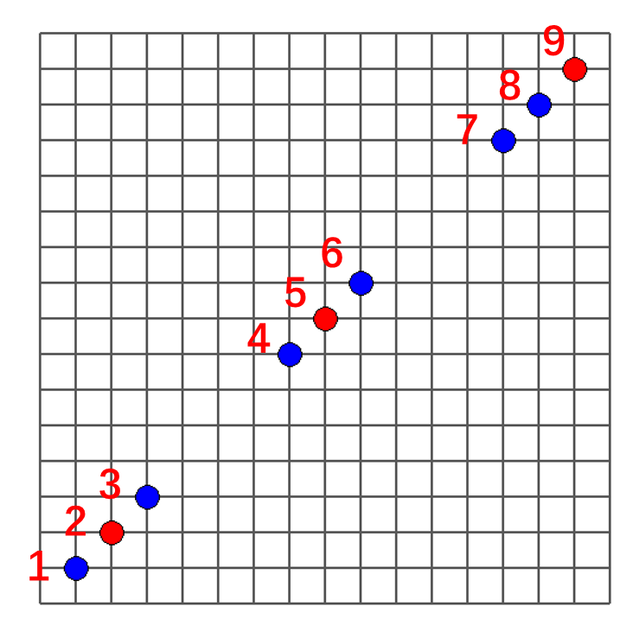
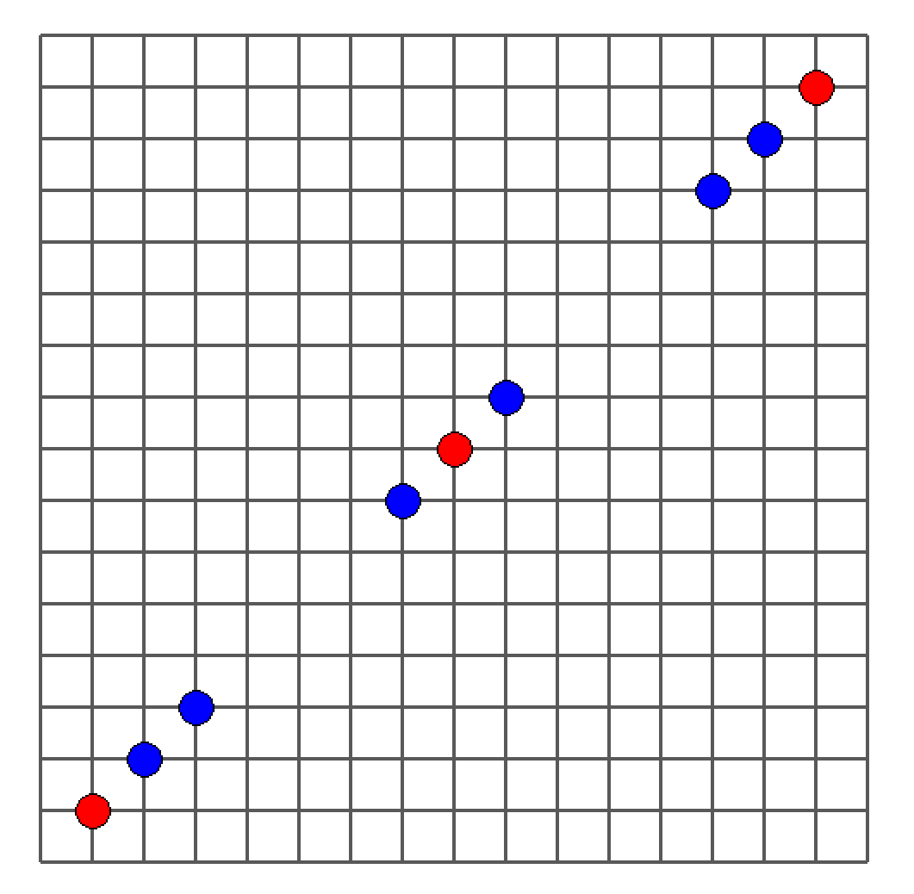


Exercise 3-2
Random Center Selection Algorithm:
Nearest Center Selection Algorithm:
9
8
7
6
5
4
3
2
1
Start point
Totdistance = $7\sqrt{2}$
Totdistance = 8$\sqrt{2}$

Slide 9
Thank you

