Slide 1


PRESENTATION POWERPOINT
TEMPLATE
刘禹熙

Slide 2
OUTLINE
TSN
Packet classification

Slide 3
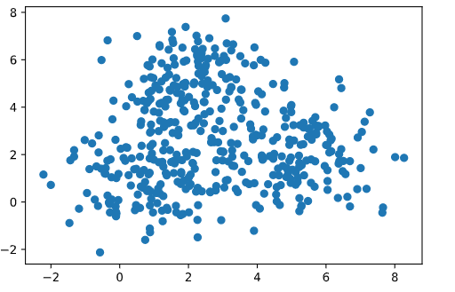
Exercise 6-1
Clearly demonstrate the effects of mon the clustering results by the fuzzy c-means algorithm through computational experiments on a test data set (i.e., create a test data set which can be used for clearly demonstrating the effects of m).
450 sites
3 centers

Slide 4
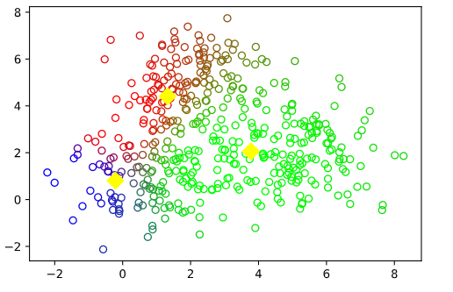
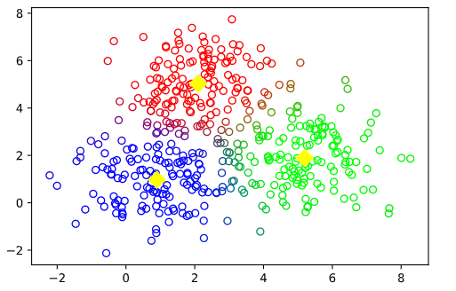
Exercise 6-1
Clearly demonstrate the effects of mon the clustering results by the fuzzy c-means algorithm through computational experiments on a test data set (i.e., create a test data set which can be used for clearly demonstrating the effects of m).
m=1.5
7 steps

Slide 5
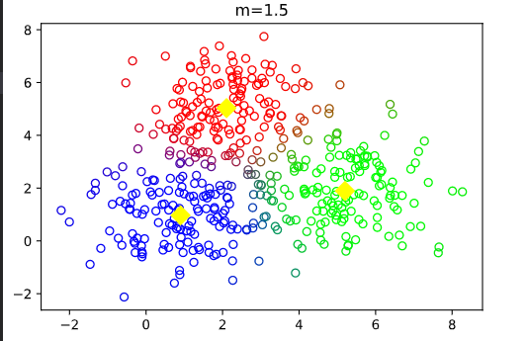
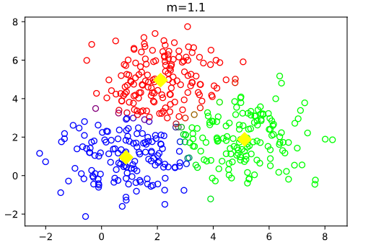
Exercise 6-1

Slide 6
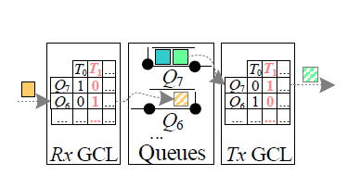
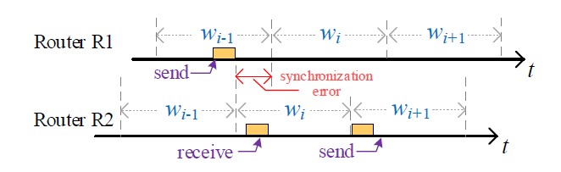
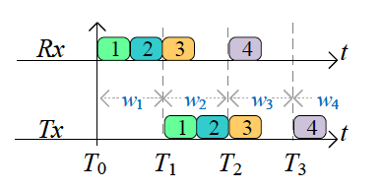
TSN
Cyclic Queuing and Forwarding (CQF)
CQF structure overview
CQF misbehavior example
packet forwarding example

Slide 7
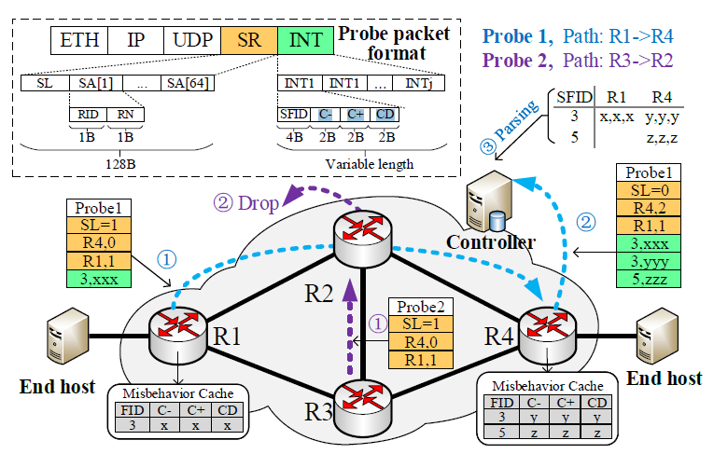
TSN
In-band Network Telemetry (INT) probe packet format and TSN-Guard overview

Slide 8
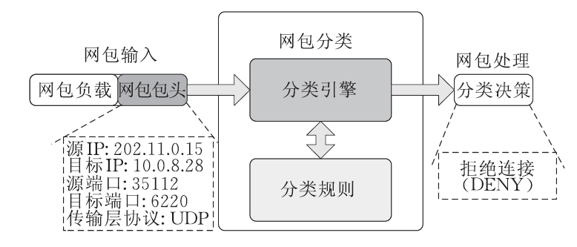
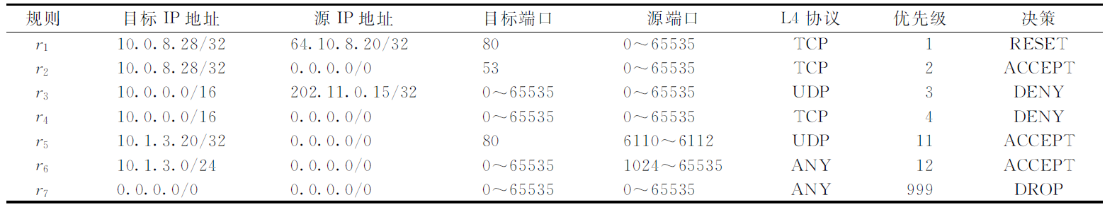
Packet classification
Packet classification background

Slide 9
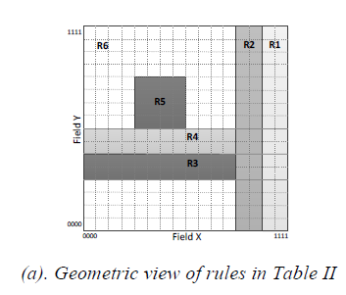
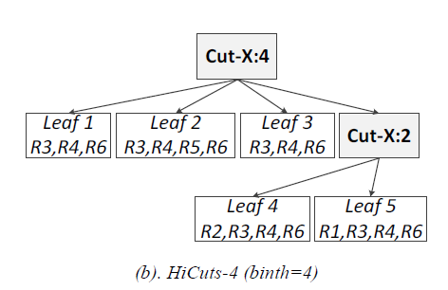
Packet classification
HiCuts method

Slide 10
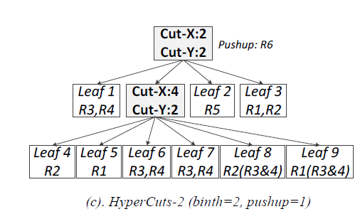
Packet classification
HyperCuts method

Slide 11
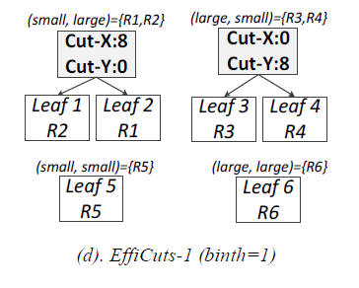
Packet classification
EffiCuts method

Slide 12
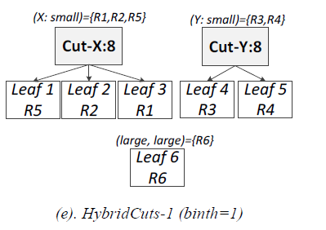
Packet classification
HybridCuts method

Slide 13
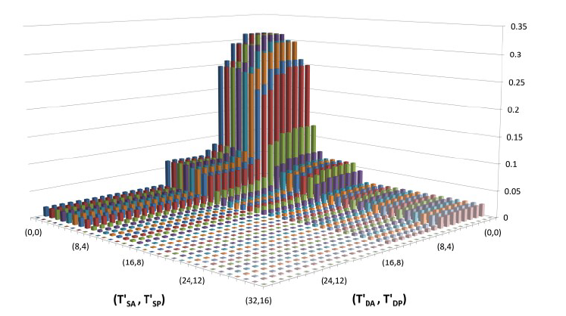
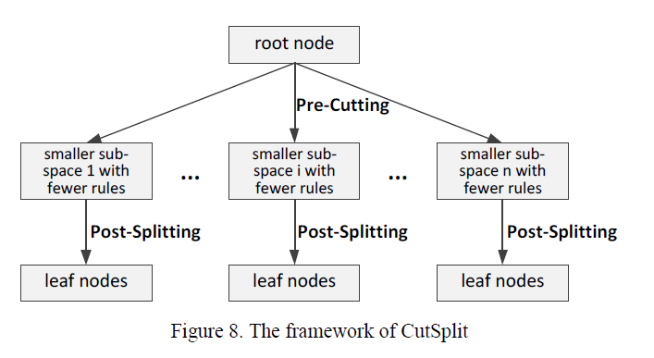
Packet classification
CutSplit method

Slide 14
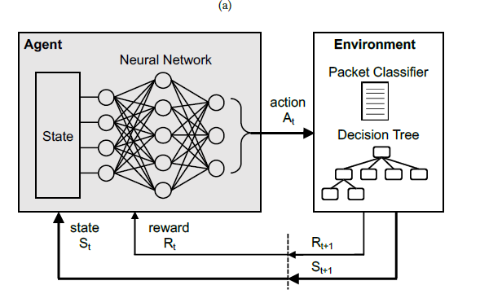
Packet classification
Neural Packet Classification

Slide 15
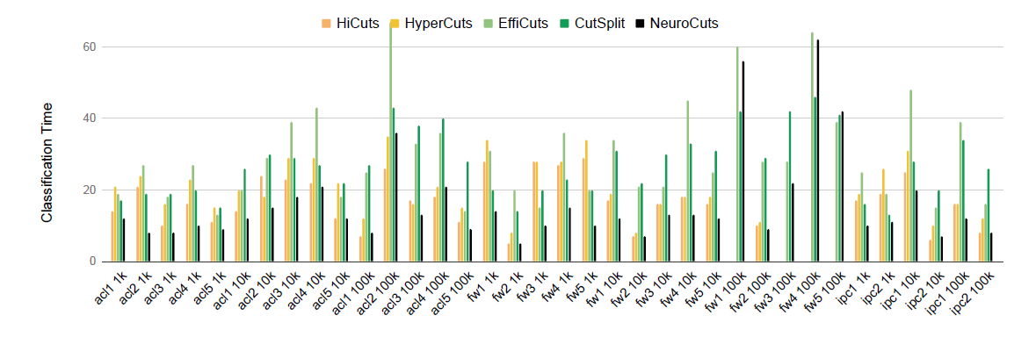
Packet classification
Neural Packet Classification

Slide 16
Packet classification
Current problem
Rule replications
Hard to insert, delete, and modify
NeuroCuts can be extended to other objectives
Quick update of rules in SDN

Slide 17
Future Plan
1. Finish Review about packet classification in November.
2. Learn RL framework and doing neuroCuts experiment in November.
3. Try more idea about packet classification.

Slide 18

THANK YOU

Slide 19
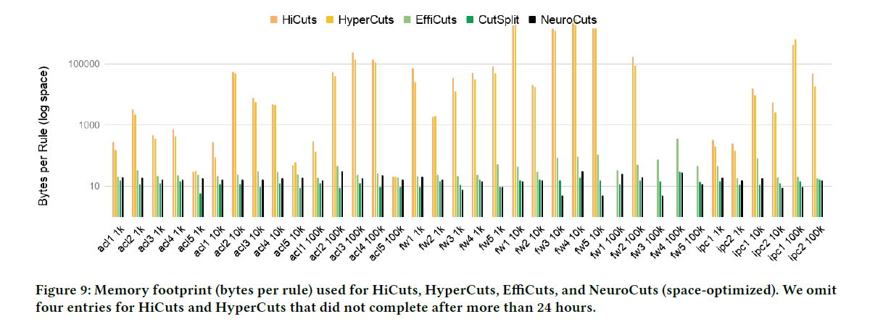
Packet classification

Slide 20
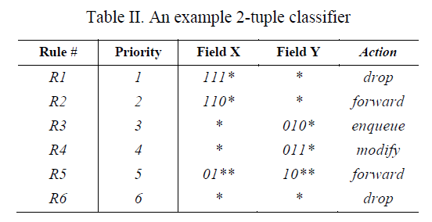
Packet classification

