Slide 1
Advanced Algorithm Assignment 3 Load Balancing Problem
12032189
Yuxi Liu

Slide 2
context
Exercise 2-1
Exercise 2
Exercise 3

Slide 3

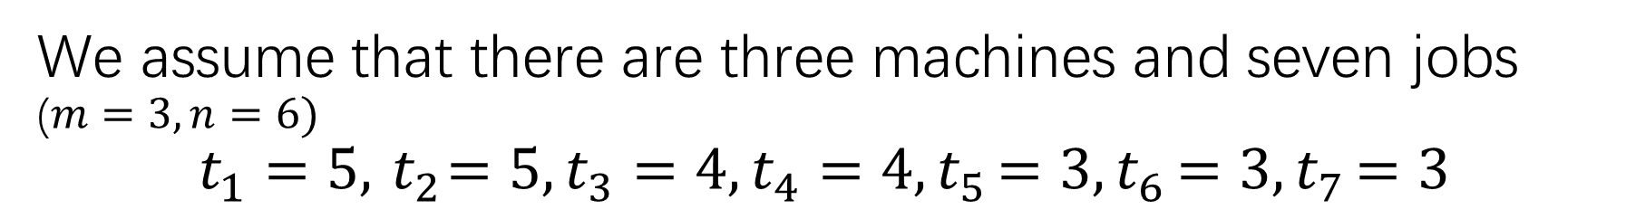
Exercise 2-1
We assume that there are three machines and seven jobs ($m=3,n=6)$
$$t_{1}=5,{ t}_{2}=5,t_{3}=4,t_{4}=4{,t}_{5}=3{,t}_{6}=3{,t}_{7}=3$$
The optimal solution:
M1
J1
J3
T1 = 9
M2
J2
J4
T2 = 9
M3
J5
J6
J7
T3 = 9
$$T^{∗}=9$$

Slide 4

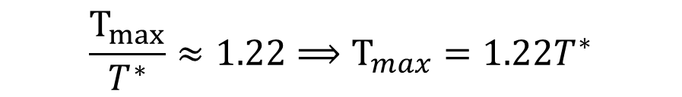
Exercise 2-1
We assume that there are three machines and seven jobs ($m=3,n=6)$
$$t_{1}=5,{ t}_{2}=5,t_{3}=4,t_{4}=4{,t}_{5}=3{,t}_{6}=3{,t}_{7}=3$$
The Sort Greedy Algorithm:
M1
J1
J6
J7
T1 = 11
M2
J2
J5
T2 = 9
M3
J3
J4
T3 = 9
$$T_{max}=11$$
$$\frac{T_{max}}{T^{∗}}≈1.22⟹T_{max}=1.22T^{∗}$$

Slide 5
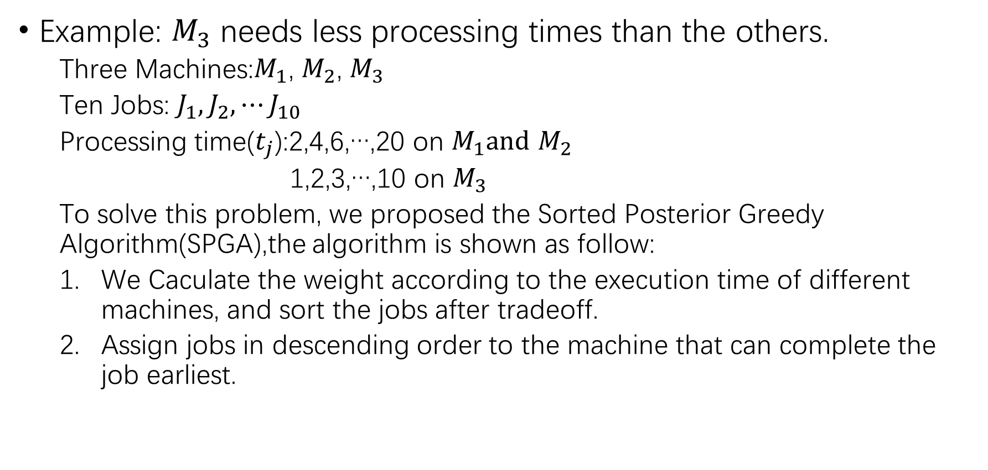
Exercise 2-2
Example: $M_{3}$ needs less processing times than the others.
Three Machines:$M_{1}$, $M_{2}$, $M_{3}$
Ten Jobs: $J_{1},J_{2},⋯J_{10}$
Processing time($t_{j}$):2,4,6,…,20 on $M_{1}and$ $M_{2}$
1,2,3,…,10 on $M_{3}$
To solve this problem, we proposed the Sorted Posterior Greedy Algorithm(SPGA),the algorithm is shown as follow:
We Caculate the weight according to the execution time of different machines, and sort the jobs after tradeoff.
Assign jobs in descending order to the machine that can complete the job earliest.

Slide 6
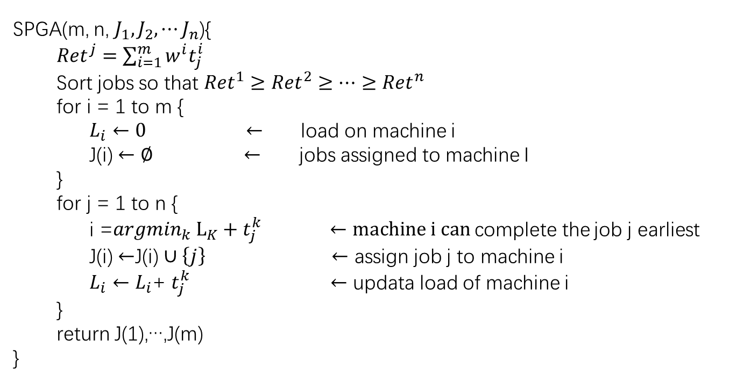
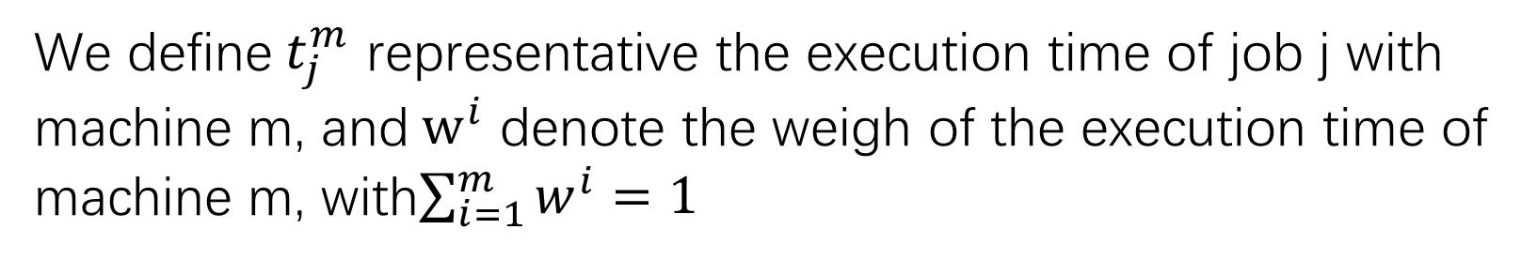
Exercise 2-2
We define$t_{j}^{m}$ representative the execution time of job j with machine m, and$w^{i}$ denote the weigh of the execution time of machine m, with$\sum_{i=1}^{m}{w^{i}=1}$
SPGA(m, n, $J_{1},J_{2},⋯J_{n}$){
${Ret}^{j}=\sum_{i=1}^{m}{w^{i}t_{j}^{i}}$
Sort jobs so that ${Ret}^{1}≥{Ret}^{2}≥⋯≥{Ret}^{n}$
for i = 1 to m {
$L_{i}←0 ←$ load on machine i
J(i) $←∅ ←$ jobs assigned to machine I
}
for j = 1 to n {
i =${argmin}_{k} L_{K}+t_{j}^{k}$ $←machine i can$complete the job j earliest
J(i) $←$J(i) $∪\left\{j\right\} ←$ assign job j to machine i
$L_{i}←L_{i}$+ $t_{j}^{k} ←$ updata load of machine i
}
return J(1),…,J(m)
}

Slide 7
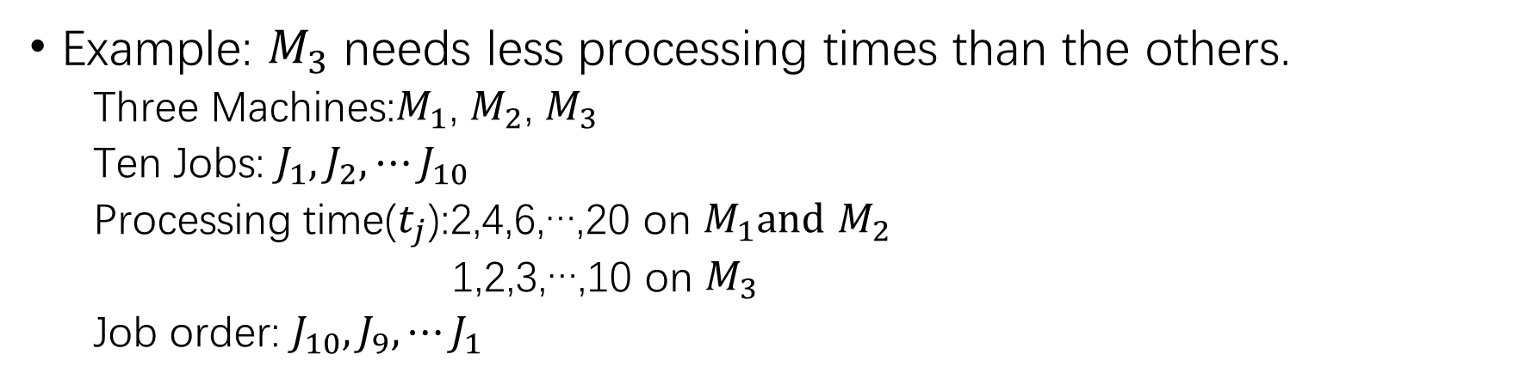
Exercise 2-2
Example: $M_{3}$ needs less processing times than the others.
Three Machines:$M_{1}$, $M_{2}$, $M_{3}$
Ten Jobs: $J_{1},J_{2},⋯J_{10}$
Processing time($t_{j}$):2,4,6,…,20 on $M_{1}and$ $M_{2}$
1,2,3,…,10 on $M_{3}$
Job order: $J_{10},J_{9},⋯J_{1}$
M1
T1 = (20)
M2
T2 = (20)
M3
J10
T3 = 10

Slide 8
Exercise 2-2
Example: $M_{3}$ needs less processing times than the others.
Three Machines:$M_{1}$, $M_{2}$, $M_{3}$
Ten Jobs: $J_{1},J_{2},⋯J_{10}$
Processing time($t_{j}$):2,4,6,…,20 on $M_{1}and$ $M_{2}$
1,2,3,…,10 on $M_{3}$
Job order: $J_{10},J_{9},⋯J_{1}$
M1
T1 = 18
J9
M2
T2 = (18)
M3
J10
T3 = 10 (19)

Slide 9
Exercise 2-2
Example: $M_{3}$ needs less processing times than the others.
Three Machines:$M_{1}$, $M_{2}$, $M_{3}$
Ten Jobs: $J_{1},J_{2},⋯J_{10}$
Processing time($t_{j}$):2,4,6,…,20 on $M_{1}and$ $M_{2}$
1,2,3,…,10 on $M_{3}$
Job order: $J_{10},J_{9},⋯J_{1}$
M1
T1 = 18(34)
J9
M2
J8
T2 = 16
M3
J10
T3 = 10(18)

Slide 10
Exercise 2-2
Example: $M_{3}$ needs less processing times than the others.
Three Machines:$M_{1}$, $M_{2}$, $M_{3}$
Ten Jobs: $J_{1},J_{2},⋯J_{10}$
Processing time($t_{j}$):2,4,6,…,20 on $M_{1}and$ $M_{2}$
1,2,3,…,10 on $M_{3}$
Job order: $J_{10},J_{9},⋯J_{1}$
M1
T1 = 18(32)
J9
M2
J8
T2 = 16(30)
M3
J10
J7
T3 = 17

Slide 11
Exercise 2-2
Example: $M_{3}$ needs less processing times than the others.
Three Machines:$M_{1}$, $M_{2}$, $M_{3}$
Ten Jobs: $J_{1},J_{2},⋯J_{10}$
Processing time($t_{j}$):2,4,6,…,20 on $M_{1}and$ $M_{2}$
1,2,3,…,10 on $M_{3}$
Job order: $J_{10},J_{9},⋯J_{1}$
M1
T1 = 18(30)
J9
M2
J8
T2 = 16(28)
M3
J10
J7
J6
T3 = 23

Slide 12
Exercise 2-2
Example: $M_{3}$ needs less processing times than the others.
Three Machines:$M_{1}$, $M_{2}$, $M_{3}$
Ten Jobs: $J_{1},J_{2},⋯J_{10}$
Processing time($t_{j}$):2,4,6,…,20 on $M_{1}and$ $M_{2}$
1,2,3,…,10 on $M_{3}$
Job order: $J_{10},J_{9},⋯J_{1}$
M1
T1 = 18(28)
J9
M2
J8
J5
T2 = 26
M3
J10
J7
J6
T3 = 23(28)

Slide 13
Exercise 2-2
Example: $M_{3}$ needs less processing times than the others.
Three Machines:$M_{1}$, $M_{2}$, $M_{3}$
Ten Jobs: $J_{1},J_{2},⋯J_{10}$
Processing time($t_{j}$):2,4,6,…,20 on $M_{1}and$ $M_{2}$
1,2,3,…,10 on $M_{3}$
Job order: $J_{10},J_{9},⋯J_{1}$
M1
T1 = 26
J9
J4
M2
J8
J5
T2 = 26
M3
J10
J7
J6
T3 = 23(27)

Slide 14
Exercise 2-2
Example: $M_{3}$ needs less processing times than the others.
Three Machines:$M_{1}$, $M_{2}$, $M_{3}$
Ten Jobs: $J_{1},J_{2},⋯J_{10}$
Processing time($t_{j}$):2,4,6,…,20 on $M_{1}and$ $M_{2}$
1,2,3,…,10 on $M_{3}$
Job order: $J_{10},J_{9},⋯J_{1}$
M1
T1 = 26
J9
J4
M2
J8
J5
T2 = 26
M3
J10
J7
J6
T3 = 23(27)

Slide 15
Exercise 2-2
Example: $M_{3}$ needs less processing times than the others.
Three Machines:$M_{1}$, $M_{2}$, $M_{3}$
Ten Jobs: $J_{1},J_{2},⋯J_{10}$
Processing time($t_{j}$):2,4,6,…,20 on $M_{1}and$ $M_{2}$
1,2,3,…,10 on $M_{3}$
Job order: $J_{10},J_{9},⋯J_{1}$
M1
T1 = 26(32)
J9
J4
M2
J8
J5
T2 = 26(32)
M3
J10
J7
J6
J3
T3 = 26

Slide 16
Exercise 2-2
Example: $M_{3}$ needs less processing times than the others.
Three Machines:$M_{1}$, $M_{2}$, $M_{3}$
Ten Jobs: $J_{1},J_{2},⋯J_{10}$
Processing time($t_{j}$):2,4,6,…,20 on $M_{1}and$ $M_{2}$
1,2,3,…,10 on $M_{3}$
Job order: $J_{10},J_{9},⋯J_{1}$
M1
T1 = 26(30)
J9
J4
M2
J8
J5
T2 = 26(30)
M3
J10
J7
J6
J3
j2
T3 = 28

Slide 17
Exercise 2-2
Example: $M_{3}$ needs less processing times than the others.
Three Machines:$M_{1}$, $M_{2}$, $M_{3}$
Ten Jobs: $J_{1},J_{2},⋯J_{10}$
Processing time($t_{j}$):2,4,6,…,20 on $M_{1}and$ $M_{2}$
1,2,3,…,10 on $M_{3}$
Job order: $J_{10},J_{9},⋯J_{1}$
M1
T1 = 28
J9
J4
1
M2
J8
J5
T2 = 26(28)
M3
J10
J7
J6
J3
J2
T3 = 28
In this case $T=T^{∗}=$28

Slide 18
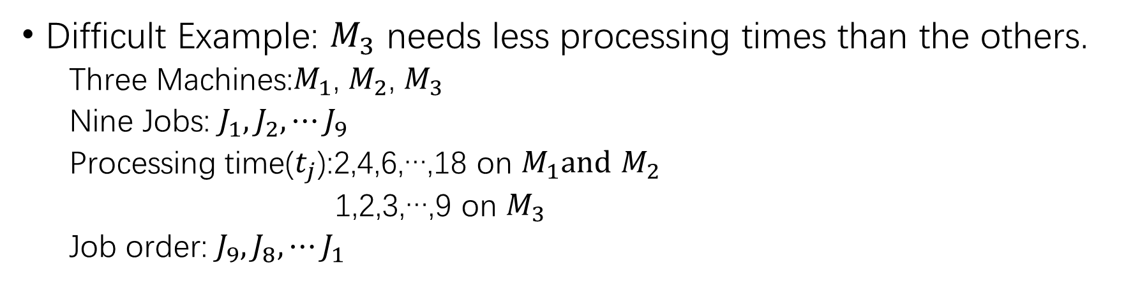
Exercise 2-2
Difficult Example: $M_{3}$ needs less processing times than the others.
Three Machines:$M_{1}$, $M_{2}$, $M_{3}$
Nine Jobs: $J_{1},J_{2},⋯J_{9}$
Processing time($t_{j}$):2,4,6,…,18 on $M_{1}and$ $M_{2}$
1,2,3,…,9 on $M_{3}$
Job order: $J_{9},J_{8},⋯J_{1}$
SPGA Function:
M1
T1 = 26(30)
J8
J3
M2
J7
J4
T2 = 26(30)
M3
J9
J6
J5
J2
J1
T3 = 28
T = 28

Slide 19
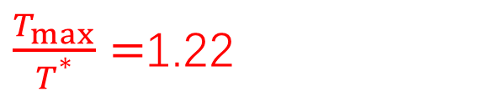
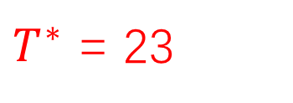
Exercise 2-2
Difficult Example: $M_{3}$ needs less processing times than the others.
Three Machines:$M_{1}$, $M_{2}$, $M_{3}$
Nine Jobs: $J_{1},J_{2},⋯J_{9}$
Processing time($t_{j}$):2,4,6,…,18 on $M_{1}and$ $M_{2}$
1,2,3,…,9 on $M_{3}$
Job order: $J_{9},J_{8},⋯J_{1}$
Optimal Function:
M1
T1 = 22
J6
J5
M2
J9
J2
T2 = 22
M3
J8
J7
J4
J3
1
T3 = 23
$T^{∗}$ = 23
$\frac{T_{max}}{T^{*}}=$1.22

Slide 20
Thank you

