Slide 1
Introduction to Deep Learning
By Yanyang Lee

Slide 2
State at First
Provide (may not) all key elements of DL in a broad sense
Not meant to give all mathematic details and all aspects of DL
Assume audiences had mathematic foundation and basic knowledge of NN
There might be mistakes

Slide 3
How to Organize?
Consist of 5 parts
Variants differed from 3 ways
Neurons, Connections and Learning
Also cover relative techniques and architectures in one part
Provided a general view finally

Slide 4
Basic Concepts Review

Slide 5
What is Learning?
Find the “best” approximation (chosen from a fixed function family) of underlying function based on current data
“best” = minimize the error in unseen data
Learning is actually an optimization problem
Deep Learning is learning on special graph
Notes:
Data we used to adjust parameters of approximation function called training set.

Slide 6
What define error?
Principles:
Target(supervised)
Objective(unsupervised)

Slide 7
Supervised Error Measurements
Approximate the underlying function which mapped inputs to targets
Regression = Target -> Continuous
Square Error
L(f(x), y) = (f(x) - y)^2
Where L = error measurement, f = approximator, x = input, y = target
Classification = Target -> Discrete
Misclassification Error Rate(0-1 error)
L(f(x), y) = I{f(x) ≠ y}
Where I is equal to 1 when condition within brackets was satisfied and 0 otherwise
Called “loss function”
Sometime I’ll denote it as E
Notes:
Model learnt such mapping called discriminative model, but there are models called generative model learnt under a different objective, which is maximize sum of log probability of all input-target pairs.
For discriminative model, its objective is to make model’s output/prediction of each training examples’ input as close as its corresponding target, so the error measurement always try to minimize the difference between prediction and target.
Generative vs Discriminative = P(x,y) vs P(y|x).
Square error originated from GLM.

Slide 8

Supplement
0-1 error is hard to optimize directly
Gradient is 0 everywhere(const)
Often use Cross-Entropy instead
Where K = number of possible classes, y_k = target in class k, y_k = prediction of f in class k

Slide 9
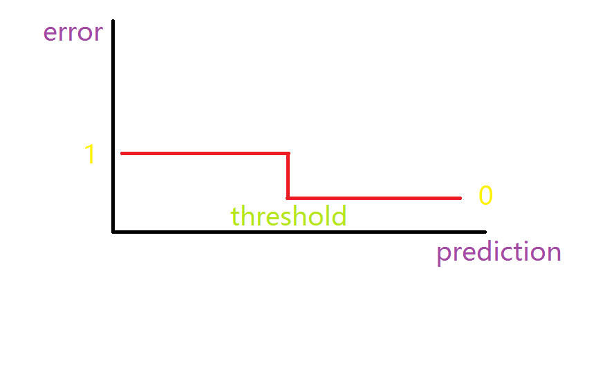
0-1 error

Slide 10
Unsupervised Error Measurements
Approximate the underlying function which generated training samples
Learn to reconstruct training samples with high probability or accuracy
Identity function:
Turn into a supervised learning problem
Square Error
Probability Distribution:
Maximize Log Likelihood of Each Data Point
Notes:
For unsupervised learning, target is always obscure, but there are still some clues we can fallow.
Generally, in unsupervised learning, we always want to approximate the underlying function which generated such samples(our training data). This objective often leads us to approximate a identity function or a probability distribution, such that we can choose a corresponding error measurement, like square error for identity function or log likelihood for probability distribution. For the former example, it turn unsupervised learning problem into a supervised learning problem.

Slide 11
Potential Problem
Can’t access unseen data -> Training error
Low Training error ≠ Low error in unseen data
Above problem called “overfitting”
Remedy:
Limit model capacity
known as “regularization”
Notes:
Overfitting is that model has a low training error but has a high error in unseen data.
This is often caused by the model’s extra capacity, because they tend to fit accident regularities to try to make training set error lower, while these regularities often come from the noise of data or the unreliability of data itself.
Number of free parameters is rough estimation of model capacity.

Slide 12
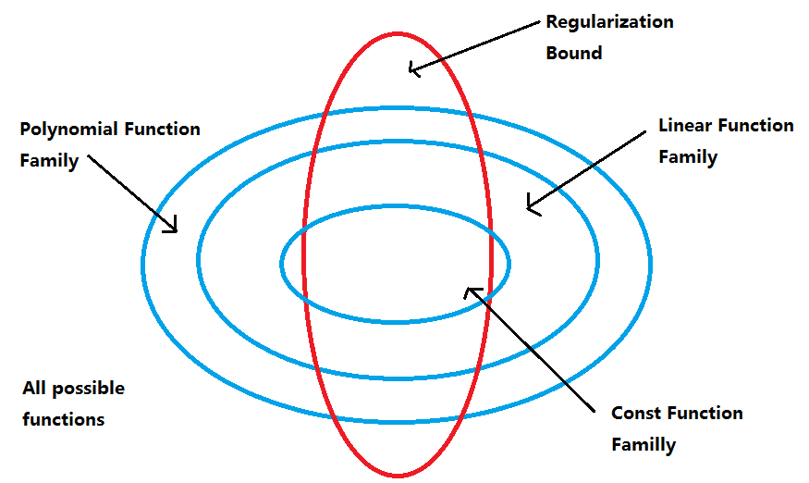

Slide 13
Neural Network Review

Slide 14
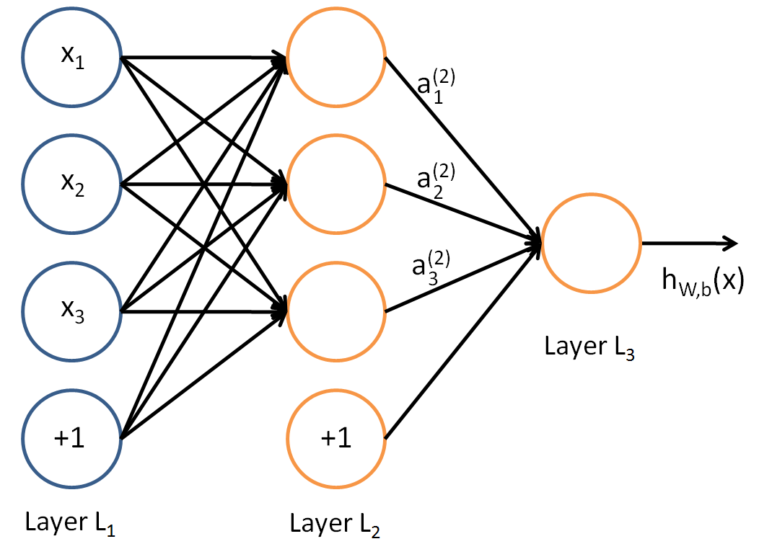

Example of NN
Notes:
Input layer -> hidden layer -> output layer, each neurons represent one dimension/feature.
W = weights matrix; z = input of layer; a = output of layer; b = bias term; l = the l-th layer; f = activation function.
Such computations called forward propagation.
Using bias term can power up network’s capacity. If no bias, W*a have to cross the origin, so it can’t represent those off origin.
Sometimes bias term will be refer as x_0.

Slide 15
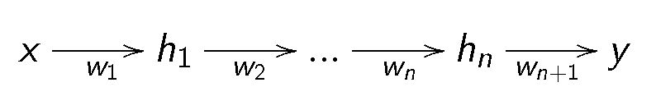
What NN actually do?
Notes:
In each layer, it transform the output, i.e., representation, of previous layer into new representation by means of weights matrix and activation function.
X: raw input; h: output of layer; y: prediction.

Slide 16
So much for Recap
Next: Learning in DL, part 1

