Slide 1
Learning in Deep Learning part 1
By Yanyang Lee

Slide 2
Methods of Learning
Methods | Order
Predetermined | Example
Evolution | No
Gradient Descent | 1
Layer-by-layer Greedy Strategy | 2
Combination of above | 3
Notes:
Using domain specific knowledge to initialize weights and do not change it after that. Semi-predetermined cases are RBF network, SVM.
Random Walking in the space of parameters to find parameters setting which had better performance.
Most famous BP. Actually it is a compromised form of searching(hill-climbing) in parameter(continuous) space.
Stacked Autoencoders/RBMs are examples.
Pretraining.

Slide 3
Learning Tricks
Methods | Order
Speed up learning | 1
Regularization | 2
Notes:
Examples like momentum, RMSprop, HF optimizer, Adam, Adaptive adjusting learning rates.
Examples like weight decay, adding noise(weight, input), dropout, baysian, early stopping.

Slide 4
Gradient Descent
BP & BPTT

Slide 5
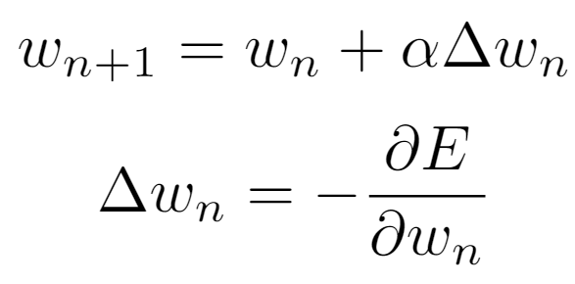
General Form of GD
In usual:
But in NN, hidden units didn’t have any error measurement of their behaviors
How to obtain their error derivatives?
Notes:
Why GD work? See P18.

Slide 6
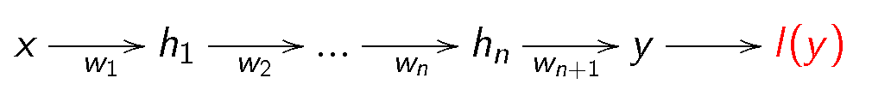
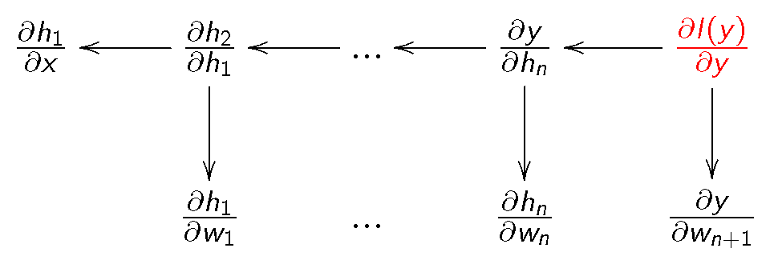
Information Flow
(Input signal)Forward Propagation/FP
(Error signal)Backward Propagation/BP
= E(y)
Notes:
Images are copied from Silver’s PPT, so I add red E to unify notations.
h: output of each layer
What got backprop, i.e., the error signal each layer received, is gradient of error w.r.t their outputs.
To get error derivative w.r.t weights, multiplying terms in image from rear to front based on Chain Rule.

Slide 7
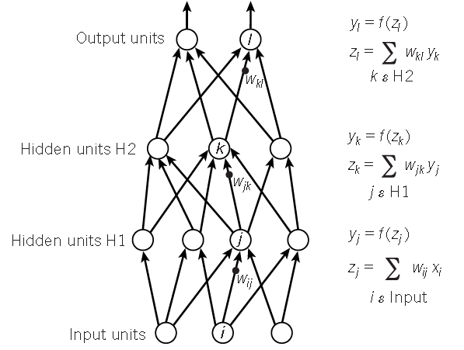
Example of FP
Notes:
Z: input of neuron; y: output of neuron; f: activation function; w: weights matrix.

Slide 8
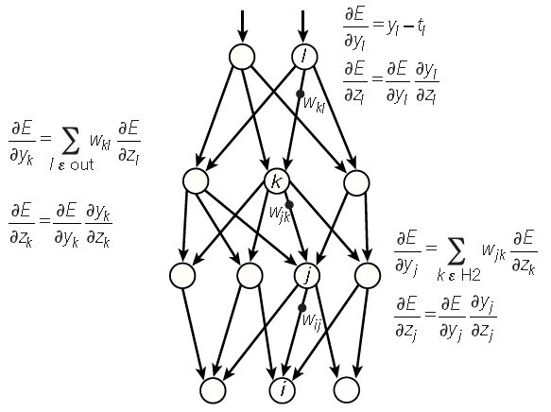
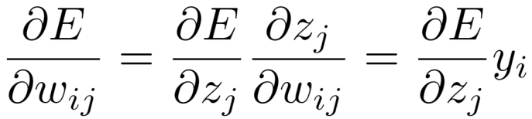
Example of BP
Derivative of
Error w.r.t output
Using Square Error here
In FP, weighted output flow
into next layer independently,
so sum up with weights
Derivative of output of
Activation Function
w.r.t its input

Slide 9
BPTT
GD used to train network with recurrent connection
Consider it as BP in an usual NN after original one were spanned through time
Error signal flow backward as previous
Final derivative w.r.t weights in recurrent connection = Sum of corresponding derivatives over different time steps

Slide 10
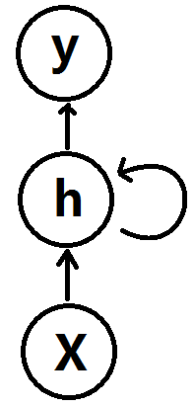
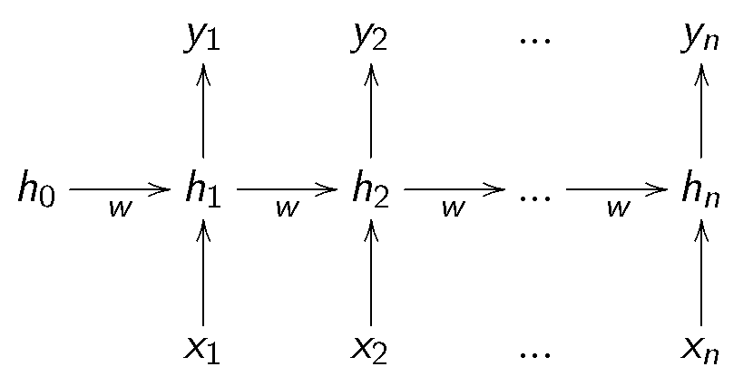
Example
Notes:
Convert RNN to ANN:
Every neuron in the same time step can be treated as neurons in the same layer. Number of time step = Number of layers. Number of neurons in RNN = Number of neurons in a single layer of ANN.

Slide 11
A bag of Tricks to Speed Up

Slide 12
Methods will be covered
Methods | Order
Normalization | 1
Initialization | 2
Momentum | 3
RMSprop | 4
Newton’s Method | 5
Adam | 6

Slide 13
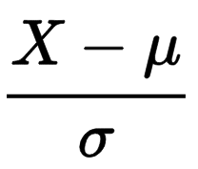
Normalization of Input
Normalization is also important to speed up learning because it reshape error surface so that helps to speed up learning
General Form:
Consisting of 2 part: shifting input and scaling input

Slide 14
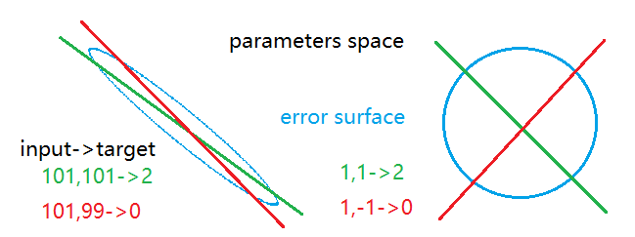
Why Shifting Input works?
Straight line with different color = set of parameters settings which satisfied the equation between input and target both are of same color with line’s
Notes:
Also called “weight space”.
A circular error surface means gradient exactly pointing to optima, so we prefer it.

Slide 15
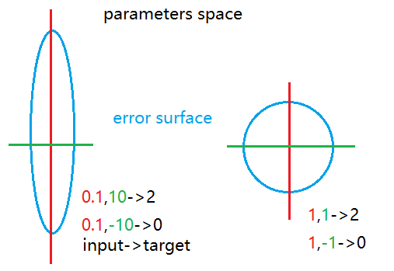
Why Scaling Input works?
Different color of straight line = different axis

Slide 16

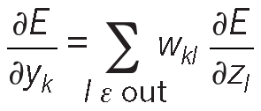
Initialization Potential Problems
If 2 hidden units have exactly same incoming and outgoing weights
-> received same gradient
-> won’t learn different features
Big weights -> Big gradient -> Divergence
1
2
Notes:
Recall that in BP, gradient for weights between n and n+1 layer depends on gradients w.r.t input of n+1 layer’s neurons and output of n layer’s neurons, as shown in the equation. 2 neurons in same layer have same bias and same incoming weights means they have same output, and having same outgoing weights means they received same gradient from above layers, thus their own gradients will be the same.
a in last formula = y in first formula = neuron’s output

Slide 17
Initialize Small Weights Randomly
Often initialize weights using Gaussian Distribution with 0 mean & 1(or less) variance
This help to break symmetry
Avoid problems described in previous slide

Slide 18
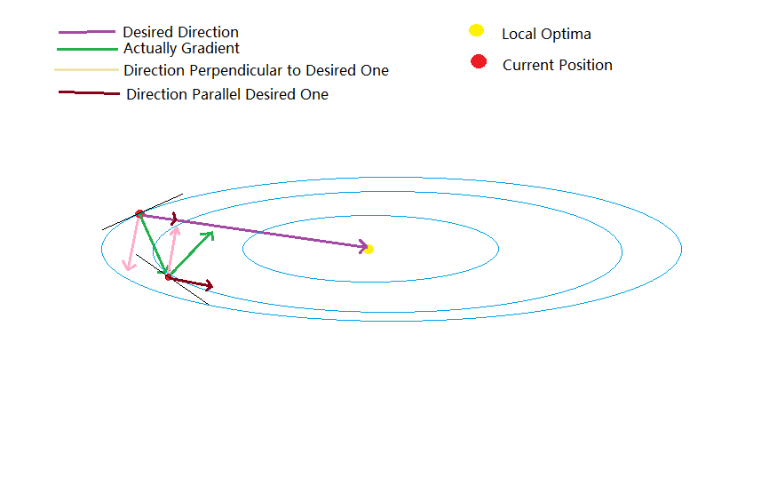
Motivation of Momentum
Analysis on error surface
Notes:
This is a parameter space, all except one dimensions are parameters, the exception is error.
Points on blue ellipse indicate they share the same error but with different parameters settings.

Slide 19
Momentum
Objective:
Eliminate oscillation of wrong direction(i.e., Pink line)
Accumulate “speed” of desired direction(i.e., Brown line)
Manner:
Treat gradients received as velocity
Update parameters by a accumulated velocity

Slide 20
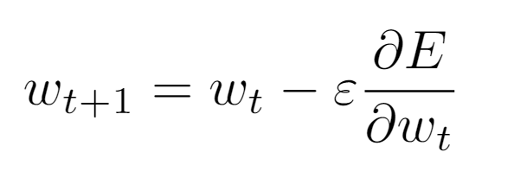
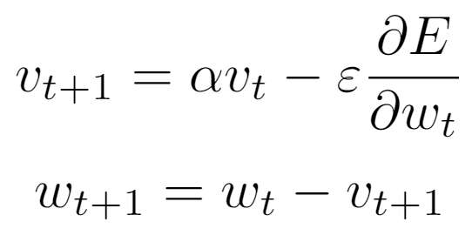
Momentum Details
Normal Update Rule
Momentum Update Rule

Slide 21
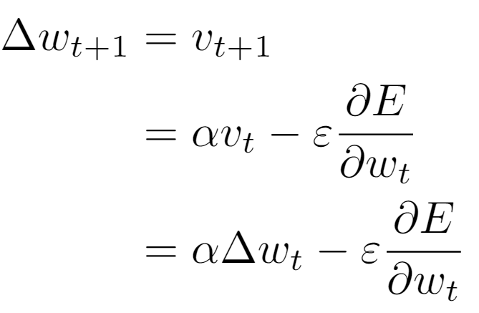
Why Momentum Works?
Expand weight change of momentum
It update parameters with current gradient and decayed previous weight change
It is desired because we want to accumulate past gradients to speed up learning
Notes:
It weight more on current gradient and decay past gradients because current position is differ from past, so does desired direction.
Momentum always use together with early stopping, since it accumulate a lot of speed in some direction, and this may cause it unstable when it already reach optima.

Slide 22
Motivation of RMSprop
Magnitude of gradient differ for different weights at different time
Hard to find a single global learning rate appropriate for all weights and all times
Sign of gradient is enough to decide which direction to update weights
Automatic adjust learning rate
Notes:
If two recent gradients have the same sign, we believe that following gradients will be the same, i.e., we are in right direction, so it is rational to increase their learning rates, otherwise we should decrease it.
We should increase slowly(times 1.2) and decrease dramatically(times 0.5), because increasing slowly helps to avoid divergence, decreasing sharply helps to prevent going in wrong direction further.
When we also divide our gradient with its size and adapt learning rate as describe above, this method called rprop. But its gradient is gradient for whole data set.

Slide 23
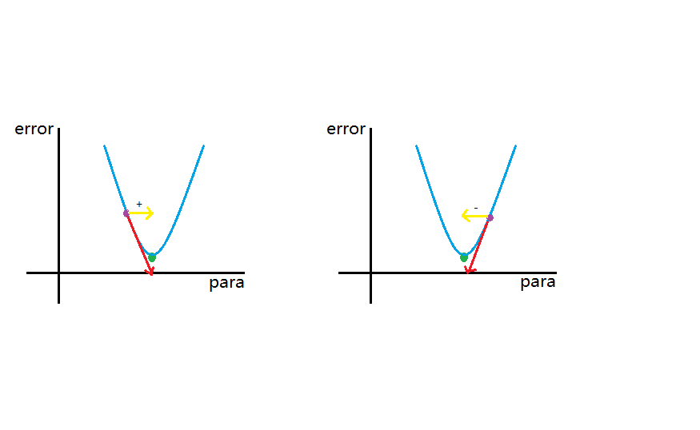
Why just using Sign is enough?
+,-: sign of gradient
Yellow line: negative sign
Original parameter + negative sign of gradient -> moving parameter in right direction
Notes:
para is a short name of parameter.

Slide 24
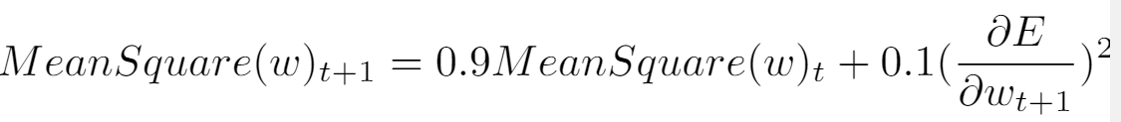

RMSprop Details
Use gradient but divided by its size
Assume the number we divide by for each batch are very similar for adjacent mini-batches
Maintain a running average of the squared gradient for each weight
Dividing the gradient by
MeanSquare: estimate of the size of gradient for whole training set
Notes:
Why not just divide gradient’s absolute value for each batch?
Gradient we received at each batch actually is a noise version of gradient for whole data set. If we use rprop for mini-batch, imagined this example: Suppose we have 10 batch, first 9 of them have gradient 0.1, yet the rest one has -0.9. In expectation, i.e., gradient for whole data set, it should be 0. If we adapt learning rate as rprop and divide each gradient only by its size, the final learning rate will be too large. So we need to estimate the size of gradient for whole data set instead of dividing gradient of each batch by its size.
One advantage of this is, if we received a gradient is bigger than that average, it seems that we should take a larger step because big gradient means we could reduce error faster, and gradient dividing by such average will larger than 1, which means we could take a larger step, contrary to just using gradient divided by its absolute value, which is always 1 or -1. This is similar to automatic adjusting learning rate.

Slide 25
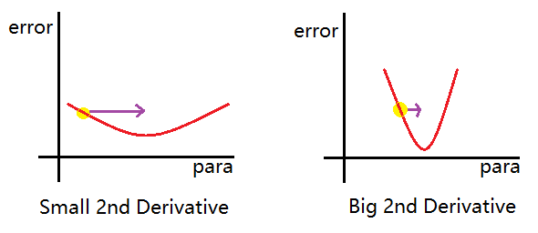
Motivation of Newton’s Method
Second Derivative: Varying Ratio of Gradient
If gradient vary only small amount over time, take a larger step
If gradient vary rapidly over time, take a small step

Slide 26
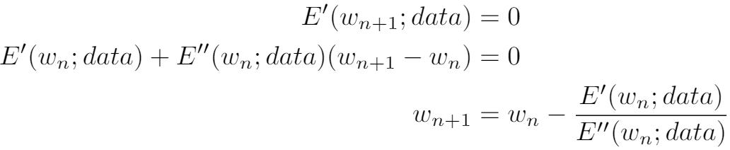
Derivation of Newton’s Method
Optimization Problem
Truncated Taylor Expansion
Solution of Linear Function about w_{n+1}
2nd Derivative as denominator is exactly what we need!

Slide 27
Drawbacks 1
Why Newton’s method is faster?
Directly solve optima of a order-2 approximation of error surface
Yet inherent problem within original optimization problem
We want minima to minimize error
Derivative is 0 = Optima ≠ Minima
Can be fixed by making sign of gradient and of 2nd derivative consistent
Notes:
Why is order-2 approximation?
In previous slide, we solve a order-1 approximation(linear part of taylor expansion) of error’s derivative. By integrating such approximation, we got an order-2 approximation of error itself.

Slide 28
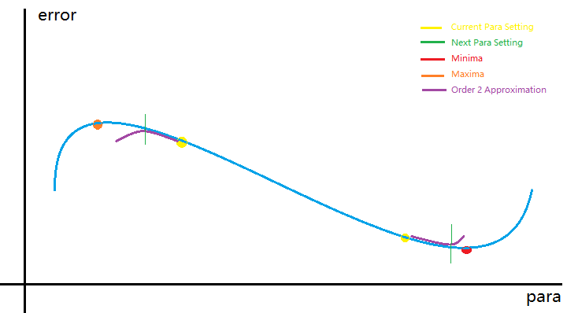

Slide 29
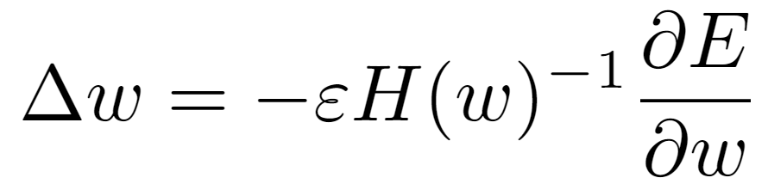
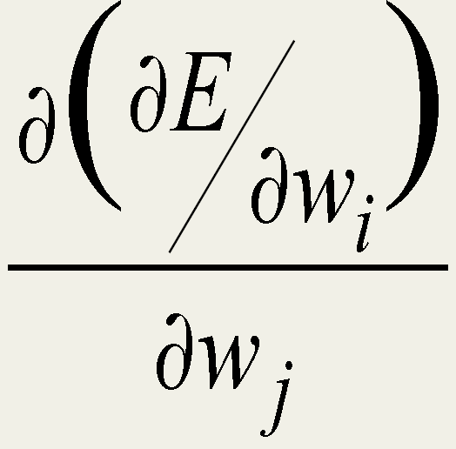
Drawbacks 2
General Form
Where H is Hessian Matrix, w*w(number of paras)
H(i,j) is 2nd derivative of error w.r.t i^{th} & j^{th} para
Which is how other weights’ changes simultaneously could interact with one weight’s gradient direction
Since number of paras in NN up to million, it is impossible to compute and store H exactly
Notes:
Each element in the curvature matrix specifies how the gradient in one direction changes as we move in some other direction.
– The off-diagonal terms correspond to twists in the error surface.
The reason steepest descent goes wrong is that the gradient for one weight gets messed up by the simultaneous changes to all the other weights.
– The curvature matrix determines the sizes of these interactions
--Hinton

Slide 30
Remedy of Newton’s Method
Approximate exact Hessian Matrix
We think diagonal terms already capture the majority of interactions
Drop all off-diagonal term -> only a small fraction of Hessian Matrix(diagonal terms) need to be maintained
Called “Hessian-Free Optimization”
Notes:
Another method called “conjugate gradient” also use inverse of Hessian Matrix.
Essence of this method is choose a new gradient which doesn’t interact with previous gradients each time.
More details should refer to Optimization Theory.

Slide 31
Motivation of Adam
SGD is suitable to huge amount of data
Also help to jump out of local optima
But sensitive to learning rate
Noise came from data(mini-batch) and objective function(several evaluation functions) slow down SGD
Could we adaptive adjust learning rate and update with true gradient?

Slide 32
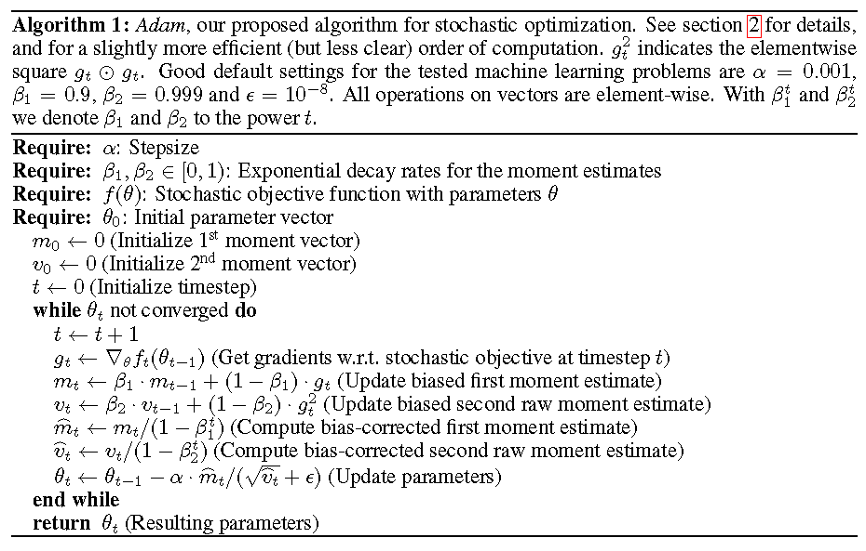
Adam Overview

Slide 33
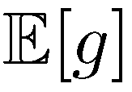
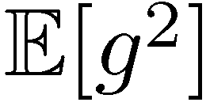
Adam Details 1
Estimate the expected value of gradient, i.e., by maintain a running average
Estimate the expected value of square gradient, i.e.,
Address the noise problem

Slide 34
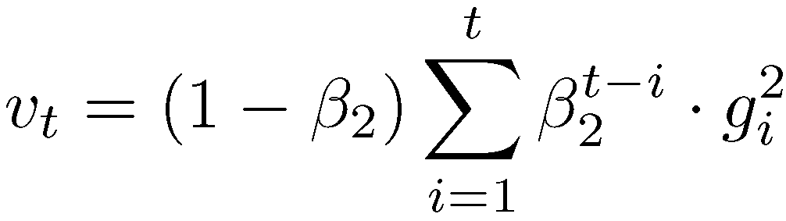
Adam Details 2
Because initial value is 0, estimates are biased toward 0, especially during the initial time steps
Turn the recursive formula into a general one:
Notes:
Could explain 1st point a little more.

Slide 35


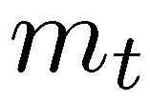
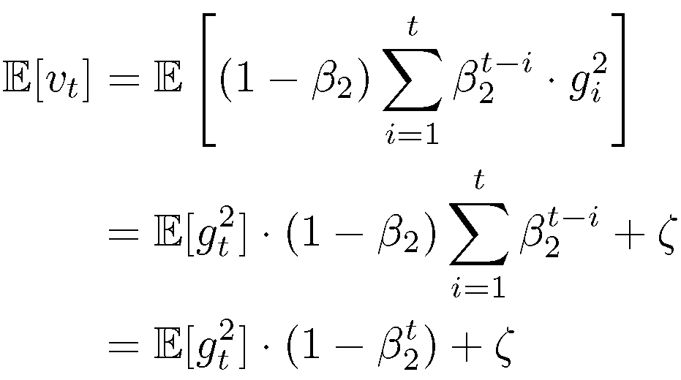
Adam Details 3
is only needed when is non-stationary
Similar for
Now we eliminate effect of initial 0

Slide 36


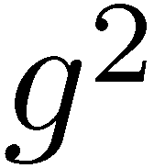
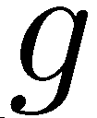


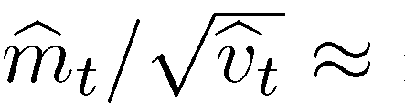
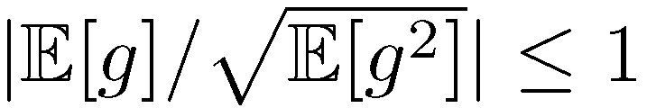
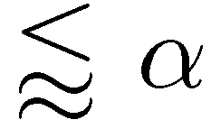
Adam Details 4
& become unbiased estimates of &
Hence:
This give a bound of each step it took is
Notes:
The bound is little mathematic complicated, so I won’t discuss it here(Because I also don’t know how to prove it, it seems like something should be covered in Prob Textbook).

Slide 37
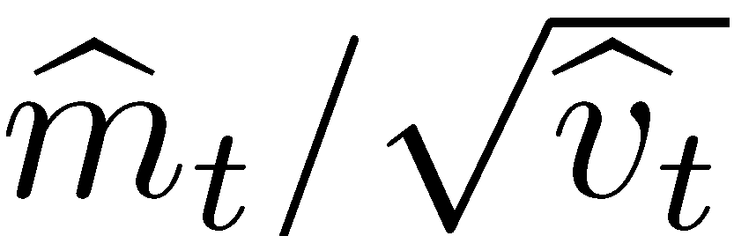
Adam Details 5
behaved similar to SNR
Smaller SNR = greater uncertainty
When closing to optima, most of step sizes didn’t lead to optima, hence SNR become small, which is what we desired
Since Adam also give a bound on each step it took, we can consider it as a form of automatic annealing
Notes:
SNR: signal-to-noise ratio.

Slide 38
Summary for Tricks 1
For momentum and Adam, both focus on how to summarize history of gradients to get a appropriate estimate of true gradient for current position we are in, i.e., desired direction(actually is the expectation of all gradients from this position to minima) to guide the direction we used to moved.
Notes:
Why desired direction = expectation of all gradients?
Expectation of all gradients is adding all gradients and scale the result. Result of adding several vectors is drawing an arrow whose tail is the tail of first vector and pointing to the arrow of last vector(assume all vectors are linked by tail-to-arrow). Noted that last vector(gradient) are pointing the minima, so the desired direction = expectation of gradients.
Since we moved, the desired direction for new position we are in actually changed, so when we estimate true gradient, we usually weight more on recent received gradient.

Slide 39
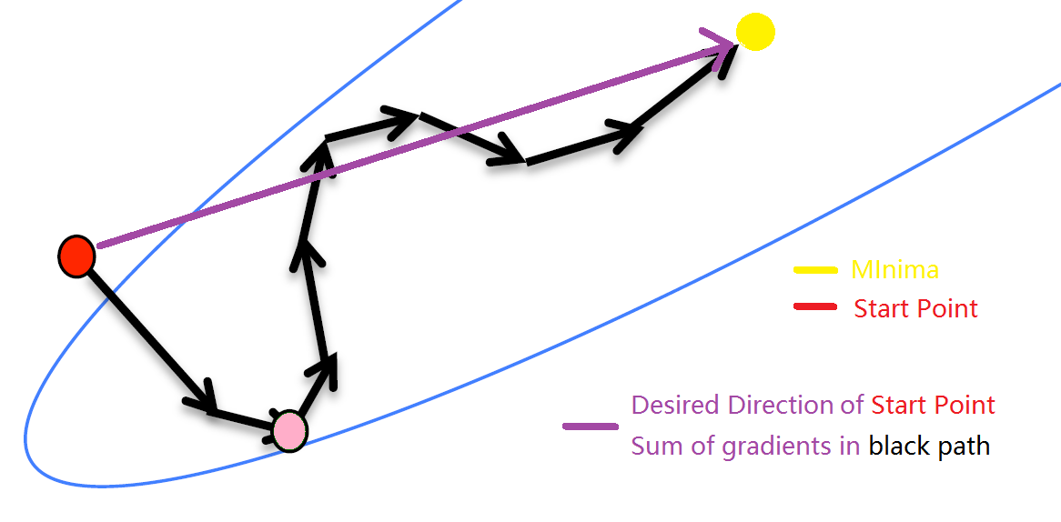

Slide 40
Summary for Tricks 2
For RMSprop, it just use the sign of gradient and make a small step in that direction, this make each step we made will not take us far away from the shortest path for current position to minima pointed by true gradient. Corresponding path taken in RMSprop is less fluctuate than the one in normal gradient descent and oscillated little around the true gradient for current position.

Slide 41
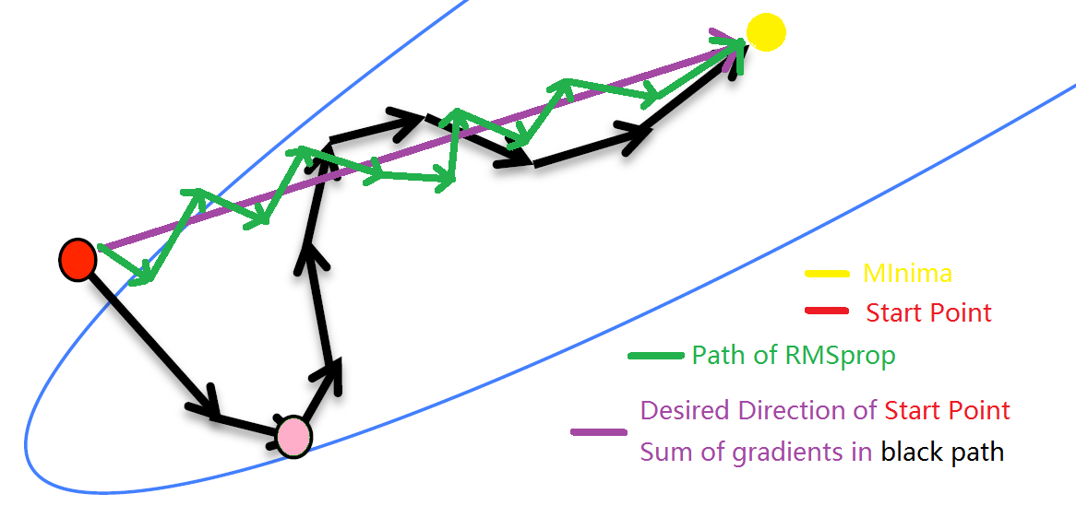
Notes:
It’s not so accurate, but hope it could give some intuition, that is each step taken in RMSprop will not too extreme such that it oscillate less than normal gradient descent, and it is unnecessary around the desired direction of start point.

Slide 42
Why I cease PPT here?
The most popular learning method nowadays is BP, which is applied in Directed Graph
There are many other tricks to speed up learning which is not covered here
Learning methods for Undirected Graph and Regularization will be covered in next part, since all covered in one PPT are too much

Slide 43
So much for Learning, Part 1
Next: Neuron in DL

