Slide 1
Neuron in Deep Learning
By Yanyang Lee

Slide 2
Key Features of Neurons
What kind of operation it provided?
Advantages & Disadvantages
Remedy/Alternatives
To what extent can Input be affected(Output affect)?
Dimension
Value
Need parameters?
Internal adjustable parameters
Hand-Crafted hyper parameters
Meta Neuron?
Gated Structure
Notes:
Operation provided by neurons called activation function.

Slide 3
Type of Neurons
Type | Order
Linear Threshold/Perceptron | 1
Sigmoid/Logistic | 2
Tanh | 3
ReLU | 4
Maxout | 5
Convolution & Pooling | 6
LSTM | 7
First version
Compromise of Perceptron
Piece-wise linear function
Prior knowledge inspired

Slide 4

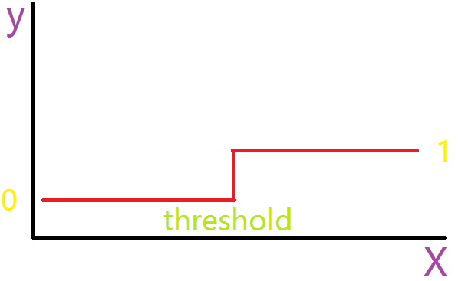
Linear Threshold/Perceptron
Also called “Perceptron”
Gradient is always 0
Hard to optimize(MLP)
Notes:
It has a hyper parameter 0(threshold), but it is unnecessary because it could be included in bias term.

Slide 5

Sigmoid/Logistic
Differentiable everywhere
Probabilistic Interpretation(range from 0 to 1)
Nonlinearity
Derivative:
Notes:
Can be seen as a compromise of Perceptron, a smooth version.
Both of Sigmoid and tanh have no internal/hyper parameters.

Slide 6
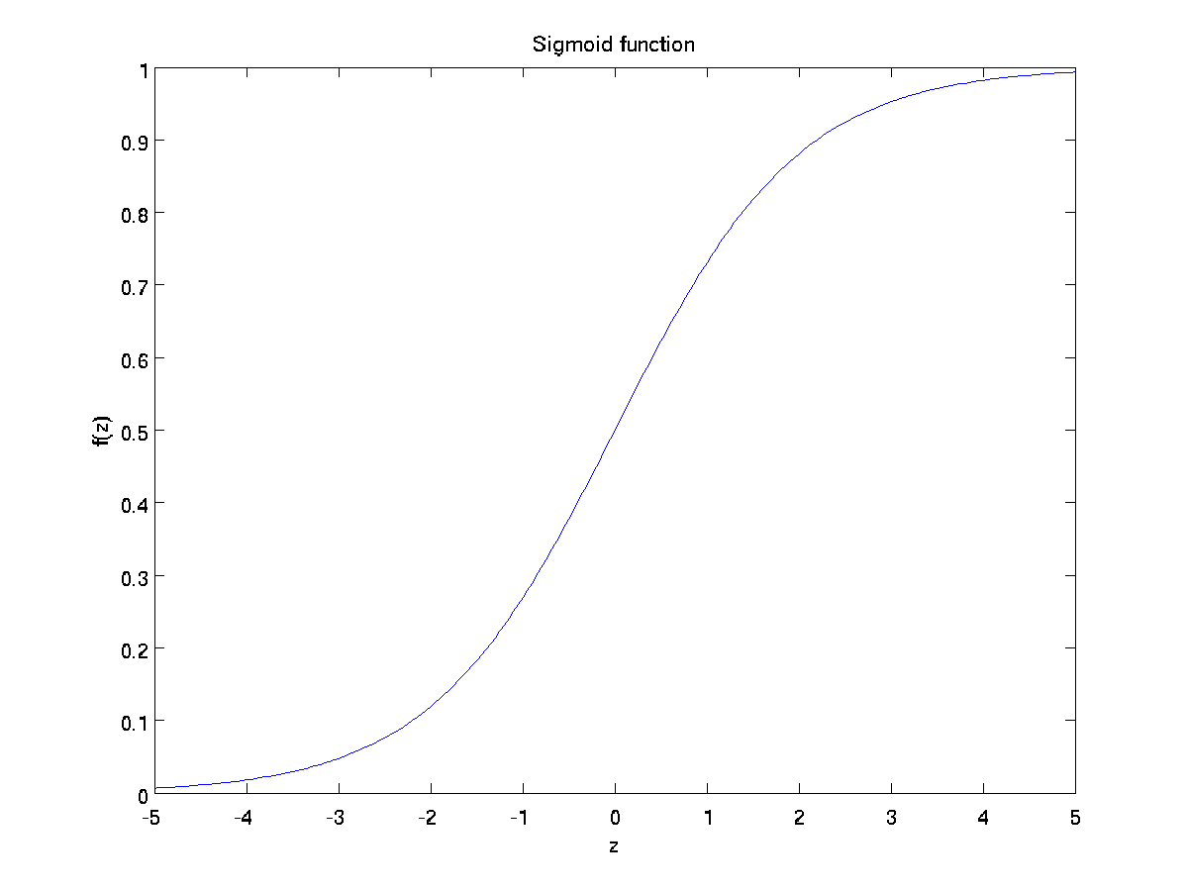

Slide 7

Tanh
Also differentiable everywhere
Nonlinearity
Derivative:
Relationship with Sigmoid:
Rescale Sigmoid output to make it ranged from -1 to 1
Notes:
Tanh is more effective than Sigmoid perhaps it has mean 0(similar to normalization, showed in slide 13, “Normalization of Input” of PPT, “2-Learning_1”).

Slide 8
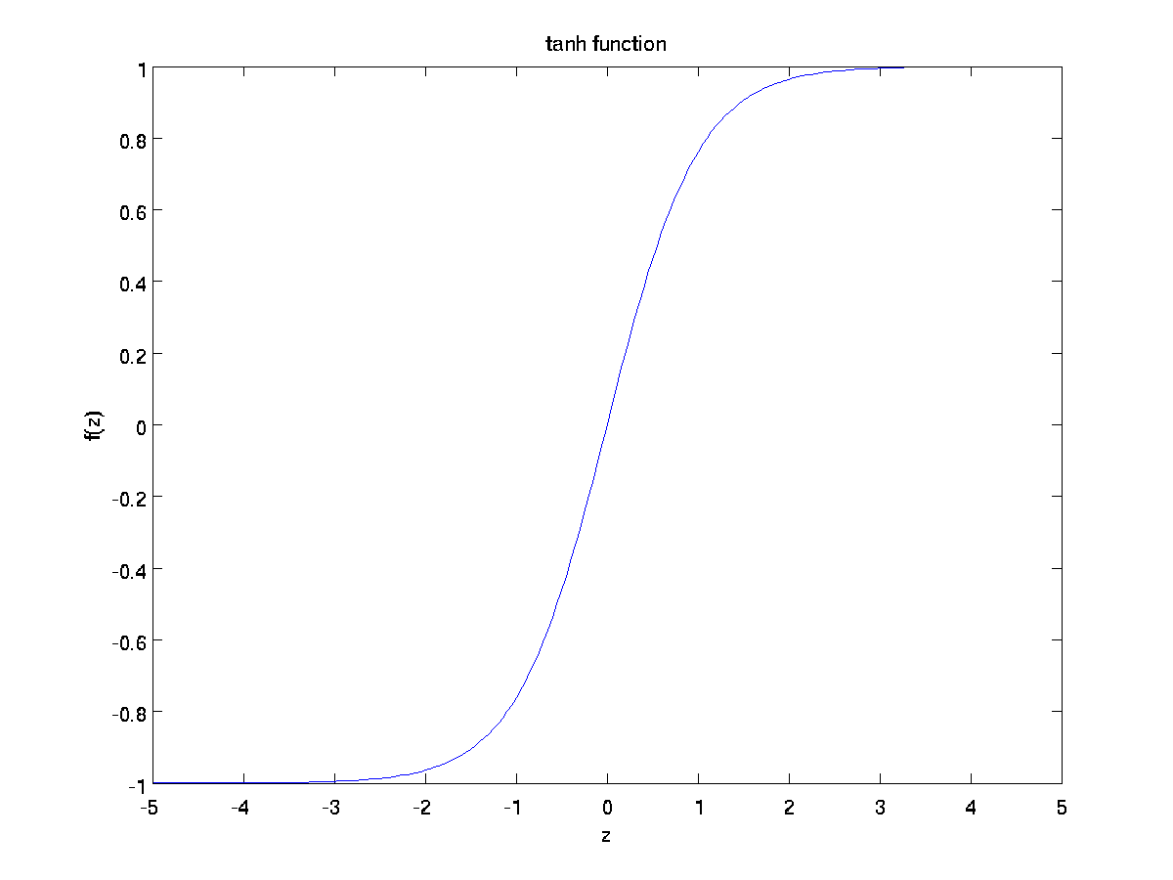

Slide 9
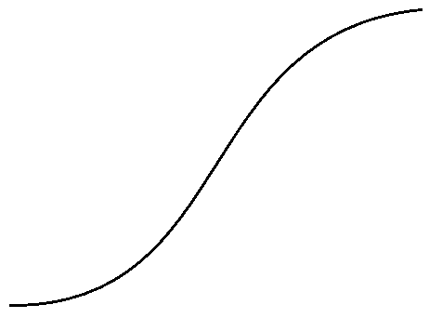
Drawbacks of Tanh & Sigmoid
When network got deeper -> gradient vanished/exploded
Saturated Regime
(near const)
Unsaturated Regime
(near linear)
Notes:
Soft-Saturated: gradient become 0 in the limit;
Hard-Saturated: gradient become 0 after some threshold.
GD is very easy to get stuck in Saturated Regime, since gradient there is very small such that it will take a long time to escape.
When network got deeper, and recalled that in BP, we multiply gradient according to Chain Rule, this problem become serious since many terms got multiplied are near 0 in Saturated Regime. This situation called Gradient Vanished. This make lower layers hard to adjust their weights.
When neurons are in Unsaturated Regime and try to BP, gradient become very large since every term got multiplied is const(near linear in Unsaturated Regime). This situation called “gradient exploded” will tend to divergent.

Slide 10
Remedy 1
Using Piece-wise Linear Function instead(This will be covered later)
Injecting noise in input/Saturated Regime

Slide 11
Remedy 2
Noise in input:
Always fluctuate input size
-> escape from Saturated Regime
Noise = Gaussian Distribution with 0 mean 1 variance

Slide 12
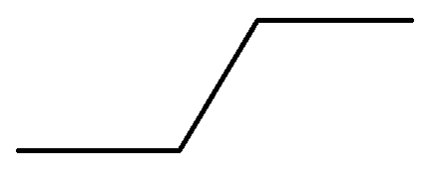
Remedy 3
Noise in Saturated Regime:
Add noise only if input is in Saturated Regime
Mean of noise is positive proportional to distance between Unsaturated and Saturated Regime (≈ simulated annealing)
-> noise in gradient
-> explore more para setting
Companion of Linear Approximation(Linear part of Taylor Expansion) of Sigmoid/Tanh
Notes:
Advantage of mean of noise is positive proportional to distance between Unsaturated and Saturated Regime is that when input is far away from Unsaturated Regime, it would got a larger gradient pushing it back to Unsaturated Regime in expectation.

Slide 13
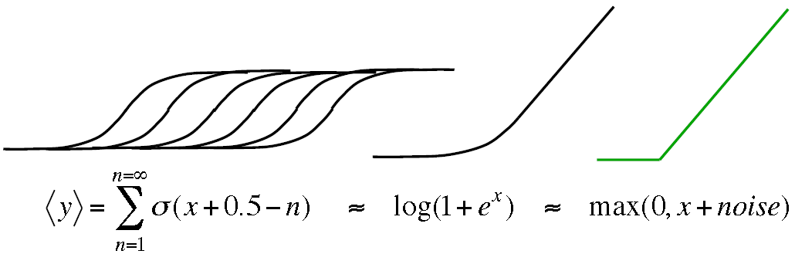
ReLU
Approximation of a family of sigmoid differed by 0.5 offset in bias
No gradient vanish/explode problem(gradient = 1)
Softplus
ReLU
Notes:
ReLU was first motivated in RBM to solve problem when standard deviation of visible units is smaller than 1, the effect from hidden units to visible units is much smaller than those from visible units to hidden units, thus we need a family of sigmoid units such that when input got bigger, i.e., standard deviation got smaller, more hidden units would be turned on to enlarge the effect from hidden units to visible units.(from Hinton)
ReLU also didn’t have internal/hyper parameters.

Slide 14
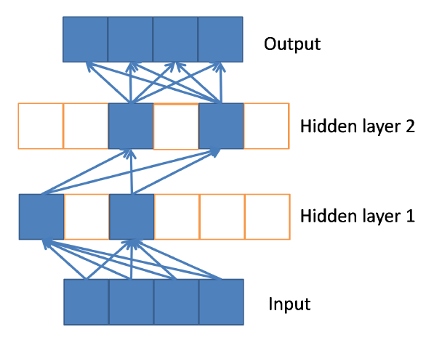
Nonlinearity of ReLU
For a given input, it activate a subset of neurons
Different linear function for different input
exponential number of linear models that share parameters

Slide 15
Drawbacks & Remedy of ReLU
Drawbacks
Remedy
Non-differentiable when x = 0
Output of ReLU could be large since it is unbounded
Identical network function if biases and weights are scaled in a special way
Need to set gradient to 0 when x = 0
Need regularization
No solution yet

Slide 16
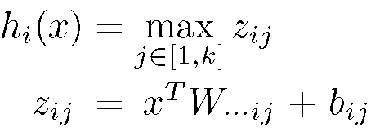
Maxout
General Form:
Able to approximate any continuous function arbitrarily well
Sparse gradients with dropout
Notes:
Maxout has internal adjustable parameters and hyper parameter.

Slide 17
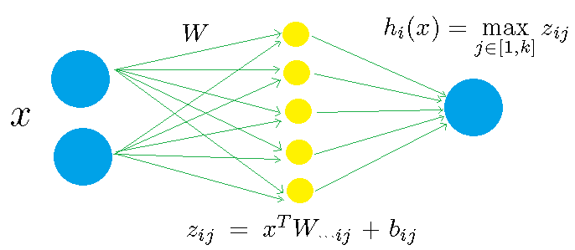
Example of Maxout
Notes:
This is a Maxout unit example with 2 inputs and k = 5.

Slide 18
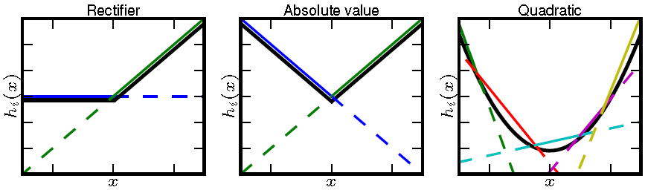
Capability of Maxout

Slide 19
Drawbacks of Maxout
Produce dense representation
Extra hyper parameter(k)
More weights(k times than normal)

Slide 20
Convolution & Pooling
I assume audiences already have concepts of convolution & pooling
So I just describe some terminologies, motivation and my understanding
If never heard about them:
UFLDL Tutorial
CS231n Lecture Notes - CNN

Slide 21
Terminologies 1
Kernel Filter: Set of weights shared by several neurons in different regions.
Feature Map/Channel: Output of neurons in different regions under the same kernel filter.
Sub-sampling/Pooling: A smaller version of feature map it received.
Receptive Field: Input of a single neuron.

Slide 22
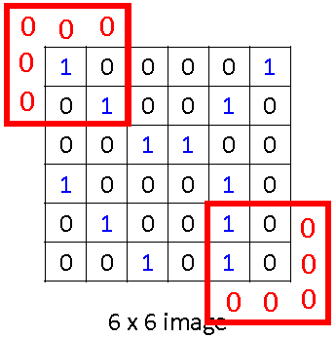
Terminologies 2
Stride: Pixel distance between 2 nearby receptive field.
Zero padding: Some receptive fields might exceed the bound of its possible inputs, for those extra elements they have value 0.
Notes:
Local Response Normalization: normalize elements in a feature map by dividing a special weighted sum of several nearby elements.
This technique is even less popular than Pooling, so it could be not covered.

Slide 23
Motivations
Same pattern of input occur in different dimensions
-> translation invariance
Images/Texts/Videos are high dimensional data
-> too many parameters for feed-forward NN

Slide 24
What did Convolution do?
Detect different features in a small region(2D) through the whole image
When cross-channel, detecting/abstracting higher dimensional patterns(3D)
Constructing abstract representation as feed-forward NN
But reduce number of paras by weights-sharing motivated by translation invariance
Notes:
Weights-sharing comes from where several neurons could have same weights(neurons in the same feature map).

Slide 25
What did Pooling do?
Summarizing nearby info from feature map of lower layer
Especially, Max Pooling
= competing outputs from same kernel filter but different nearby regions
= selecting typical output as feature of a slightly larger region
Reduce parameters by making feature map’s size smaller
Blur location info of lower layer’s feature map to make selective higher layer’s feature more general
Notes:
Now Pooling seems less popular than before.

Slide 26
LSTM
Overcome gradient vanishing problem(const self connection -> const gradient, if forget gate is set to 1)
Make learning long-term dependencies possible since memory are protected by gated structure(multiplicative operation)
Forget Gate: Update memory more effectively
Peephole: Let memory to determine open & close of gates
2 effective enhancements
Notes:
Assume we want LSTM network to take action when them see something N times, and we let memory of LSTM be a counter. If counter reach N, it should open the output gate to allow network to take action, so we need memory to determine open and close of gates, thus Peephole arose.

Slide 27
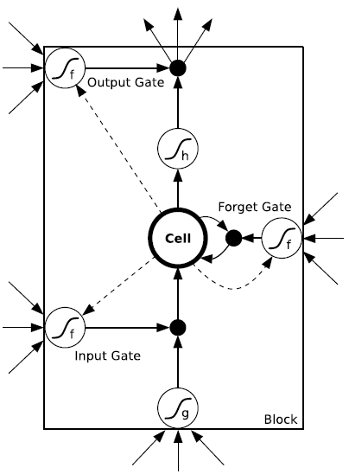
Notes:
Dash lines are peephole connection.

Slide 28
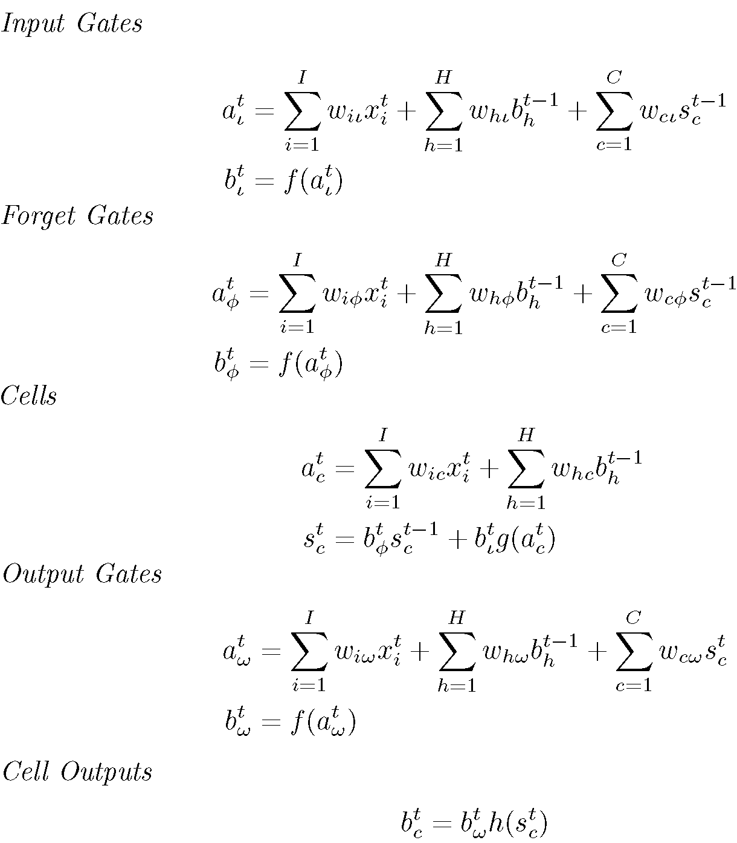
Notes:
f: sigmoid function.

Slide 29
Drawbacks of LSTM
Although LSTM can make influence pass through hundreds of time steps possible
Still unable to pass extremely long time steps
Cause by Soft-Saturated Gate
Resulted in memory leak out & erode memory by external input
Use Hard-Saturated Activation Function instead, but with non-differentiable problem
Notes:
Example of Hard-Saturated Activation Function: Linear part of Taylor Expansion of Sigmoid, expanded around 0 and is const(0/1) when linear part’s output exceed a threshold(0/1).(Figure of Slide 12, “Remedy 3”)

Slide 30
Summary
Different Neuron(Activation Function) are inspired by prior knowledge or designed for special task requirements
There are many other variants not been covered
Hope audiences could have intuition about mainstream neurons
And able to design your own neuron

Slide 31
So much for Neuron in DL
Next: Connection in DL

