Slide 1
Connection in Deep Learning
By Yanyang Lee

Slide 2
Key Features of Connection
From/To
Self Connection
Shortcut Connection
Weights Constraints
Weights Sharing
Value Constraints
Directed/Undirected

Slide 3
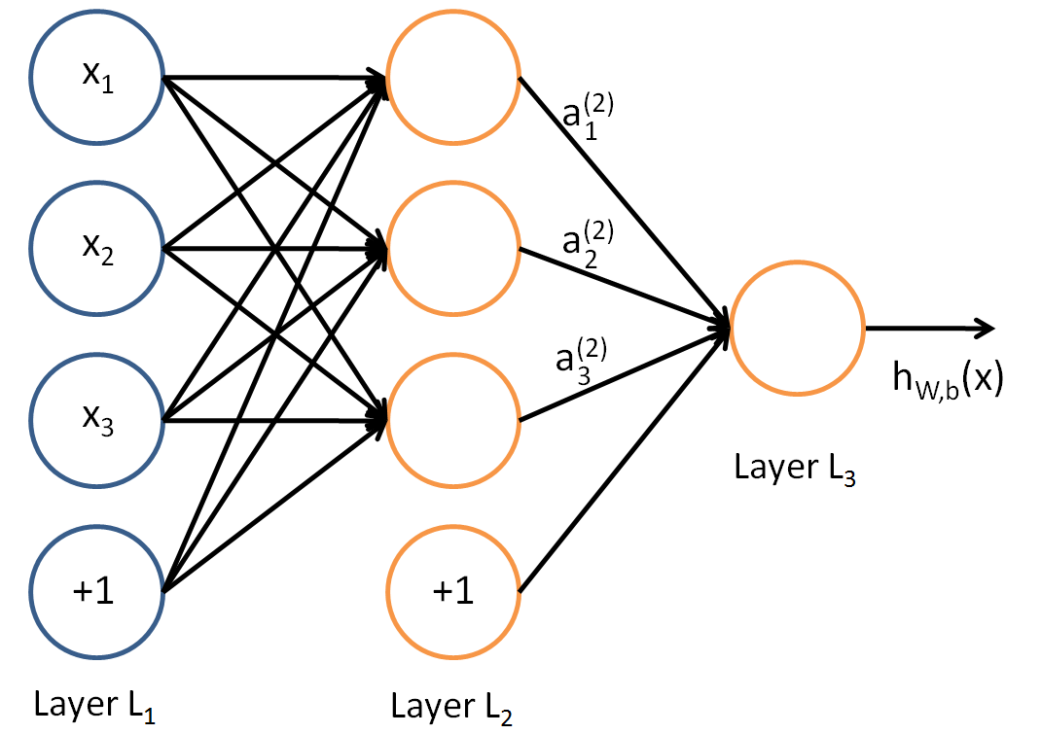
Layer-by-Layer DAG
Directed
Acyclic
Connect adjacent layers
Carry real value weight
Trained by BP

Slide 4
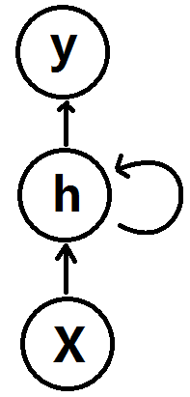
Self Connection
Still directed
But now form a circle
From one neuron to itself
Give rise to “Recurrent Neural Network”(RNN)
Trained by BPTT
Could be converted to normal ANN
Worked if need to carry information from previous time step
Can handle variable length input, output

Slide 5
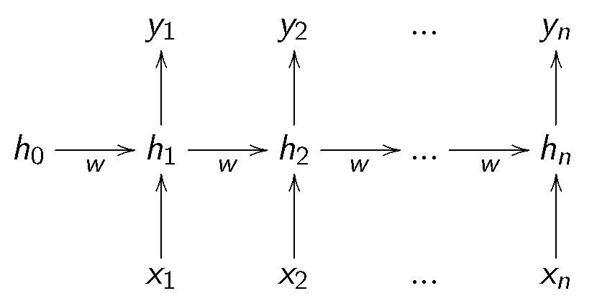
Notes:
All neurons in the same time step could be treated as a single layer of converted ANN.

Slide 6
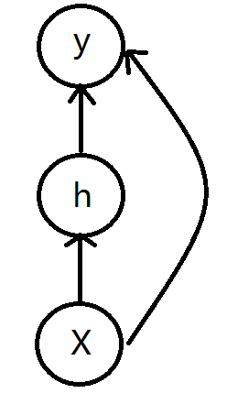
Shortcut Connection
Still directed
Still acyclic
But now connect layers even far away
Trained by BP
Make use of previous representation
Worked if higher layer prediction does related to lower layer’s representation

Slide 7
Weights Sharing
RNN
When representation flowed from previous time step to current time step
They are weighted by same weights no matter which time step they are currently in
Similar to Markov Property
CNN
For neurons in the same feature map
They are corresponding to different regions in lower layer’s feature map
But they use same kernel filter to weight its input
Detecting same features among different locations

Slide 8
RNN Example
Same Weights

Slide 9
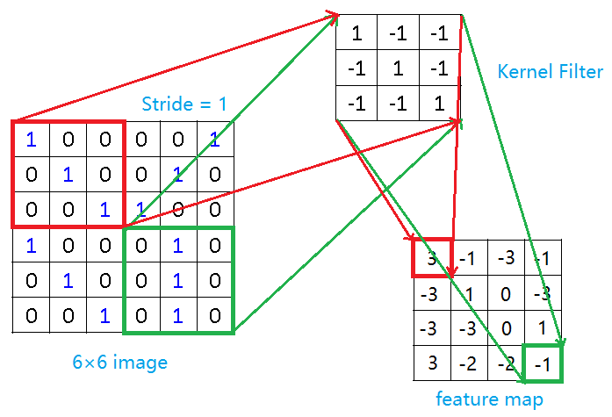
CNN Example
For red & green one, both share same weights, i.e., Kernel Filter

Slide 10
Value Constrains
In usual, weights are real values and unbounded
Set an upper bound of weights’ size(if weight’s value reach that bound, value remain as the bound) in order to regularize
Only take 0/1 value(Binarized NN) in order to efficient learning
Random weights by injecting noise so as to regularize

Slide 11
Undirected Connection
Pure undirected:
Hopfield Net(not covered)
Boltzmann Machine & its Variants(EBMs)
Semi-undirected:
Deep Belief Net
Notes:
Deep belief net != belief net with many layers/neurons

Slide 12
Energy-Based Model
For a single particle:
When one need more energy to be activated, it is not likely to be activated in statistic
For the whole system:
low energy -> high entropy -> more stable
thus system should have high probability in a stable state and vice versa
We want to use a model to capture that fact in probability distribution of the whole system
Same pattern(scalar -> distribution rather than sub-distributions -> distribution) might occur in other fields, not just this particles system, so it can be seen as a toy example to motivate EBM.
Notes:
This is a way to model real particle system.

Slide 13
Two problems
When we use a model to describe this prior belief, there comes 2 problems:
Inference: given a model, how to find its low energy configuration(under some constrains)?
Learning: given an observed data set, how to learn a model such that a reasonable configuration will have low energy?
When we use a specific model, how should it model and to solve these 2 problems?
Notes:
Here configuration refers to a particular state.

Slide 14
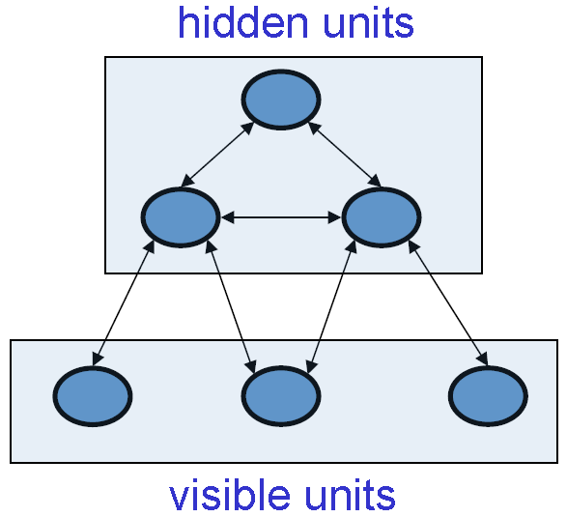
Boltzmann Machine
2 sets, not 2 layers
Particle: Binary Stochastic Neuron
Undirected connections specify interactions between nearby particles
Input = visible units
Representation of input = hidden units
Badness of representation = energy
Representation View
Notes:
Differences between BM and model for simple particles system described before are:
In Boltzmann Machine, some particles/units can’t be observed, such units correspond to a representation of visible units;
In Boltzmann Machine, we can model not just a particles system but something else, so energy have another meaning: badness of representation, rather than stability.

Slide 15
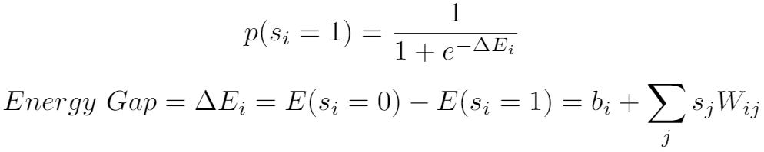
Single Neuron & Energy Gap
Probability Distribution -> Stochastic State(0/1) of a single neuron
Energy Gap -> Probability Distribution
Weights on surrounding connections -> Energy Gap
Notes:
As energy gap becomes big, the probability of this neuron will be on becomes less possible, which is similar to that required energy to activate a particle is big, it will less possible to activate such particle in statistical sense.

Slide 16
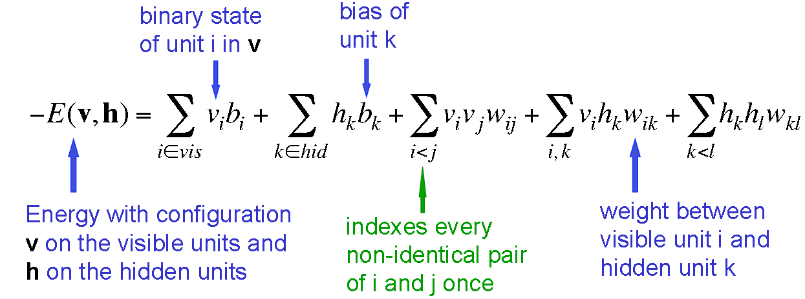
Whole Network & Energy
Energy -> Probability distribution of configurations of whole system
Notes:
Whole network with a specific configuration is measured by its corresponding energy.

Slide 17

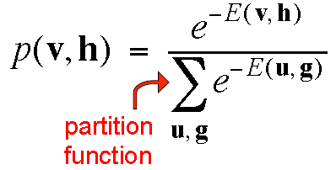
Boltzmann Distribution
Energy for a certain (v, h) is low = Present more
Energy for a certain (v, h) is high = Present less
So
Normalize(similar to Softmax):
When we are able to compute partition function, we can solve inference problem easily
Notes:
Boltzmann Distribution also contain a temperature term. Here in BM it is always 1 so I omit it.
Why not multiply probabilities of each unit on together to get this joint probability distribution? Because these probabilities are not independent to each other. In RBM, it will involve some independent assumptions.

Slide 18
Sampling as Remedy
Reason
Procedure
Number of terms in partition function grows rapidly
Unable to sum
Start from a random global configuration
Keep picking a random neuron
Update its state based on its energy gap
Stop until reach thermal equilibrium
Now draw samples
Notes:
Such sampling process is actually a Markov Chain, whose transition probability is determined by the order to pick neuron and their possible energy gaps. The stationary distribution it reached is actually Boltzmann Distribution.
If you try to sample p(h|v) rather than p(v,h), just clamp the visible units and update the hidden units.
Another way to approximate partition function is variational inference, which is try to find the best distribution from an easy-to-compute distribution family for the partition function, and “best” is often measured by KL divergence.

Slide 19
Thermal Equilibrium
Similar to stationary distribution in Markov Chain
Not settle down to lowest energy configuration
But a stationary distribution whose probability of a certain state presented no longer change
Such distribution is the probability we will in a certain state at any time
Notes:
This is thermal equilibrium with temperature 1.

Slide 20
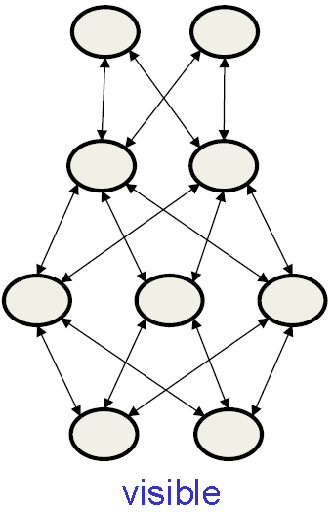
Deep Boltzmann Machine
No connections within a layer
No skip-layer connections
Allow updating states in the same layers and odd/even layers simultaneously

Slide 21
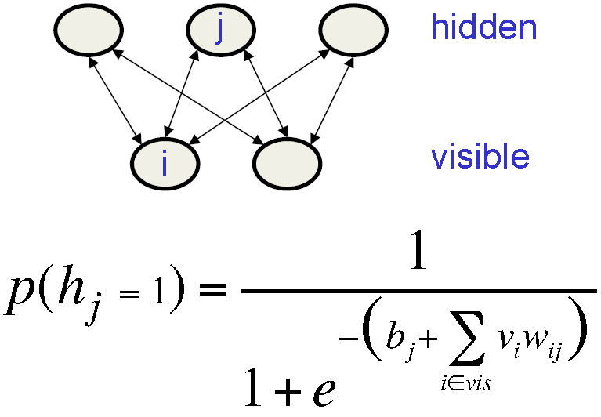
Restricted Boltzmann Machine
One layer of hidden units
No connections within a layer
Allow to reach thermal equilibrium of P(h|v) in one step(when visible units are clamped)

Slide 22
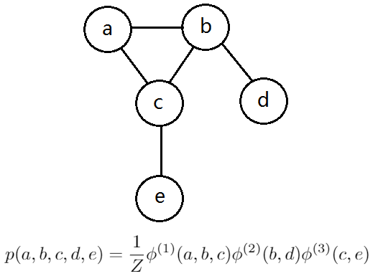



Markov Random Field
An undirected graphical model
Probability of a configuration of random variables could be factorized by cliques
Clique = a set of nodes that are all connected to each other
Each clique associated with a factor
Factorization:
Z denotes normalizing constant
Notes:
The joint probability distribution of the graph is independently determined by every cliques rather than the exponential raw form. This is Markov property occured in a small local region with respect to its name.

Slide 23
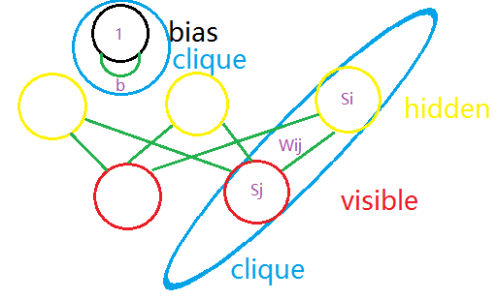

RBM as MRF
Each possible pair of a visible unit and a hidden unit form a clique
Each bias term itself form a clique
Factor is determined by weight on connection between units and states of each unit
So: RBM = log-linear MRF
Notes:
This is my point of view, I am not sure it is right, but I hope it could provide some intuition behind RBM.

Slide 24
So much for Connection in DL
Next: Learning in DL, part 2

