Slide 1
COEN 146L: Computer Networks Lab

Slide 2
Lab Outcomes
develop C programs with various system calls in a Unix/Linux – based environment.
develop multi-threaded applications with synchronization primitives
use network commands and tools such as ping, traceroute, telnet, route, arp, netstat, ifconfig, etc.
select and use appropriate system calls and socket programming tools in Unix/Linux and C to build transport layer TCP/IP and UDP/IP reliable/ unreliable data transfer services
develop algorithms and application in C for DV and LS routing protocols and for Ethernet and ARP
develop simple cryptography algorithms
Notes:
Open Shortest Path First

Slide 3
Lab Topics
Lab1. Unix/Linux Commands and Overview of C Programming
Lab2. Multithreading in C and network commands
Lab3. TCP/IP socket programming
Lab4. UDP/IP socket programming
Lab5. Stop and Wait for unreliable channel
Lab6. Stop and Wait for unreliable channel with loss
Lab7. Link state routing protocol
Lab8. GNS3 Network Emulator
Lab9. Cryptography algorithms
Notes:
Open Shortest Path First

Slide 4
Technical Requirements and Resources
Unix/Linux, C
Compiler: Unix/ Linux gcc, MAC Xcode, and/or Visual Studio Code
To access the lab computers remotely
https://wiki.helpme.engr.scu.edu/index.php/ECC_Remote_Access_Overview (Links to an external site.)
To create an account and use a default password:
https://wiki.helpme.engr.scu.edu/index.php/Accounts#Default_Passwords (Links to an external site.)
Tutorial for using SSH and Terminal:
https://sites.google.com/scu.edu/scuacmw/resources?authuser=0 (Links to an external site.)
Remote software development:
https://docs.google.com/document/d/1xH3tZ22JwYxVsu6kUKT3qPibMsGnFdmWQGWc7Vwc_jM/edit

Slide 5
Grading and Late Policy
Labs will be posted on Monday each week and will be due the next Monday
Grade distribution:
Attendance 10%
Code 65%
Demo 25%
10% of the grade will be deducted for late submission
No submission will be accepted after one week without excuse/ permission

Slide 6
Honor code
All students taking courses in the School of Engineering agree, individually and collectively, that they will neither give nor receive unpermitted aid in examinations, assignments, or other course work that is to be used by the instructor as a basis for grading.

Slide 7
Unix/Linux Commands and Overview of C Programming
COEN 146L: Computer Networks Lab
Lab 1

Slide 8
Objectives
To get along Linux environment
Execute basic Linux commands
Basics of C programming
Multithreads and multiprocesses
Packet switching vs Circuit switching

Slide 9
Tasks
To setup and demonstrate the use of Unix/ Linux or Mac OS terminal
To learn and demonstrate the use command – line programs
Commands: ls, more, mv, rm, mkdir, rmdir, cd, cp, chmod, who, ps, kill, ctrl+c, cmp, grep, cat, and man
Options: -a: all, -b: buffer, -c: command, -d: debug, -e: execute, -f: file, -l: list, -o: output, -u: user
To learn and demonstrate the use of system calls
Process creation and management (e.g. fork(), exec(), wait(), exit())
File management (e.g. open(), read(), write(), close())
Communication (e.g. pipe(), shmget(), mmap())
Networking (e.g. socket(), bind(), connect(), listen()
To develop sample programs in C
int main(int argc, char *argv[]), parent-child process, threads
Circuit switching and packet switching

Slide 10
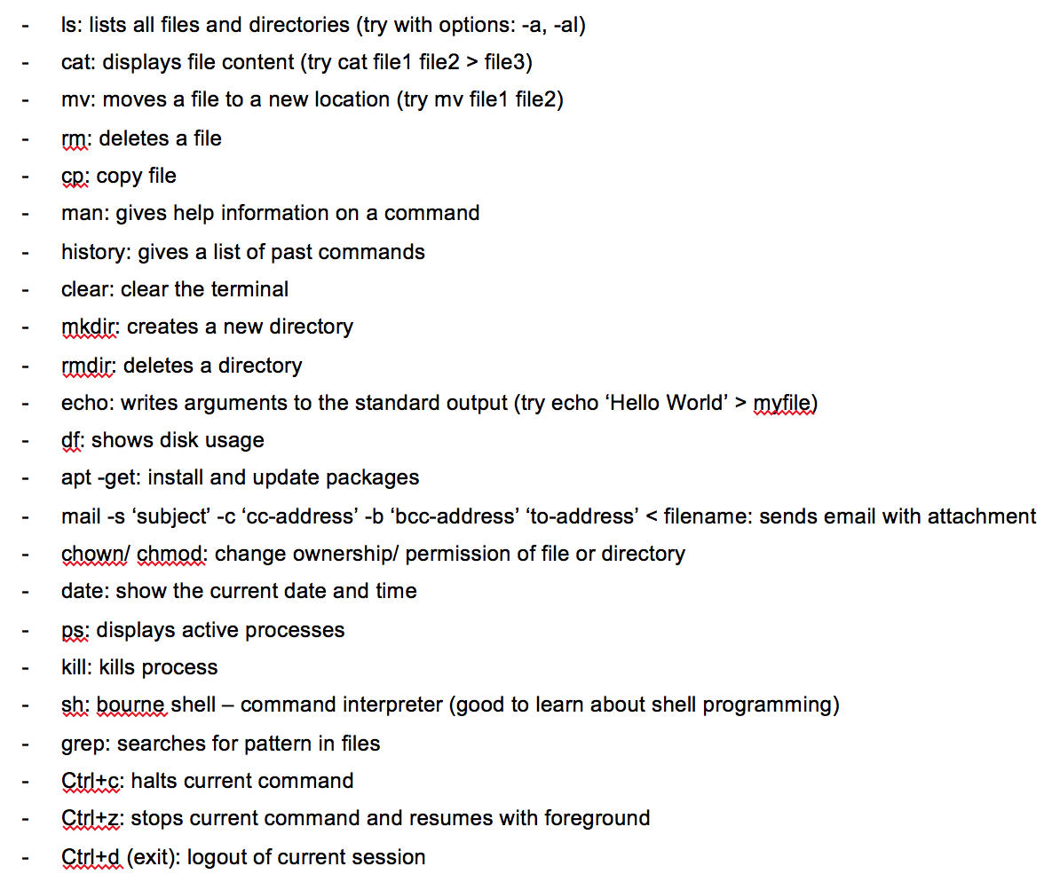
Basic Linux Commands
Open the terminal on Linux or Mac, and try out all the commands
To get more information about a command, use man
e.g. >> man echo
Press q to exit after you are done reading the information

Slide 11
fork( )
fork() creates a new (child) process, so you now have two identical processes.
To distinguish between them, we use the return value (for example, p = fork()).
In the original/parent process, you get the PID of the child process i.e., p would be equal to PID of the child process
In the child process, you get 0. i.e., p would be 0

Slide 12
Example
CODE
/*COEN 146L : Lab1 */
/*Sample C program for Lab assignment 1*/
#include <stdio.h> /* printf, stderr */
#include <sys/types.h> /* pid_t */
#include <unistd.h> /* fork */
#include <stdlib.h> /* atoi */
#include <errno.h> /* errno */
/* main function with command-line arguments to pass */
int main(int argc, char *argv[]) {
pid_t p;
int i, n = atoi(argv[1]); // n microseconds to input from keyboard for delay
printf("------------------before forking.------------------\n");
printf("PID of the parent process (using getpid()): %d \n", getpid());
printf("------------------\nabout to fork.------------------\n");
p = fork();// create two identical processes
//the value of p in the original process would be teh PID of the child process
//whereas the values of p in the child process would be 0
printf("\n\n\np that was returned: %d \n", p);
// ------------------Just to get our concepts right------------------
if (p)
printf("This should have printed from the parent process with PID (using getpid()): %d \n", getpid());
if (p == 0)
printf("This should have printed from the child process with PID (using getpid()): %d \n", getpid());
return 0;
}
- OUTPUT
-----------------before forking.------------------
PID of the parent process (using getpid()): 90649
------------------about to fork.------------------
p that was returned: 90650
This should have printed from the parent process with PID (using getpid()): 90649
p that was returned: 0
This should have printed from the child process with PID (using getpid()): 90650

Slide 13
pthread_create( )
pthread_create( ) creates a new thread (peer) with the main thread
int pthread_create(pthread_t * thread, const pthread_attr_t * attr,void * (*start_routine)(void *), void *arg);
Arguments:
thread - returns the thread id
attr - set to NULL if default thread attributes are used. Check the man page for more details.
void * (*start_routine) - pointer to the function (also called the worker function) to be threaded. Function has a single argument: pointer to void.
*arg - pointer to argument of function. To pass multiple arguments, send a pointer to a structure.
To compile a program that uses pthreads
>> gcc thread.c -o thread –lpthread

Slide 14
Example
CODE
#include <stdio.h>
#include <stdlib.h>
#include <pthread.h>
void *print_message_function( void *ptr );
main()
{
pthread_t thread1, thread2;
char *message1 = "Thread 1";
char *message2 = "Thread 2";
int iret1, iret2;
/* Create independent threads each of which will execute function */
iret1 = pthread_create( &thread1, NULL, print_message_function, (void*) message1);
iret2 = pthread_create( &thread2, NULL, print_message_function, (void*) message2);
/* Wait till threads are complete before main continues. */
/* wait we run the risk of executing an exit which will terminate */
/* the process and all threads before the threads have completed */
pthread_join( thread1, NULL);
pthread_join( thread2, NULL); printf("Thread 1 returns: %d\n",iret1);
printf("Thread 2 returns: %d\n",iret2);
exit(0);
}
void *print_message_function( void *ptr )
{
char *message;
message = (char *) ptr;
printf("%s \n", message);
}
OUTPUT
Thread 1
Thread 2
Thread 1 returns: 0
Thread 2 returns: 0

Slide 15
Any questions?

