Slide 1
COEN 146 Computer Networks
Basic Linux, network commands, and C programming skills

Slide 2
General Announcements
TA email:
Your emails
Your emails
Demoing & Grading:
Grading will be based on
Whether code works
Programming style
Embedded comments
Observations/answer for questions
Demos are 45% of your final lab score
Late penalties will be 10%
Lab instructions:
If needs to attend other sessions, let TAs know ahead of time
Can finish lab early and just come to demo

Slide 3
Week 1 Agenda
ECC/Terminal Basics
Lab 1 (Day)
Step 1 – Linux basic networking commands
Step 2 – Packet delivery
Step 3 – Copy files using functions, compile, debug, run, and test
Step 4 – Copy files using system calls, compile, debug, run, and test
Step 5 – Calculate the time taken to copy files for both steps 3 and 4
Instructions for Submitting Lab 1

Slide 4
Terminal/Remote into the ECC
In general, you need to be running on a linux OS
Recommended to SSH into engineering linux computers
The username and password is the same as your scu email entries
ssh username@linux.dc.engr.scu.edu
Please refer to https://wiki.helpme.engr.scu.edu/index.php/SSH for more information
Get file from and to linux machine:
sftp username@linux.dc.engr.scu.edu
cd : move around
put filename : put file onto remote machine
get filename : get file from remote machine
Remote with GUI access:
Please refer to https://wiki.helpme.engr.scu.edu/index.php/NX_Workstation

Slide 5
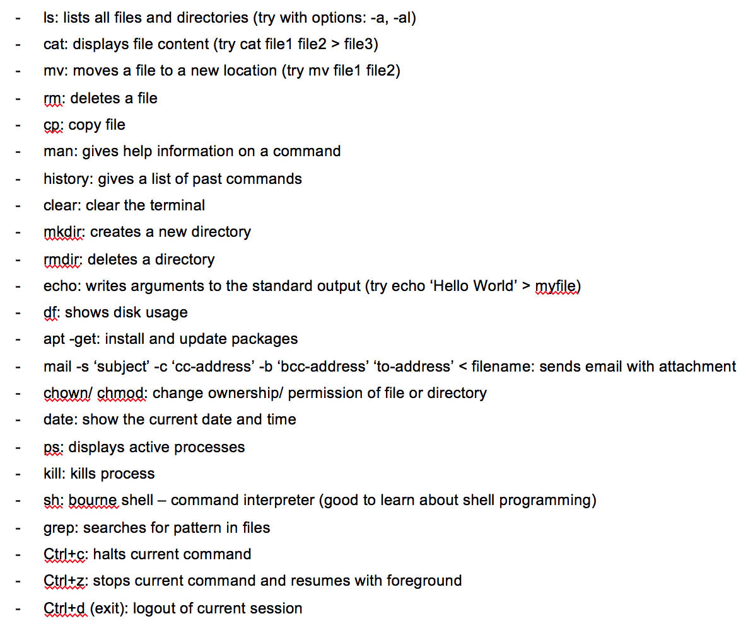
Terminal Basics
To navigate around use cd dir_name
To go to parent folder use cd ..
To learn more about a command, use man
man command
Press q to exit when done reading
Command will work with different options: -a: all, -b: buffer, -c: command, -d: debug, -e: execute, -f: file, -l: list, -o: output, -u: user

Slide 6
Pipe & Redirect
Pipe
Send output of one program to input of another
Can be done by using ‘|’
Eg. cat /dev/random | head -c 100000
Redirect
Output redirection can be done by using ‘>’
Can be used to output to a file
Eg. cat /dev/random | head -c 100000 > src1.dat
Using pipes & redirects to generate a random file
cat /dev/random | head -c <bytecount> > <outputfile>
cat: read data from a file, /dev/random: a special file that serve as pseudo random generator
head: command that output first part of file, -c <bytecount>: option to take <bytecount> bytes

Slide 7
Using Vi editor (optional)
vi filename : open a file
Press i to enter edit mode
Press esc in edit mode to get back to command mode
In command mode
:w : to save
:q : to quit
:wq : to save and quit
:q! : to quit without saving

Slide 8
Compiling with GCC
gcc -o executable_name filename
If not specified, the output name will be called a.out
i.e. gcc filename == gcc -o a.out filename
To compile a file using pthread, -lpthread flag will be used
gcc -lpthread -o executable_name filename
After compilation, you can execute the file
./executable_name [parameters]

Slide 9

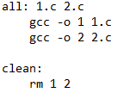
Makefile
Makefile will be useful when you have multiple files to compile.
Provided for lab 1!
General format: eg:
To compile all files: make
To clean up: make clean
For more information: go to https://www.gnu.org/software/make/manual/make.html

Slide 10
Lab 1

Slide 11
Steps 1 & 2
Step 1 – Linux basic networking commands
For each of the provided networking commands…
Run the command (with any options mentioned as well)
Write down your observations
Explain the usage of each command
Step 2 – Packet delivery
Ping each host with different packet sizes
For each host (and packet sent)...
Identify the packet loss
Identify the RTT “Round-Trip-Time”
Explain the correlation between these measurements to the geographical location of the hosts.

Slide 12
Step 3
Write your C program to copy files using functions
#include <stdio.h>
FILE *fopen(const char *filename, const char *mode)
// mode: “r” || “w” || “a” || “r+” || “w+” || “a+”
size_t fread(void* ptr, int size, int n, FILE *fp); // or fscanf() (for text files)
size_t fwrite(void* ptr, int size, int n, FILE *fp); // or fprintf() (for text files)
fclose(ptr);
More info: https://www.cplusplus.com/reference/cstdio/fopen/

Slide 13
Step 4
Write your C program to copy files using system calls
#include<sys/types.h> #include<sys/stat.h> #include <fcntl.h>
int open (const char* Path, int flags [, int mode ]);
// access mode flags: O_RDONLY, O_WRONLY, O_RDWR
size_t read (int fd, void* buf, size_t cnt);
size_t write (int fd, void* buf, size_t cnt);
int close(int fd)
More info: https://man7.org/linux/man-pages/man2/open.2.html

Slide 14
Step 5
Calculate the time taken to copy files for both steps 3 and 4
Lab document says steps 1 and 2, but that’s from a previous quarter
#include <time.h>
clock_t start, end;
double cpu_time_used;
start = clock();
/* Time consuming process. */
end = clock();
cpu_time_used = ((double) (end - start)) / CLOCKS_PER_SEC;

Slide 15
Instructions for Submitting Lab 1
Demo to the TA correct execution of your programs
Worth 45% of your grade!
Start each program with a descriptive block
# Name: <your name>
# Date: <date> (the day you have lab)
# Title: Lab1 – <task/step>
# Description: This program computes ... <appropriate description here>.
Submit your answers and C files using the Lab 1 Worksheet on Camino

