Slide 1

Inc.
Tells you which AI model to choose for your business.
Notes:
About 10 seconds (ends at 0:10 of 5:00).
Hello, we are BenchCraft. We tell technical founders which AI model to choose for their business.

Slide 2
Founders pick the wrong AI model
Too big
Too small
Wasted money.
Lost customers.
$1,500 a month, when $15 would do.
Notes:
About 25 seconds (ends at 0:35 of 5:00).
A founder must pick an AI model early. Too big, and they waste money. Too small, and the quality is weak, customers leave, and that is lost money too. In our example, a top-tier model costs fifteen hundred dollars a month, when a fifteen-dollar model would do.

Slide 3



BenchCraft tells you which model fits
The right model
A clear comparison
Where to buy it
Notes:
About 10 seconds (ends at 0:45 of 5:00).
BenchCraft gives you the right model, a clear comparison of the top three, and where to buy it. Let me show you.

Slide 4
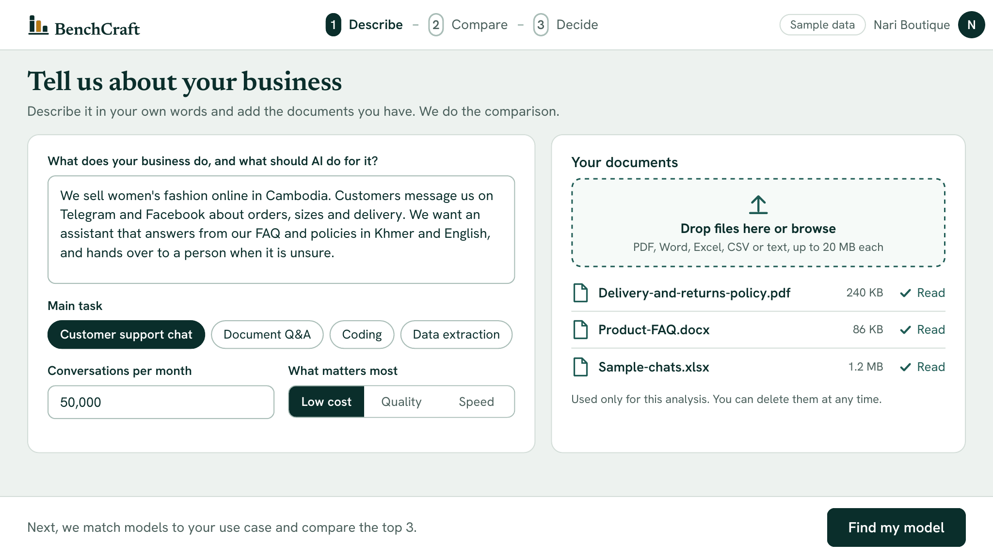
Describe your business
Sample data
Notes:
About 15 seconds (ends at 1:00 of 5:00).
These are sample screens. Nari Boutique is a fashion shop in Cambodia. The owner describes the business in plain words, uploads their documents, and clicks Find my model.

Slide 5
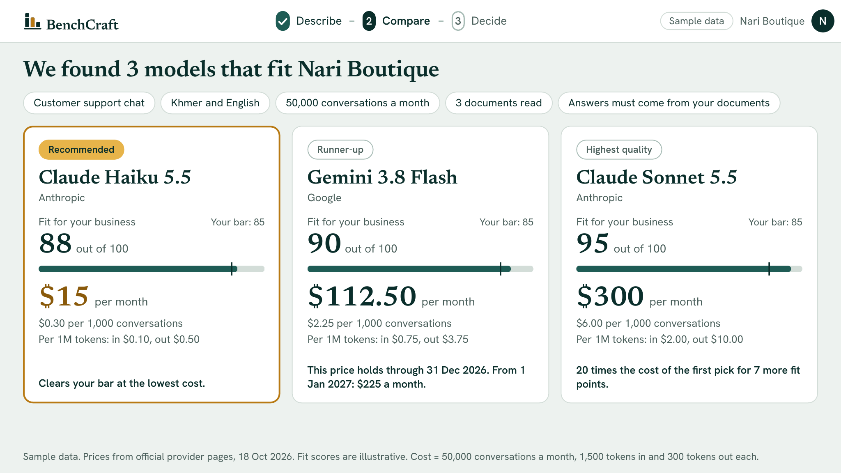
See the top 3
Sample data
Notes:
About 20 seconds (ends at 1:20 of 5:00).
BenchCraft returns three models, each with a fit score and a monthly cost. Haiku 5.5 is recommended: it clears the owner's quality bar for fifteen dollars a month. Sonnet costs twenty times more for seven more fit points.

Slide 6
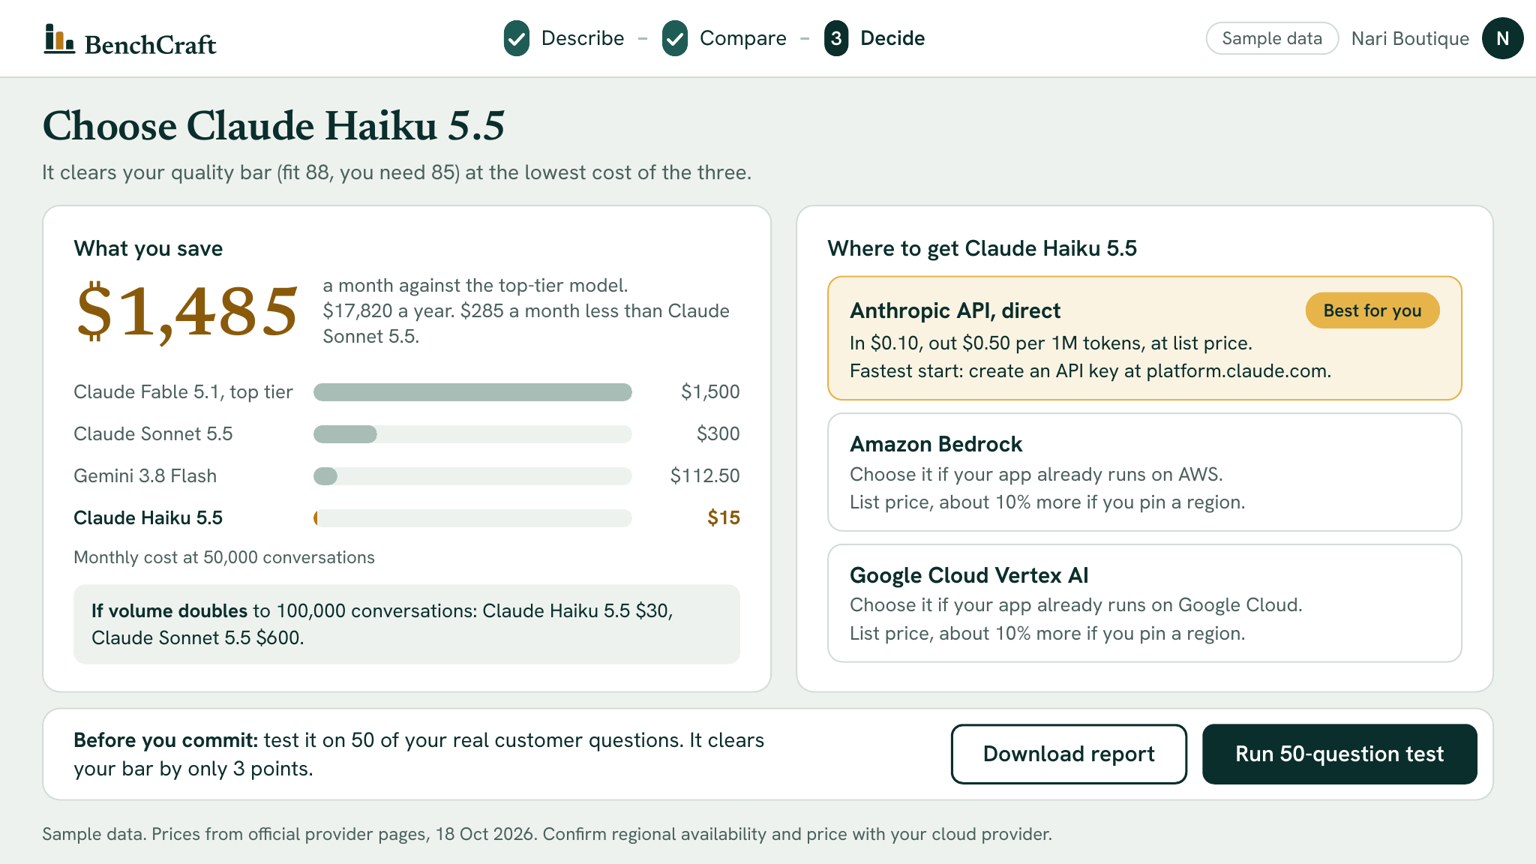
Know what to buy, and where
Sample data
Notes:
About 25 seconds (ends at 1:45 of 5:00).
Then the decision. Choosing Haiku saves one thousand four hundred eighty-five dollars a month against the top tier, and two hundred eighty-five against Sonnet. We say where to buy it. And we are honest: it clears the bar by only three points, so we advise a test on fifty real questions first.

Slide 7
How we make money
$29
68%
2
a month per customer
margin after fees
customers cover our costs
Planning assumptions, to be tested.
Notes:
About 15 seconds (ends at 2:00 of 5:00).
We charge twenty-nine dollars a month. After AI and payment fees, the margin is about sixty-eight percent, and two customers cover our running costs. These are assumptions we will test.
Full margin sum, if asked: twenty-nine dollars, less eight dollars of AI fees (twenty comparisons at forty cents), less one dollar fourteen of payment fees, leaves nineteen dollars eighty-six.

Slide 8
Starting market
4,511
$1.6M
generative AI companies
a year at $29 a month
We need 100 of them.
Source: Tracxn, Oct 2026
Notes:
About 20 seconds (ends at 2:20 of 5:00).
We start with about forty-five hundred generative AI companies. At twenty-nine dollars a month, that is about one point six million dollars a year. Our goal is one hundred customers, about two percent of them.

Slide 9

The team
[Name]
[Name]
[Name]
[Name]
[Name]
Team lead
Frontend
Backend
Document analysis
Model catalog
[One line: why this team is right for this problem]
Notes:
About 15 seconds (ends at 2:35 of 5:00).
We are five students. [Name] is the team lead and product owner. [Names and roles of the other four.] [One sentence: why this team is right for this problem.]
FILL IN the names and the one-line reason on the slide before presenting. The amber text marks what to replace.

Slide 10
What we need
$365
10 weeks
Working MVP
Month 3
10 customers
to build the MVP in 10 weeks
Month 6
30 customers
$250
AI credits
$100
Buffer
Month 12
100 customers, $2,900 a month
$15
Domain name
100 customers fund our next stage.
Notes:
About 35 seconds (ends at 3:10 of 5:00).
We need three hundred sixty-five dollars: two hundred fifty for AI credits, which is about six hundred twenty-five test comparisons, a hundred for a buffer, and fifteen for the domain. Our own time is not charged. It buys a working product in ten weeks. Our targets: ten customers at month three, thirty at month six, and one hundred at month twelve, about twenty-nine hundred dollars a month. At one hundred customers we fund our next stage. Thank you. Questions?

