Slide 1
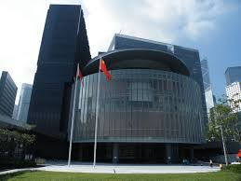
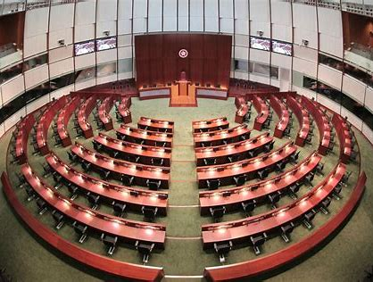

Motions and voting in the 6th hong kong (Hksar) legislative council (2016-2020)
Yongzhen lai

Slide 2
Legislative council
Function
The Legislative council (legco) is the law-making branch of the Hong kong special administrative region.
Executive branch motioning bills and amendments
Legco Members motions and amendments
Voting for motions, amendments and bills
Webscrapping:
Official website (xml)

Slide 3
Legislative council
Members
70 members in total
Number of Members is subjected to change during the term
Parties and affiliations
Webscrapping:
Wiki for reference, including party information (HTML)
Coding members affiliations (government and opposition camp)

Slide 4
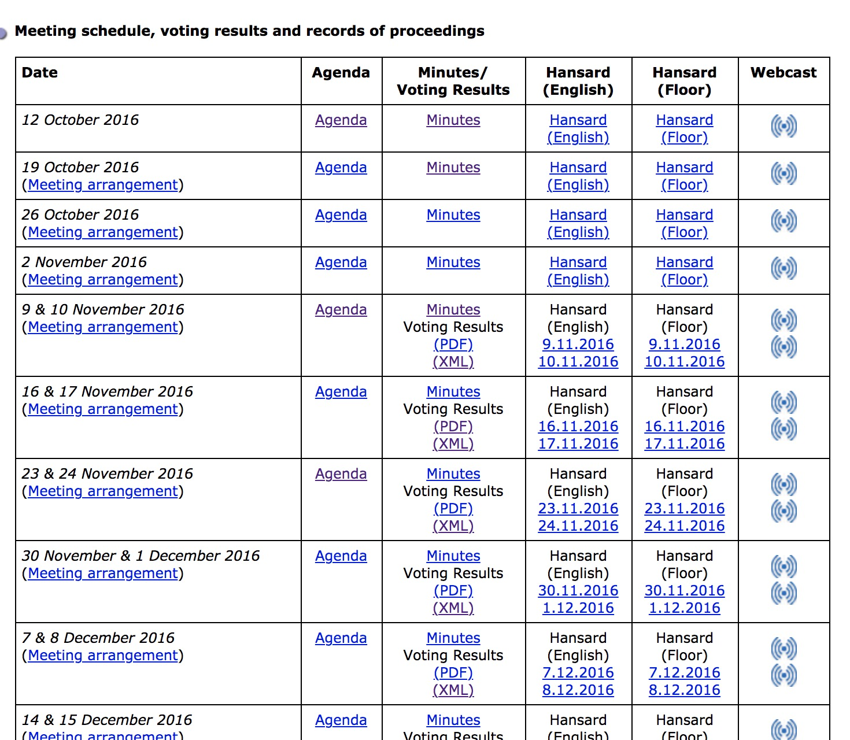
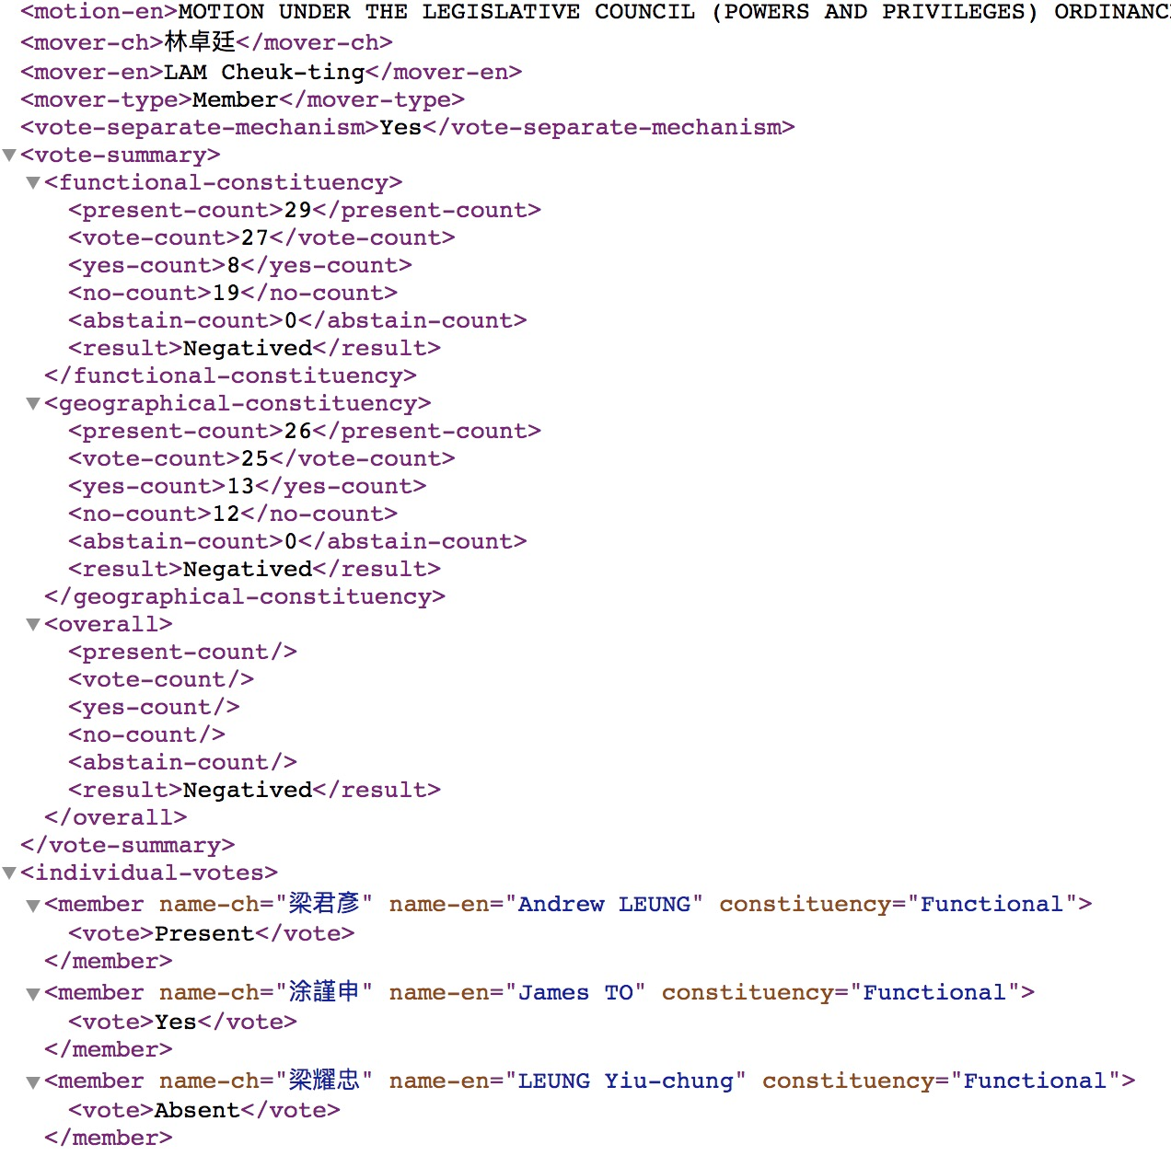
website

Slide 5
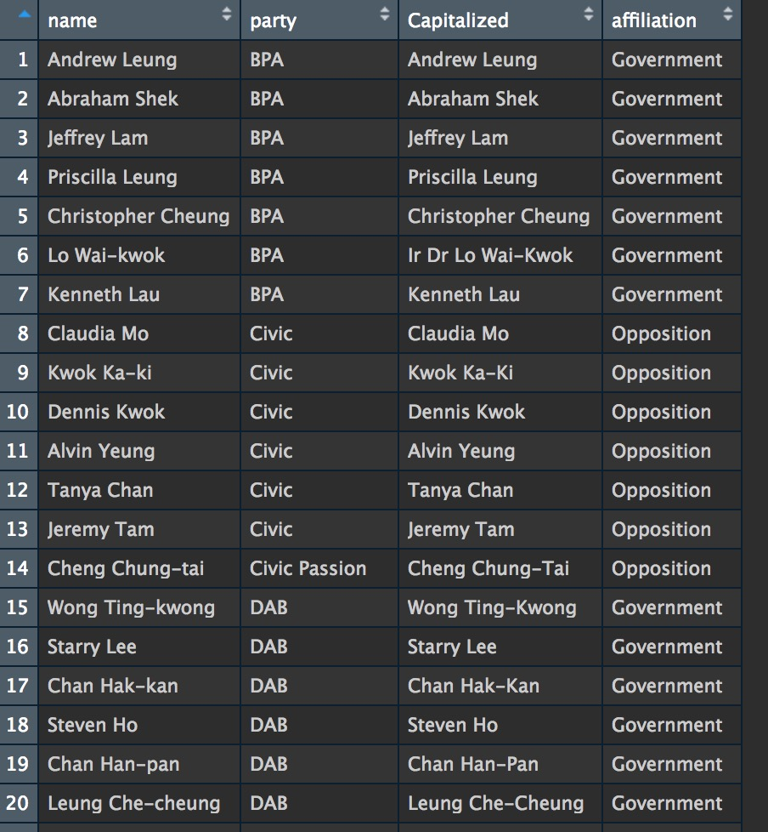
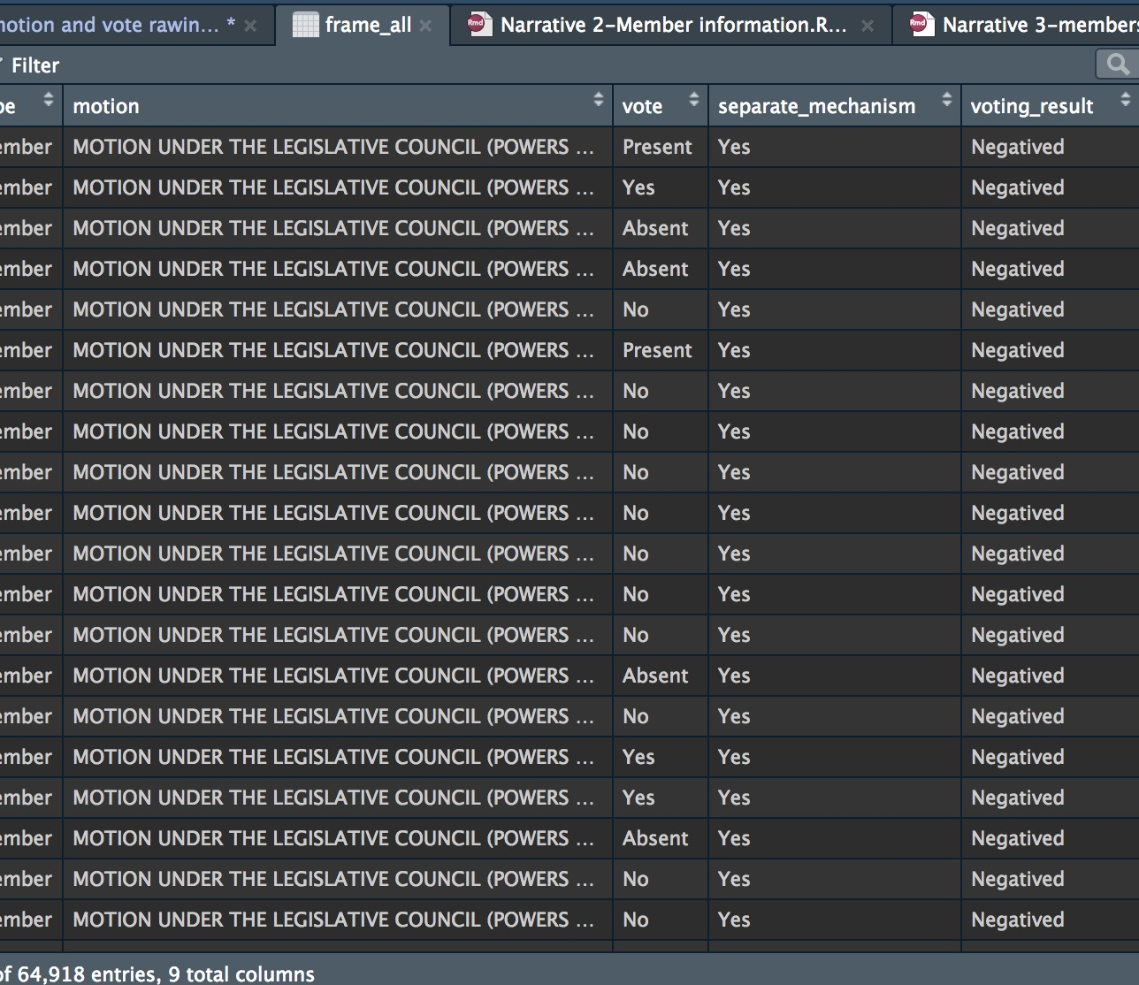
dataframe

Slide 6
Analysis
bills discussed and amended most
Frequency Members raising motions
Categorized By year/by bills/by political affiliation
Attendance rate and approval rate and their correlation

