Slide 1

SCALEr - Detection and Prediction system integrated on SCALE
CS237 Middleware Network and Distribution System
Group 9: Xuan Shi, Yuxuan Hao, Yuanzhe Li

Slide 2
Motivation and Goals
Motivation
Scale system provides many weather data.
However,Scale can only show detected data which lacks many information..
Add more significant data onto SCALE for use
It is a good idea to make weather prediction directly with movable deployed SCALE device.
Goals
Our purpose is to predict weather with SCALEs data (ex, weather condition)
Build prediction model and prediction middleware
Make prediction of weather conditions with data gathered from broker
Public predicted weather on broker

Slide 3
Related work
SCALE
Safe Community Awareness and Alerting Network (SCALE), aims to improve the safety of residents
FlexSCALE is a sensor box which can support many different sensors and network adapters.
Data in Motion Exchange (DIME) system is proposed to act as an open communications hub for IoT that simplifies the development and deployment processes. JSON is used to format data, MQTT is used as machine to machine protocol.
IBM BlueMix platform receives sensed data and routes it to the appropriate event-detection function.
Celery task queue manager is used to handle distributed system event.
Django’s ORM is used to abstract the PostgreSQL database tables.
The dashboard, hosted on BlueMix, written using Node.js at the backend, Javascript and Twitter Bootstrap in the front-end.
SCALE box
DIME
Celery task queue manager
Broker
on IBM BlueMix
PostgreSQL database
Js and Twitter Bootstrap
Dashboard on IBM BlueMix
Node.js

Slide 4
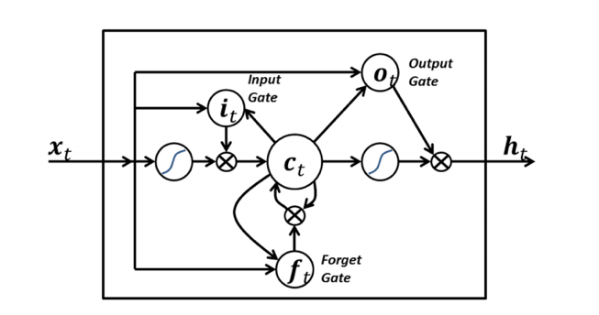
Related work --- LSTM
LSTM represents for “long short-term memory”.
The term long short-term refers to the fact that LSTM is a model for the short-term memory which can last for a long period of time.
Mohamed and Chaker’s used LSTM on sequence to sequence weather forecasting.
Similarly, Xingjian, el have successfully applied LSTM to the challenging precipitation nowcasting, which has not been solved even by sophisticated machine learning techniques.

Slide 5
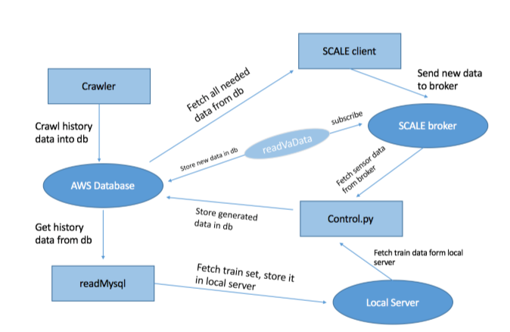
Design Specifics
Crawl Weather Data of past one year.
Control.py acts as master node, providing clocks and coordinating other components
Historical data is stored in AWS database
Components subscribe to the broker, and can also send generated data into broker.

Slide 6
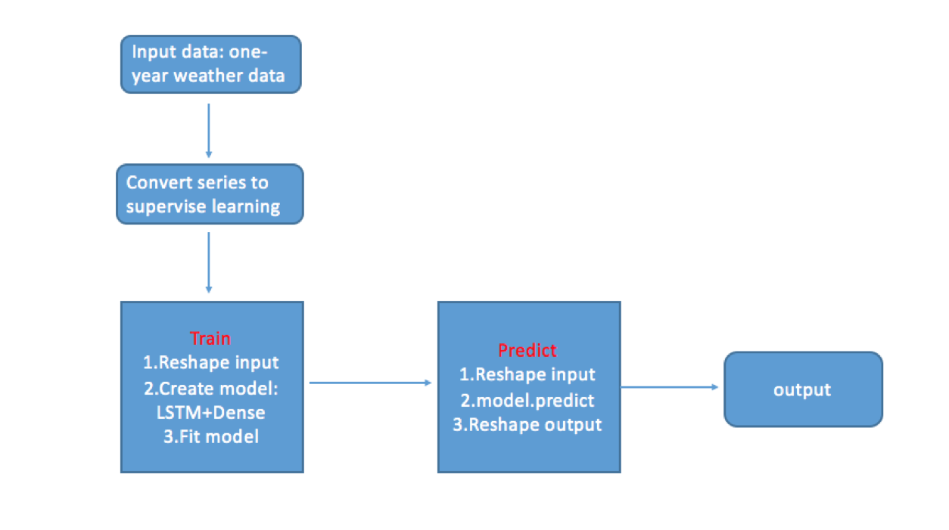

Slide 7
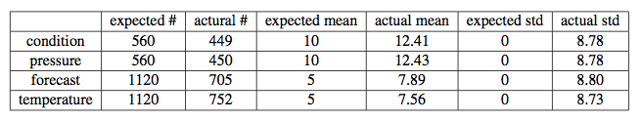
Evaluation
Prediction:
For test data of 30 days, MSE is 3.0.
It means that the average error is reasonable, the predicted data is close to the ground truth.
Sensors

