Slide 1
Re-evaluating Microbial Community Dynamics in Methane-Driven Ammonia Removal
BIOMI 6300: Computational Approaches for Microbial Systems
Instructor: Dr. Mar L. Schmidt
Liangzi Zheng
PhD student in Environmental Processes (CEE)
April 30, 2025

Slide 2
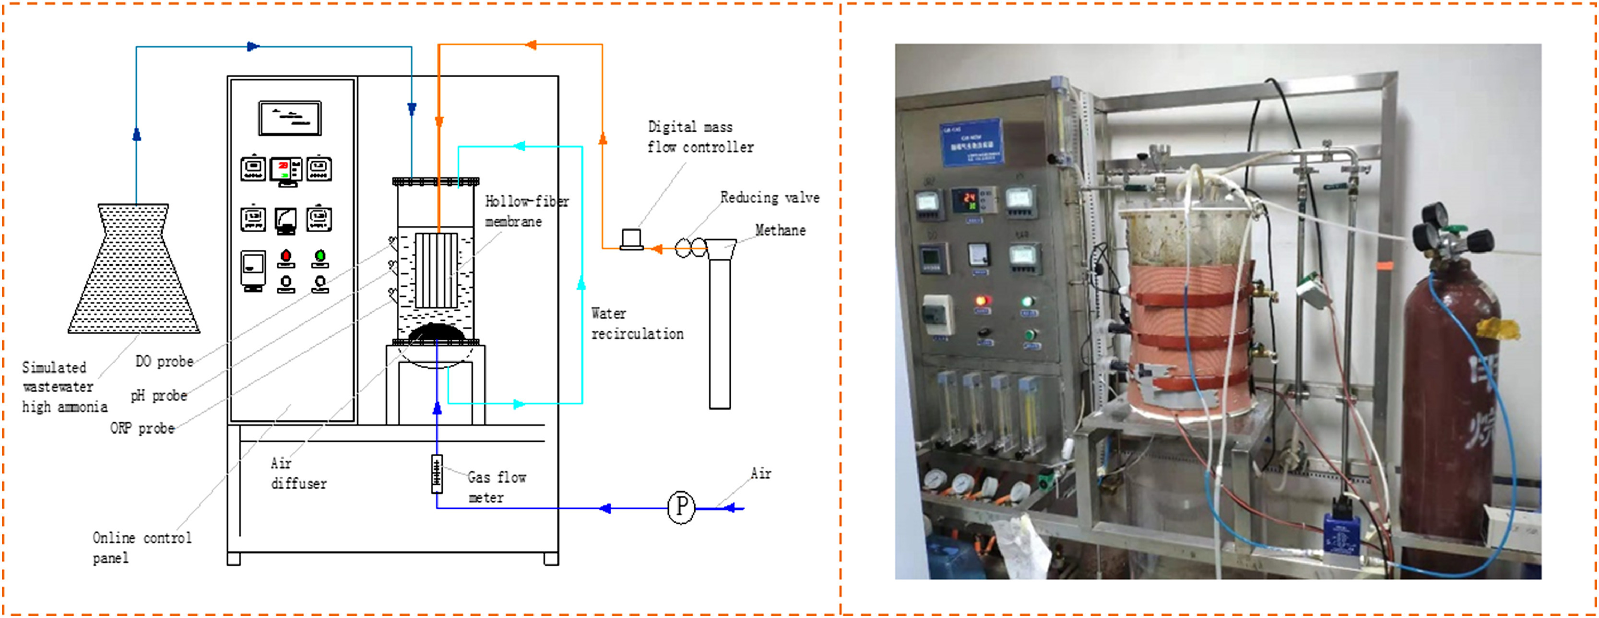
Experiment Setup
Cao, Qin, Xiaochuan Li, Huier Jiang, Han Wu, Zhijie Xie, Xiaoyi Zhang, Na Li, et al.
“Ammonia Removal through Combined Methane Oxidation and Nitrification-Denitrification and the Interactions among Functional Microorganisms.” Water Research 188 (January 1, 2021): 116555. https://doi.org/10.1016/j.watres.2020.116555.
Fig. 1. The laboratory-scale hollow-fiber membrane biofilm reactor. Cao et al., 2021
A coupling system in a laboratory-scale hollow-fiber membrane biofilm reactor, in which methanotrophs mainly accumulated in the hollow-fiber membrane, and ammonia-oxidizing bacteria and denitrifiers were acclimated in the suspension.
To study the coupling systems, the microbial communities and functional bacteria were analyzed by using the Illumina high-throughput sequencing of the 16S rRNA.
Notes:
- I am doing a research, focusing on improving methanol production by using methanotrophs. (Methanotrophs could oxidize methane into CO2, and generate a series of soluble intermediate metabolites, such as methanol which is useful in industry. MeOH is a key component in the production of other important chemicals like formaldehyde and acetic acid. These chemicals are then used in the production of various products like plastics, resins, and textiles.)
Since I expect to analyze the microbial community and potential methanotrophs at the end, I chose this paper: “ ” to do the microbial analysis and help me understand the microbial structures and functional bacteria in their bioreactor systems.
- In this study, they acclimated a mixed culture to deal with simultaneous nitrification-denitrification coupled to methane oxidation in a laboratory-scale hollow-fiber membrane biofilm reactor. (Fig. 1. Schematic diagram of the laboratory-scale hollow-fiber membrane biofilm reactor and the photo of the laboratory-scale hollow-fiber membrane biofilm reactor.)
A series of batch experiments were conducted to test methane oxidation coupled to nitrate denitrification (AME-D3), nitrite denitrification (AME-D2), and simultaneous nitrification and denitrification (ME-SND).

Slide 3
Analysis of Microbial Communities and Functional Bacteria in Methane-Driven Ammonia Removal Systems
#1 Scientific Question:
How does microbial alpha diversity differ between bioreactor samples with different oxygen concentrations?
Null Hypothesis:
Microbial alpha diversity (e.g., ASV richness or Shannon diversity) does not differ significantly among systems across oxygen concentration.
Alternative Hypothesis:
Microbial alpha diversity does vary across different oxygen concentrations, potentially increasing under lower oxygen conditions due to shifts in community composition.
Notes:
Many studies show that oxygen concentration could impact the microbial community in the bioreactor systems. But we want to know how do the microbial community and dominant species change with oxygen concentration gradient.
The goal: Re-running 16S rRNA sequencing to analyze the microbial community composition in methane-driven ammonia removal systems.
The results will help refine our understanding of functional microbial interactions in wastewater treatment and optimize bioreactor performance for nitrogen removal.

Slide 4
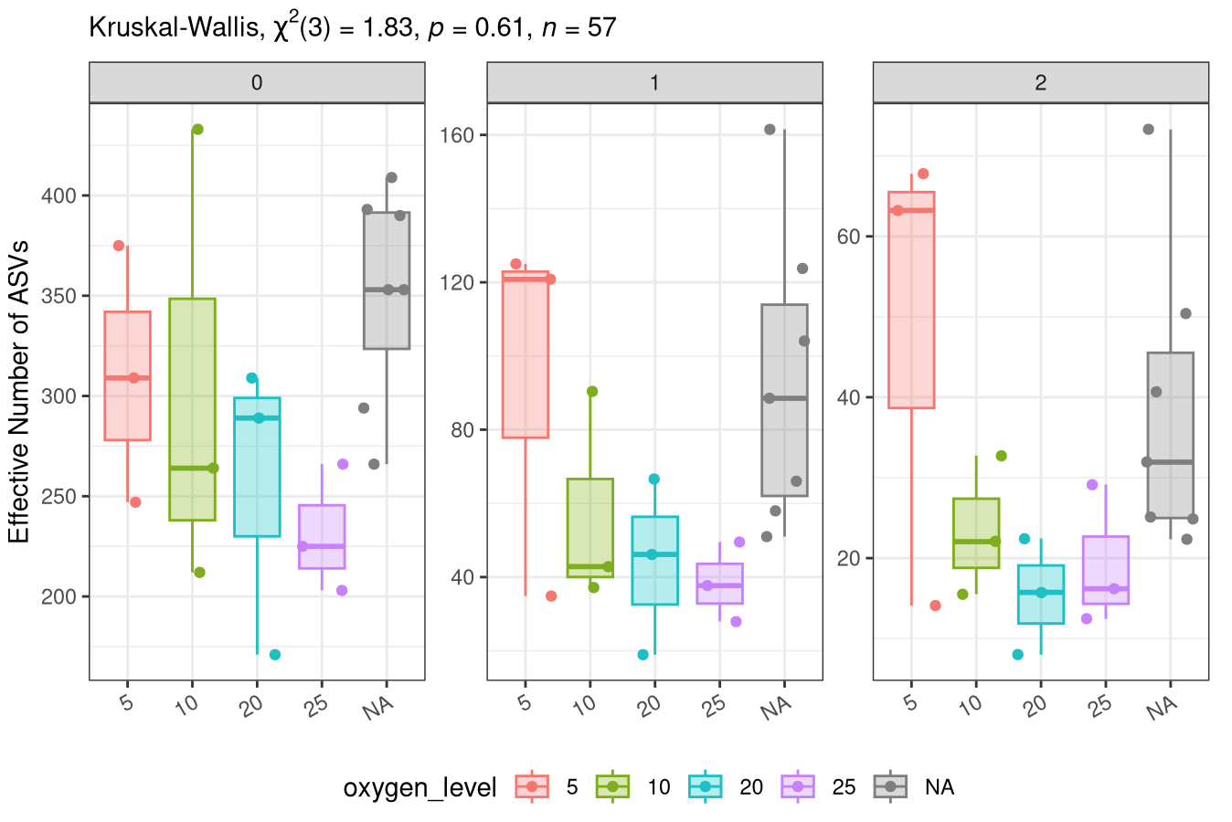
Diversity by Oxygen Level - Alpha diversity is related to oxygen level
Richness: q = 0
More ASV types were present in lower oxygen concentrations.
Low oxygen levels promotes taxonomic diversity.
Shannon Diversity: q = 1
Shannon diversity decreased with oxygen level increase, but more dramatically than richness.
Simpson Diversity: q = 2
The low-oxygen environments supported not just more ASVs, but also a more balanced community.
High-oxygen samples were dominated by a few tolerant taxa, lowering q = 2 values.
Notes:
All the samples were grouped by oxygen level. The question regarding alpha diversity is related to oxygen level, which roughly correlates with collection data.
Richness (q = 0): Samples exposed to lower oxygen concentrations exhibited substantially higher richness, indicating that more ASV types were present. This suggests low oxygen levels promotes taxonomic diversity.
Shannon Diversity (q = 1): …This suggests that while more taxa are present at low oxygen, their relative abundances are not evenly distributed.
Simpson Diversity (q = 2):

Slide 5
Analysis of Microbial Communities and Functional Bacteria in Methane-Driven Ammonia Removal Systems
#2 Scientific Question:
How does microbial community composition and biodiversity shift across an oxygen concentration gradient in the bioreactor systems?
Null Hypothesis:
Microbial community composition does not change across an oxygen concentration gradient.
Alternative #1 Hypothesis:
Microbial composition shifts significantly with oxygen concentration. There is an inverse relationship between richness and oxygen level.
Alternative #2 Hypothesis:
Dominant members of the microbial community differ between low-oxygen and high-oxygen environments.
Notes:
This question focused on abundance-based and presence/absence-based differences in community structure, with some attention to phylogenetic relationships, depending on the diversity metrics used.
#1Hy: As oxygen increases or decreases, microbial communities become more dissimilar (e.g., higher Bray-Curtis distances). There is an inverse relationship between oxygen concentration and microbial diversity.
Beta diversity refers to the similarity or dissimilarity.

Slide 6
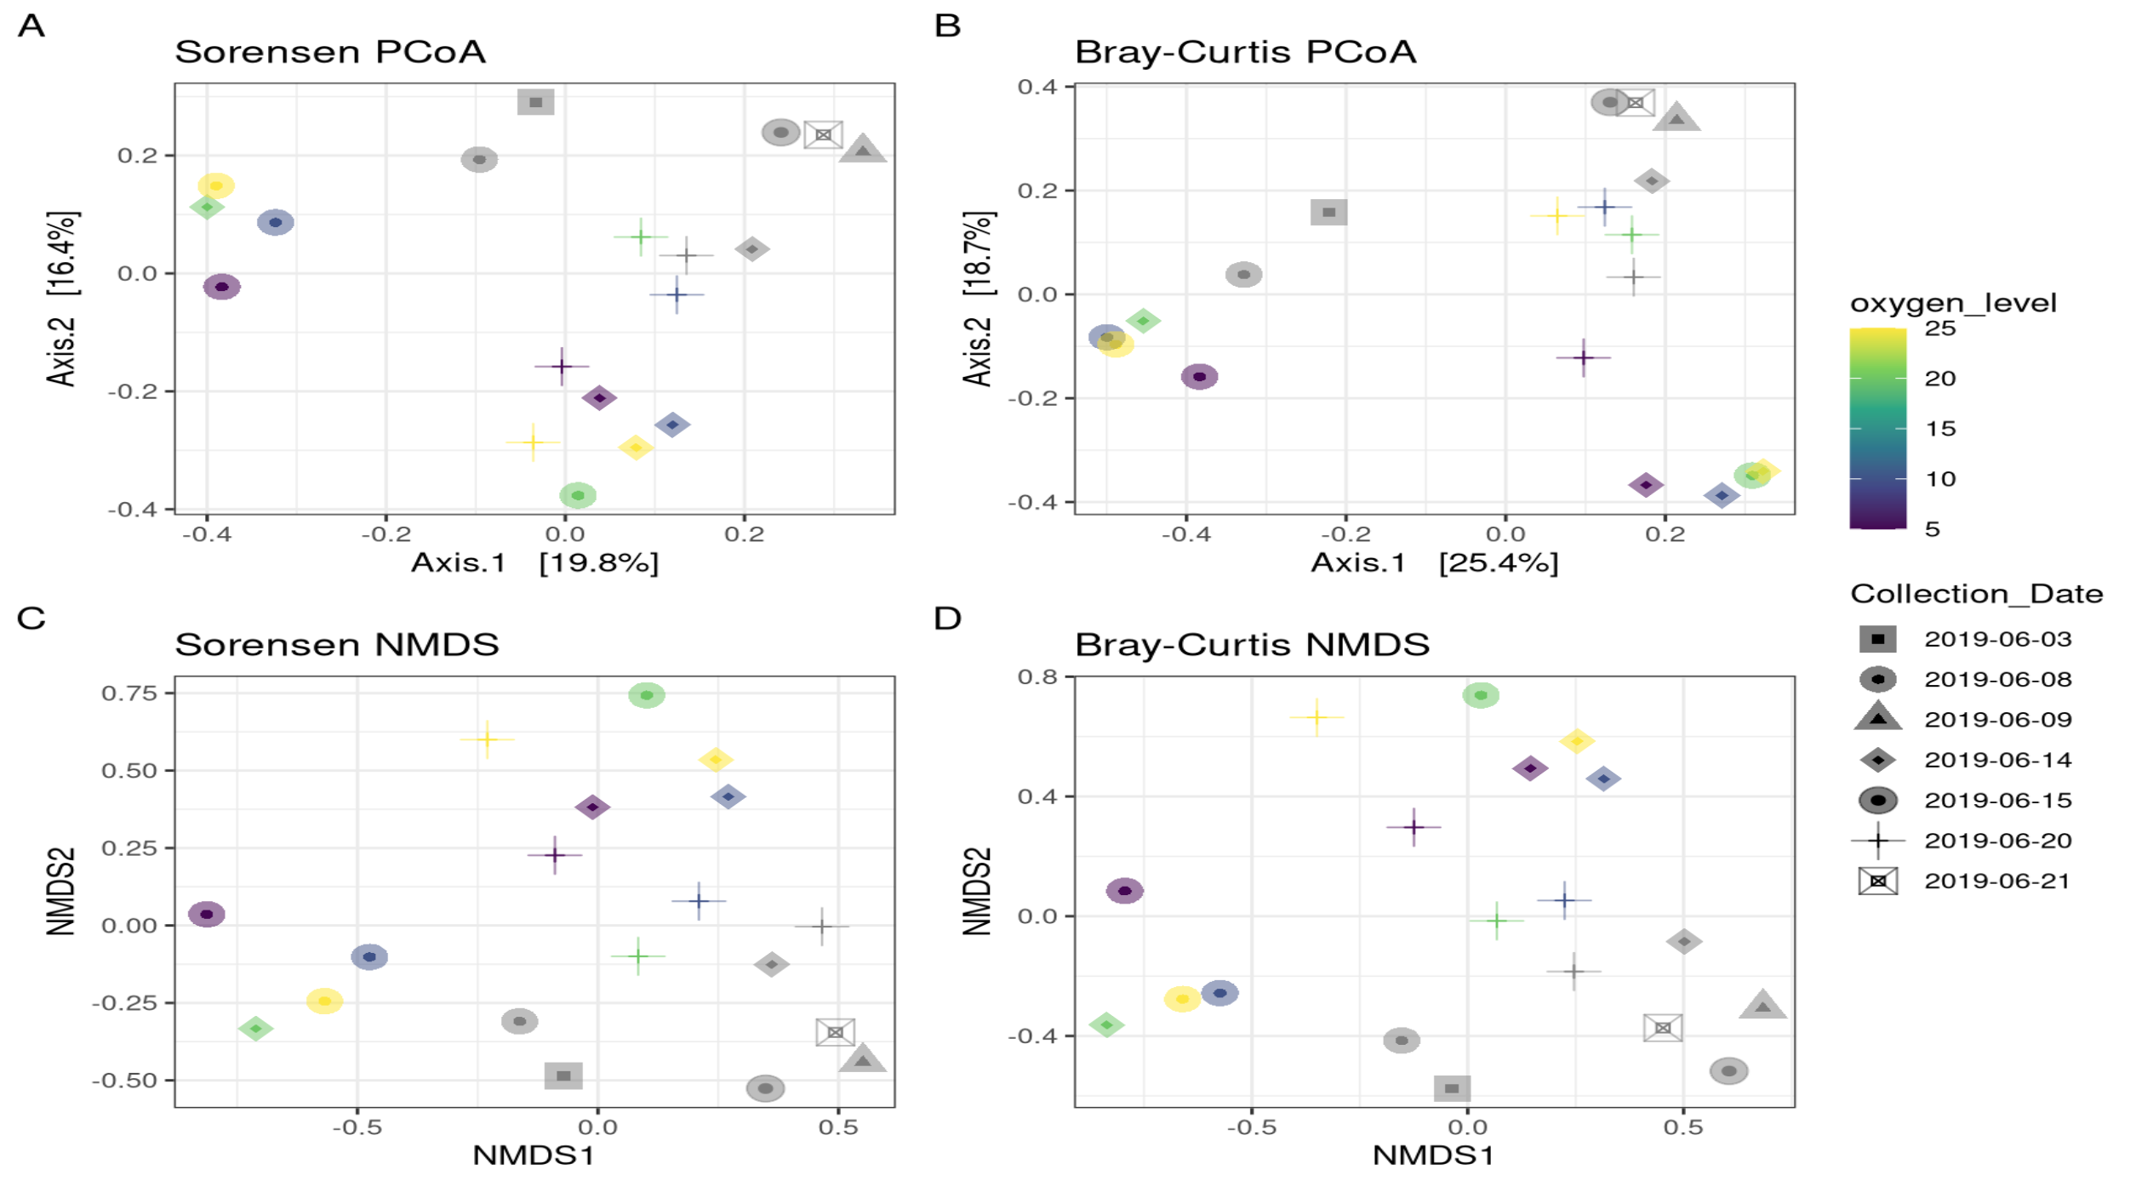
Visualize Community Dissimilarity - Abundance-based differences are an important driver of microbial community structure in the systems
Panel A&C
Higher oxygen levels (yellow/green) and lower oxygen levels (purple/blue) tend to group separately.
Panel B&D
Samples exhibit stronger spatial separation, with tighter grouping by oxygen levels.
Panel A&B
Bray-Curtis PCoA shows that Axis 1 explains a relatively larger portion of variation (~25.4%) than Sorensen (~19.8%) → Abundance differences among taxa matter in this system.
Notes:
To visualize the community data, I used two unconstrained ordinations -- PCoA (Principal Coordinates Analysis) and NMDS (Non-Metric Multidimensional Scaling).
They are specifically designed to work with dissimilarity (or distance) matrices. The distance between points reflects how different the communities are.
Panel A: Sorensen dissimilarity (presence/absence-based; *Do the two environments share the same microbes, regardless of abundance?)
Panel B: Bray-Curtis dissimilarity (abundance-weighted; *How does abundance differ between communities?)
Both PCoA and NMDS approaches show broadly similar patterns.
A&C: Samples show moderate separation based on both oxygen level (color gradient) and collection date (shape). However, points are relatively more dispersed, indicating there are some overlap between groups based on community presence/absence patterns.
B&D: Samples exhibit stronger spatial separation, with tighter grouping by oxygen levels. The Bray-Curtis PCoA shows that Axis 1 explains a relatively larger portion of variation (~25.4%) than Sorensen (~19.8%), suggesting that abundance differences among taxa matter in this system.
In summary:
Bray-Curtis PCoA (B) seems to best resolve differences among samples, indicating that abundance-based differences are an important driver of microbial community structure in the systems.
- Oxygen level appears to have a strong influence — possibly due to different microbial metabolic requirements (e.g., aerobic vs anaerobic taxa).
- Collection date likely reflects temporal environmental shifts, seasonal variation, or ecological succession.

Slide 7
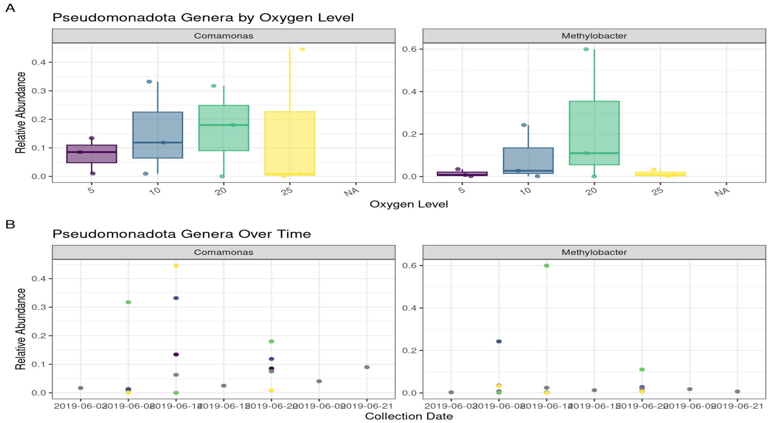
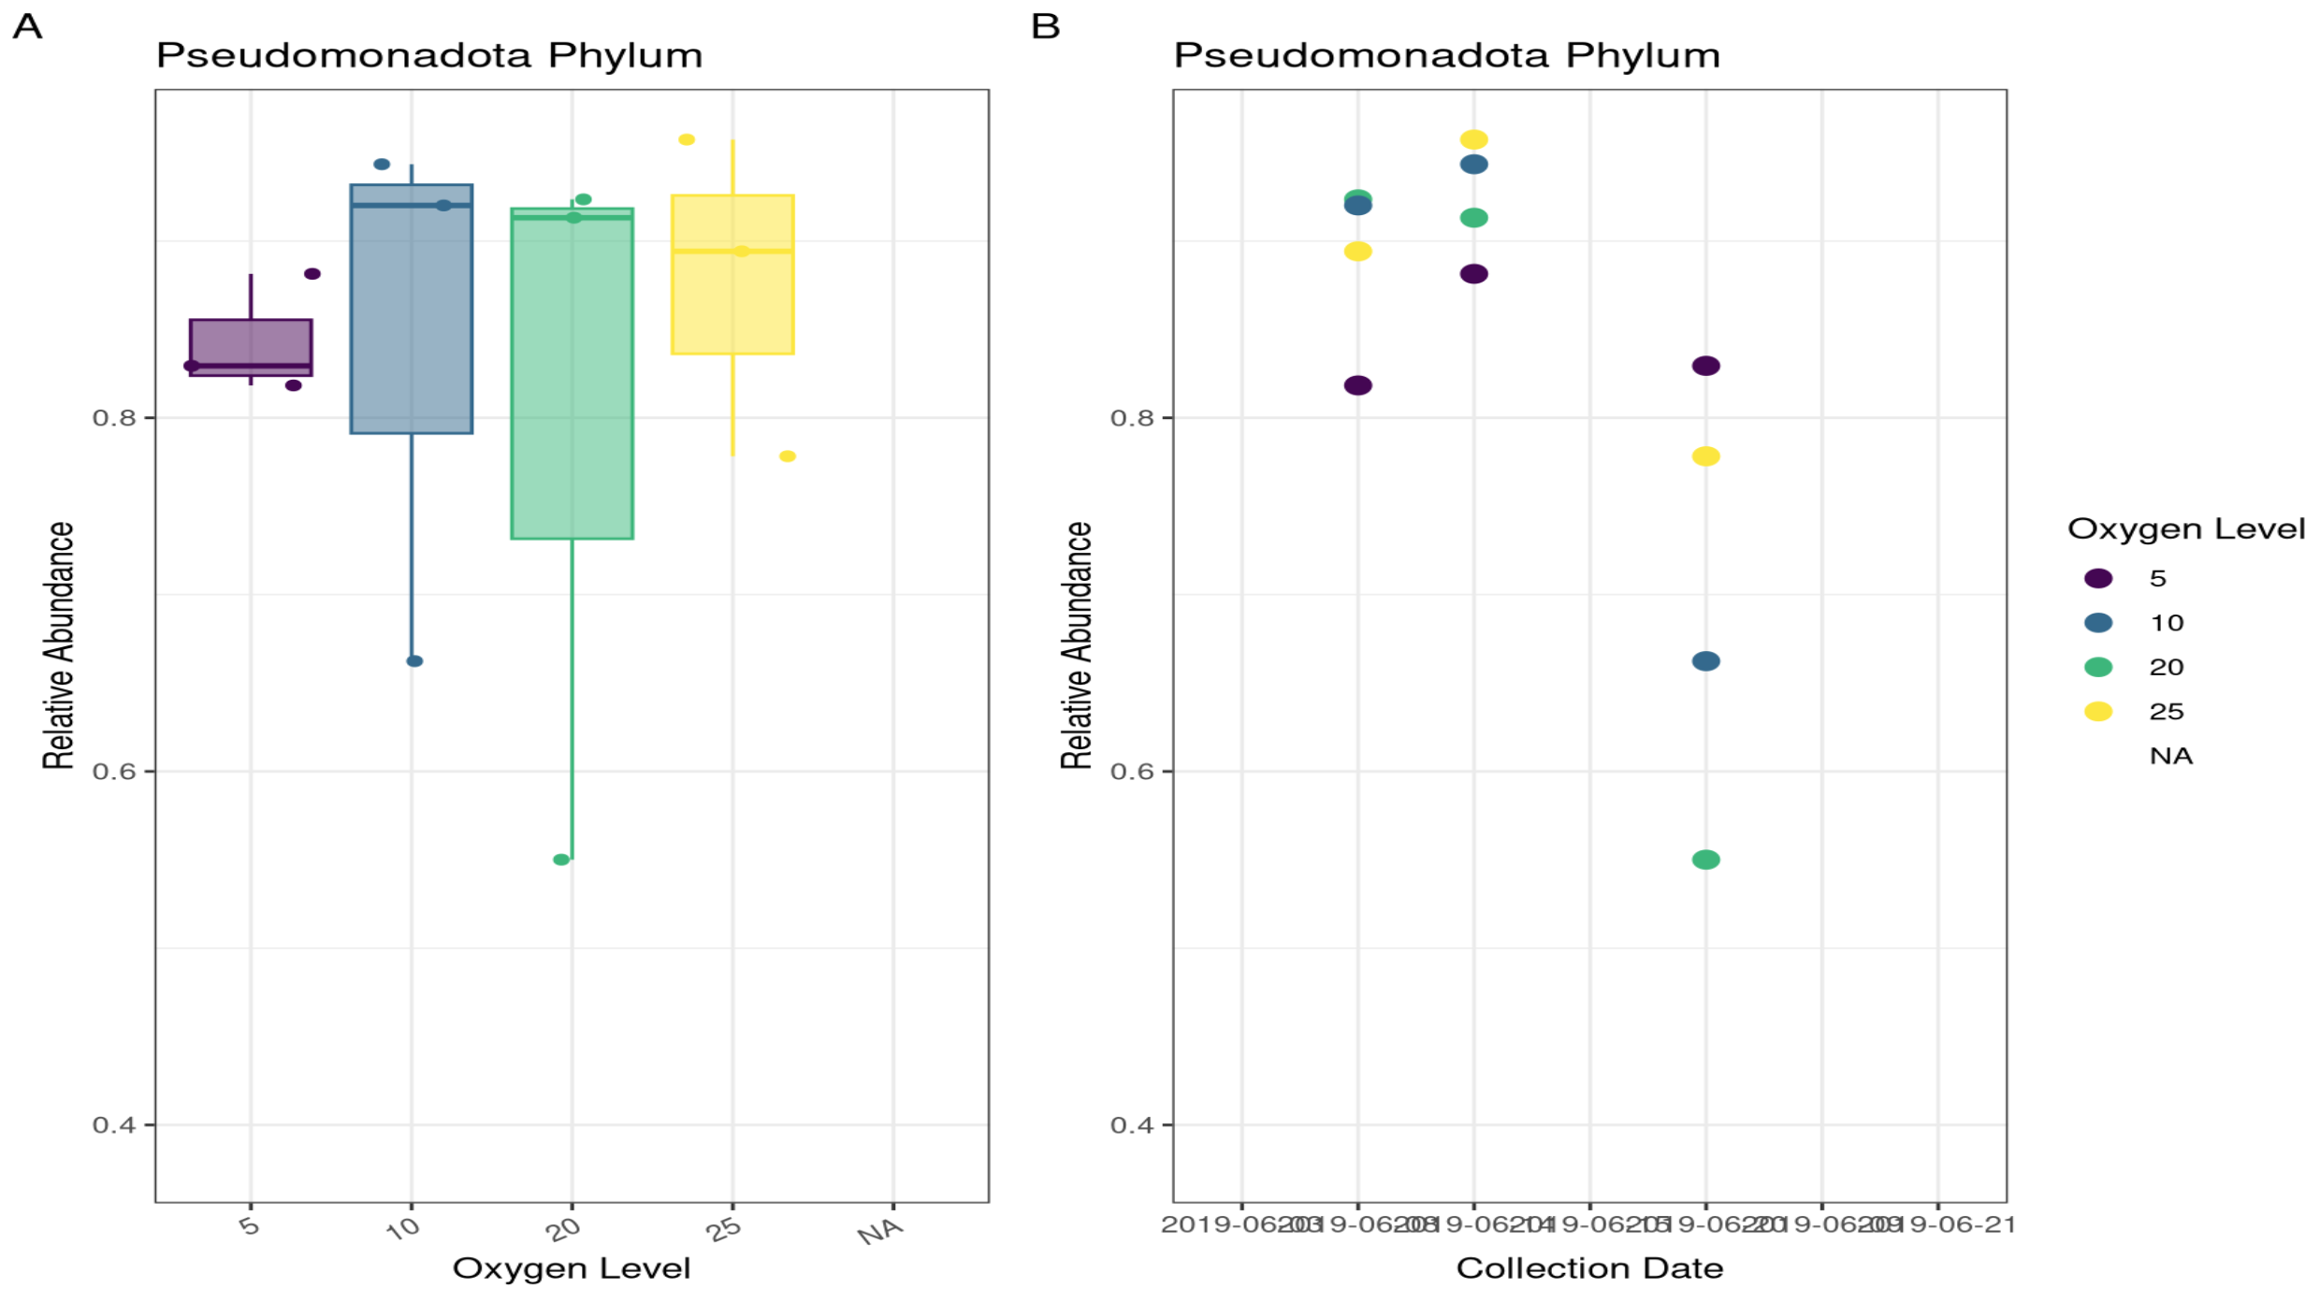
The Dominate Microbial Group - Pseudomonadota Phylum
Panel A:
Pseudomonadota abundance is consistently high across all oxygen levels.
A slight increasing trend from low to high oxygen concentrations.
Panel B:
The abundance peaks around mid-sampling dates.
Pseudomonadota are a stable, dominant group in these microbial communities throughout the sampling period.
Panel A:
Comamonas (denitrifiers) abundance is high across all oxygen levels.
Methylobacter (methanotroph) exhibited greater potential for methane oxidation, particularly in the 20% oxygen group.
Panel B:
Comamonas shows temporal fluctuations.
Methylobacter is not plotted in the time series.
“Pseudomonas is a multi-functional genus containing many species that have anaerobic or aerobic denitrification abilities.”
Notes:
This figure shows the relative abundance of the Pseudomonadota across oxygen level and collection date.
Panel A: It’s clear that relative abundance is consistently high across all oxygen levels, but there is a slight increasing trend from low (5) to higher (25) oxygen concentrations.
Panel B: Over time, Pseudomonadota abundance peaks around mid-sampling dates and slightly decreases toward the later sampling points. However, the abundance remains relatively high across all collection dates, indicating that Pseudomonadota are a stable, dominant group in these microbial communities throughout the sampling period.
The results correspond with the results showed in the paper:
- Pseudomonas is a multi-functional genus containing many species that have anaerobic or aerobic denitrification abilities.
Now let’s look at two important genera: Comamonas and Methylobacter.
Panel A:
- Many strains of Comamonas are denitrifiers, some of which conduct conventional anaerobic heterotrophic denitrification, and some of which play a role in aerobic denitrification.
- Methylobacter has been found to be an active methanotroph at relatively high oxygen concentrations.
Panel B:
- Comamonas shows temporal fluctuations, suggesting that transient environmental conditions (nutrient pulses, temperature shifts) may strongly influence its abundance.
- Methylobacter is not plotted in the time series, possibly due to filtering or low detection frequency on some dates.

Slide 8
Conclusion
Microbial communities are structured by both oxygen concentration and collection date.
Oxygen level appears to have a strong influence — possibly due to different microbial metabolic requirements (e.g., aerobic / anaerobic taxa).
Abundance-based differences are an important driver of microbial community structure in the systems.

Slide 9
Thank you!
Questions?
Student: Liangzi Zheng
BIOMI 6300: Computational Approaches for Microbial Systems
Instructor: Dr. Mar L. Schmidt

