Slide 1
Adjoint gradient validation
Zhe Liu

Slide 2
Reservoir Case
Reservoir Dimension | X | Y | Z
 | 6 | 6 | 1
Size | 2500 | 2500 | 10
Well Number | Is vertical | Is producer | Is pressure controll | Well radius | Coordinate |  | Perform Depth
1 | 1 | 1 | 1 | 0.5 | 0 | 0 | 0 | 0
2 | 1 | 0 | 0 | 0.5 | 3 | 3 | 0 | 0
Generic Purpose Adjoint Simulator
Type: Two phase (O,W)
Gridding: 3D
Discretize: EDFM & Single Porosity
Type of Well: Single & Multi-perforation & Horizontal

Slide 3
Well Schedule & Well Constraints
 | Well schedule
30 | Time | 1 | CT-type | CS-type | 2 | CT-type | CS-type
1 | 90 | 3500 | 0 | 1 | 50 | 3 | 0
1 | 180 | 3500 | 0 | 1 | 50 | 3 | 0
1 | 270 | 3500 | 0 | 1 | 50 | 3 | 0
1 | 360 | 3500 | 0 | 1 | 50 | 3 | 0
1 | 450 | 3500 | 0 | 1 | 50 | 3 | 0
1 | 540 | 3500 | 0 | 1 | 50 | 3 | 0
1 | 630 | 3500 | 0 | 1 | 50 | 3 | 0
1 | 720 | 3500 | 0 | 1 | 50 | 3 | 0
1 | 810 | 3500 | 0 | 1 | 50 | 3 | 0
1 | 900 | 3500 | 0 | 1 | 50 | 3 | 0
1 | 990 | 3500 | 0 | 1 | 50 | 3 | 0
1 | 1080 | 3500 | 0 | 1 | 50 | 3 | 0
1 | 1170 | 3500 | 0 | 1 | 50 | 3 | 0
1 | 1260 | 3500 | 0 | 1 | 50 | 3 | 0
1 | 1350 | 3500 | 0 | 1 | 50 | 3 | 0
1 | 1440 | 3500 | 0 | 1 | 50 | 3 | 0
1 | 1530 | 3500 | 0 | 1 | 50 | 3 | 0
1 | 1620 | 3500 | 0 | 1 | 50 | 3 | 0
1 | 1710 | 3500 | 0 | 1 | 50 | 3 | 0
1 | 1800 | 3500 | 0 | 1 | 50 | 3 | 0
1 | 1890 | 3500 | 0 | 1 | 50 | 3 | 0
1 | 1980 | 3500 | 0 | 1 | 50 | 3 | 0
1 | 2070 | 3500 | 0 | 1 | 50 | 3 | 0
1 | 2160 | 3500 | 0 | 1 | 50 | 3 | 0
1 | 2250 | 3500 | 0 | 1 | 50 | 3 | 0
1 | 2340 | 3500 | 0 | 1 | 50 | 3 | 0
1 | 2430 | 3500 | 0 | 1 | 50 | 3 | 0
1 | 2520 | 3500 | 0 | 1 | 50 | 3 | 0
1 | 2610 | 3500 | 0 | 1 | 50 | 3 | 0
1 | 2700 | 3500 | 0 | 1 | 50 | 3 | 0
C-type | 0 | 1 | 2 | 3 | 4
 | BHP | qt | qo | qw | WCT

Slide 4
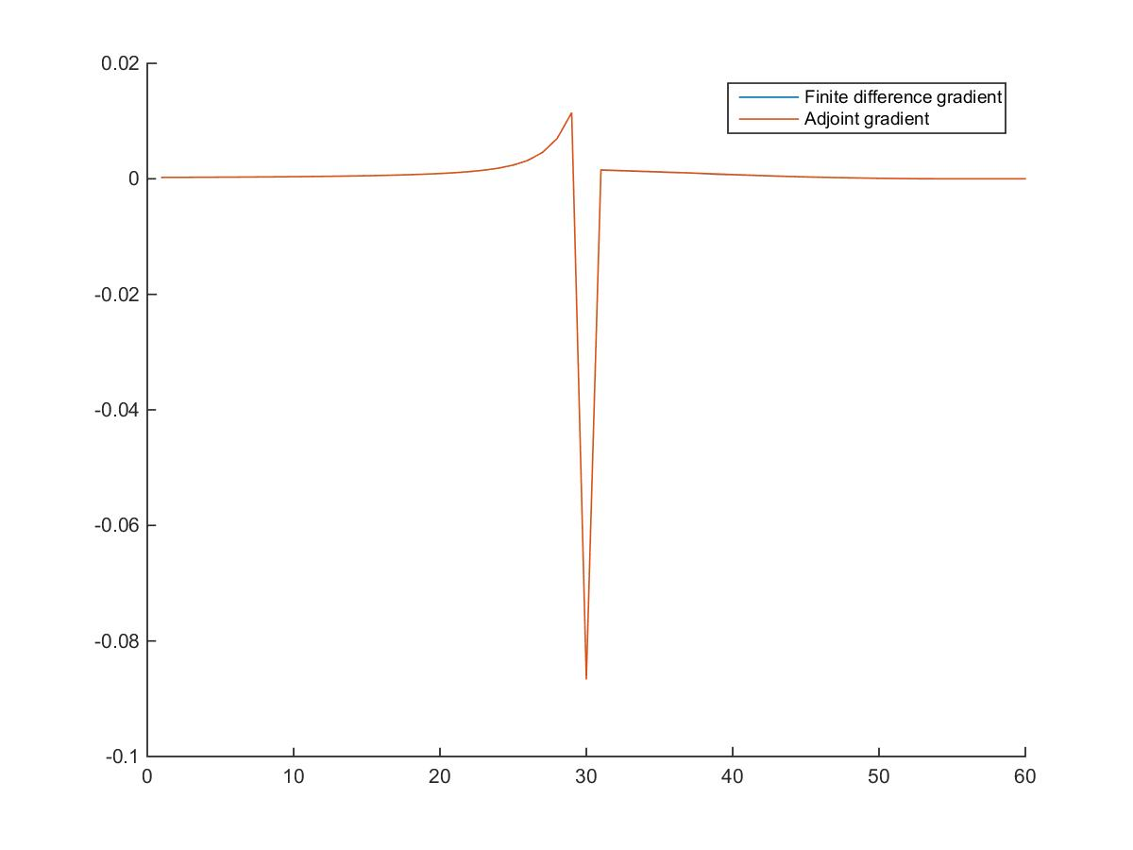
Control: P Constraint: qt

Slide 5
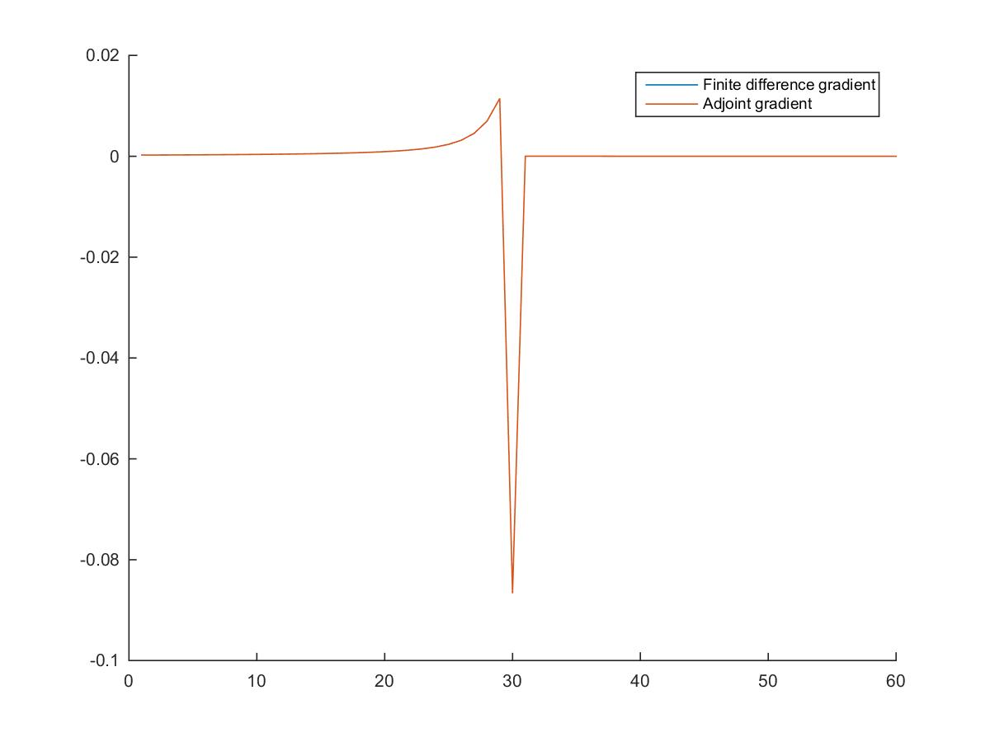
Control: P Constraint:qo

Slide 6

Control: P Constraint: qw

Slide 7
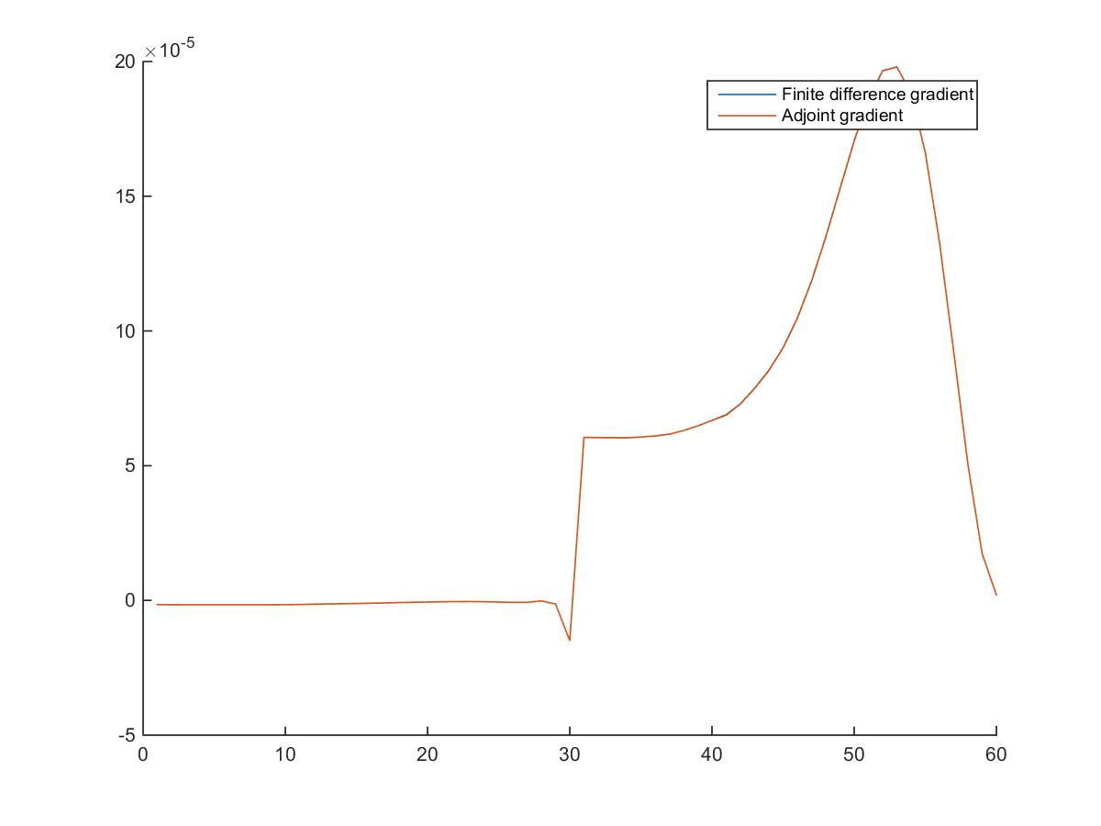
Control: P Constraint: WCT

Slide 8
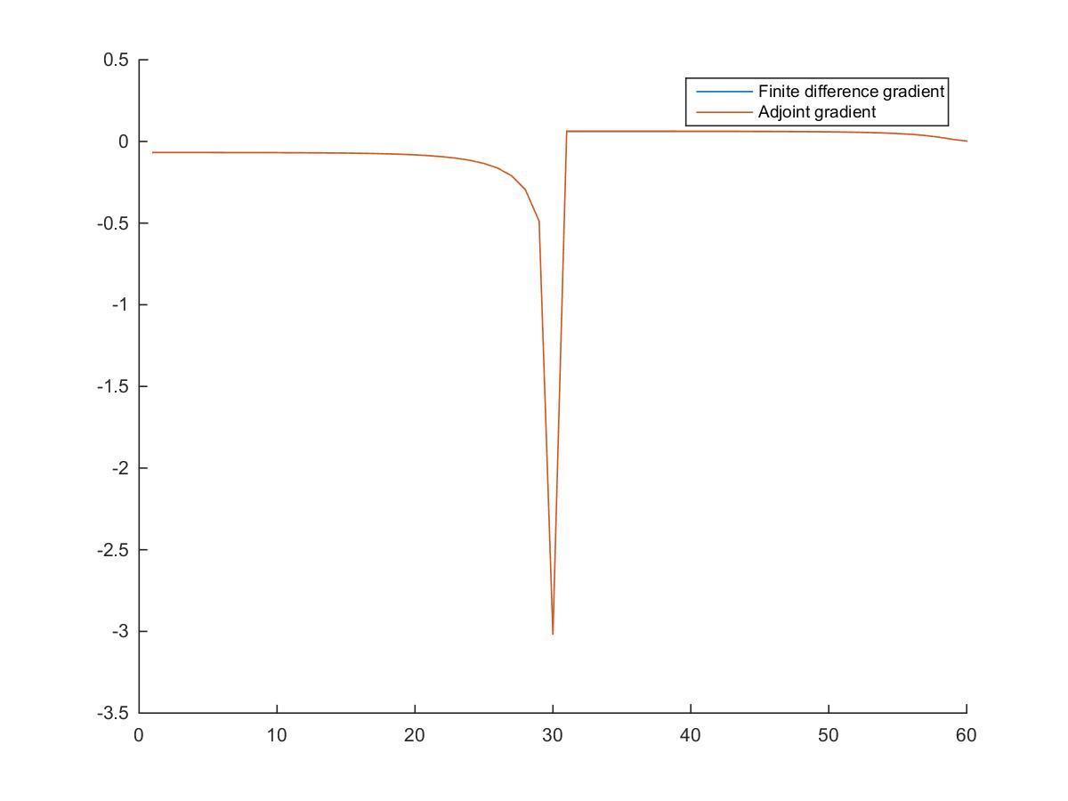
Control: qt Constrain:P

Slide 9
Control: qt Constraint:qo

Slide 10
Control: qt Constrain:qw

Slide 11
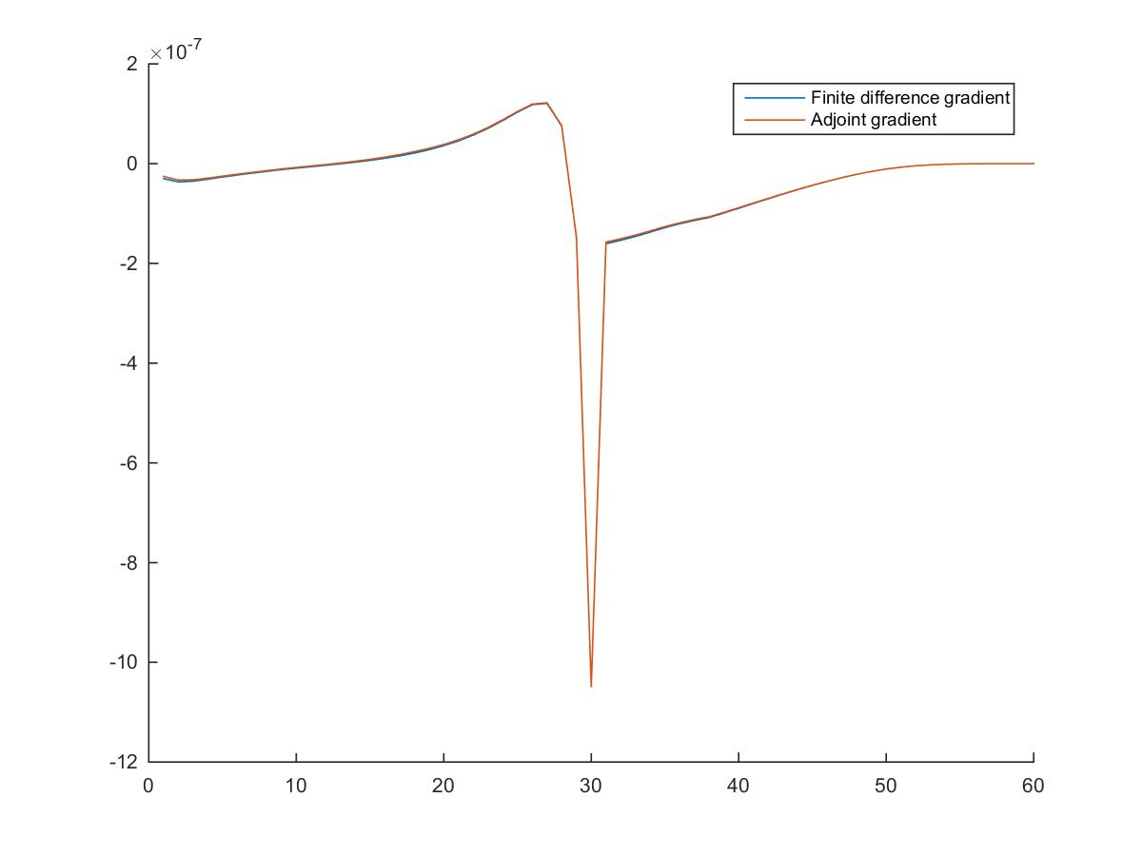
Control: qt Constraint:WCT

Slide 12
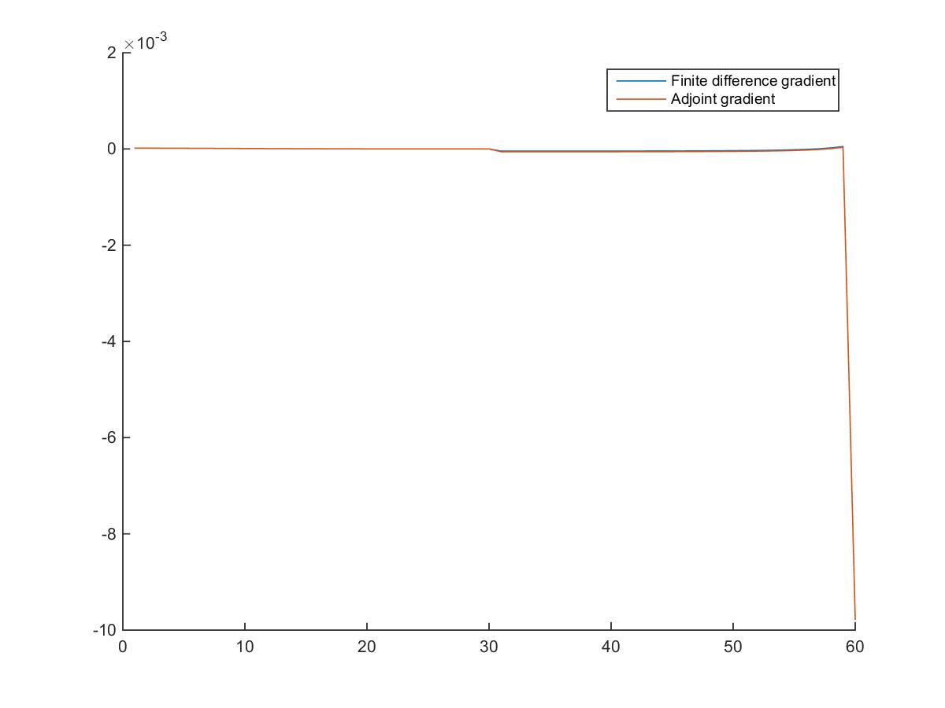
Injector Control: P Constraint:qw

Slide 13
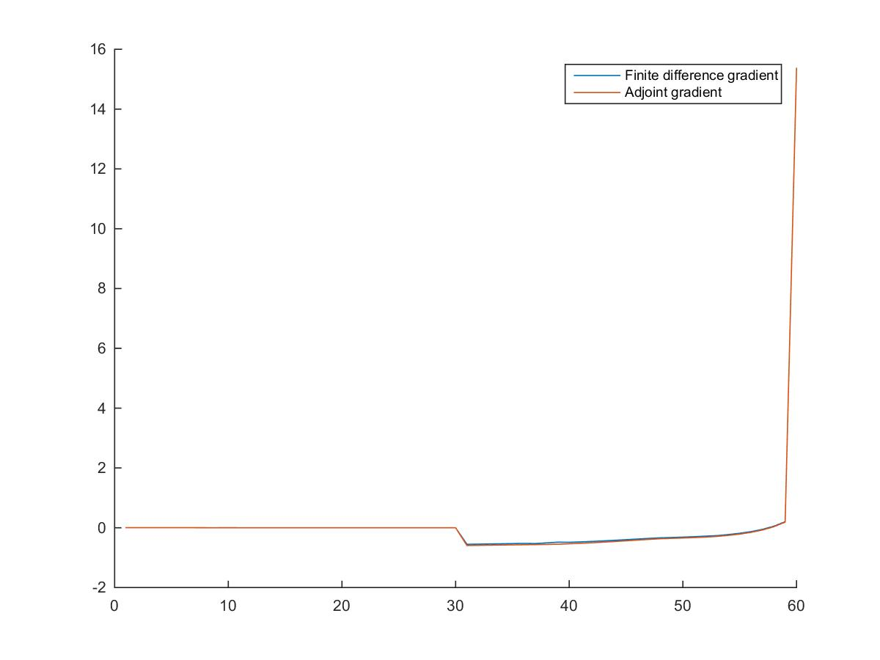
Injector Control: qw Constraint:P

