Slide 1
Comparison of Black Oil Simulator

Slide 2
Case Description
Grid size：50*50*1
Reservoir size: 2500*2500*10
Property package：Black Oil
Initial state: Pi=4400 psi, Sw=0.25, Sg=0,Rs=1.6

Slide 3
Well Information
Well Number | Is vertical | Is producer | Is pressure controll | Well radius | Start Point |  | End Point
1 | 1 | 1 | 1 | 0.5 | 24 | 24 | 0 | 0
2 | 1 | 0 | 0 | 0.5 | 12 | 12 | 0 | 0
3 | 1 | 0 | 0 | 0.5 | 36 | 36 | 0 | 0
Production well: Producing at 2000 psi
Injection well: 0-1350 day no water injection
1350-2700 constant injection rate at 200 std/day

Slide 4
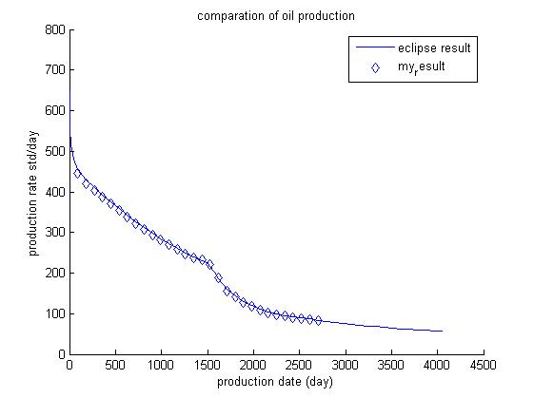
Comparison of Oil Production

Slide 5
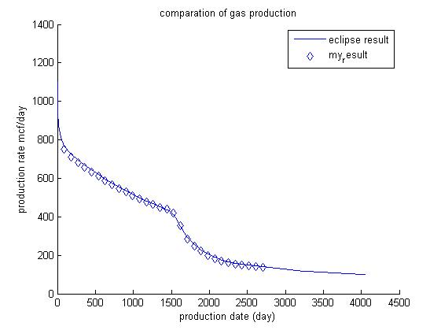
Comparison of Gas Production

Slide 6
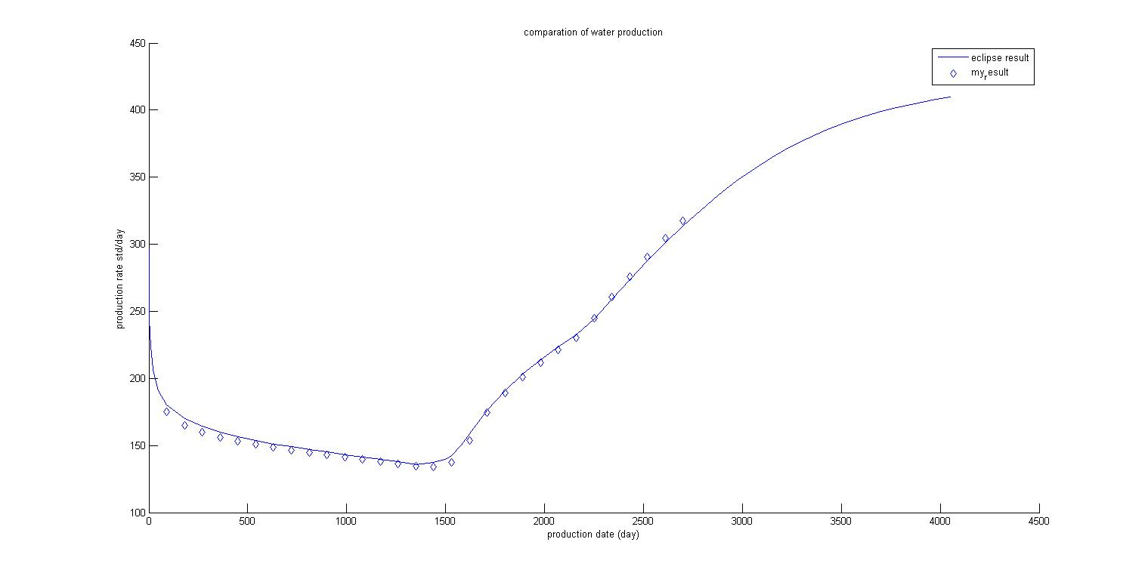
Comparison of Water Production

Slide 7
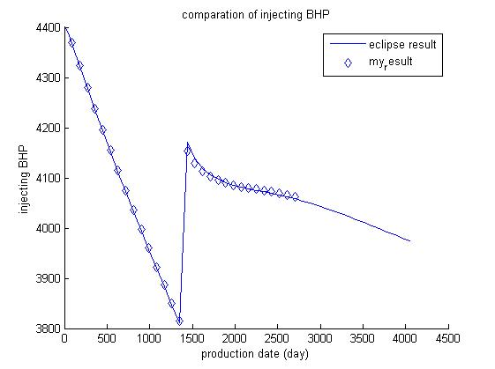
Comparison of Injecting Pressure

Slide 8
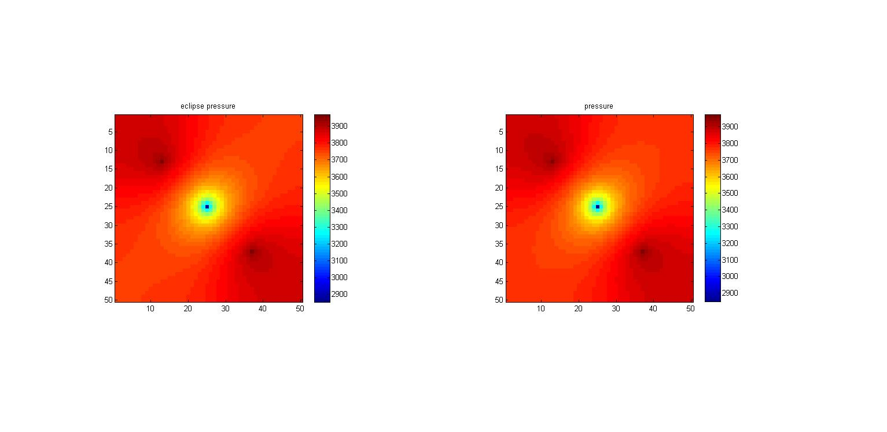
Comparison of Po

Slide 9
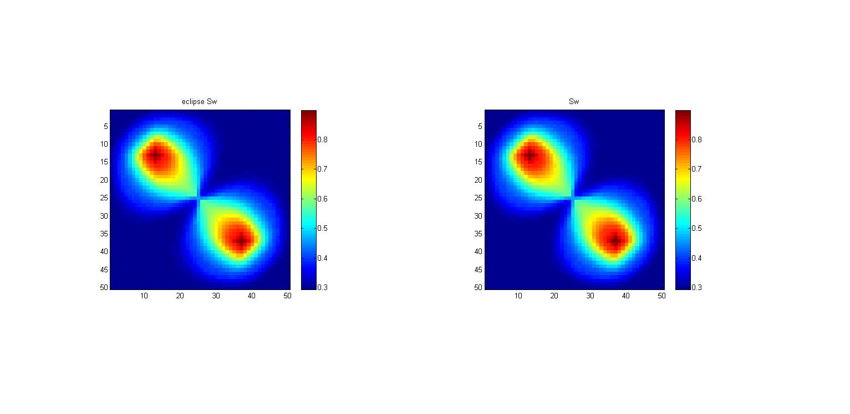
Comparison of Sw

Slide 10
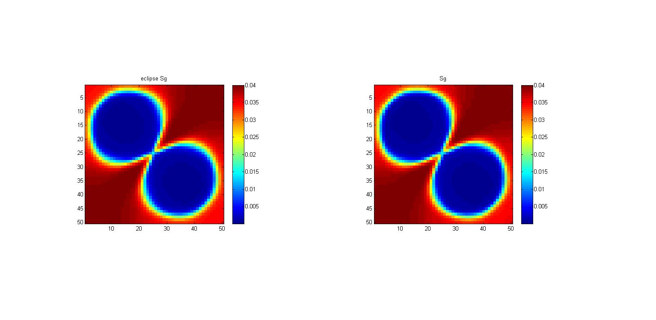
Comparison of Sg

Slide 11
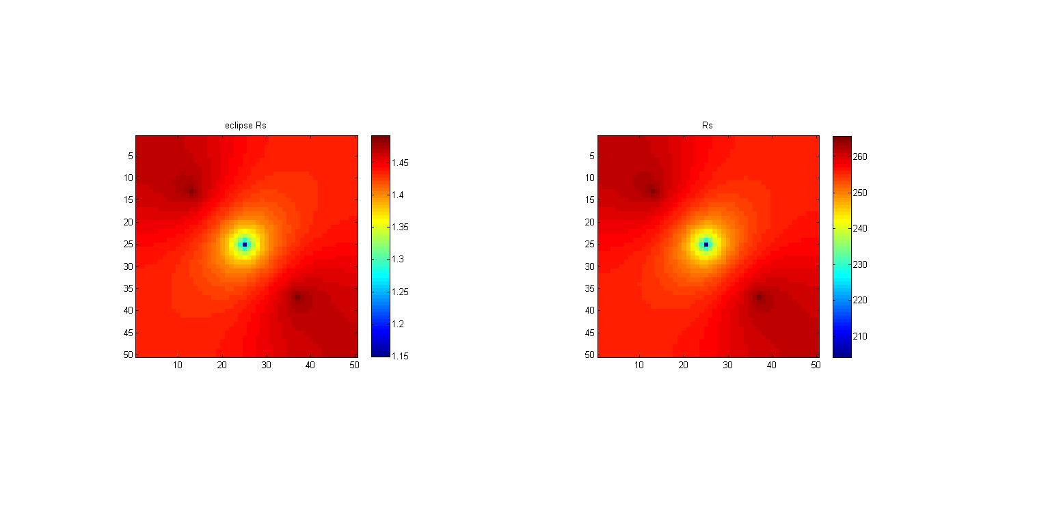
Comparison of Rs

