Slide 1
Final Project
CourseRegistrar9000
Zachariah Lowe
The University of Arizona Global Campus
CST499: Capstone for Computer Software Technology
Amr Elchouemi
4/4/2022

Slide 2
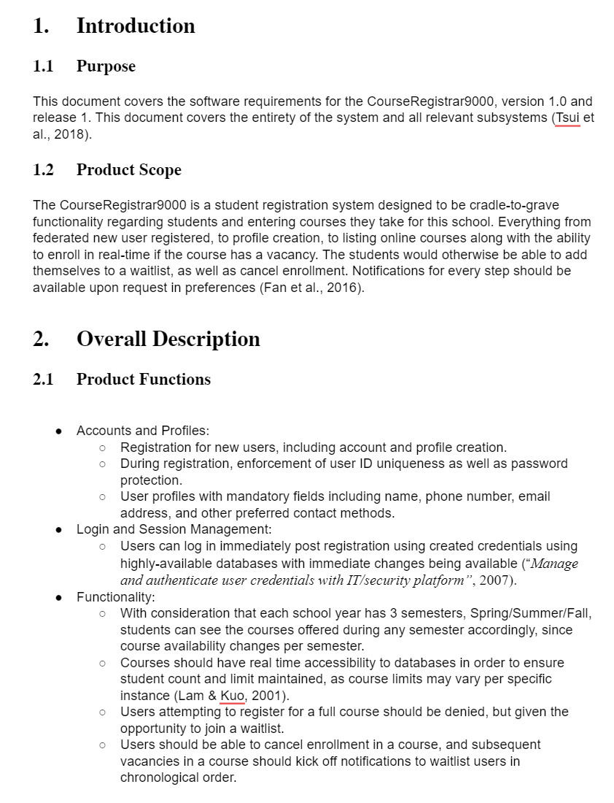
SRS

Slide 3
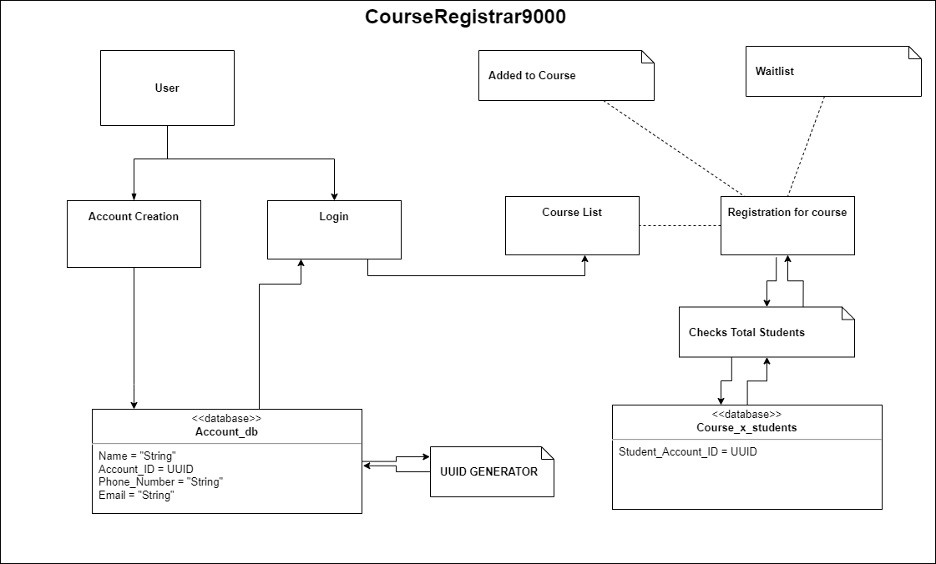
UML

Slide 4
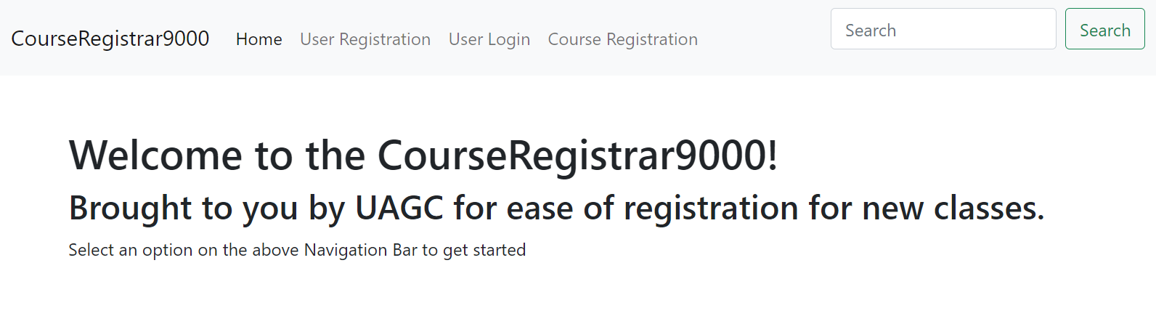
Landing Design

Slide 5
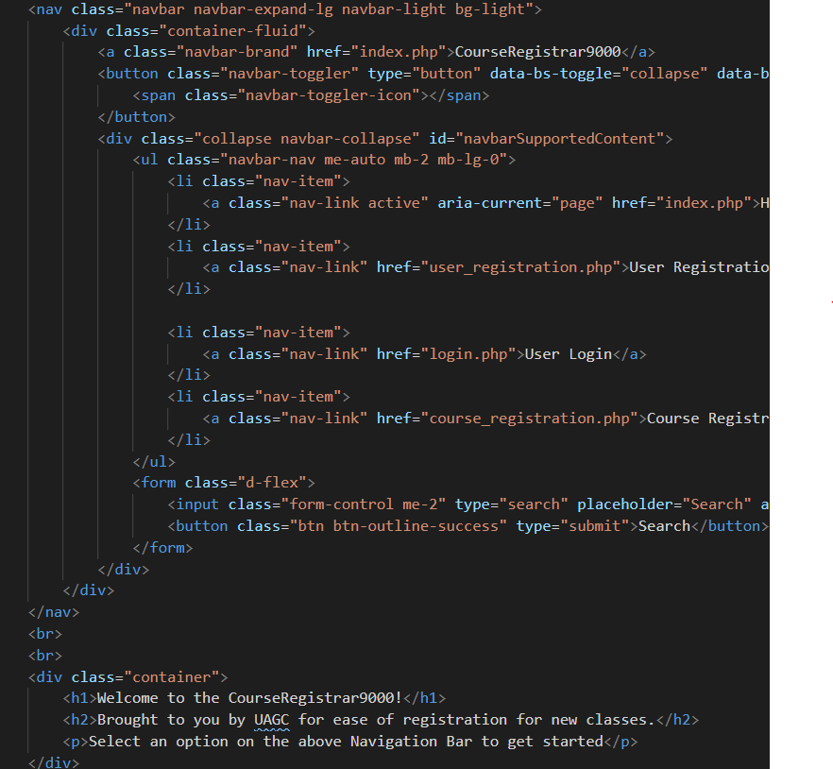
Landing Code

Slide 6
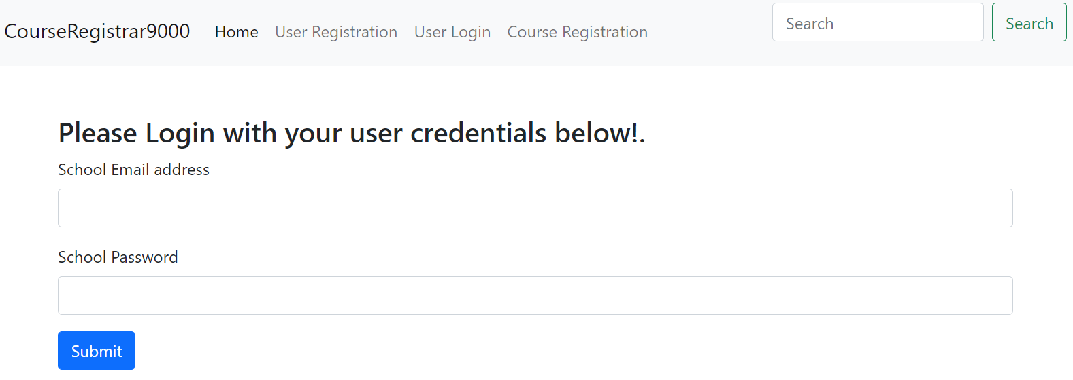
Login Design

Slide 7
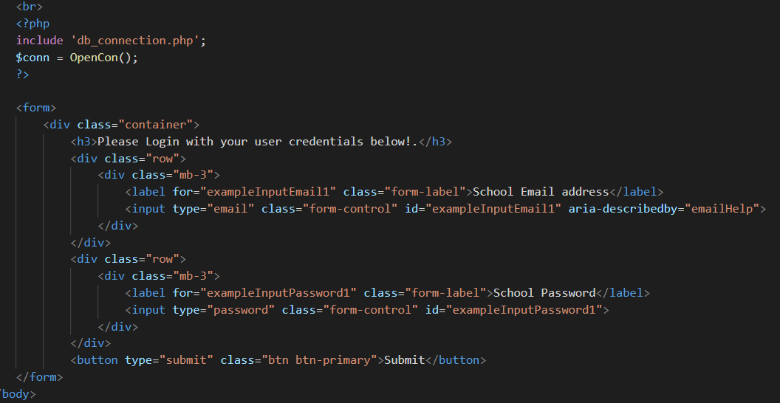
Login Code

Slide 8
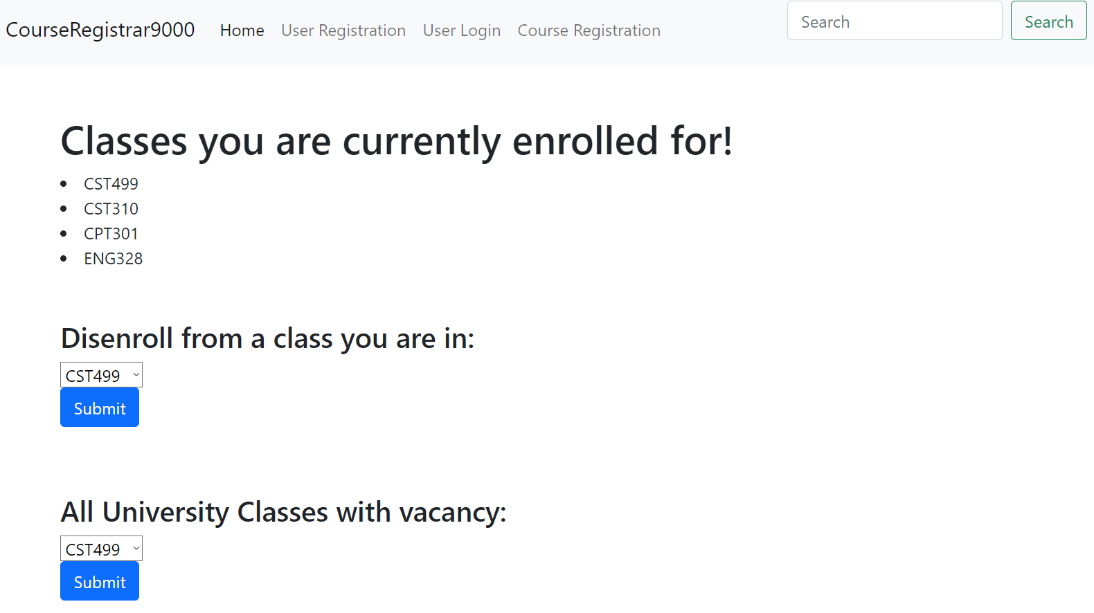
Enrollment Design

Slide 9
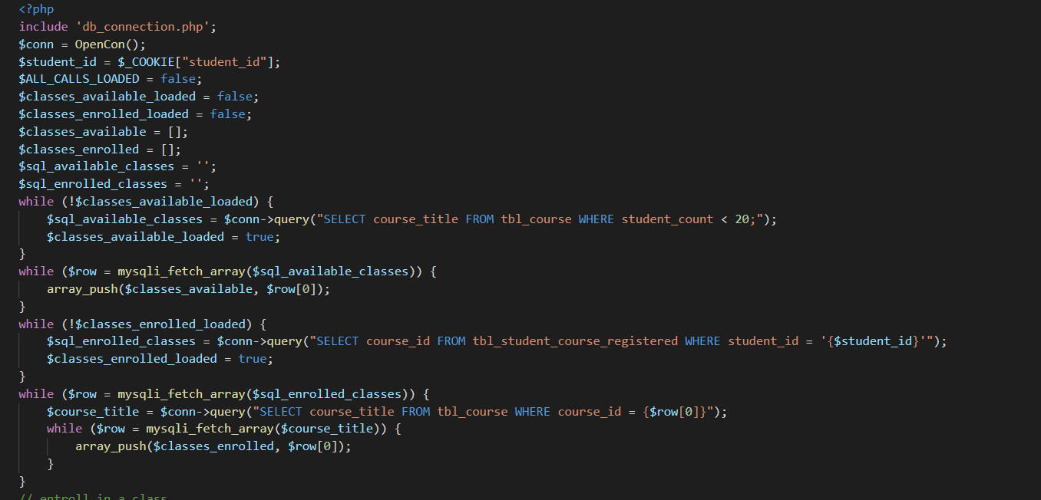
Enrollment Code
TOO LONG TO SHOW HERE

Slide 10
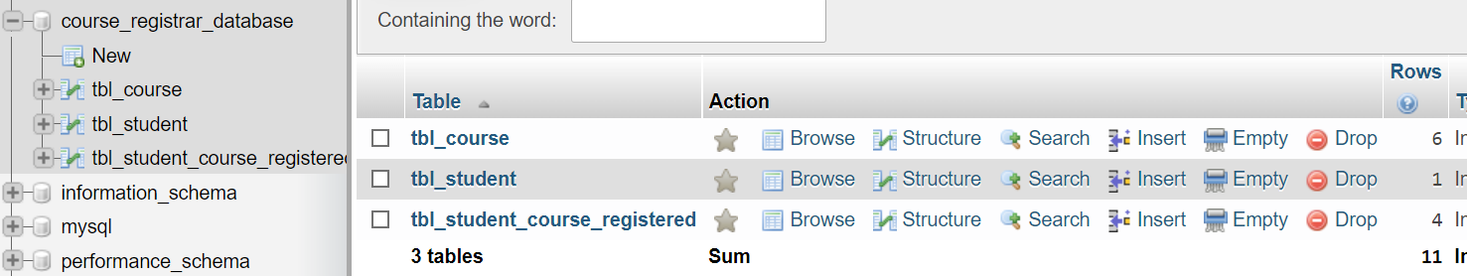
MySQL Database

Slide 11
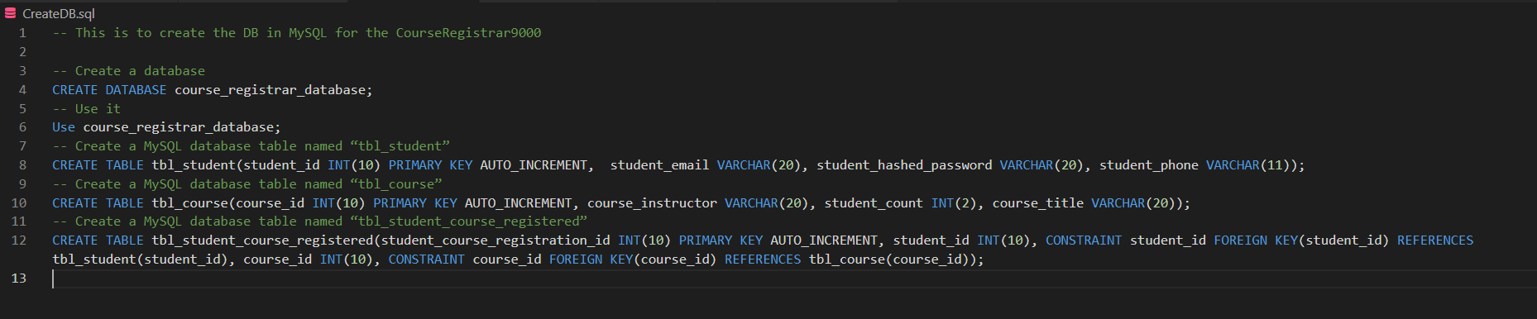
MySQL Code

Slide 12
References
Tsui, F., Karam, O., & Bernal, B. (2018). Essentials of software engineering (4th ed.). Jones & Bartlett Learning.
Fan, X., Sinnen, O., & Giacaman, N. (2016). Towards an Event-Driven Programming Model for OpenMP. 2016 45th International Conference on Parallel Processing Workshops (ICPPW) 240–249. https://doi.org/10.1109/ICPPW.2016.44
Manage and authenticate user credentials with IT/security platform. (2007, October 1). Government Product News, 46(10).
Lam, K.-Y., & Kuo, T.-W. (2001). Real-time database systems. [electronic resource] : architecture and techniques. Kluwer Academic.

