Slide 1
Object-Oriented Design Patterns

Slide 2
Creational Patterns
Abstract Factory
Factory Method

Slide 3
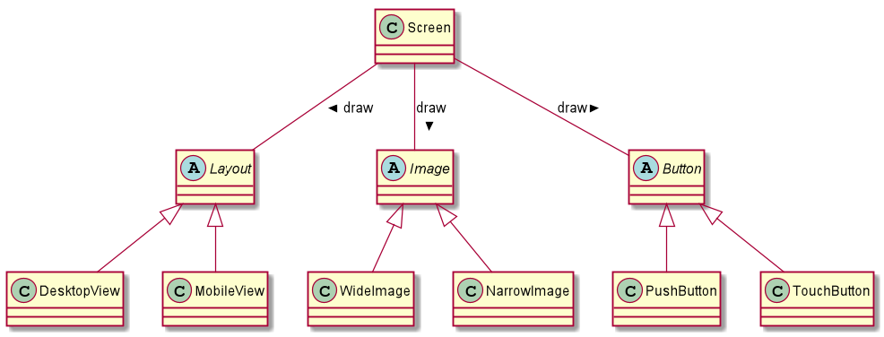
Abstract Factory - Problem
Notes:
<number>

Slide 4
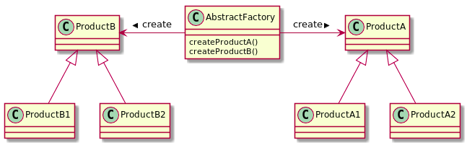
Abstract Factory - Solution
Notes:
<number>

Slide 5
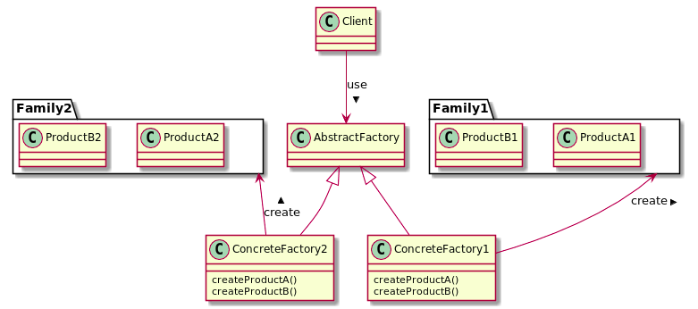
Abstract Factory - Solution
Notes:
<number>

Slide 6
Abstract Factory - Takeaway
Provide a way for creating families (of related) objects without specifying their concrete classes.
Notes:
<number>

Slide 7
Factory Method - Problem
Notes:
<number>

Slide 8
Factory Method - Solution
Notes:
<number>

Slide 9
Factory Method - Solution
Notes:
<number>

Slide 10
Factory Method - Takeaway
Define an interface for creating an Object, and let subclasses decide which type (of this object) to instantiate.
Notes:
<number>

Slide 11
Structural Patterns
Composite
Decorator
Adapter

Slide 12
Behavioral Patterns
Strategy
Observer
Template Method

