Slide 1
Object-Oriented Design Patterns

Slide 2
Creational Patterns
Abstract Factory
Factory Method

Slide 3
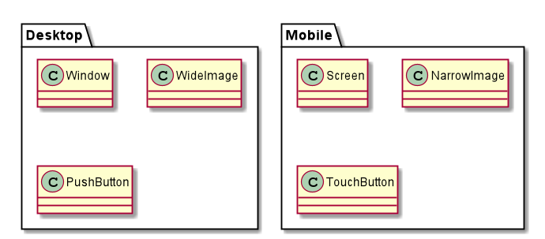
Abstract Factory - Problem
Notes:
3

Slide 4
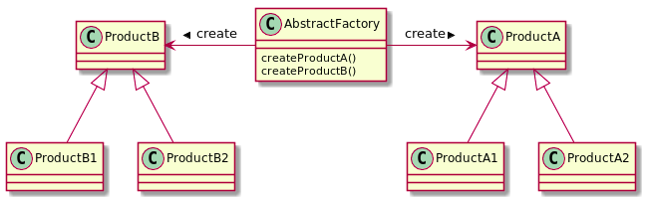
Abstract Factory - Solution
Notes:
4

Slide 5
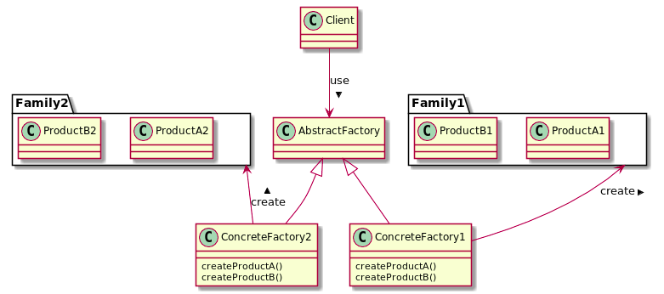
Abstract Factory - Solution
Notes:
5

Slide 6
Abstract Factory - Takeaway
Provide a way for creating families (of related) objects without specifying their concrete classes.
Notes:
6

Slide 7
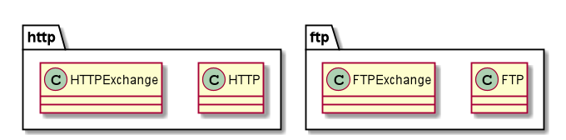
Factory Method - Problem
Notes:
7

Slide 8
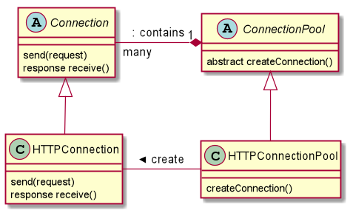
Factory Method - Solution
Notes:
8

Slide 9
Factory Method - Takeaway
Define an interface for creating an Object, and let subclasses decide which type (of this object) to instantiate.
Notes:
9

Slide 10
Creational Patterns - Contrast
Abstract Factory | Factory Method
Creation of family is consistent | Defer object creation to user-defined subclass
Object families are known in advance | We don’t know yet the concrete class to instantiate
UC: GUI Kits | UC: Extendable frameworks
Complexity increases when adding new families | Parallel Hierarchy
Notes:
10

Slide 11
Structural Patterns
Composite
Decorator
Adapter

Slide 12
Adapter - Problem

Slide 13
Adapter - Solution

Slide 14
Adapter - Takeaway
Allow two incompatible classes to work together, by converting one’s interface to the other’s interface,
Notes:
14

Slide 15
Structural Patterns - Contrast
Adapter
Alias: Wrapper
Reuse a library that wasn’t designed with our context in mind
UC: Reuse toolkits
Notes:
15

Slide 16
Behavioral Patterns
Strategy
Observer
Template Method
Visitor

