Slide 1
Object-Oriented Design Patterns

Slide 2
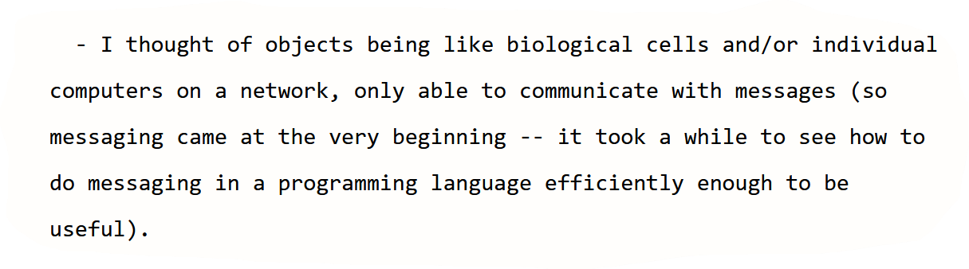
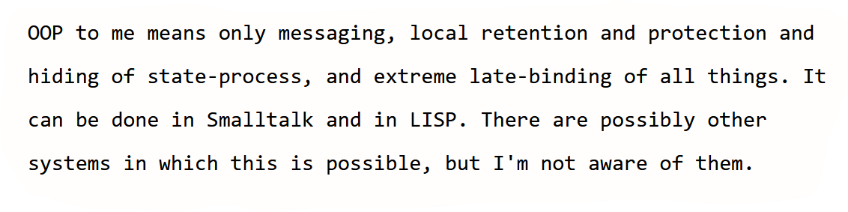
OOP Background
Historical notes (by Alan kay):
https://www.purl.org/stefan_ram/pub/doc_kay_oop_en

Slide 3
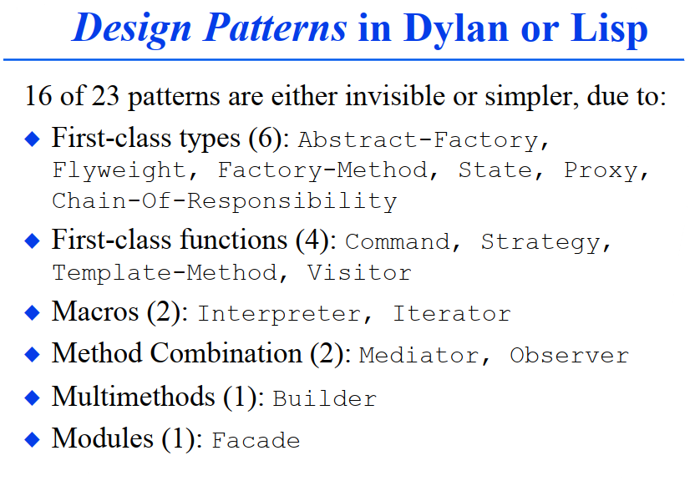
DP as language limitations
Peter Norvig (1996):
Design Patterns in Dynamic Languages
http://www.norvig.com/design-patterns/

Slide 4
OOP DP Background
Kent Beck & Ward Cunningham papers (1987):
A Laboratory For Teaching Object-Oriented Thinking
http://c2.com/doc/oopsla89/paper.html
Using Pattern Languages for Object-Oriented Programs http://c2.com/doc/oopsla87.html

Slide 5
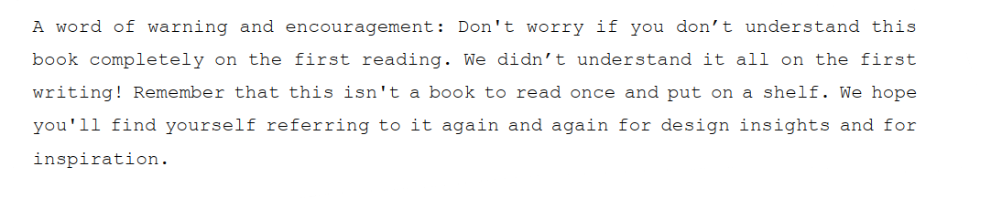
GoF book (1994) Preface

Slide 6
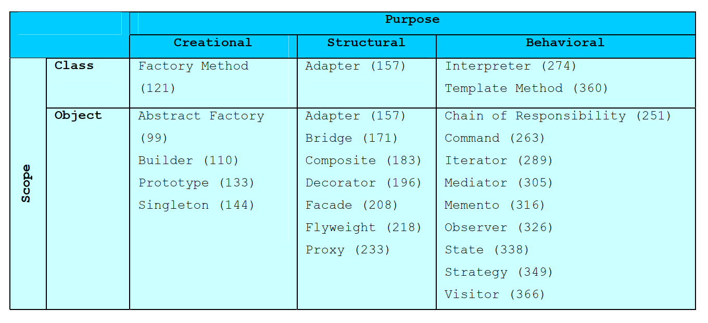
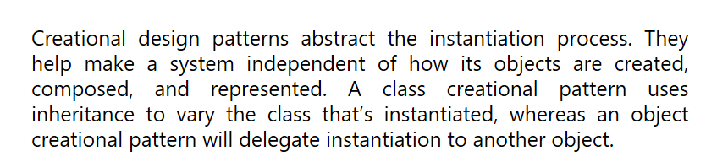
GoF Classification

Slide 7
GoF Classification : Purpose criterion
Creational patterns concern the process of object creation.
Structural patterns deal with the composition of classes or objects.
Behavioral patterns characterize the ways in which classes or objects interact and distribute responsibility.

Slide 8
GoF Classification : Scope criterion
Class patterns deal with relationships between classes and their subclasses. These relationships are established through inheritance, so they are static—fixed at compile-time.
Object patterns deal with object relationships, which can be changed at run-time and are more dynamic.
e.g.
Class pattern: Use Factory method pattern to support both HTTP & FTP connection pooling
Object pattern: Use Strategy pattern to select right/needed connection pool at runtime.

Slide 9
GoF Classification : Scope vs Purpose
Creational class patterns defer some part of object creation to subclasses, while Creational object patterns defer it to another object.
The Structural class patterns use inheritance to compose classes, while the Structural object patterns describe ways to assemble objects.
The Behavioral class patterns use inheritance to describe algorithms and flow of control, whereas the Behavioral object patterns describe how a group of objects cooperate to perform a task that no single object can carry out alone.

Slide 10
Creational Patterns
Abstract Factory
Factory Method

Slide 11
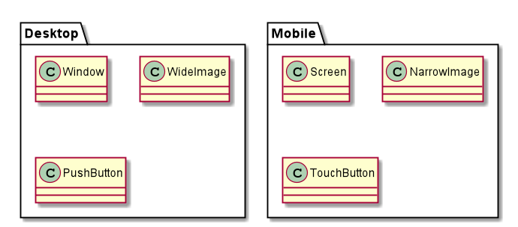
Abstract Factory - Problem
Notes:
11

Slide 12
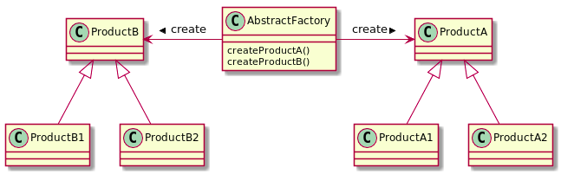
Abstract Factory - Solution
Notes:
12

Slide 13
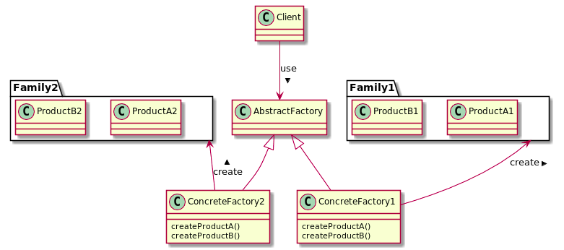
Abstract Factory - Solution
Notes:
13

Slide 14
Abstract Factory - Takeaway
Provide a way for creating families (of related) objects without specifying their concrete classes.
Notes:
14

Slide 15
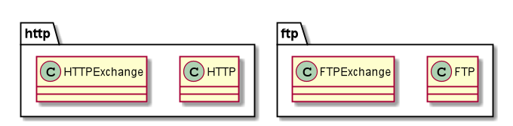
Factory Method - Problem
Notes:
15

Slide 16
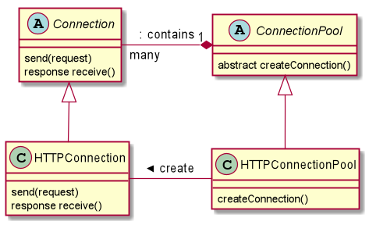
Factory Method - Solution
Notes:
16

Slide 17
Factory Method - Takeaway
Define an interface for creating an Object, and let subclasses decide which type (of this object) to instantiate.
Notes:
17

Slide 18
Creational Patterns - Contrast
Abstract Factory | Factory Method
Creation of family is consistent | Defer object creation to user-defined subclass
Object families are known in advance | We don’t know yet the concrete class to instantiate
UC: GUI Kits | UC: Extendable frameworks
Complexity increases when adding new families | Parallel Hierarchy
Notes:
18

Slide 19
Structural Patterns
Composite
Decorator
Adapter

Slide 20
Adapter - Problem

Slide 21
Adapter - Solution

Slide 22
Adapter - Takeaway
Allow two incompatible classes to work together, by converting one’s interface to the other’s interface,
Notes:
22

Slide 23
Structural Patterns - Contrast
Adapter
Alias: Wrapper
Reuse a library that wasn’t designed with our context in mind
UC: Reuse toolkits
Notes:
23

Slide 24
Behavioral Patterns
Strategy
Observer
Template Method
Visitor

