Slide 1
Keep moving, be smart
Sensor Descriptive Movements
Zheng Lu, Zhiyang Zhang, Michael Craze
University of Tennessee - Knoxville
Notes:
9/30/13 04:00:54 PM
1

Slide 2
Lanterns
2
What are we going to do?
Describe our movement by using Sensors
Low energy cost
Low latency
Poor precision
Way too much GPS！！！
Notes:
9/30/13 04:00:54 PM 1. It’s just not worth to use GPS sometimes.
2. Standing awkwardly at the cross for 5 minutes?
2

Slide 3
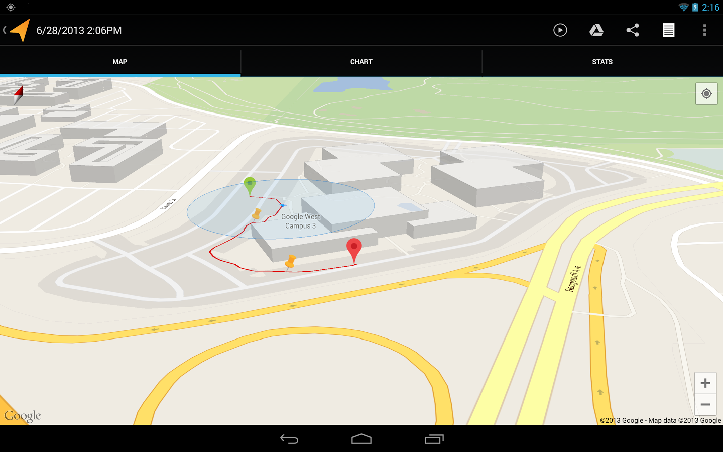
Lanterns
3
Path Recording
Notes:
9/30/13 04:00:54 PM
3

Slide 4
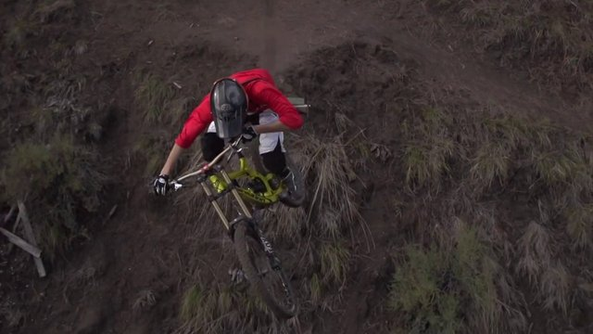
Lanterns
4
Personal Aerial Photography
Notes:
9/30/13 04:00:54 PM
4

