Slide 1
How difficult a book is
Streaming Methods to Evaluate Books’ Readability Level
Ant Team

Slide 2


Problem Description
We want to know the readability of a book
Easy reading helps learning and enjoyment^{[1]}
Choose the book that fits your reading ability
Take a book as a stream S:
Three types of elements in the stream: word , .
Then length of the stream S is s
[1] Fry, Edward B. “Readability, Reading Hall of Fame Book, Newark.” DE: International Reading Association (2006).

Slide 3
Achievements
Good Estimation
50 worldwide classic literature books has been tested
Space Efficiency
Only maintains 84 bytes as stream goes by!!
For an arbitrary book with less than 100 thousand of words
Time Efficiency
Evaluate all 50 books costs 1 second!

Slide 4
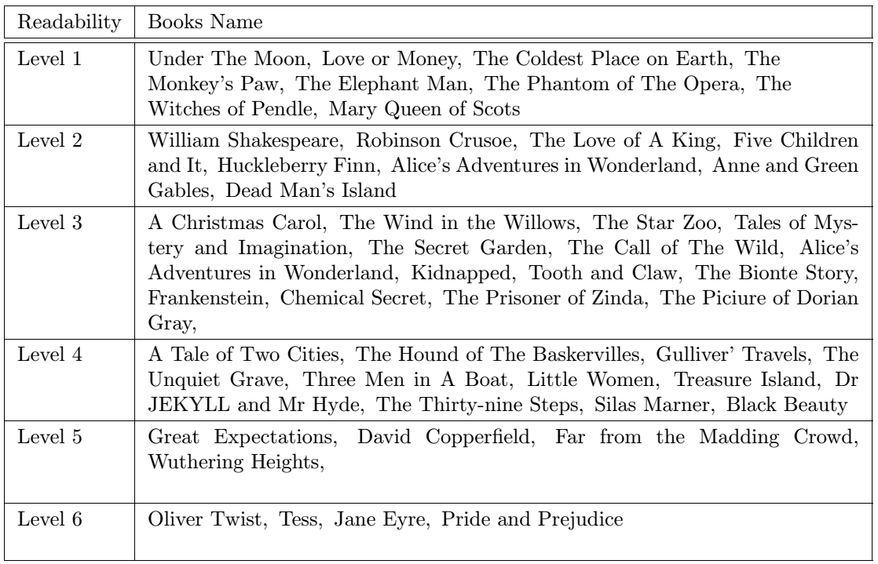
Data Set: Oxford Bookworms Series Books^{[2]}
These difficulty levels are given by Oxford ELT.
[2] Oxford English Language Teaching, “Booksworms Series Books” https://elt.oup.com/catalogue/items/ global/graded_readers/oxford_bookworms_library

Slide 5

Evaluation Criteria
Vocabulary
Huge vocabulary reduce the readability
Count distinct words amount
Difficult words reduce the readability
Give difficulty to each words in a book
Grammar
Long sentences reduce the readability
Estimate the average sentence length.

Slide 6
Streaming Algorithm
We use a value R to represent the readability of a book
R is the weighted sum of following three values
What do we maintain?
Variance: 3 sketches (about 12 bytes)
Hyperloglog: 16 sketches (about 64 bytes)
Average Length: 2 sketches (about 8 bytes)

Slide 7
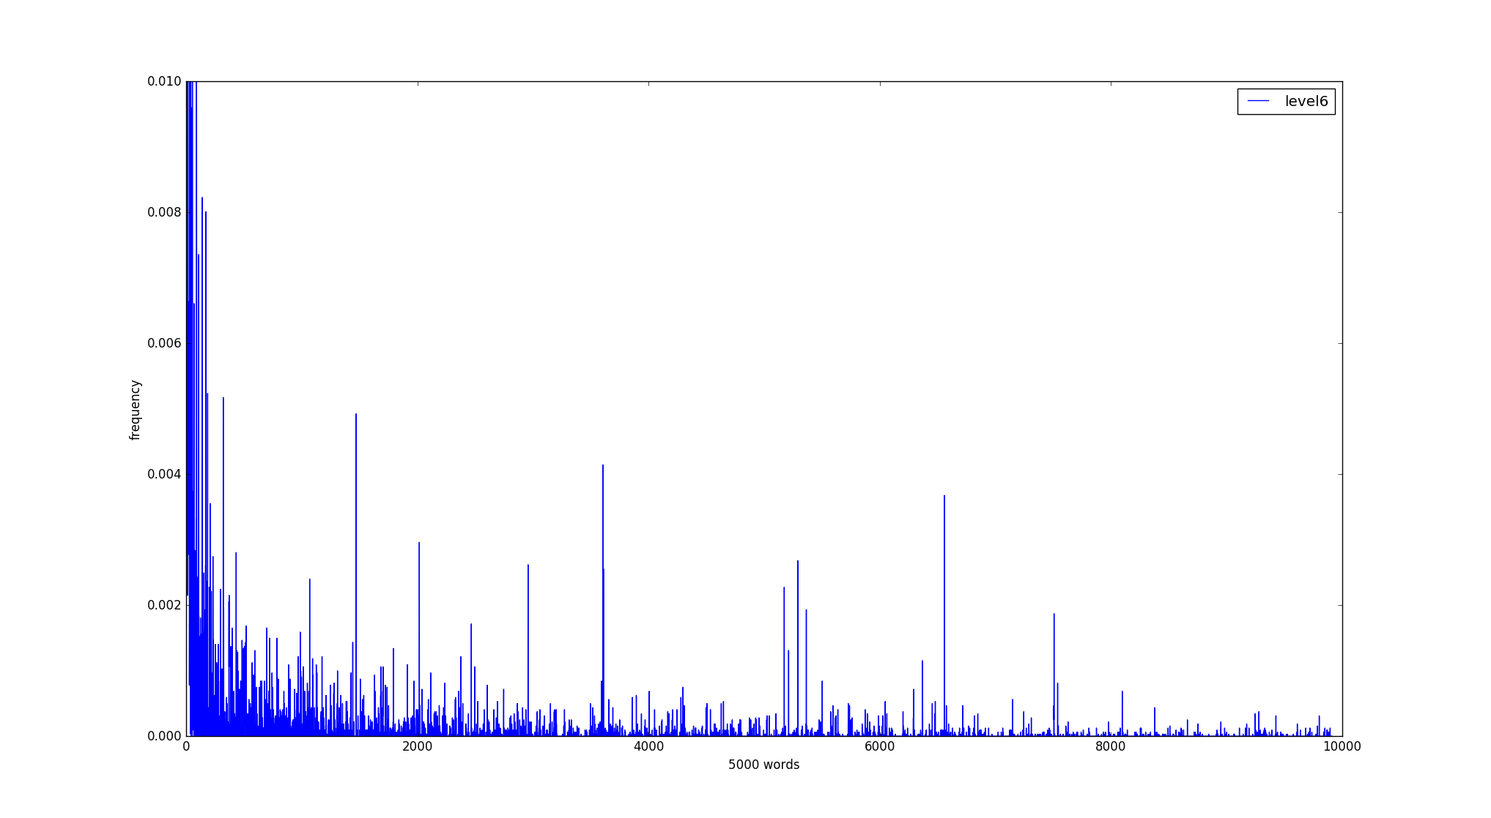
Vocabulary-popularity
Top 10000 common English words by Google ^{[3]}
N-th word gets score N
Average score doesn’t work
[3] Google.com, “Google Ngram Viewer - Google Books”, Books. (2012)

Slide 8

Vocabulary-popularity
$Var\left[x\right]=\frac{1}{n}\sum{{(x−E\left[x\right])}^{2}}$
$Var\left[x\right]={E\left[x^{2}\right]−E}^{2}\left[x\right]$
Time: $O(s)$
Space: $O(1)$

Slide 9
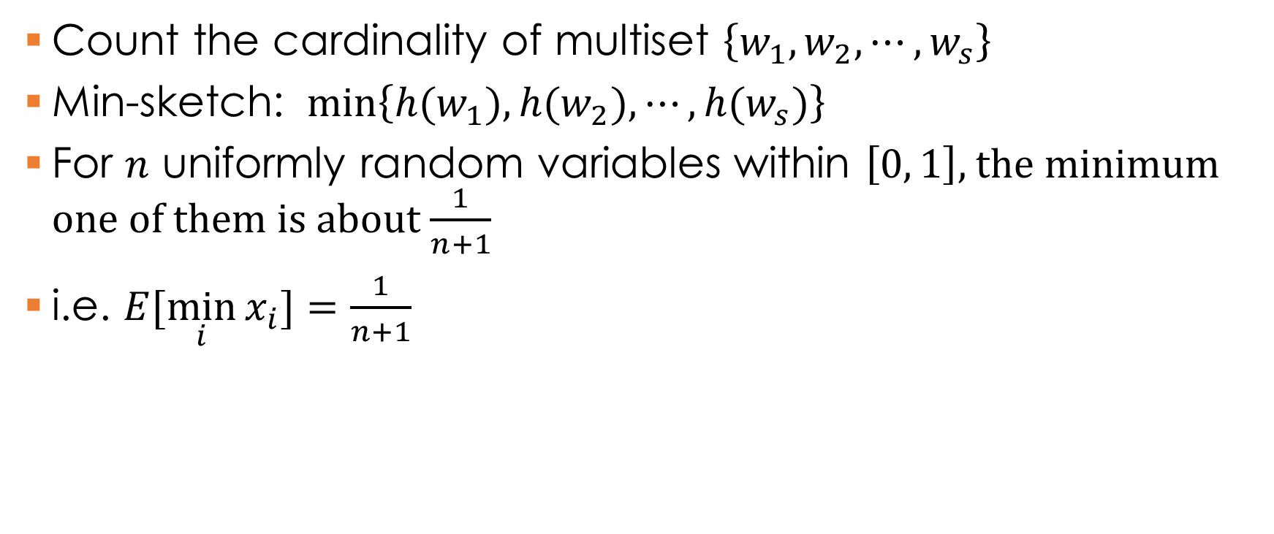
Vocabulary-amount
Count the cardinality of multiset $\left\{w_{1},w_{2},⋯,w_{s}\right\}$
Min-sketch: $min\left\{{h(w}_{1}),{h(w}_{2}),⋯,{h(w}_{s})\right\}$
For $n$ uniformly random variables within $\left[0, 1\right]$, the minimum one of them is about $\frac{1}{n+1}$
i.e. $E[\min_{i}{x_{i}]=\frac{1}{n+1}}$

Slide 10
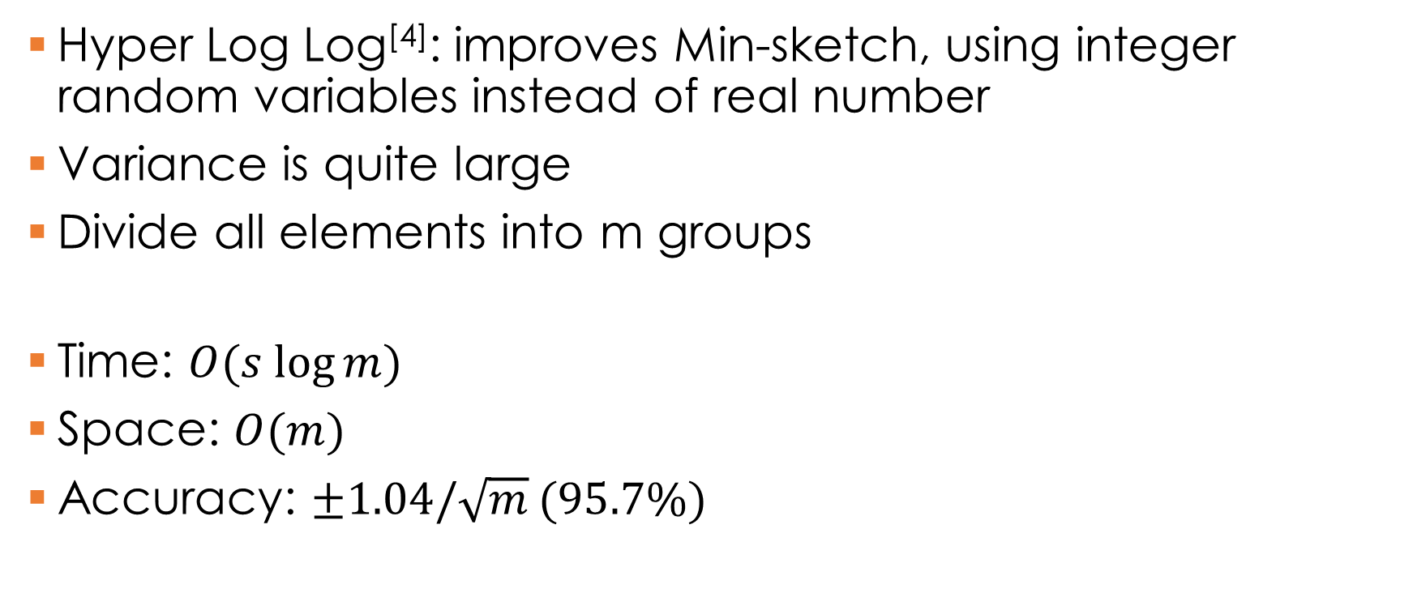
Vocabulary-amount
Hyper Log Log^{[4]}: improves Min-sketch, using integer random variables instead of real number
Variance is quite large
Divide all elements into m groups
Time: $O(s log⁡m)$
Space: $O(m)$
Accuracy: $±1.04/\sqrt{m}$ $(95.7\%)$
[4] Flajolet, Philippe, et al, “Hyperloglog: the analysis of a near-optimal cardinality estimation algorithm.” DMTCS Proceedings 1 (2008)

Slide 11

Grammar
How?
Just calculate the average length of each sentence
Time: $O(s)$
Space: $O(1)$

Slide 12
Results
Level 6
Level 5
Level 4
Level 3
Level 2
Level 1

Slide 13
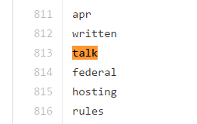
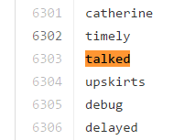
Future works
Large data set: only hundred thousand words now
Fix Google’s word-list: different word classes
Sophisticated analysis on grammar

Slide 14
Summary
Streaming methods
has great efficiency on space and time
Not 100% precise, but enough
Trade-off
Streaming method sacrifice little accuracy to gain huge space
Programmers also should read more books~

Slide 15
Thanks for listening!
Siyi Yang
Zhendong Liu
Nov 10

