Slide 1
CMPUT 396
Cryptanalysis Review Exercise

Slide 2
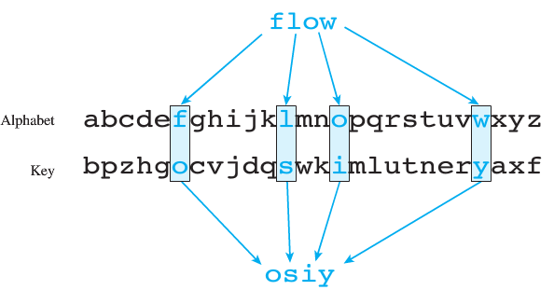
Substitution Cipher
Plaintext is encrypted using a key
Each letter in the plaintext substituted by the corresponding letter in the key

Slide 3
Generating a Key
Key is generated from a password
E.g., if the key is “ciphering”
A | B | C | D | E | F | G | H | I | J | K | L | M
c | i | p | h | e | r | n | g | j | k | l | m | o
N | O | P | Q | R | S | T | U | V | W | X | Y | Z
q | s | t | u | v | w | x | y | z | a | b | d | f

Slide 4
Breaking a Code
Brute force search is too inefficient
We can use some tools to incrementally decode
Letter frequency analysis
Letter pairs analysis
Word frequency analysis
Pattern matching

Slide 5
Letter Frequency Analysis
Count the occurences of letters in a corpus to estimate the frequency of use of letters
Count the frequency of letters in the encrypted text
If “E” is the most frequent letter in a corpus
And, the most frequent letter in encrypted text is “b”
It is highly likely “E” was encrypted to “b”
You can use showLetterFrequency(text)

Slide 6
Letter Pair Analysis
Matching the most frequent letters in corpus with encrypted text does not always work - let’s exploit knowledge!
Vowels are more “sociable” - they occur more frequently next to other letters
Consonants occur next to a smaller number of letters

Slide 7
Letter Pair Analysis
Create dictionary with letters as keys
Value for each letter is another dictionary
This dictionary contains counts of neighboring letters
neighborCount(text) returns a dictionary of neighbor counts
showCounts(dict) prints the neighbor counts dictionary

Slide 8
Word Frequency Analysis
After guessing letters, guess some words
Try guessing the frequent, short words
Use these to guess more letters
“THE” is the most frequent English word
If “dvE” exists in the ciphertext it is probably “THE”
“E” was already guessed
“d” is probably “T”
“v” is probably “H”

Slide 9
Word Frequency Analysis
Use countWords(text) to return a dictionary of frequency of words
Use sortByFreq(w) to sort words by their frequency
Use sort() and sortByLen(w) to sort the words in the dictionary of frequencies

Slide 10
Pattern Matching With Partial Words
After guessing some short words, guess longer words
Use findLetters(unused, pattern) to print a list of correct mappings
unused is a string of unmapped letters
pattern is the regex pattern

Slide 11
Pattern Matching With Partial Words
Calling
print(findLetters('bcjkmpqruvwxyz', 'AiiInAL'))
would print out
['i', 'i', 'n']
['arrival', [('i', 'R'), ('i', 'R'), ('n', 'V')]]

Slide 12
Putting It All Together
Use tools
Letter frequency analysis
Letter pair analysis
Word frequency analysis
Pattern matching
Guess some letters
Repeat 1 - 2

