Slide 1
Lab0
CMPUT 206

Slide 2
Lab Rules
Each student should attend just the registered lab section, so each student can just attend one lab section and that's the one the student is registered in.
Each lab assignment has some part(s) to be done in the lab and some part(s) to be submitted after the lab. ALL codes must be uploaded on the course site.
Late submissions will be penalized 10% of the marks allotted to those parts per day up to a maximum of 2 days after which no submissions will be accepted
Students need to write their own code.
TA may ask students randomly to explain their code, procedure, etc. If the student is unable to explain it or gives wrong answer he/she will not get credit for it.
Make sure to save your work.
TA will do the best to answer your questions during the labs but she/he is not responsible to debug your codes and find mistakes in your codes.

Slide 3
Python warm up
CMPUT 206

Slide 4
Cheat sheets
Python
http://sixthresearcher.com/wp-content/uploads/2016/12/Python3_reference_cheat_sheet.pdf
Numpy
https://s3.amazonaws.com/assets.datacamp.com/blog_assets/Numpy_Python_Cheat_Sheet.pdf

Slide 5
List Comprehension
nums = [0, 1, 2, 3, 4] squares = [x ** 2 for x in nums] print(squares)
nums = [0, 1, 2, 3, 4] squares = [] for x in nums: squares.append(x ** 2) print(squares)

Slide 6
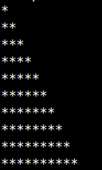

Triangle
Write python code to generate triangle of stars in increasing order.
print('*\n**\n***\n****\n*****\n******\n*******\n********\n*********\n**********');

Slide 7
Triangle
Write python code to generate triangle of stars in increasing order.
n = 100 print( '\n'.join( '*' * i for i in range(1,n) ) );

Slide 8
Dictionary
d = {'cat': 'cute'} # Create a new dictionary with some data print(d['cat']) # Get an entry from a dictionary; prints "cute" print('cat' in d) # Check if a dictionary has a given key; prints "True" d['fish'] = 'wet' # Set an entry in a dictionary print(d['fish']) # Prints "wet" # print(d['monkey']) # KeyError: 'monkey' not a key of d # Iterating on dictionary

Slide 9
String format
d = {'person': 2, 'cat': 4, 'spider': 8} for animal, legs in d.items(): print('A %s has %d legs' % (animal, legs))
print('%.2f' % 0.25678) //0.26 print('%4i' % 2) //0002 print('%4i' % 10) //0010

Slide 10
Function
def sign(x): return 'positive' if x >= 0 else 'negative'
def sign(x): if x > 0: return 'positive' elif x < 0: return 'negative' for x in [-1, 1]: print(sign(x)) # Prints "negative", "positive"

Slide 11
Lambda
signLambda = lambda x: 'positive' if x >= 0 else 'negative'

Slide 12
Lambda
dict = {'cat':1,'dog':2,'elephant':3,'alligator':3} print(dict) //{'alligator': 3, 'elephant': 3, 'dog': 2, 'cat': 1} sorted(dict.items(),key=lambda(k,v): v)
//[('cat', 1), ('dog', 2), ('alligator', 3), ('elephant', 3)]
sorted(dict.items(),key=lambda(k,v): v, reverse = True)
//[('alligator', 3), ('elephant', 3), ('dog', 2), ('cat', 1)]
sorted(dict.items(),key=lambda(k,v): (v,k) ,reverse = True) //[('elephant', 3), ('alligator', 3), ('dog', 2), ('cat', 1)]

Slide 13
Numpy
Numpy array vs list?
More compact in memory and faster in indexing
Lot of support and manipulation functionality
a = np.array([[.1,.2,.3,.4], [.5,.6,.7,.8], [.9,.10,.11,.12],[.13,.14,.15,.16],[.17,.18,.19,.20]]) #float b = [[.1,.2,.3,.4], [.5,.6,.7,.8], [.9,.10,.11,.12],[.13,.14,.15,.16],[.17,.18,.19,.20]] #float print('Numpy array %i MB, Python list %i MB' % (sys.getsizeof(a),sys.getsizeof(b)))
//Numpy array 80 MB, Python list 112 MB → Platform dependent

Slide 14
Numpy
# Create the following rank 2 array with shape (3, 4) # [[ 1 2 3 4] # [ 5 6 7 8] # [ 9 10 11 12]] a = np.array([[1,2,3,4], [5,6,7,8], [9,10,11,12]]) row_r1 = a[1, :] # Rank 1 view of the second row of a row_r2 = a[1:2, :] # Rank 2 view of the second row of a col_r1 = a[:, 1] col_r2 = a[:, 1:2]

Slide 15
Numpy
a = np.array([[1,2], [3, 4], [5, 6]]) bool_idx = (a > 2) print(bool_idx) # Prints "[[False False] # [ True True] # [ True True]]" print(a[bool_idx]) # Prints "[3 4 5 6]"
# We can do all of the above in a single concise statement: print(a[a > 2]) # Prints "[3 4 5 6]"

Slide 16
Array math
x = np.array([[1,2],[3,4]], dtype=np.float64) y = np.array([[5,6],[7,8]], dtype=np.float64) # Elementwise operations print(x + y) print(x - y) print(x * y) print(x / y) print(x // y) print(np.sqrt(x)) #Dot product / Matrix multiplication print(x.dot(y))

Slide 17
Array math
x = np.array([[1,2],[3,4]]) print(np.sum(x)) # Compute sum of all elements; prints "10" print(np.sum(x, axis=0)) # Compute sum of each column; prints "[4 6]" print(np.sum(x, axis=1)) # Compute sum of each row; prints "[3 7]"
#mean, sub, reshape, expand_dim

Slide 18
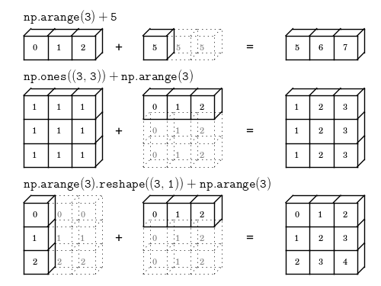
Broadcasting

Slide 19
Python debugger
import pdb //commands pdb.set_trace()
Commands in debugging mode:
s(tep)
Execute the current line, stop at the first possible occasion (either in a function that is called or on the next line in the current function).
n(ext)
Continue execution until the next line in the current function is reached or it returns.
r(eturn)
Continue execution until the current function returns.
c(ontinue)
Continue execution, only stop when a breakpoint is encountered.
l(ine)
Display current executing line

Slide 20
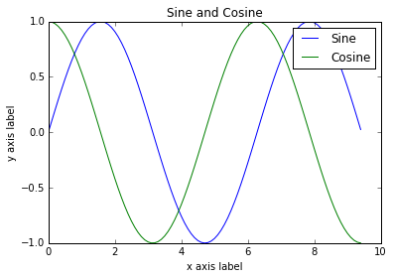
Plotting
import matplotlib.pyplot as plt # Compute the x and y coordinates for points on sine and cosine curves x = np.arange(0, 3 * np.pi, 0.1) y_sin = np.sin(x) y_cos = np.cos(x) # Plot the points using matplotlib plt.plot(x, y_sin) plt.plot(x, y_cos) plt.xlabel('x axis label') plt.ylabel('y axis label') plt.title('Sine and Cosine') plt.legend(['Sine', 'Cosine']) plt.show()

