Slide 1
Parse Tree Visualizer
By: Leon Zeltser
Mentor: Professor Charles Thomas Wilkes
Committee Member: Professor Matteo Cimini

Slide 2

About the Tool
Python tool that shows how a parse tree is built step-by-step.
Started as Java applet written by Zerksis D. Umrigar 30 years ago.
Ported to later versions of Java by David Bacon (2020) and Victoria Munroe (2022).
Now ported to Python and PyQt6.
Available on GitHub:
https://github.com/lzeltser/ParseTreeVisualizer-Python

Slide 3
Parsing / Syntactic Analysis
Discover structure and meaning of code and ensure it is syntactically correct, then encode it into a data structure.
Must discover all features of code, including:
Order of operations.
Function parameters.
What code belongs to what subroutine.
Etc.
E.g. x:= 10+2
assign sum of 10 and 2 to variable x.

Slide 4
Parsing / Syntactic Analysis
Discover structure and meaning of code and ensure it is syntactically correct, then encode it into a data structure.
Must discover all features of code, including:
Order of operations.
Function parameters.
What code belongs to what subroutine.
Etc.
E.g. x:= 10+2 *4
multiply 2 by 4 first then add to 10.

Slide 5
Parsing / Syntactic Analysis
Discover structure and meaning of code and ensure it is syntactically correct, then encode it into a data structure.
Must discover all features of code, including:
Order of operations.
Function parameters.
What code belongs to what subroutine.
Etc.
E.g. x:=(10+2)*4
Add 10 and 2 first then multiply by 4.

Slide 6
Context-Free Grammar
Made up of rules and derivations.
Two types of derivations:
Terminal (in “quotes”): symbol.
Non-terminal (in <triangle brackets>): calls another rule.
::= means “derived from”.
| means “or”.
ε (epsilon) means empty string.
<statement> ::= <variable> “:=” <expression>
<expression> ::= <expression> <operator> <term>
| <term>
<term> ::= <number> | <variable>
<operator> ::= “+” | “-” | “*” | “/”

Slide 7
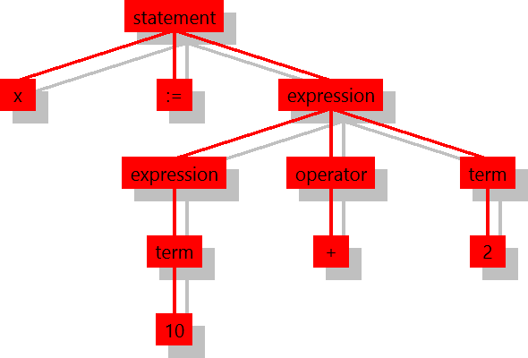
Parse Tree
Shows structure of string from context-free grammar rules.
Each node corresponds to a rule, children correspond to derivation.
Parse tree for x:=10+2 using the following grammar:
Trees can be built top-down or bottom-up.
<statement> ::= <variable> “:=” <expression>
<expression> ::= <expression> <operator> <term> | <term>
<term> ::= <number> | <variable>
<operator> ::= “+” | “-” | “*” | “/”

Slide 8
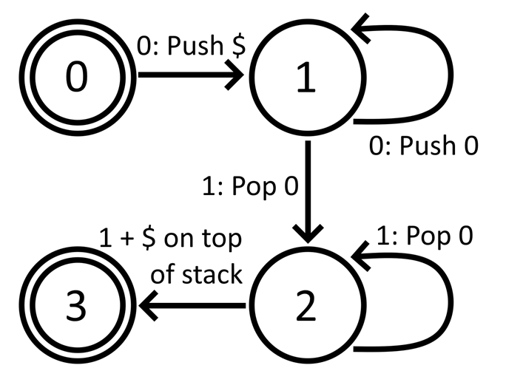
Pushdown Automaton (PDA)
Any context-free grammar can be recognized by a PDA.
Consists of a state machine and a stack.
Transitions to states based on current state, input token and top of stack.
May push or pop from stack on transition.
State | 0 | 1 | None
0 | Push $, Goto 1 |  | Accept
1 | Push 0, Goto 1
2 |  | If 0 on top Pop 0, Goto 2 If $ on top Goto 3
3 |  |  | Accept

Slide 9

Simple Calculator Language
From Programming Language Pragmatics by Michael L. Scott.
3 types of statements:
read v
Read user input to variable v.
write x
Write expression x to output.
v := x
Assign value of expression x to variable v.
Includes mathematical operators: +, -, *, /, and ().

Slide 10
LL (Top-Down) Parser
Read tokens from left, derive rules from left.
Build tree starting with root node and work down.
Must predict next rule from next token.
Table-driven:
Single state, acts based on top of stack and next token.
Generated by parser generator.
Recursive Descent:
Written code with recursive functions.
Usually handwritten.
Takes effort to write and maintain but more efficient and gives better error messages.

Slide 11

LR (Bottom-Up) Parser
Read tokens from left, derive rules from right.
Build tree starting with leaf nodes and work up.
Recognizes what tokens form what rule, uses state machine to keep track.
Two actions: shift and reduce.
Shift: push token from input stream to parse stack.
Reduce: pop tokens off stack and put them on tree.

Slide 12

Future Work
Add additional grammars and languages for recursive descent.
More algorithms.
Earley and CYK algorithms: less efficient but can parse any grammar.
LALR: similar to SLR but better at resolving ambiguities.
Multiple token lookahead.
Error handling.
Delete tokens until returned to “safe” tokens.
Insert expected token and continue parsing with it.
Would require additional inputs.

Slide 13

Thank You. Questions?
https://github.com/lzeltser/ParseTreeVisualizer-Python

