Slide 1

Toolkit Presentation
Group 6:
Peiran Yan
Zhenhao Li
Kendrick Wang

Slide 2
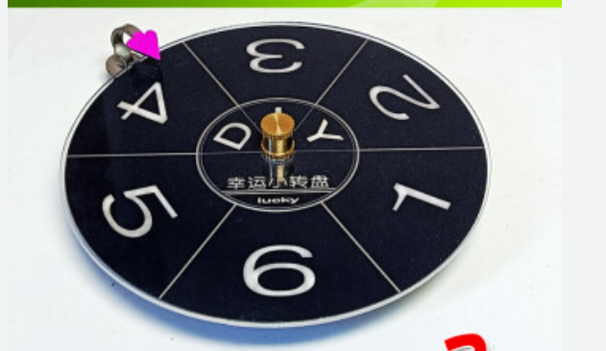
Toolkit 1
Wheel of Fortune game

Slide 3
Participants of the game
Players Solutions
Referee The project's managers, shareholders or project owners.

Slide 4
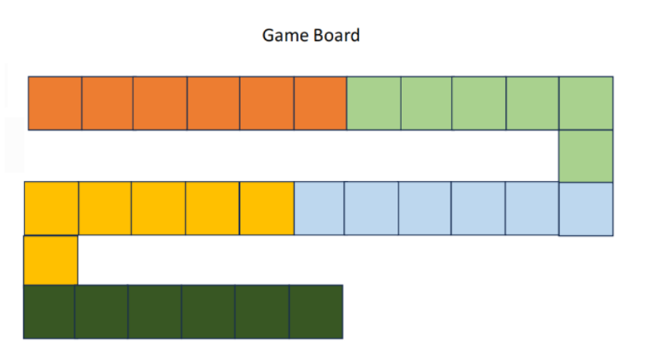
Game
Mechanics
Step 1: Spin the wheel（number = step = cards）
Step 2: Draw cards
Step 3: Answer the drawn questions
Step 4: Move forward N steps
Step 5: Repeat steps 1-4.
Step 6: The game ends when all players' pieces reach the end of the game map.

Slide 5
Reward and Punishment Rules
Correct answer = 1 point ; Incorrect answer = -1 point.
all questions correctly will be rewarded with 1 points and can move forward 1 step.
all questions incorrectly will be penalized by being suspended from spinning the wheel in the next round.

Slide 6

Winning Conditions
Case 1: The player with the most points wins directly.
Case 2: If players have the same score, the player who has spun the wheel the least number of times wins, as he is luckier.

Slide 7
1, Does the project contribute to the society positively? Please list three aspects and explain it.
------------------------------------------------
2, Could you please list several social systems that will be impacted by your project and explain the reasons?
3,..................................
Question Pool
1, How would you resolve conflicts within your team?
-------------------------------------------
2, Could you please list at least three stakeholders who significantly impact and are impacted by this project?
3...............................
Teamwork
Society
1, Can you provide a concise description of your product’s recyclability?
---------------------
2, Could you discuss the likelihood of your project affecting any disabled or old people?
3,….........
Energy
Ethical
1, Does your project gather user data, and how will you ensure the data’s security?
--------------------------
2, How will you ensure that your collection method gather its data safely?
3.......
Stakeholder
1, Could you identify and list the top three stakeholders relevant to your project?
------------------------------------------------
2, How would you handle stakeholders who consistently present challenges and not reasonable requirements?
3.......

Slide 8
Reference answer (partial)
How would you resolve conflicts within your team?
Does the project contribute to the society positively? Please list three aspects and explain it.​
Neuroscientists and researchers: They contribute their expertise in neuroscience and brain-computer interfaces to advance technology and its applications.
Medical professionals (neurologists, neurosurgeons): They provide insights on clinical usage, safety considerations, and potential medical benefits for patients.
Patients and their families: They are the primary beneficiaries of the technology, and their feedback and experiences are crucial for its development and optimization.
Improved Quality of Life: The brain-computer chip project has the potential to significantly enhance the quality of life for individuals with neurological conditions. By enabling them to regain motor functions, communicate effectively, and enhance their independence, the project can contribute to improving their overall well-being and social integration.
Advancements in Healthcare: The project's research and development can lead to advancements in healthcare, particularly in the fields of neurology, neurorehabilitation, and neuroengineering. These advancements can benefit not only individuals with neurological conditions but also contribute to a broader understanding of the brain and potentially lead to breakthroughs in diagnosing and treating various neurological disorders.
Scientific Knowledge and Innovation: The project's research s...........

Slide 9
Toolkit 2
We will classify the stakeholders by applying salience model based on three factors:
Power: The ability of impacting the project.
Urgency: The need for immediate action.
Legitimacy: Whether its actions are appropriate.

Slide 10
Salience Model of Stakeholder Analysis
1
2
3
1 | Dormant
2 | Discretionary
3 | Demanding
4 | Dominant
5 | Dangerous
6 | Dependent
7 | Definitive
Power
5
4
7
6
Urgency
Legitimacy

Slide 11
Salience Model Classification
Item | Name | Description | Description
1 | Dormant | Only hold power, low urgency and legitimacy. There is no need to plan their communication needs. | None
2 | Discretionary | Only hold legitimacy, low urgency and power. Their needs maybe achieved for some details. Do not need much attention. | General Public
3 | Demanding | Only hold urgency, low power and legitimacy. Their need is important. | None
4 | Dominant | High power and legitimacy. This type of stakeholders is legal and authoritative. Its needs are significant | Investors and Government
5 | Dangerous | High power and urgency but low legitimacy. They could lead the project to the wrong direction by making illegal decisions. | Advertising Companies
6 | Dependent | High legitimacy and urgency, and low power. They are useful when project need its strengthens in navigating complexities. | Future user
7 | Definitive | High power, urgency, and legitimacy. The most important part of project. Core characteristics; Their need is the most significant. | Research team and Neuralink Administration

