Slide 1

11
Recursion
5TH EDITION
Lewis & Loftus
java
Software Solutions
Foundations of Program Design
<footer>© 2007 Pearson Addison-Wesley. All rights reserved

Slide 2
Recursion
Recursion is a fundamental programming technique that can provide an elegant solution certain kinds of problems
Chapter 11 focuses on:
  thinking in a recursive manner
  programming in a recursive manner
  the correct use of recursion
  recursion examples

Slide 3
Outline
Recursive Thinking
Recursive Programming
Using Recursion
Recursion in Graphics

Slide 4
Recursive Thinking
A recursive definition is one which uses the word or concept being defined in the definition itself
When defining an English word, a recursive definition is often not helpful
But in other situations, a recursive definition can be an appropriate way to express a concept
Before applying recursion to programming, it is best to practice thinking recursively

Slide 5
Recursive Definitions
Consider the following list of numbers:
24, 88, 40, 37
Such a list can be defined as follows:
A LIST is a: number
or a: number comma LIST
That is, a LIST is defined to be a single number, or a number followed by a comma followed by a LIST
The concept of a LIST is used to define itself

Slide 6
Recursive Definitions
The recursive part of the LIST definition is used several times, terminating with the non-recursive part:
number comma LIST
24 , 88, 40, 37
number comma LIST
88 , 40, 37
number comma LIST
40 , 37
number
37

Slide 7
Infinite Recursion
All recursive definitions have to have a non-recursive part
If they didn't, there would be no way to terminate the recursive path
Such a definition would cause infinite recursion
This problem is similar to an infinite loop, but the non-terminating "loop" is part of the definition itself
The non-recursive part is often called the base case

Slide 8
Recursive Definitions
N!, for any positive integer N, is defined to be the product of all integers between 1 and N inclusive
This definition can be expressed recursively as:
1! = 1
N! = N * (N-1)!
A factorial is defined in terms of another factorial
Eventually, the base case of 1! is reached

Slide 9
Recursive Definitions
5!
5 * 4!
4 * 3!
3 * 2!
2 * 1!
1
120
24
6
2

Slide 10
Outline
Recursive Thinking
Recursive Programming
Using Recursion
Recursion in Graphics

Slide 11
Recursive Programming
A method in Java can invoke itself; if set up that way, it is called a recursive method
The code of a recursive method must be structured to handle both the base case and the recursive case
Each call to the method sets up a new execution environment, with new parameters and local variables
As with any method call, when the method completes, control returns to the method that invoked it (which may be an earlier invocation of itself)

Slide 12
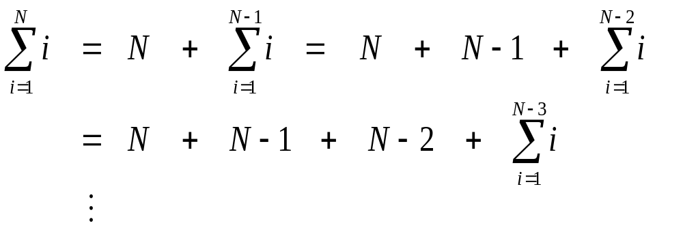
Recursive Programming
Consider the problem of computing the sum of all the numbers between 1 and any positive integer N
This problem can be recursively defined as:

Slide 13
Recursive Programming
// This method returns the sum of 1 to num
public int sum (int num)
{
int result;
if (num == 1)
result = 1;
else
result = num + sum (n-1);
return result;
}

Slide 14
Recursive Programming
result = 6
main
sum(3)
sum
result = 3
sum(2)
sum
result = 1
sum(1)
sum

Slide 15
Recursive Programming
Note that just because we can use recursion to solve a problem, doesn't mean we should
For instance, we usually would not use recursion to solve the sum of 1 to N problem, because the iterative version is easier to understand
However, for some problems, recursion provides an elegant solution, often cleaner than an iterative version
You must carefully decide whether recursion is the correct technique for any problem

Slide 16
Indirect Recursion
A method invoking itself is considered to be direct recursion
A method could invoke another method, which invokes another, etc., until eventually the original method is invoked again
For example, method m1 could invoke m2, which invokes m3, which in turn invokes m1 again
This is called indirect recursion, and requires all the same care as direct recursion
It is often more difficult to trace and debug

Slide 17
Indirect Recursion
m1
m2
m3
m1
m2
m3
m1
m2
m3

Slide 18
Outline
Recursive Thinking
Recursive Programming
Using Recursion
Recursion in Graphics

Slide 19
Maze Traversal
We can use recursion to find a path through a maze
From each location, we can search in each direction
Recursion keeps track of the path through the maze
The base case is an invalid move or reaching the final destination
See MazeSearch.java (page 587)
See Maze.java (page 588)

Slide 20
Towers of Hanoi
The Towers of Hanoi is a puzzle made up of three vertical pegs and several disks that slide on the pegs
The disks are of varying size, initially placed on one peg with the largest disk on the bottom with increasingly smaller ones on top
The goal is to move all of the disks from one peg to another under the following rules:
  We can move only one disk at a time
  We cannot move a larger disk on top of a smaller one

Slide 21
Towers of Hanoi
Original Configuration
Move 1
Move 2
Move 3

Slide 22
Towers of Hanoi
Move 4
Move 5
Move 6
Move 7 (done)

Slide 23
Towers of Hanoi
An iterative solution to the Towers of Hanoi is quite complex
A recursive solution is much shorter and more elegant
See SolveTowers.java (page 594)
See TowersOfHanoi.java (page 595)

Slide 24
Outline
Recursive Thinking
Recursive Programming
Using Recursion
Recursion in Graphics

Slide 25
Tiled Pictures
Consider the task of repeatedly displaying a set of images in a mosaic
  Three quadrants contain individual images
  Upper-left quadrant repeats pattern
The base case is reached when the area for the images shrinks to a certain size
See TiledPictures.java (page 598)

Slide 26
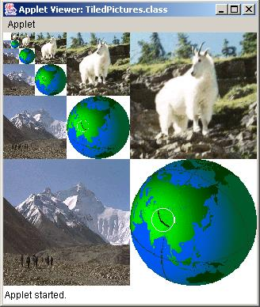
Tiled Pictures

Slide 27
Fractals
A fractal is a geometric shape made up of the same pattern repeated in different sizes and orientations
The Koch Snowflake is a particular fractal that begins with an equilateral triangle
To get a higher order of the fractal, the sides of the triangle are replaced with angled line segments
See KochSnowflake.java (page 601)
See KochPanel.java (page 604)

Slide 28
Koch Snowflakes
< x₅, y₅>
< x₅, y₅>
< x₄, y₄>
Becomes
< x₃, y₃>
< x₂, y₂>
< x₁, y₁>
< x₁, y₁>

Slide 29
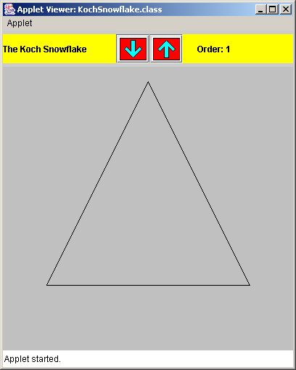

Koch Snowflakes

Slide 30
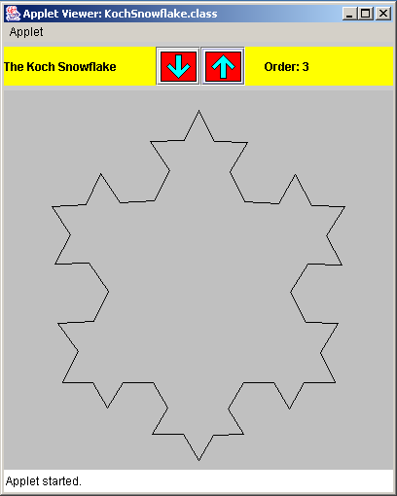

Koch Snowflakes

Slide 31
Summary
Chapter 11 has focused on:
  thinking in a recursive manner
  programming in a recursive manner
  the correct use of recursion
  recursion examples

