Slide 1
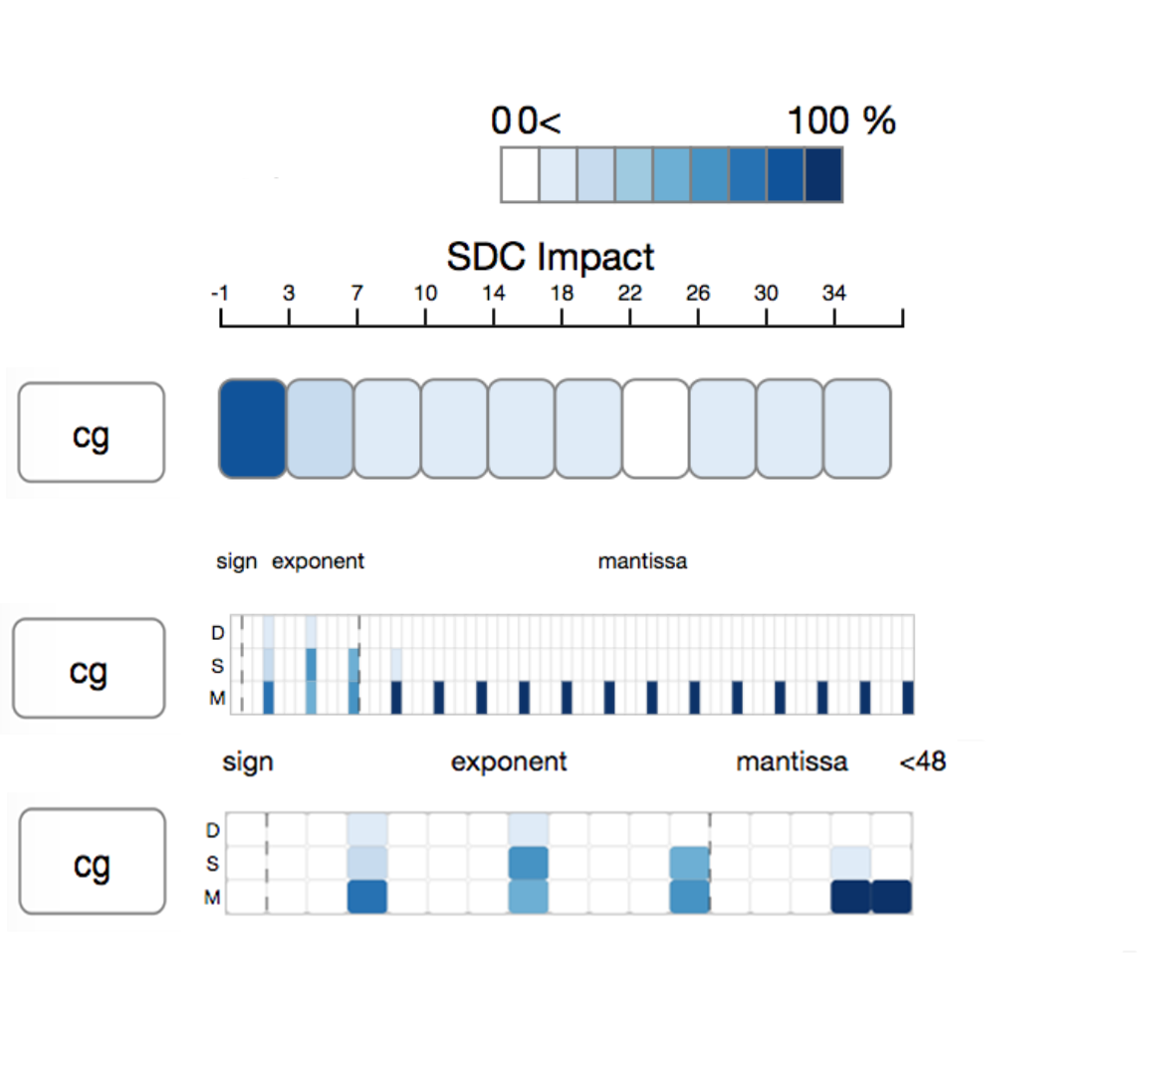
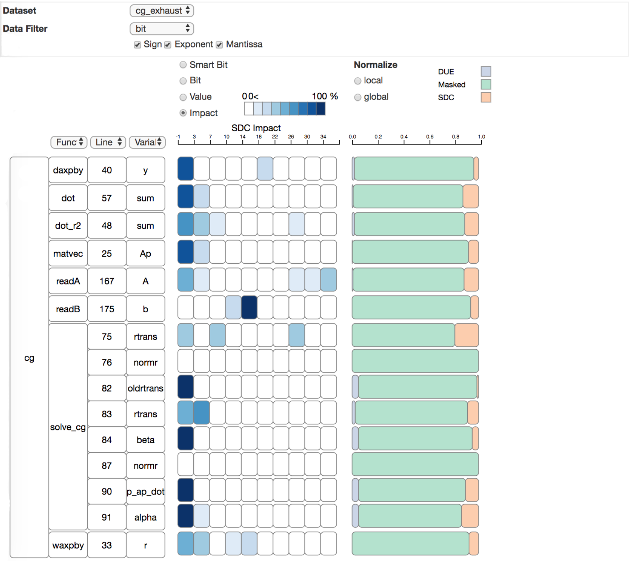
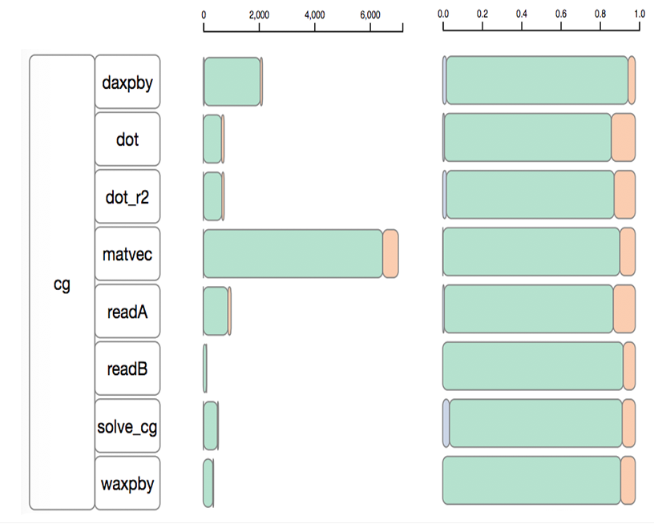
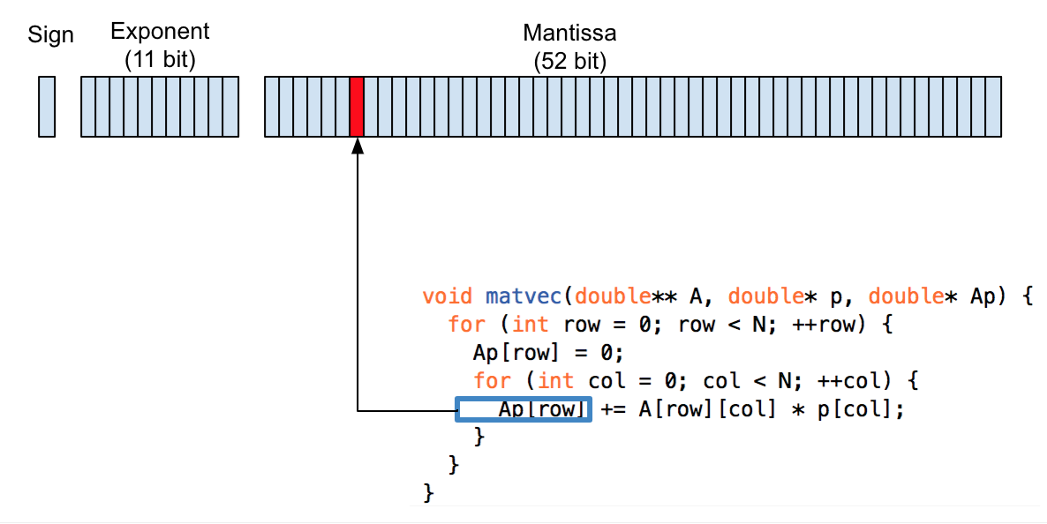
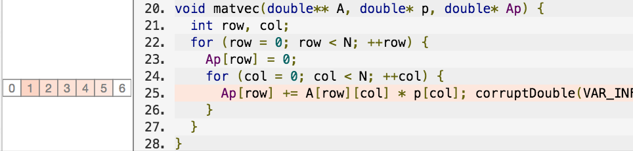
Error Visualization
Zhimin Li*, Harshitha Menon+, Yarden Livnat*, Kathryn Mohror+, Valerio Pascucci*
SCI Institute *
Lawrence Livermore National Laboratory +
ABSTRACT
MATERIALS & METHODS
RESULTS
CONCLUSIONS
The aggressive scaling trend in high-performance computation threat the computation result’s reliability. How to improve applications' resiliency become a concern in computation community. Understand the resiliency property of existing applications are an essential step to develop a more robust and efficient application.
In this study, we cooperate with domain expert design a visualization system to understand application's resiliency property. Our system enables the user to target error prone region quickly and reveal its impact on the application's outcome.
G1:Understand the error’s impact on different code region.
G2:Understand different code region’s silent data corruption vulnerability.
G3: Understand the error propagate through program.
G4: Reason about the interesting feature.
sad
Error Visualization is a visualization system use to help HPC expert to understand a program’s resiliency property. Understand the silent data corruption impact.
It help domain expert understand different code region’s resilient property by examine until the bit level’s impact to the final outcome.
It provide user detail inspect of how error propagate through the program to reason about the program’s outcome.
It help domain expert build better intuition about the resiliency property of an application and motivate them to design better algorithm, protection technique,and analysis technique.
OBJECTIVES
REFERENCE
Protect the program against silent data corruption.
Understand the transient error’s impact in different code region.
Understand different code region’s silent data corruption vulnerability.
Understand how error propagate through program.
Some thing
BACKGROUND
ACKNOWLEDGE AND CONTACTS
The other stuff

