Slide 1


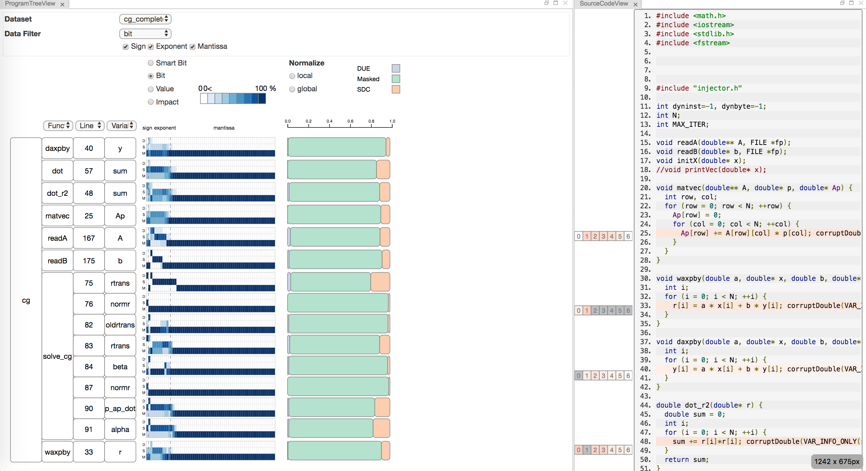
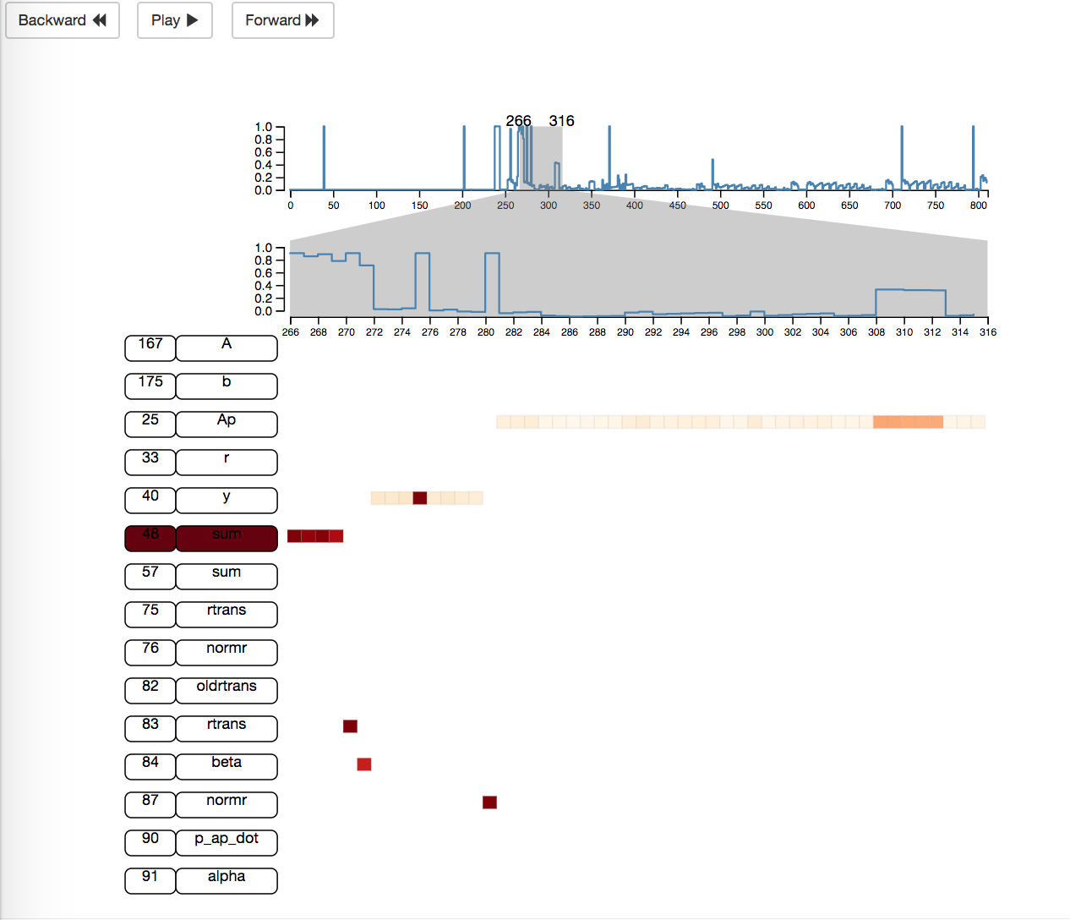
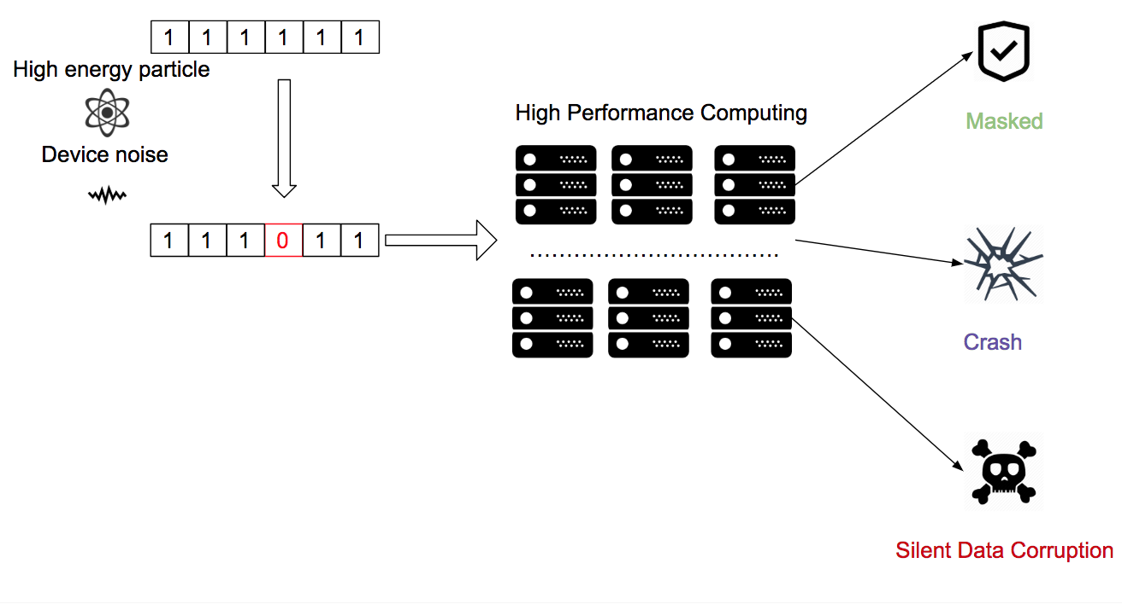
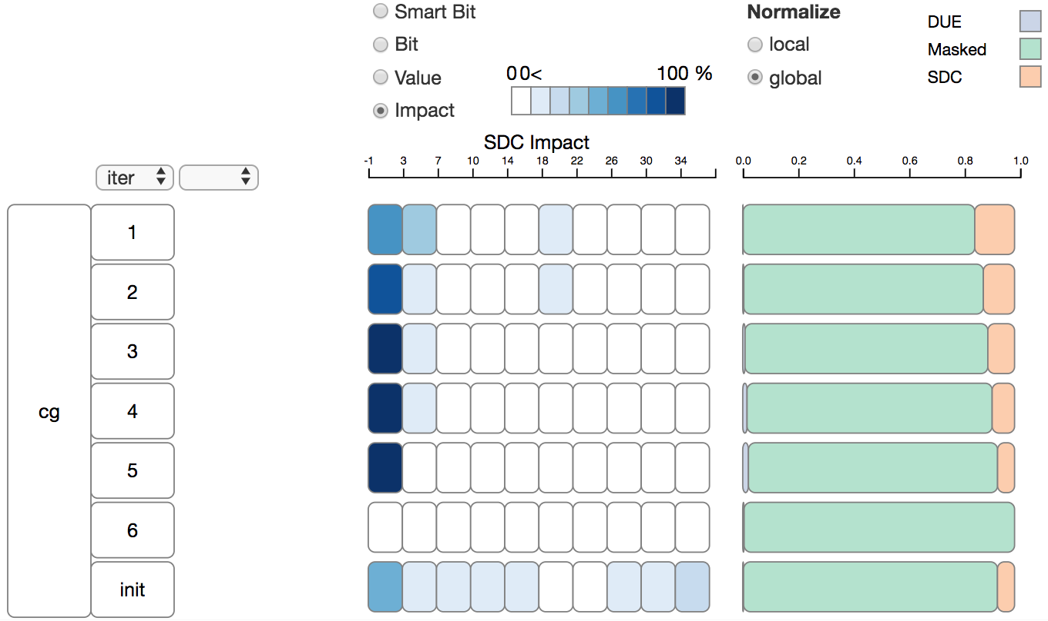
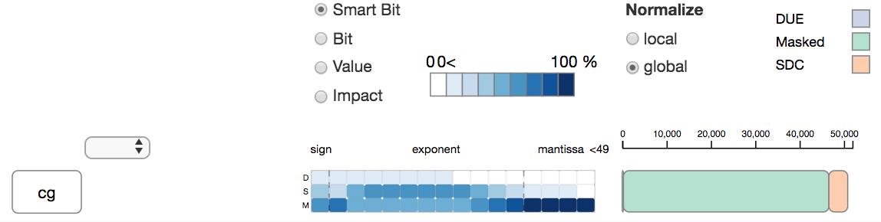
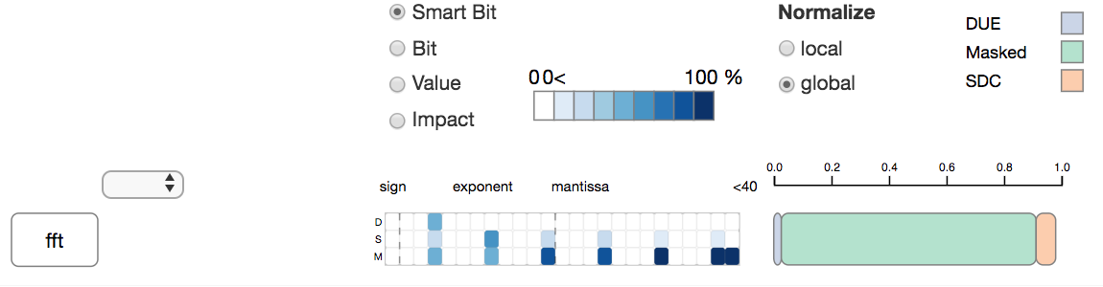
SpotSDC: An Information Visualization System To Analyze Silent Data Corruption
Zhimin Li*, Harshitha Menon+, Yarden Livnat*, Kathryn Mohror+, Valerio Pascucci*
SCI Institute *
Lawrence Livermore National Laboratory +
The aggressive scaling trend in high-performance computation increase the probability of silent data corruption and make the computation result’s unreliability. How to improve applications‘ resiliency become a concern in computation community. In this study, we cooperate with two high- performance computation researchers design a visualization system to understand a program’s resilient property to silent data corruption.
Transient error, such as a random bit flip, caused by high energy particle or device noise may silently corrupt the computation outcome.
SDC: Error corrupt the computation output silently.
Masked: Error vanish, and computation outcome is under the threshold.
Crash: Error crash the program
.
What’s transient errors’ impact on different How each bit impact the program outcome?
iteration?
How will the error propagation through the program?
SpotSDC is a visualization system designed to study the silent data corruption’s impact on a programs.
SpotSDC helps HPC researchers build better intuition about program’s resiliency property and motivate them to design more robust programs.
Menon, Harshitha, and Kathryn Mohror. "DisCVar: discovering critical variables using algorithmic differentiation for transient faults." Proceedings of the 23rd ACM SIGPLAN Symposium on Principles and Practice of Parallel Programming. ACM, 2018.
This work was performed under the auspices of the U.S. Department of Energy by Lawrence Livermore National Laboratory under Contract DE-AC52-07NA27344 (LLNL-POST-XXXX)
ABSTRACT
THE SYSTEM
FUTURE WORK
BACKGROUND
CONCLUSION
RESULT 1
RESULT 2
REFERENCE
OBJECTIVES
Understand how the silent data corruption’s impact on a program.
Understand how a transient error propagates through a program.

