Slide 1

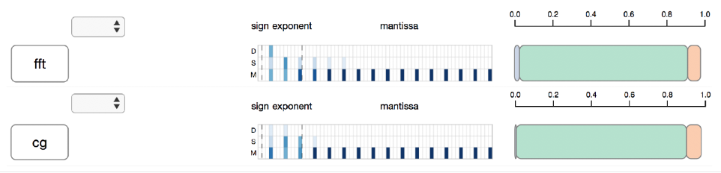
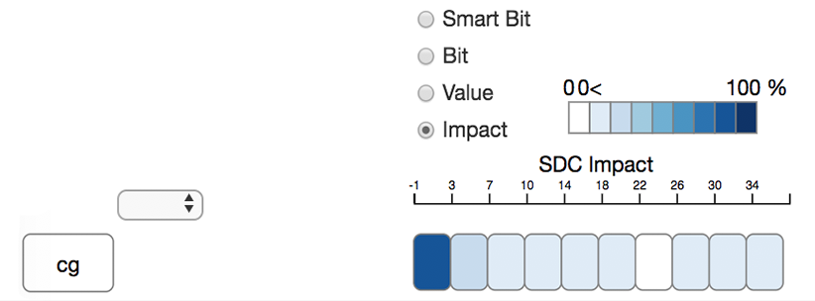
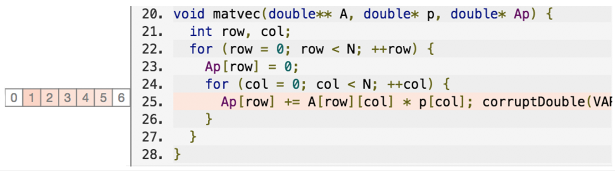
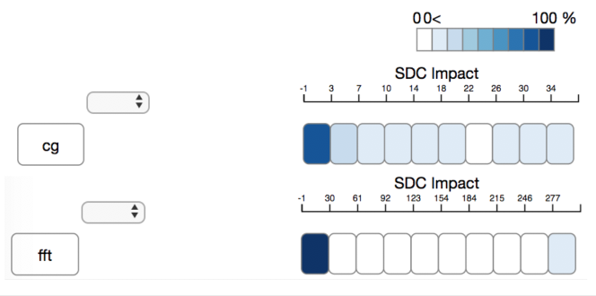
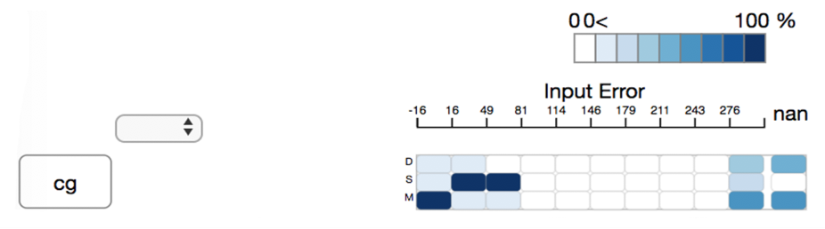
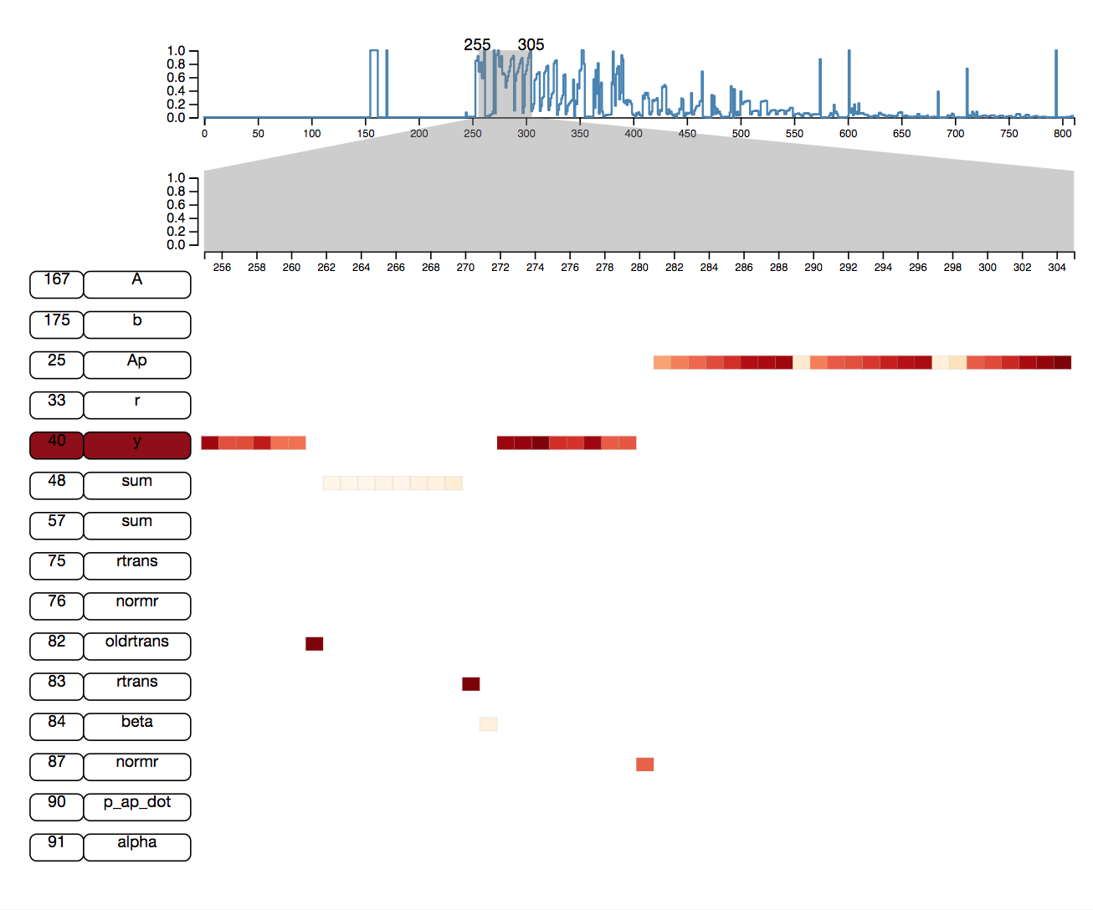
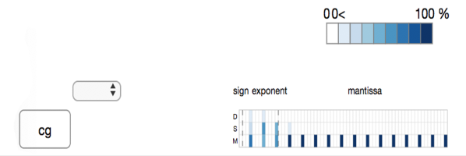
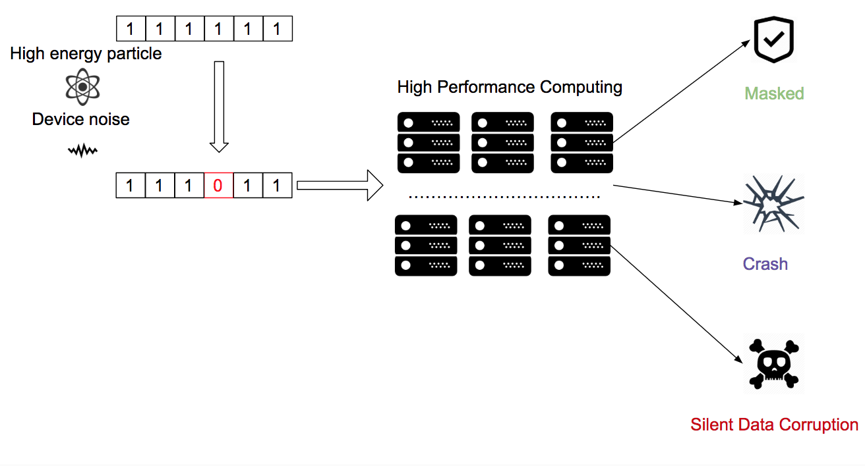
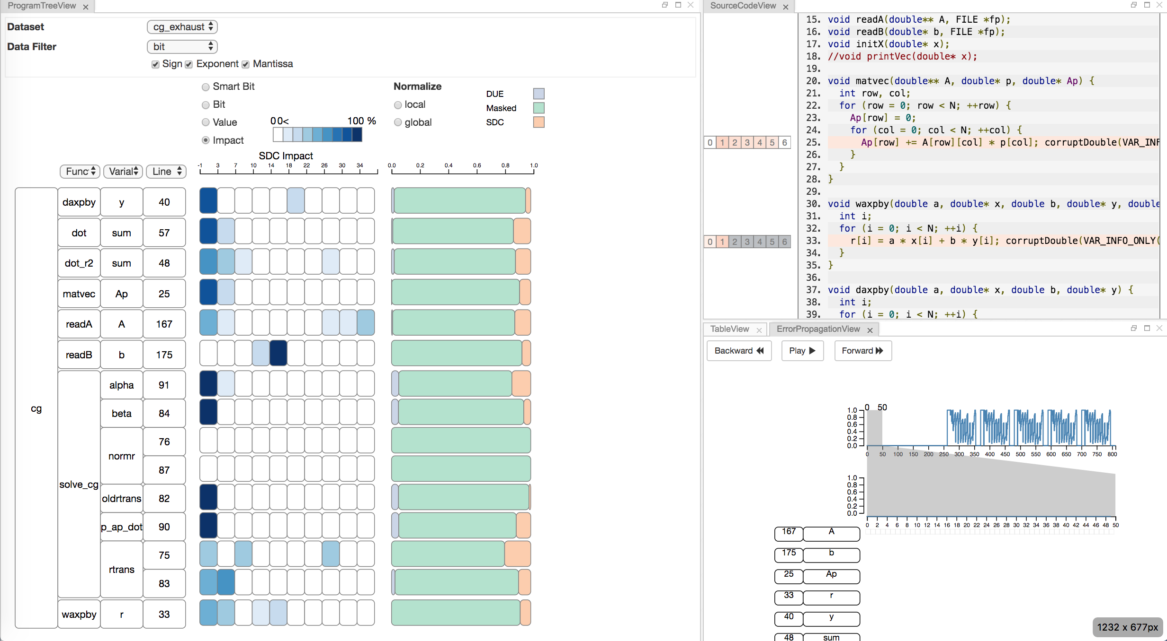
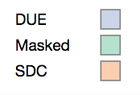
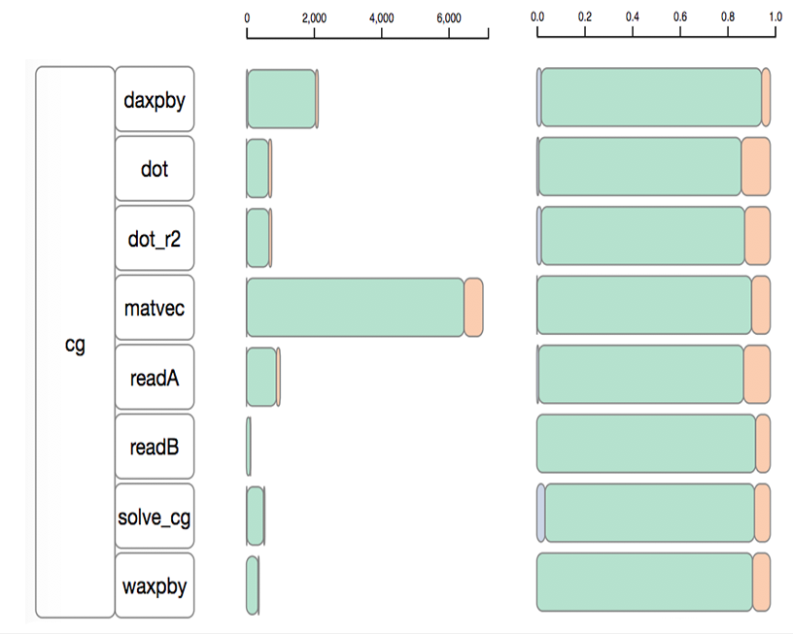
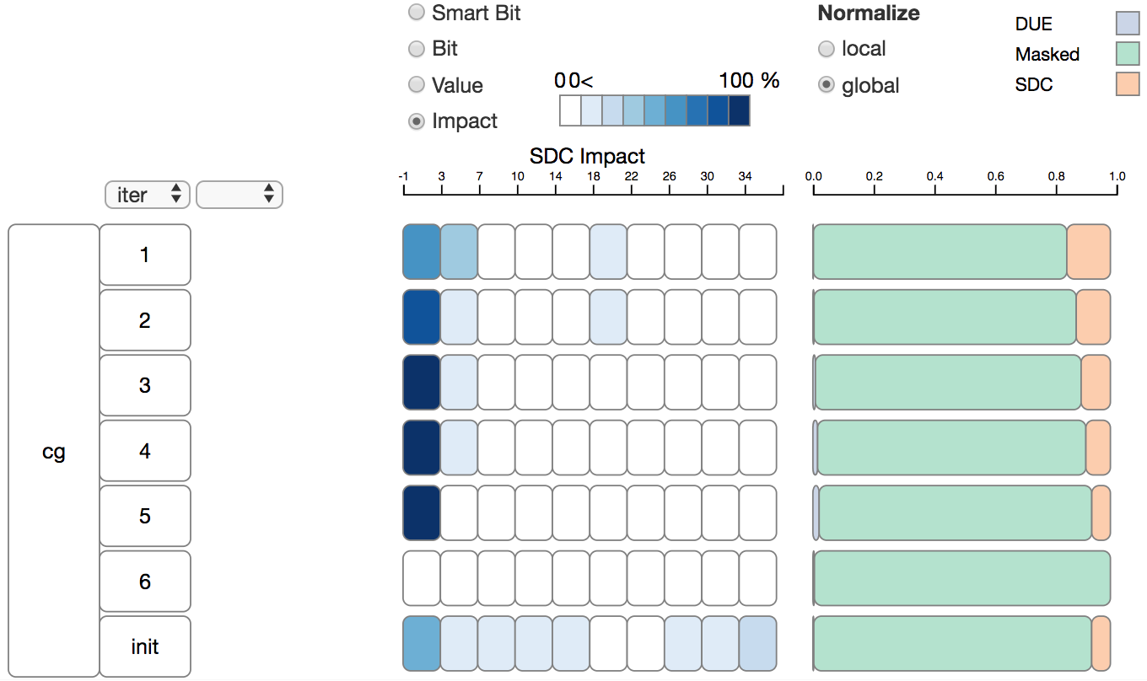
SpotSDC: An Information Visualization System To Analyze Silent Data Corruption
Zhimin Li*, Harshitha Menon+, Yarden Livnat*, Kathryn Mohror+, Valerio Pascucci*
SCI Institute *
Lawrence Livermore National Laboratory +
The aggressive scaling trend in high-performance computation increase silent data corruption and make the computation result’s unreliability. How to improve applications' resiliency become a concern in computation community. In this study, we cooperate with domain expert design a visualization system to understand the impact of silent data corruption on a program.
Transient error, such as random bit flip, cause by high energy particle or device noise will affect the output of a computation.
SDC: Silently corrupt the computation ouput.
Masked: Error vanish and computation outcome is correct.
Crash: Program Crash
Task1. What is the silent data corrupted output distribution at specific code region?
Task2. How’s the input error scale impact the silent data corruption output?
Task3. How each bit flip will affect the outcome of the program？
Task4:How’s the vulnerability of different code region?
Task5. select a subset of the data
Task 6. Source code analysis
.
Task 7. Observing error propagate through the key variable during program execution.
Different Iteration will affect by the transient error differently.
Exponent bit has more impact than Mantissa bit.
Silent data corruption has different impact on different program.
SpotSDC is a visualization system use to help HPC expert to understand the silent data corruption impact cause by transient error.
It help domain expert understand different code region’s resilient property by examine until the bit level’s impact to the final outcome.
It provide user detail inspect of how error propagate through the program to reason about the program’s outcome.
It help domain expert build better intuition about the resiliency property of an application and motivate them to design better algorithm, protection technique,and analysis technique.
ABSTRACT
BASIC TASKS
BACKGROUND
THE SYSTEM
SOME RESULTS
OBJECTIVES
CONCLUSIONs
Understand how the silent data corruption impact on a program.
Understand a program different code region’s silent data corruption vulnerability.
Observe how a transient error propagate through a program.

