Slide 1


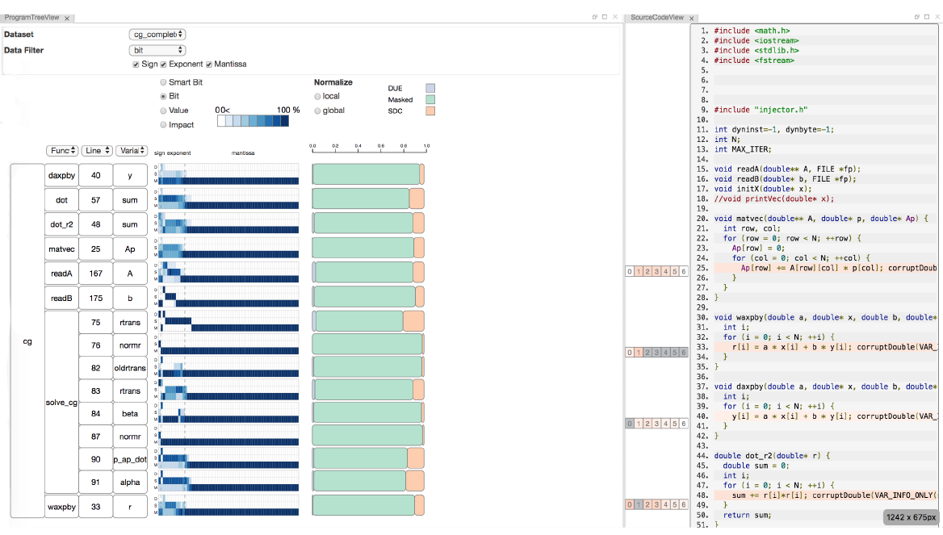
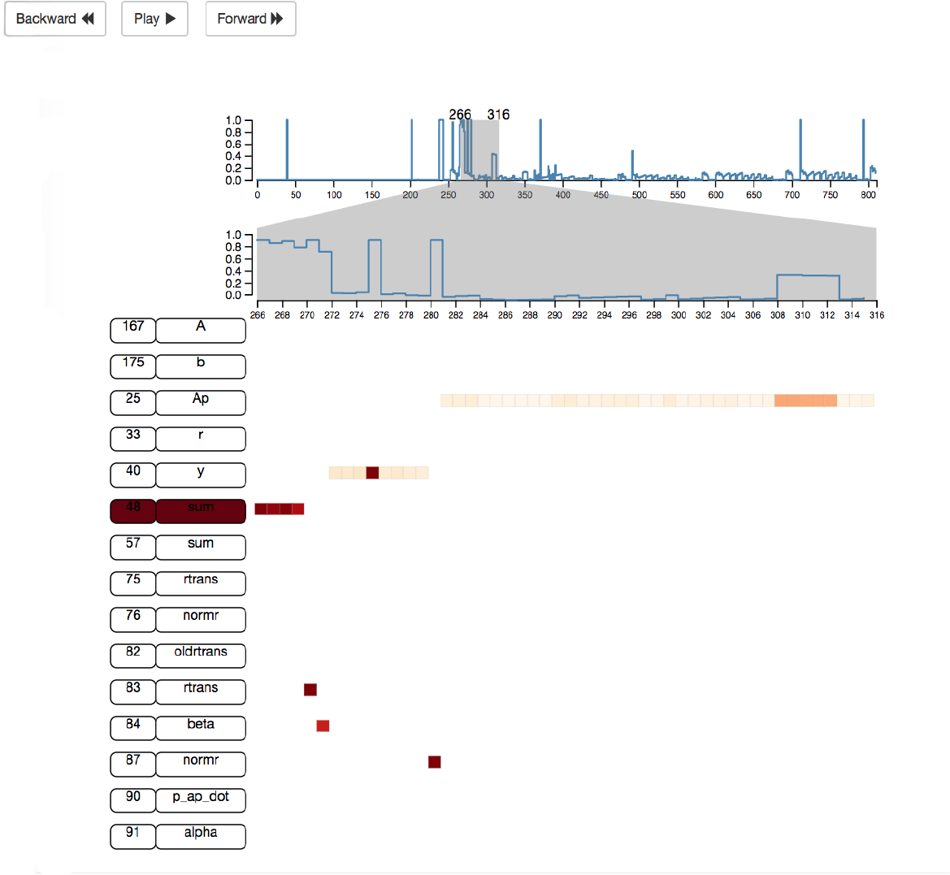
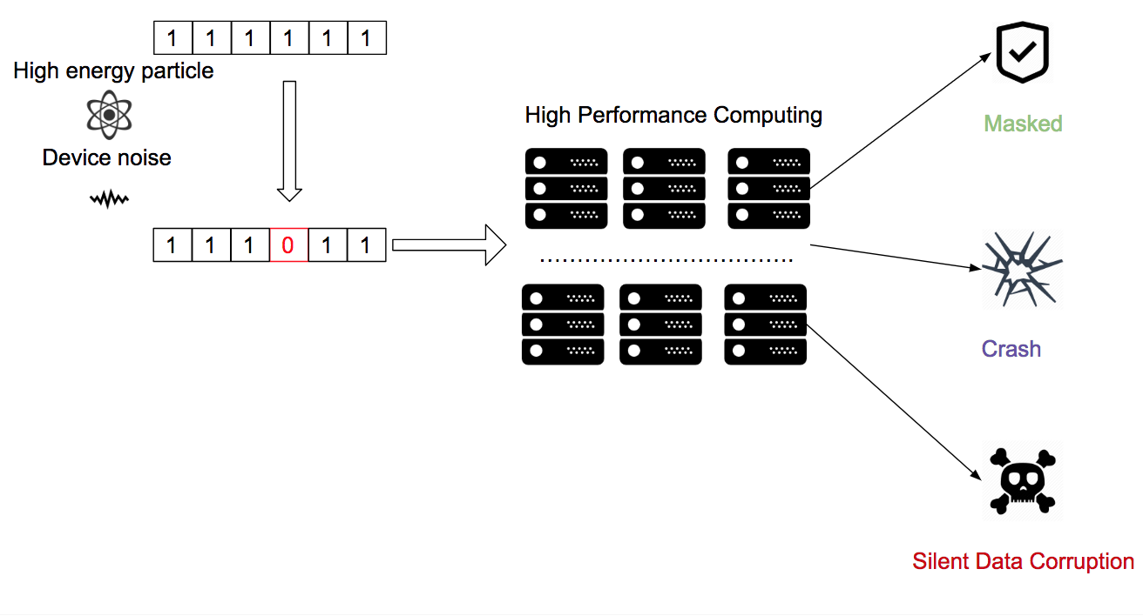
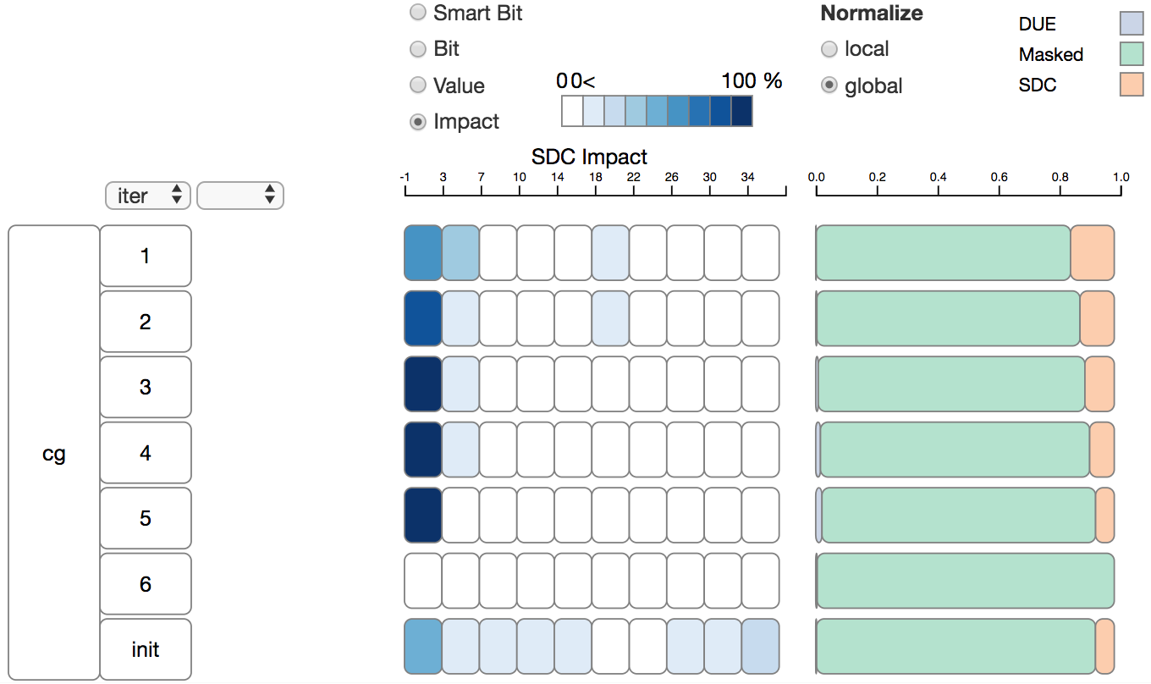
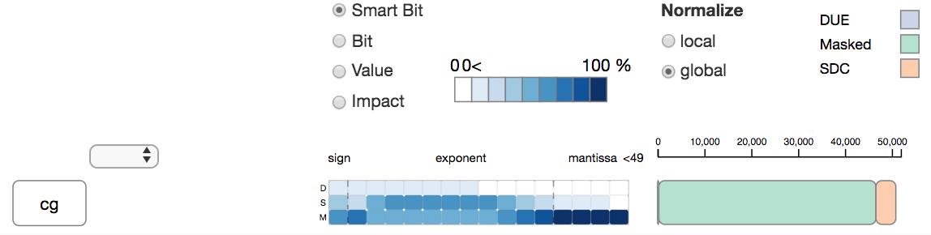
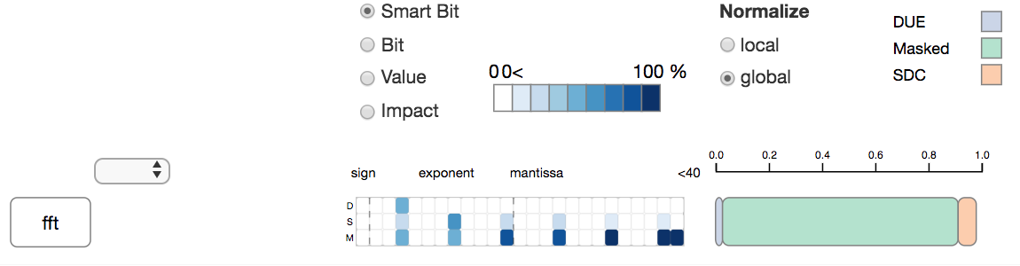
SpotSDC: An Information Visualization System To Analyze Silent Data Corruption
Zhimin Li*, Harshitha Menon+, Yarden Livnat*, Kathryn Mohror+, Valerio Pascucci*
SCI Institute *
Lawrence Livermore National Laboratory +
The aggressive scaling trend in high-performance computing architectures increases the probability of silent data corruption (SDC) and reduces result reliability. Methods to improve applications‘ resiliency has become a concern in the HPC community. In this study, we design a visualization system to understand the impact of silent data corruption on HPC programs.
Transient errors, such as a random bit flips, are caused by high energy particles or device noise and may silently corrupt the computation outcome.
SDC: Error silently corrupts the computation output.
Masked: Error is under the detection threshold.
Crash: Error causes the program to crash.
.
SpotSDC shows the impact of corrupting each bit in a variable value
What’s transient errors’ impact on different How each bit impact the program outcome?
iteration?
How will the error propagation through the program?
SpotSDC is a visualization system designed to study the silent data corruption’s impact on a programs.
SpotSDC helps HPC researchers build better intuition about program’s resiliency property and motivate them to design more robust programs.
Menon, Harshitha, and Kathryn Mohror. "DisCVar: discovering critical variables using algorithmic differentiation for transient faults." Proceedings of the 23rd ACM SIGPLAN Symposium on Principles and Practice of Parallel Programming. ACM, 2018.
ABSTRACT
SpotSDC ANALYSIS OF CONJUGATE GRADIENT BENCHMARK
FUTURE WORK
BACKGROUND
CONCLUSION
RESULT 1
RESULT 2
OBJECTIVES
Understand the impact of silent data corruption on a program.
Understand transient error propagation through a program execution.
REFERENCE

