Slide 1
Displaying and Describing Quantitative Data

Slide 2
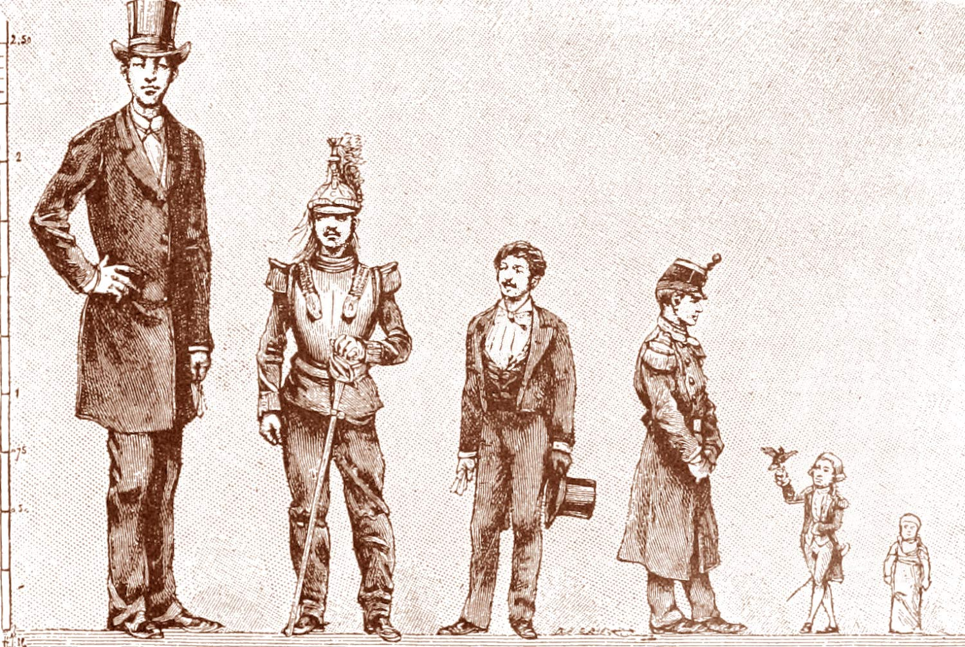
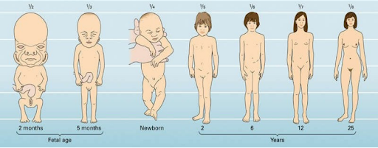
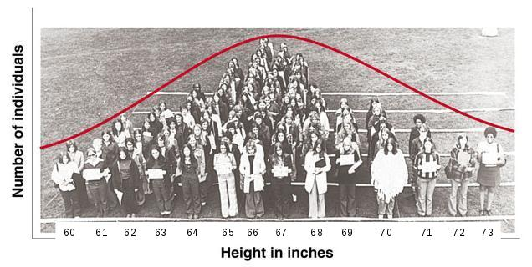
Variables
Question: Which one is more important to human body height, genes or environment?
We need to do a study to address this question.
We measure body heights (data) from different individuals (cases).
Body height is a variable. A variable is any characteristic of an individual.
A variable varies among individuals.
A variable may change with time.
A variable follows a distribution. The distribution tells us what values the variable takes and how often it takes these values.
Researchers Find New Genetic Variants that Influence Human Adult Height
Physical Development and Health: Body Growth and Changes (Growth Pattern)

Slide 3
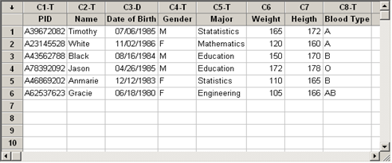
Other examples
A college‘s student database includes information about every currently enrolled student. Individual students are each characterized by the values of variables, such as date of birth, gender, choice of major, and grade point average (GPA). Some biological variables may also be included.

Slide 4
Case
An individual from whom or which the data is collected.
The characteristics recorded about each individual are called variables
Variable 3
Variable 1
Variable 2
Variable 4
Variable 5
subject | gender | age | high school GPA | college GPA
1 | m | 32 | 2.2 | 3.5
2 | f | 23 | 2.1 | 3.5
3 | f | 27 | 3.3 | 3
4 | f | 35 | 3.5 | 3.2
Case 1
Case 2
Case 3
Case 4
To summarize, in the data table:
The rows correspond to cases;
The columns correspond to variables.

Slide 5
Two types of variables
Quantitative variables
Variables that take numerical values for which arithmetic operations, such as adding and averaging, work.
Example: How tall you are, your age, your blood cholesterol level, the number of credit cards you own.
Categorical variables
Variables that fall into one of several categories. What can be counted is the count or proportion of individuals in each category.
Example: Your blood type (A, B, AB, O), your hair color, your ethnicity, whether you paid income tax last tax year or not.

Slide 6
Quantitative vs. categorical
If the values of a variable are words rather than numbers, it is categorical.
If the values of a variable are numbers, it does not necessarily mean that it is quantitative.
A start-up company is building a database of customers and sale information. For each customer, it records name, #ID, region of the country (1=East, 2=South, 3=Midwest, 4= West), date of last purchase, amount of purchase, and item purchased. A part of the database is displayed by using the following data table:
Customer’s Name | ID number | Region of the Country | Date of Last Purchase | Amount of Purchase | Item Purchased
Bill, J | 36287 | 1 | May 24,2009 | $290.03 | Home Appliance
Anderson, P | 49271 | 1 | Jul 13,2009 | $78.23 | Food and Grocery
Stapleton, J | 84090 | 3 | Jun 24,2009 | $149.46 | Electronics
Kaplan, J | 27194 | 4 | Apr 15,2009 | $27.01 | Pharmacy
Wang, S | 92810 | 2 | Sept 01, 2009 | $230.42 | Automotive
Vince, L | 28491 | 4 | Jun 20, 2009 | $42.49 | Office Supplies
Julian, S | 32971 | 3 | Mar 23, 2010 | $932.01 | Electronics
Kathy, G | 59348 | 2 | Dec 01,2009 | $54.92 | Office Supplies
Beverly, F | 95047 | 1 | Feb 23,2010 | $391.09 | Pharmacy
Kevin, T | 57632 | 4 | Apr 10, 2010 | $52.41 | Food and Grocery
(i) How many cases are there in this table ?
(ii) How many variables are there in this table?
(iii) Which are categorical variables? Which are quantitative variables?

Slide 7
Exercise
Which of the following variable is quantitative or categorical?
smoking (yes or no)
number of flowers in a plant
name (Adam, Mike, Christina, Dave . . .)
car speed
blood pressure

Slide 8
Ways to chart quantitative data
Histograms and stemplots
These are summary graphs for a single variable. They are very useful to understand the pattern of variability in the data.
Line graphs: time plots
Use when there is a meaningful sequence, like time. The
line connecting the points helps emphasize any change
over time.

Slide 9
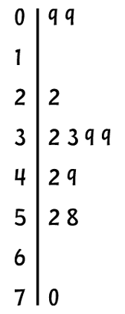
Stem plots
How to make a stemplot:
Separate each observation into a stem, consisting of all but the final (rightmost) digit, and a leaf, which is that remaining final digit. Stems may have as many digits as needed, but each leaf contains only a single digit.
Write the stems in a vertical column with the smallest value at the top and draw a vertical line at the right of this column.
Write each leaf in the row to the right of its stem, in increasing order out from the stem.
STEM
LEAVES

Slide 10
Examples
Math test scores out of 50 points: 35, 36, 38, 40, 42, 42, 44, 45, 45, 47, 48, 49, 50, 50, 50.
The tree height (cm) of certain species measured during an experiment: 141 135 132 138 154 142 150 146 155 158 150 140 147 148 144 151 149 145 149 158 143 164 137 163 126

Slide 11
Stem Plot
The leaf is the digit in the place farthest to the right in the number, and the stem is the digit, or digits, in the number that remain when the leaf is dropped.
To show a one-digit number (such as 9) using a stem-and-leaf plot, use a stem of 0 and a leaf of 9.
To compare two related distributions, a back-to-back stem plot with common stems is useful.
Stem plots do not work well for large datasets.
When the observed values have too many digits, trim the numbers before making a stem plot.

Slide 12
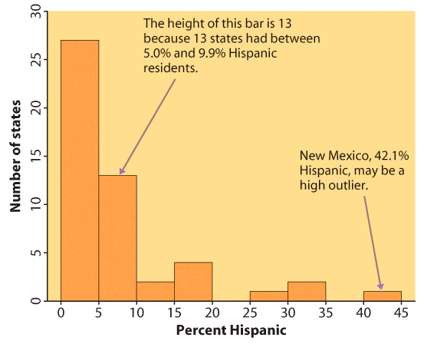
Histograms
The range of values that a variable can take is divided into equal size intervals.
The histogram shows the number of individual data points that fall in each interval.
The first column represents all states with a Hispanic percent in their population between 0% and 4.99%. The height of the column shows how many states (27) have a percent in this range.
The last column represents all states with a Hispanic percent in their population between 40% and 44.99%. There is only one such state: New Mexico, at 42.1% Hispanics.

Slide 13
How to create a histogram
Count how many times each of the values occurs, then draw bars with the height representing the (relative) frequency of the corresponding values.
Group the data, then count how many times the data fall within each category. Too few classes will give a “skyscraper” graph, with all values in a few classes with tall bars. Too many will produce a “pancake” graph, with most classes having one or no observations.
What bin size should you use?
Not too many bins with either 0 or 1 counts
Not overly summarized that you loose all the information
Not so detailed that it is no longer summary
➔ rule of thumb: start with 5 to 10 bins
Look at the distribution and refine your bins
(There isn’t a unique or “perfect” solution)

Slide 14
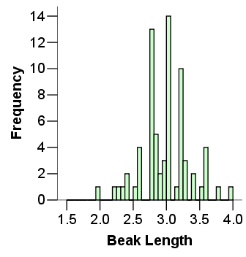
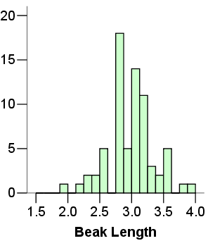

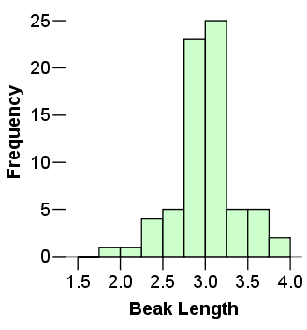
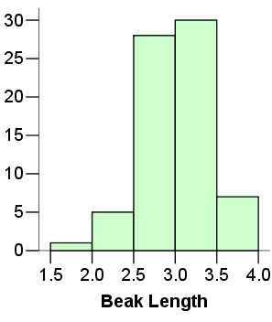
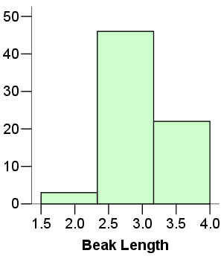
Not summarized enough
Too summarized

Slide 15
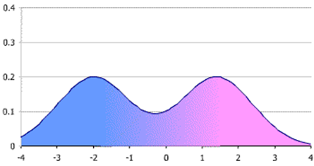
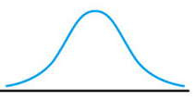
Interpreting histograms
Identify the overall pattern and the deviation from that pattern
The overall pattern of a distribution can be described by its shape, center, and spread
Center: midpoint
Spread: range (minimum, maximum)
Shape: unimodal, bimodal, or multimodal? symmetric, asymmetric? if asymmetric, skewed to the left or the right?
Histogram shape is called
Unimodal if it has a single peak
Bimodal if it has 2 different peaks
Multimodal if it has >2 peaks

Slide 16
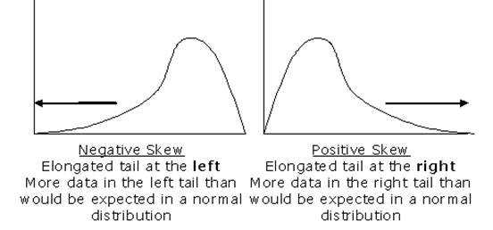
Symmetric if the right half is the mirror image of the
left half.
(positively) skewed to the right if the right tail is stretched out, compared with the left tail.
(negatively) skewed to the left if the left tail is stretched out, compared with the right tail.

Slide 17
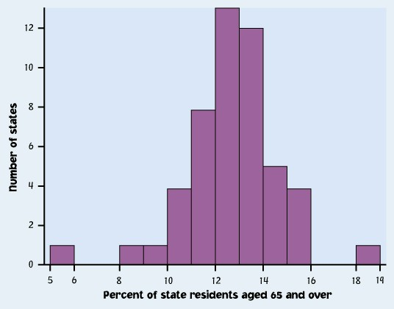
Outliers
Outliers are observations that lie outside the overall pattern of a distribution. Always look for outliers and try to explain them.
The overall pattern is fairly symmetrical except for 2 states that clearly do not belong to the main trend. Alaska and Florida have an unusual representation of the elderly in their population.
A large gap in the distribution is typically a sign of an outlier.
Alaska
Florida
Notes:
This is from the book. Imagine you are doing a study of health care in the 50 US states, and need to know how they differ in terms of their elderly population.
This is a histogram of the number of states grouped by the percentage of their residents that are 65 or over.
You can see there is one very small number and one very large number, with a gap between them and the rest of the distribution.
Values that fall outside of the overall pattern are called outliers. They might be interesting, they might be mistakes - I get those in my data from typos in entering RNA sequence data into the computer.
They might only indicate that you need more samples. Will be paying a lot of attention to them throughout class both for what we can learn about biology and also because they can cause trouble with your statistics.
Guess which states they are (florida and alaska).

Slide 18
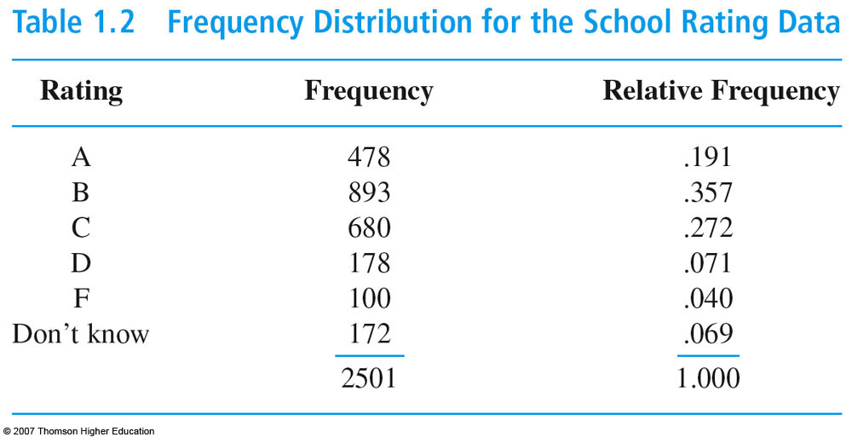
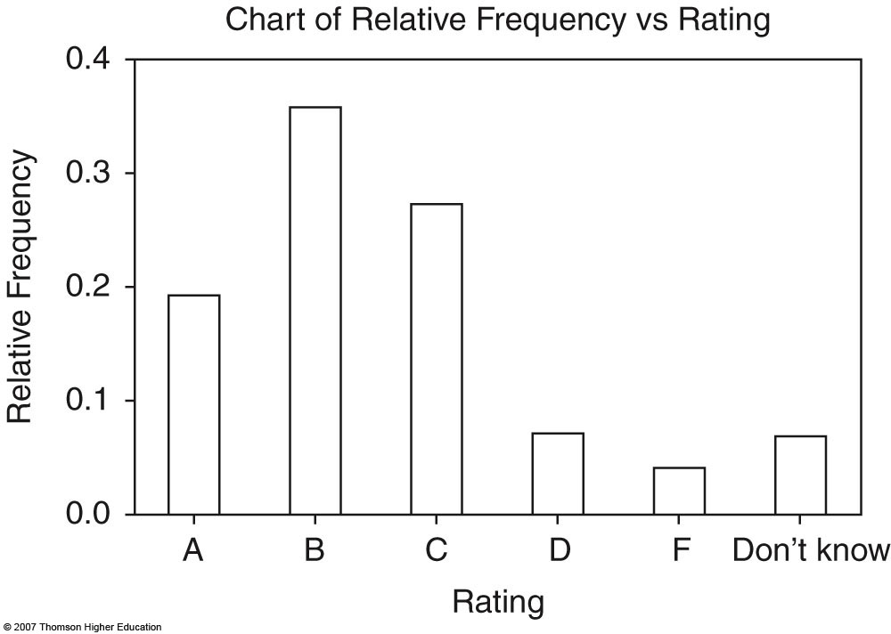
Histogram for qualitative data

Slide 19
Exercise
The number of children of 20 randomly picked families in the Haidian District is summarized: 2,0,1,2,2,3,1,2,3,2,3,1,2,1,2,1,2,3,1,2
Then the frequency table is:
The histogram by Minitab:

Slide 20
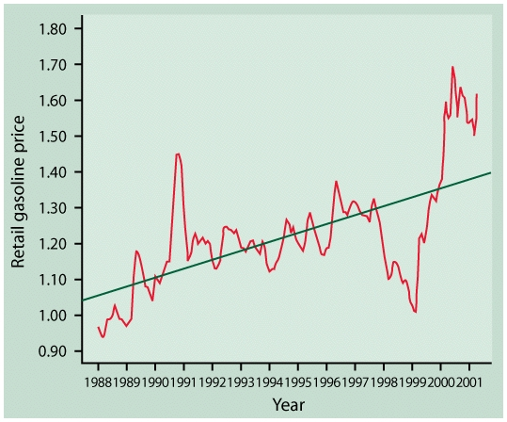
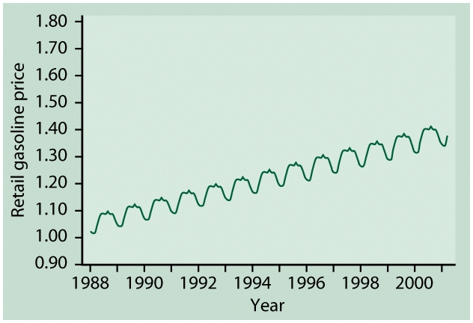
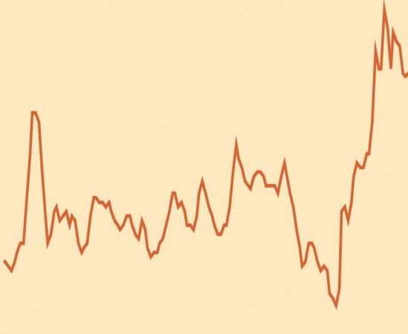
Line graphs: time plots
In a time plot, time always goes on the horizontal x axis.
We describe time series by their overall pattern and deviation from that pattern. A time-series:
A trend is a rise or fall that persists over time, despite small irregularities.
A pattern that repeats itself at regular intervals of time is called seasonal variation.

Slide 21
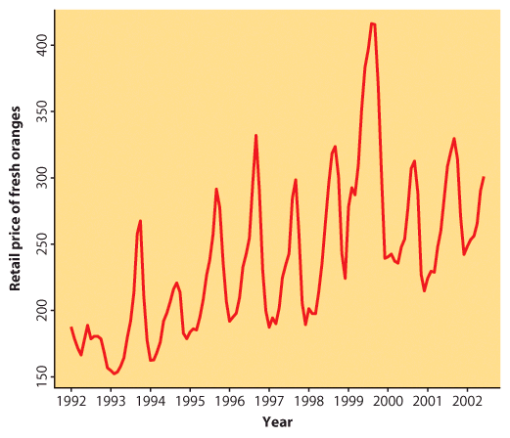
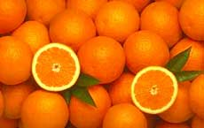
Retail price of fresh oranges over time
Time is on the horizontal, x axis.
The variable of interest—here “retail price of fresh oranges”— goes on the vertical, y axis.
This time plot shows a regular pattern of yearly variations in fresh orange pricing. These are seasonal variations most likely due to similar seasonal variations in the production of fresh oranges.
There is also an overall upward trend in pricing over time. It could simply be reflecting inflation trends or a more fundamental change in this industry.

Slide 22
Describing distributions with numbers
Measures of center: mean, median
Mean versus median
Measures of spread: quartiles, standard deviation
Five-number summary and boxplot
Choosing among summary statistics

Slide 23
Measure of center: the mean
The mean or arithmetic average
To calculate the average, or mean, add all values, then divide by the number of individuals. It is the “center of mass.”
Sum of heights is 1598.3
divided by 25 adult men:
Mean = 63.9 inches
Notes:
Most of you know what a mean, or common arithmetic average is.
You should know how to calculate the mean both by hand and using your calculator. See Dr. Baldi.

Slide 24
Mathematical notation:
Man
Height
Man
Height
(
i
)
(
x
)
(
i
)
(
x
)
i
=
1
x
1
=
5
8
.
2
i
=
14
x
14
=
6
4
.
0
i
=
2
x
2
=
5
9
.
5
i
=
15
x
15
=
6
4
.
5
i
=
3
x
3
=
6
0
.
7
i
=
16
x
16
=
6
4
.
1
i
=
4
x
4
=
6
0
.
9
i
=
17
x
17
=
6
4
.
8
i
=
5
x
5
=
6
1
.
9
i
=
18
x
18
=
6
5
.
2
i
=
6
x
6
=
6
1
.
9
i
=
19
x
19
=
6
5
.
7
i
=
7
x
7
=
6
2
.
2
i
=
20
x
20
=
6
6
.
2
i
=
8
x
8
=
6
2
.
2
i
=
21
x
21
=
6
6
.
7
i
=
9
x
9
=
6
2
.
4
i
=
22
x
22
=
6
7
.
1
i
=
10
x
10
=
6
2
.
9
i
=
23
x
23
=
6
7
.
8
i
=
11
x
11
=
6
3
.
9
i
=
24
x
24
=
6
8
.
9
i
=
12
x
12
=
6
3
.
1
i
=
25
x
25
=
6
9
.
6
n
=
Σ
=
1
5
9
8
.
3
i
=
13
x
13
=
6
3
.
9
2
5
Learn right away how to get the mean using your calculators.

Slide 25
Measure of center: the median
The median is the midpoint of a distribution—the number such that half of the observations are smaller and half are larger.
1. Sort observations by size.
n = number of observations
______________________________
2.a. If n is odd, the median is observation (n+1)/2 down the list
⬅ n = 25
(n+1)/2 = 26/2 = 13
Median = 3.4
2.b. If n is even, the median is the
mean of the two middle observations.
n = 24 ➔
n/2 = 12
Median = (3.3+3.4) /2 = 3.35

Slide 26
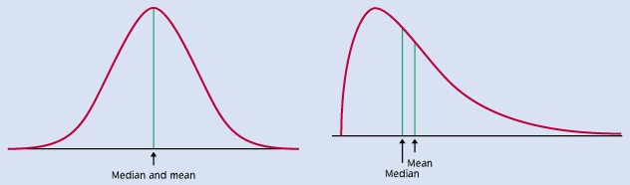
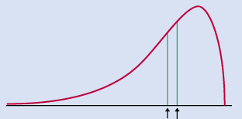
Comparing the mean and the median
The mean and the median are the same only if the distribution is symmetrical. The median is a measure of center that is resistant to skew and outliers. The mean is not.
Mean and median for a symmetric distribution
Mean
Median
Mean and median for skewed distributions
Left skew
Right skew
Mean
Median
Mean
Median

Slide 27
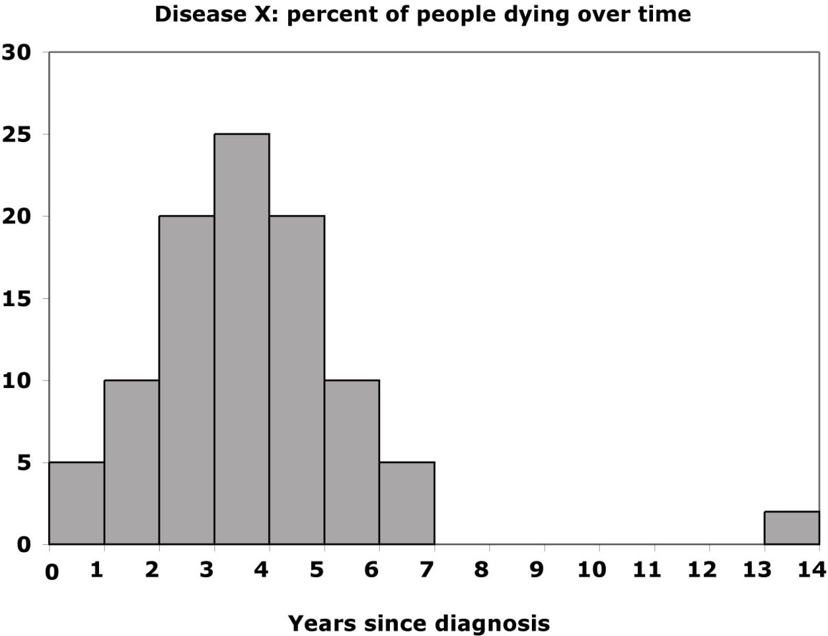
Mean and median of a distribution with outliers
Without the outliers
With the outliers
Percent of people dying
The mean is pulled to the right a lot by the outliers (from 3.4 to 4.2).
The median, on the other hand, is only slightly pulled to the right by the outliers (from 3.4 to 3.6).
Mean is sensitive to extreme observations (or outliers), but Median not!!!
Notes:
Here is the same data set with some outliers - some lucky people who managed to live longer than the others.
The few large values moved the mean up from 3.5 to 4.0
However, the median , the number of years it takes for half the people to die only went from 3.4 to 3.6
This is typical behavior for the mean and median. The mean is sensitive to outliers, because when you add all the values up to get the mean the outliers are weighted disproportionately by their large size.
However, when you get the median, they are just another two points to count - the fact that their size is so large does not matter much.

Slide 28
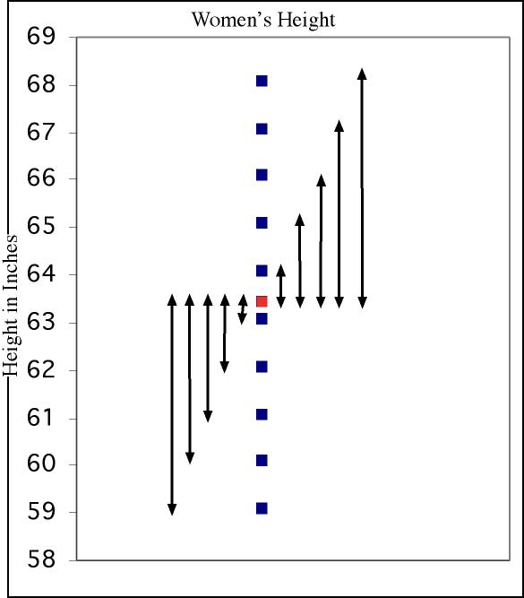
Measure of spread: standard deviation
The standard deviation “s” is used to describe the variation around the mean. Like the mean, it is not resistant to skew or outliers.
Men Height
1. First calculate the variance s².
2. Then take the square root to get the standard deviation s.
Mean
± 1 s.d.
Notes:
Boxplots are used to show the spread around a median - can use no matter what the distribution, and is a good way to contrast variables having different distributions.
But if your distribution is symmetrical, you can use the mean as the center of your distribution, you can use a different (and more common) measure of spread around the mean - standard deviation.
The Standard Deviation measures spread by looking at how far the observations are from their mean.
Go through calc. This is women’s height data again, First, N is again the number of observations. From this we calculate the degrees of freedom, which is just n-1.
Come back to this in a second.
Take difference from mean, square it so all are positive, add them up. Then divide not by number of observations by by n-1 = df
Although variance is a useful measure of spread, it’s units are units squared.
So we like to take the square root and use that number, the SD, which has the same units as the mean.
Height squared is not intuitive.
Now, as to why dividing by n-1 instead of n. When we got the mean it was easy to imagine why we divided by N intuitively.
But actually, what we are doing even there is dividing by the number of independent pieces of information that go into the estimate of a parameter.
This number is called the degrees of freedom (df, and it is equal to the number of independent scores that go into the estimate minus the number of parameters estimated as intermediate steps in the estimation of the parameter itself. For example, if the variance, s2 , is to be estimated from a random sample of N independent scores, then the degrees of freedom is equal to the number of independent scores (N) minus the number of parameters estimated as intermediate steps (here, we have estimated the mean) and is therefore equal to N-1.
But why the term “degrees of freedom”?
When we calculate the s-square of a random sample, we must first calculate the mean of that sample and then compute the sum of the several squared deviations from that mean. While there will be n such squared deviations only (n - 1) of them are, in fact, free to assume any value whatsoever. This is because the final squared deviation from the mean must include the one value of X such that the sum of all the Xs divided by n will equal the obtained mean of the sample. All of the other (n - 1) squared deviations from the mean can, theoretically, have any values whatsoever. For these reasons, the statistic s-square is said to have only (n - 1) degrees of freedom.
I know this is hard to understand. I don’t expect you to understand it completely. But in a second I will come back to it to show you the effect of dividing by n-1 rather than n, and perhaps that will make is easier to accept.

Slide 29
Calculations …
Men height (inches)
Mean = 63.4
Sum of squared deviations from mean = 85.2
Degrees of freedom (df) = (n − 1) = 13
s² = variance = 85.2/13 = 6.55 inches squared
s = standard deviation = √6.55 = 2.56 inches
We’ll never calculate these by hand, so make sure to know how to get the standard deviation using your calculator or software.

Slide 30
Properties of Standard Deviation
s measures spread about the mean and should be used only when the mean is the measure of center.
s = 0 only when all observations have the same value and there is no spread. Otherwise, s > 0.
s is not resistant to outliers.
s has the same units of measurement as the original observations.

Slide 31
Measure of spread: the quartiles
The first quartile, Q₁, is the value in the sample that has 25% of the data at or below it.
The median of the lower half of the sorted data, excluding M.
⬄
Q₁= first quartile = 2.2
M = median = 3.4
The median of the upper half of the sorted data, excluding M.
⬄
Q₃= third quartile = 4.35
The third quartile, Q₃, is the value in the sample that has 75% of the data at or below it.
Notes:
We are going to start out with a very general way to describe the spread that doesn’t matter whether it is symmetric or not - quartiles.
Just as the word suggests - quartiles is like quarters or quartets, it involves dividing up the distribution into 4 parts.
Now, to get the median, we divided it up into two parts. To get the quartiles we do the exact same thing to the two halves.
Use same rules as for median if you have even or odd number of observations.
Now, what an we do with these that helps us understand the biology of these diseases?

Slide 32
Five-number summary and boxplot
Largest = max = 6.1
BOXPLOT
Q₃= third quartile
= 4.35
M = median = 3.4
Q₁= first quartile
= 2.2
Five-number summary:
min Q₁ M Q₃ max
Smallest = min = 0.6
Notes:
Add in a one other thing we know - the spread - the largest and smallest values, and make a box plot.
Now, why would you want to make one of these?

Slide 33
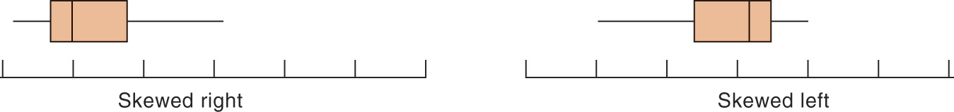
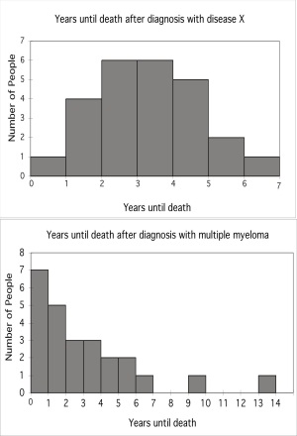
Boxplots for skewed data
Comparing box plots for a normal and a right-skewed distribution
Boxplots remain true to the data and depict clearly symmetry or skew.
Notes:
They are most useful for comparing two things.
Here we see immediately that they are different beasts.
Start at the bottom - you can die of either in the first year,
The first quarter of individuals die of disease X in 2 years, only takes 1 for MM
Medians, or point at which half are dead, are not too different - 3 1/2 vs 2 1/2
For both diseases 3/4 of people are dead by about 4.5 years.
Disease X kills everyone by year 6 while some people with MM hang on a long time.
Quite obvious that the distribution of variation around midpoint is symmetric for X and highly skewed towards larger values for MM.
That is actually quite a bit of information -

Slide 34
Suspected outliers
Outliers are troublesome data points, and it is important to be able to identify them.
One way to raise the flag for a suspected outlier is to compare the distance from the suspicious data point to the nearest quartile (Q₁ or Q₃). We then compare this distance to the interquartile range (distance between Q₁ and Q₃).
We call an observation a suspected outlier if it falls more than 1.5 times the size of the interquartile range (IQR) above the third quartile or below the first quartile. This is called the “1.5 * IQR rule for outliers.” For example, we call X is an outlier if X> Q₃ +1.5*IQR or if X< Q₁ -1.5*IQR.
Notes:
Add in a one other thing we know - the spread - the largest and smallest values, and make a box plot.
Now, why would you want to make one of these?

Slide 35
8
Distance to Q₃
7.9 − 4.35 = 3.55
Q₃ = 4.35
Interquartile range
Q₃ – Q₁
4.35 − 2.2 = 2.15
Q₁ = 2.2
Individual #25 has a value of 7.9 years, which is 3.55 years above the third quartile. This is more than 3.225 years, 1.5 * IQR. Thus, individual #25 is a suspected outlier.
Notes:
Add in a one other thing we know - the spread - the largest and smallest values, and make a box plot.
Now, why would you want to make one of these?

Slide 36
Choosing among summary statistics
Because the mean is not resistant to outliers or skew, use it to describe distributions that are fairly symmetrical and don’t have outliers. → Plot the mean and use the standard deviation for error bars.
Otherwise, use the median in the five number summary which can be plotted as a boxplot.
Height of 25 men
Boxplot Mean ± SD

