Slide 1
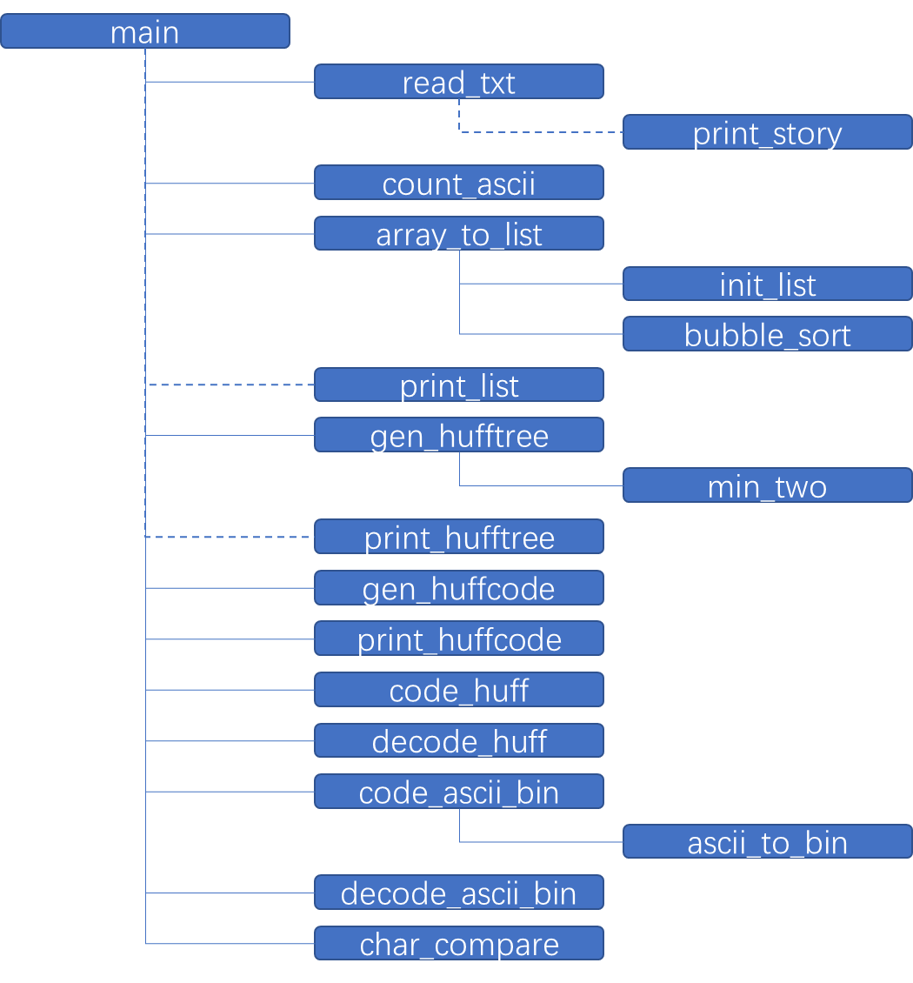
main
read_txt
print_story
count_ascii
array_to_list
init_list
bubble_sort
print_list
gen_hufftree
min_two
print_hufftree
gen_huffcode
print_huffcode
code_huff
decode_huff
code_ascii_bin
ascii_to_bin
decode_ascii_bin
char_compare

