Slide 1

NINTENDO
Advertising

Slide 2

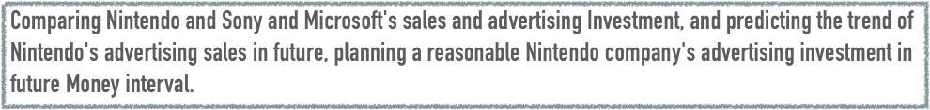

Introduction
Question
Does Nintendo continue to strengthen advertising investment in North America？
Data Sources
3 different SOURCES：game’s sales
game’s advertising
game’s Platform

Slide 3

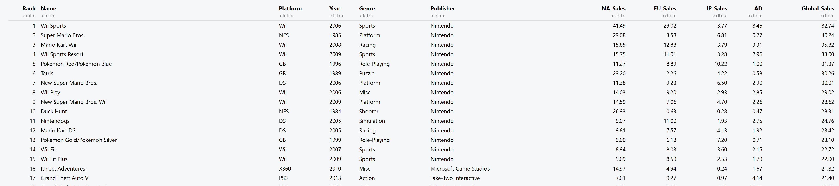

Slide 4

variable
Platform
Sales
Ad invest

Slide 5
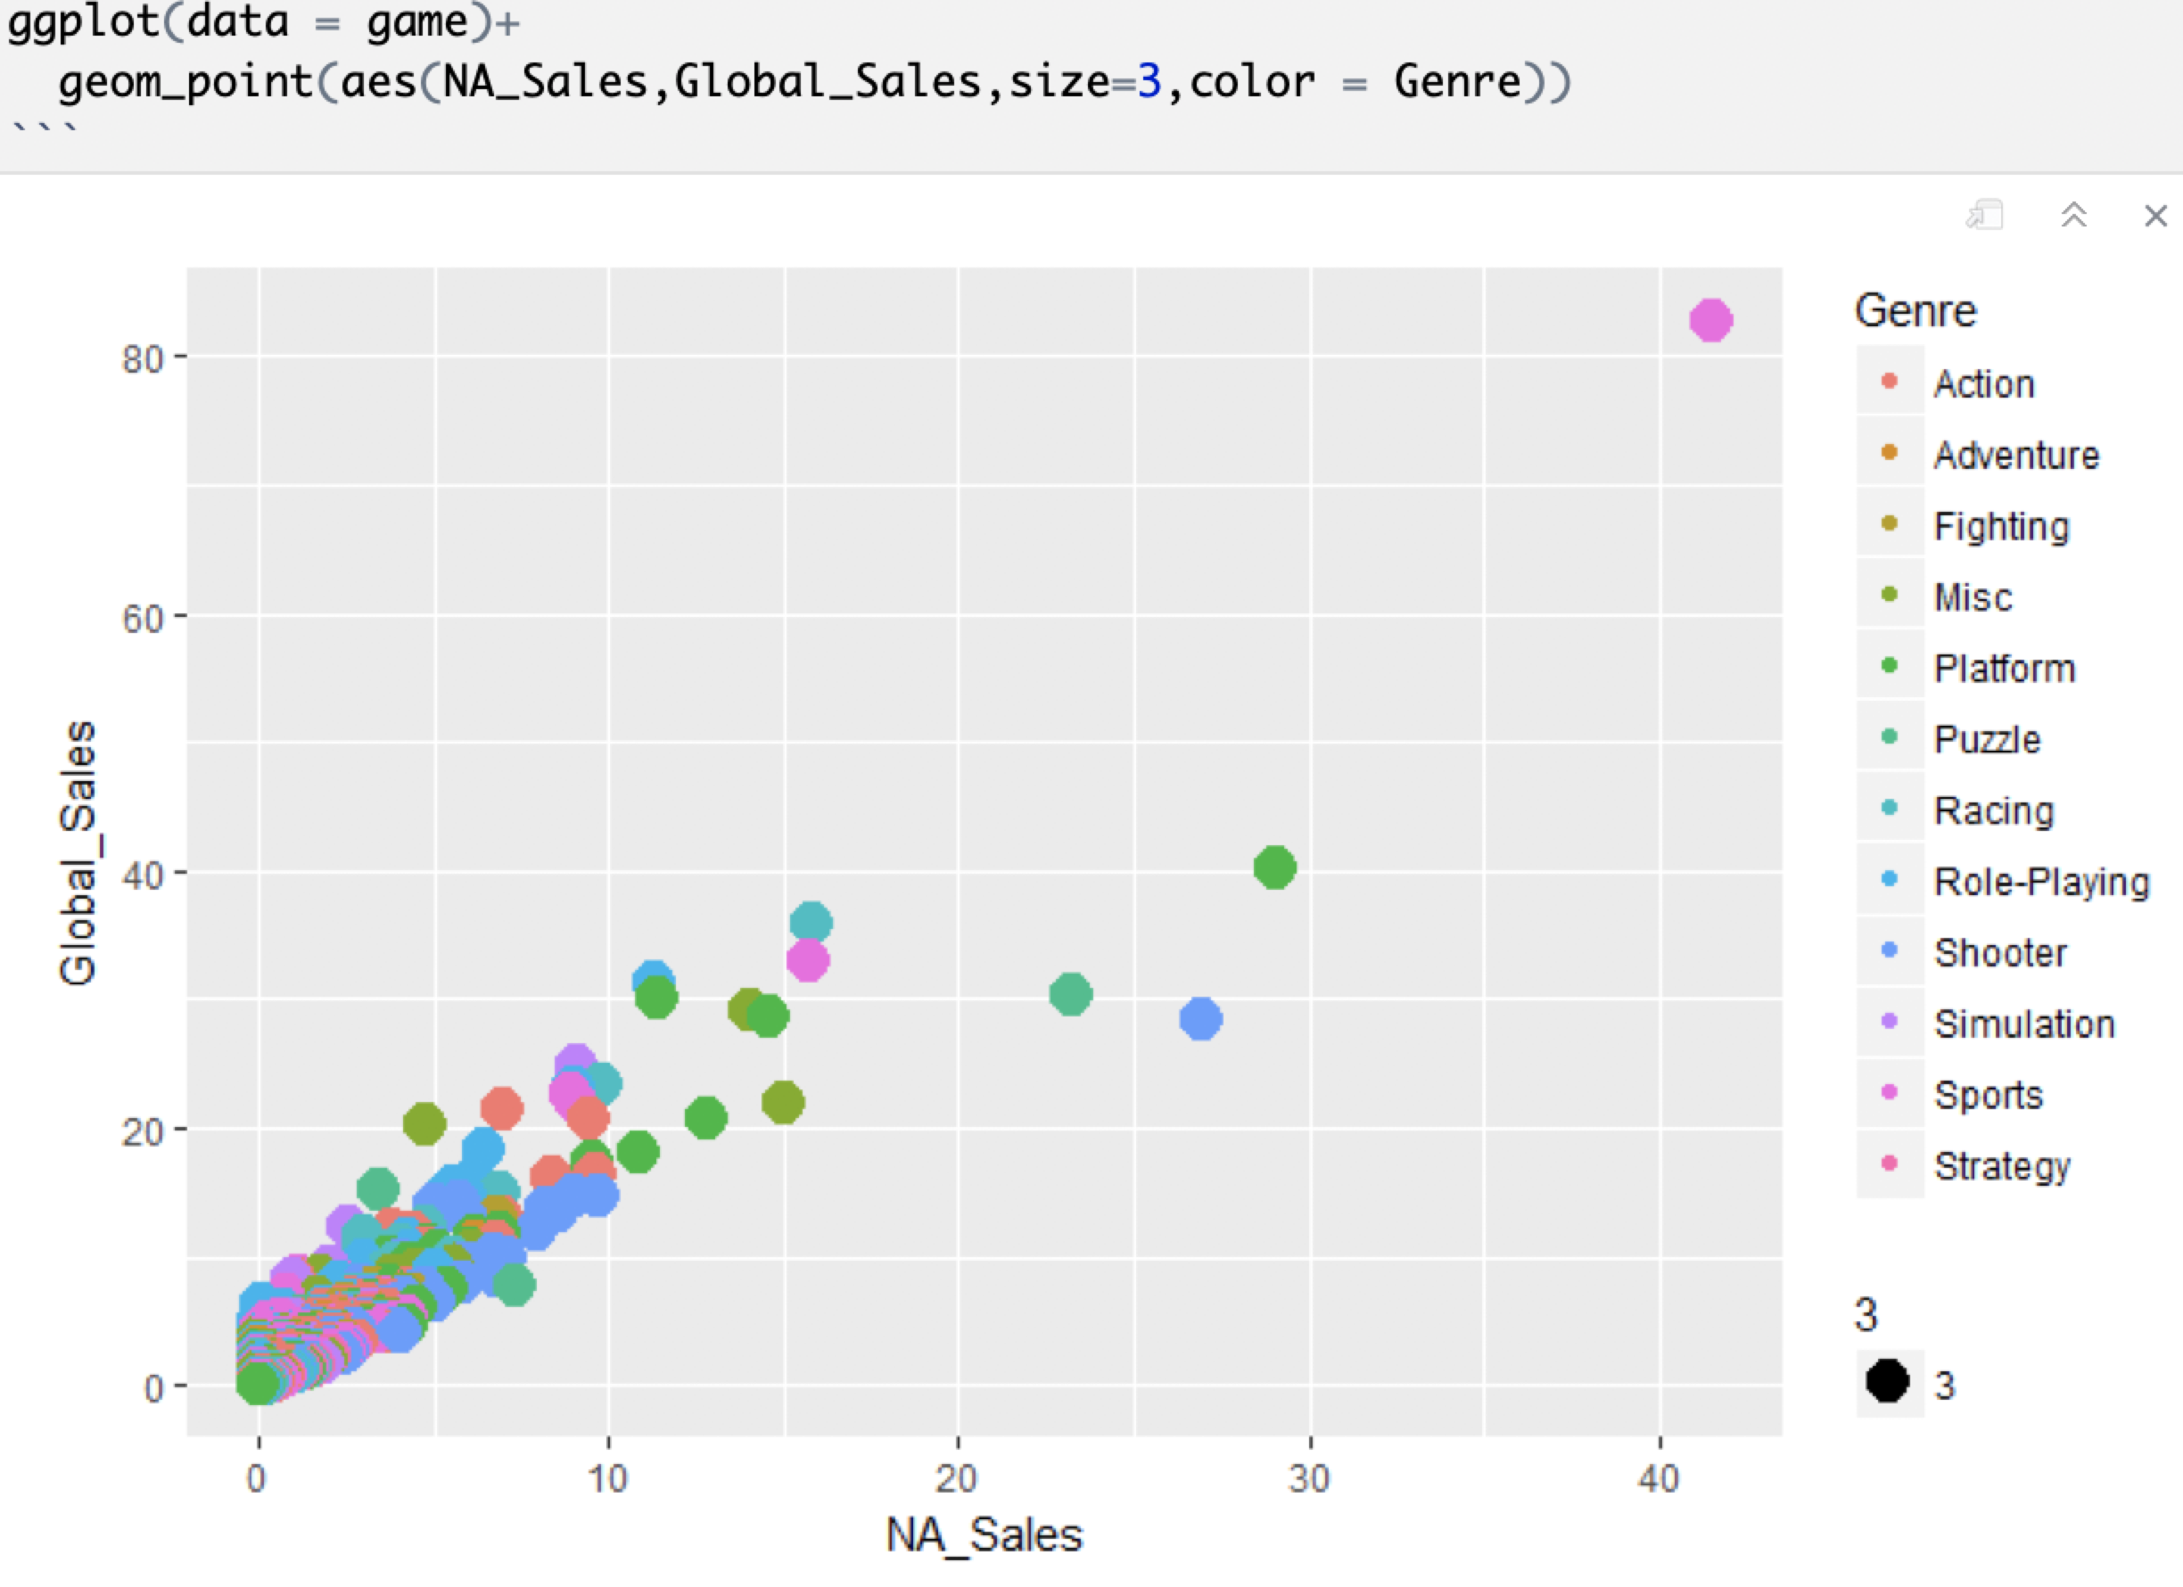
SALES COMPARE

Slide 6
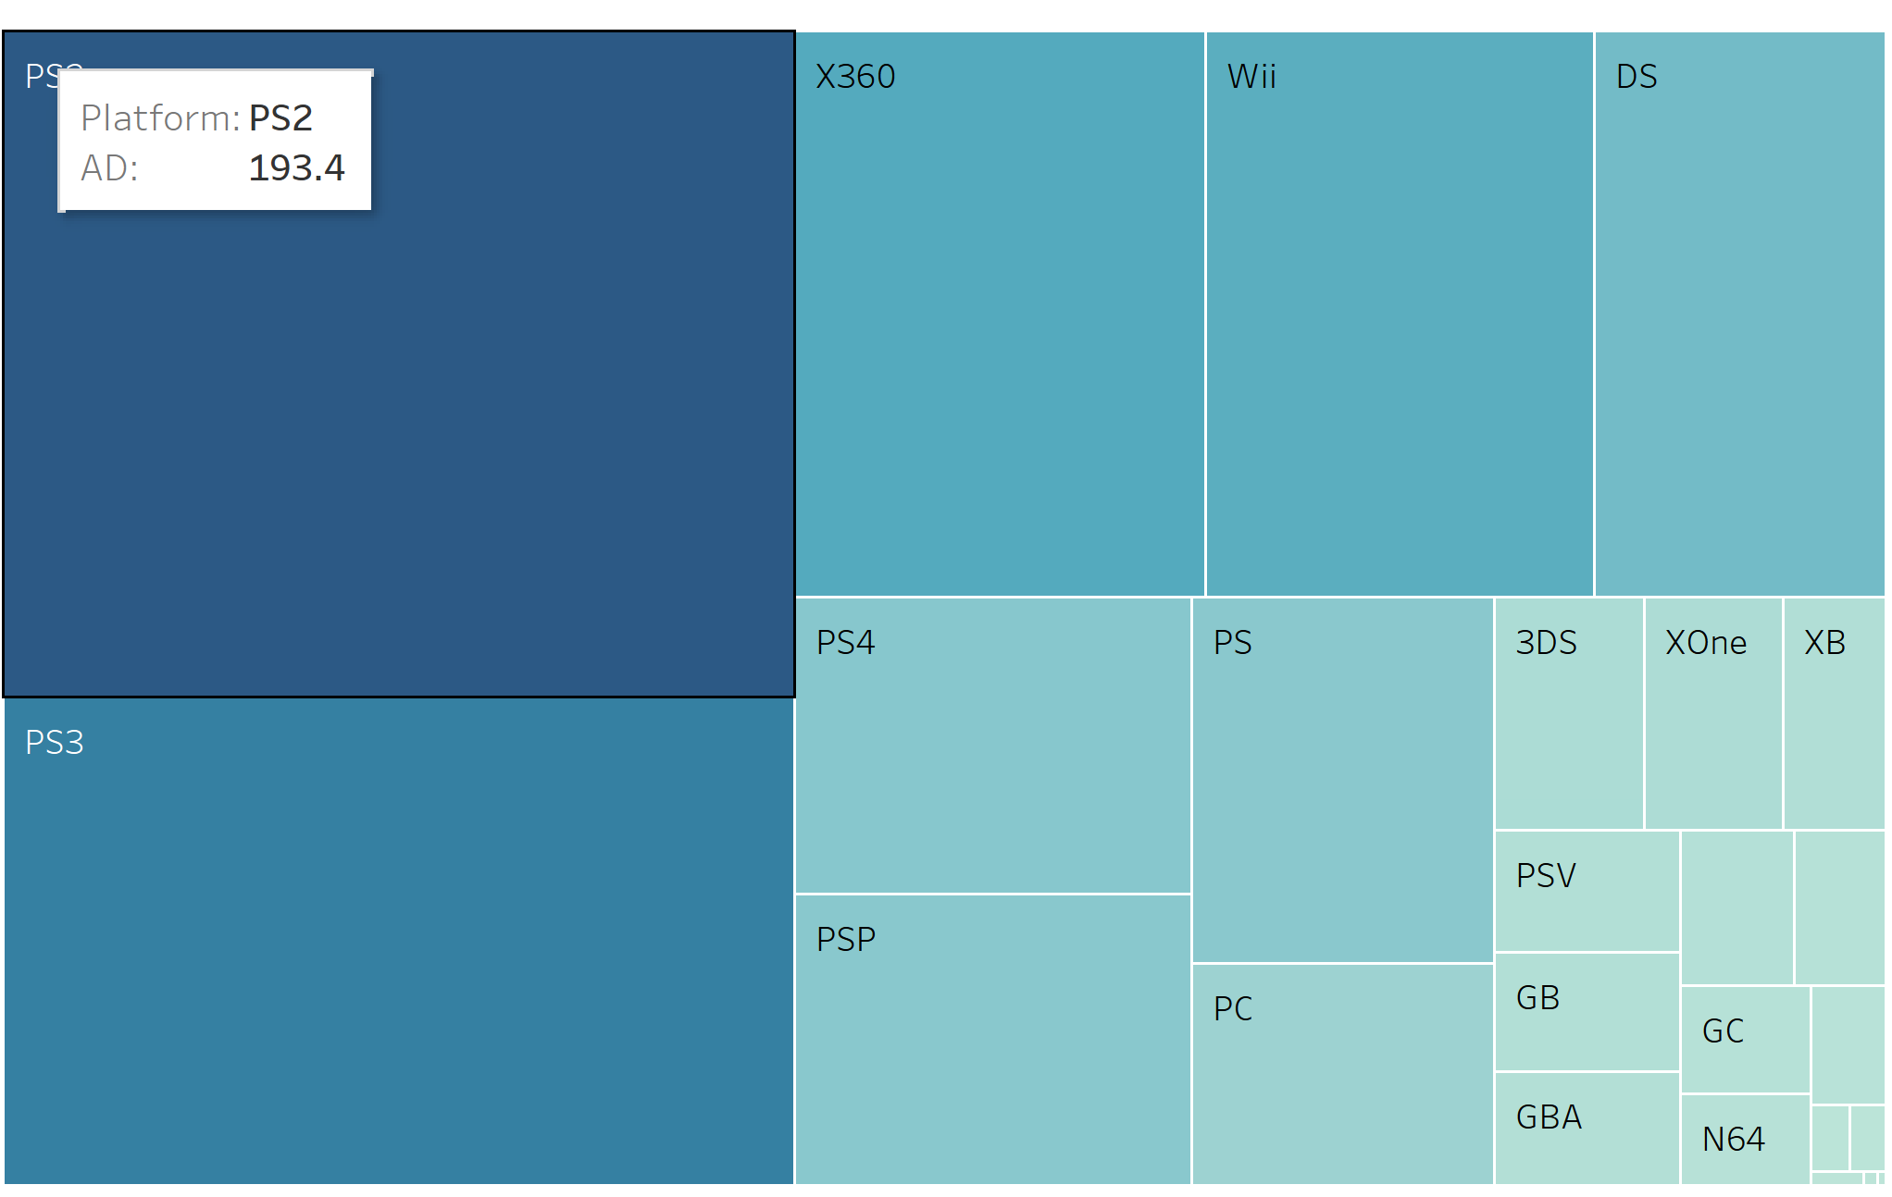

Slide 7
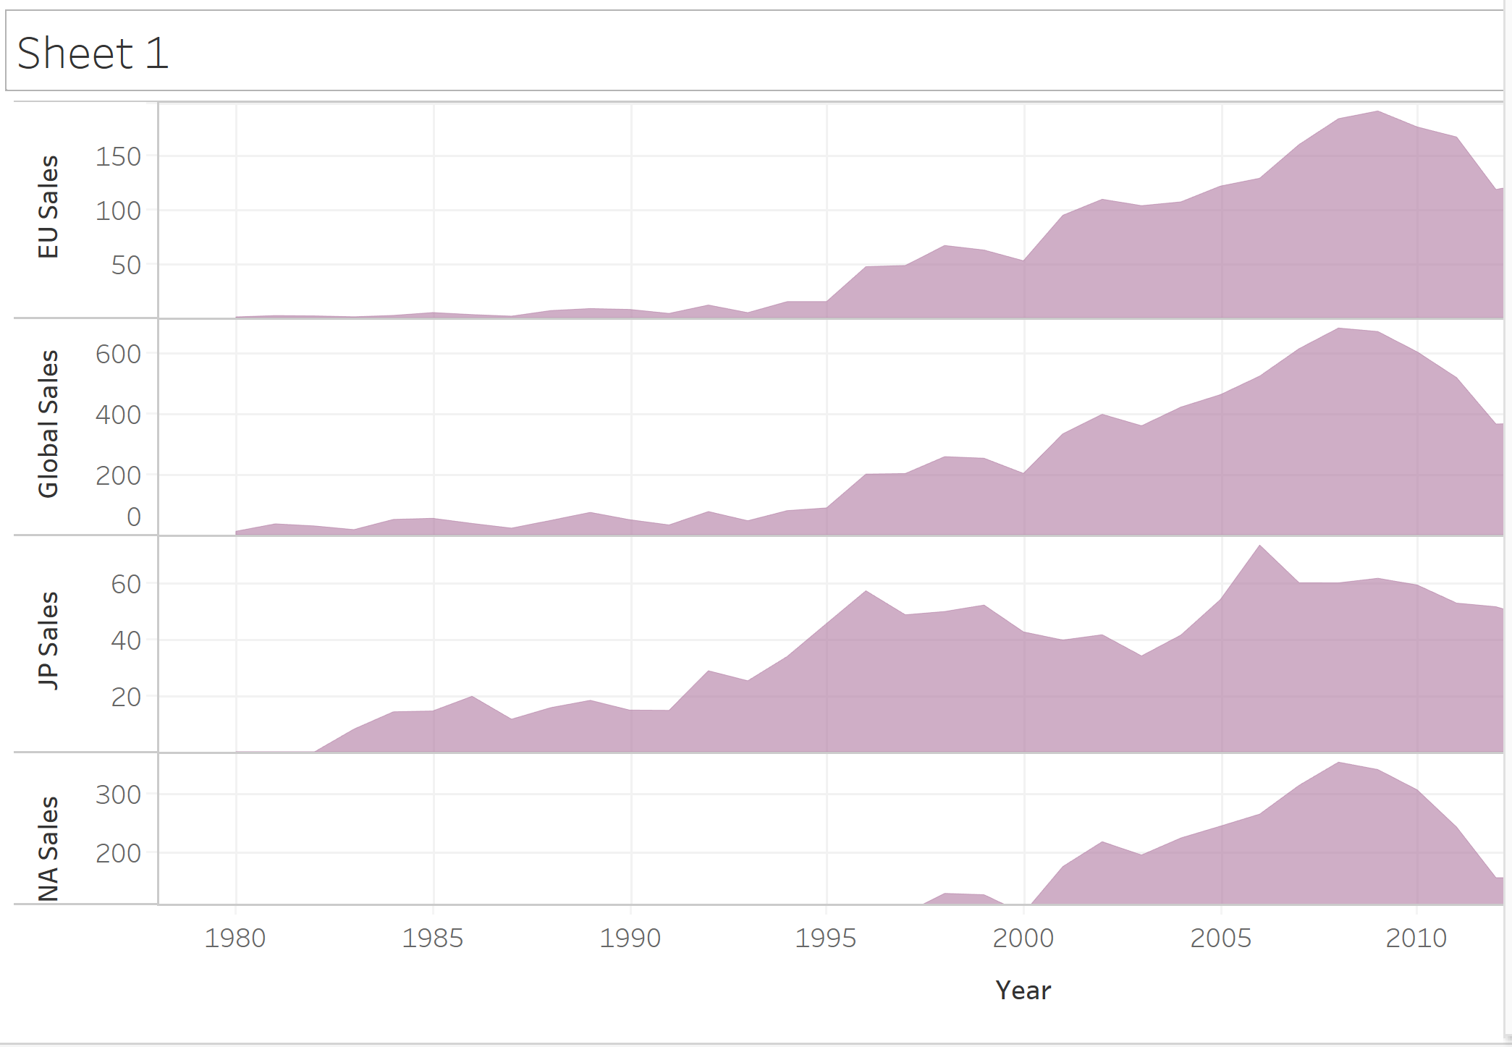

Slide 8
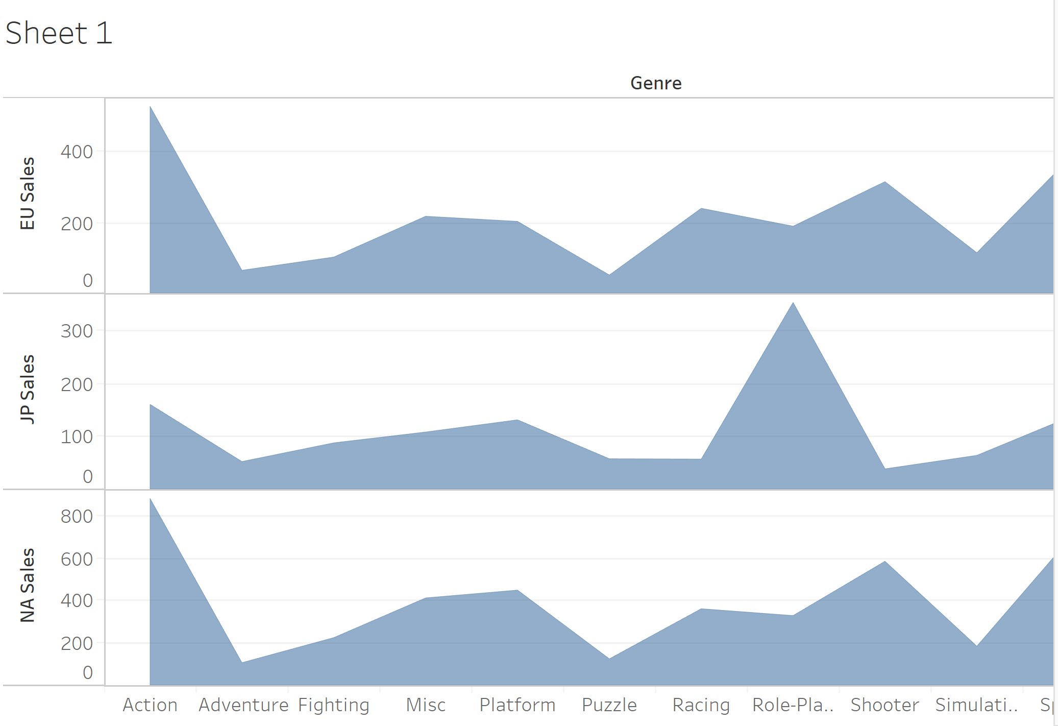

Slide 9
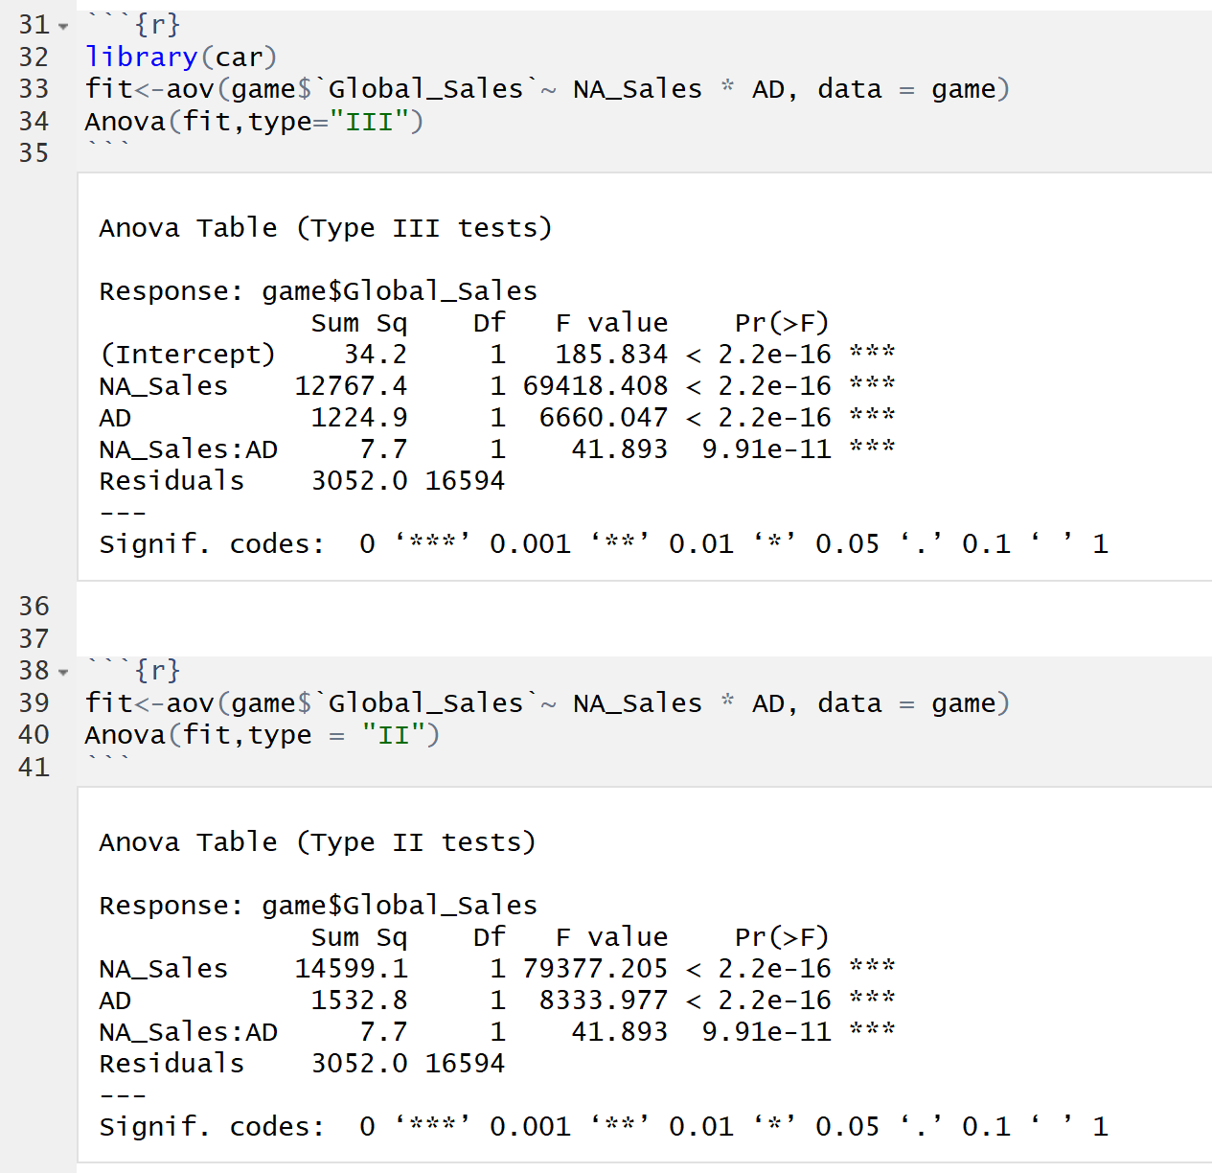

Slide 10
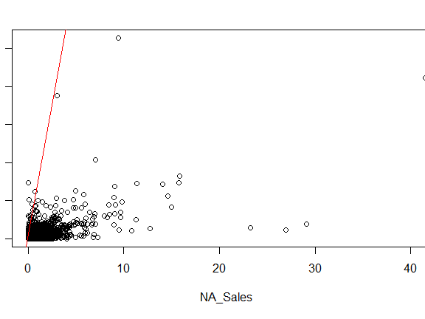

Slide 11
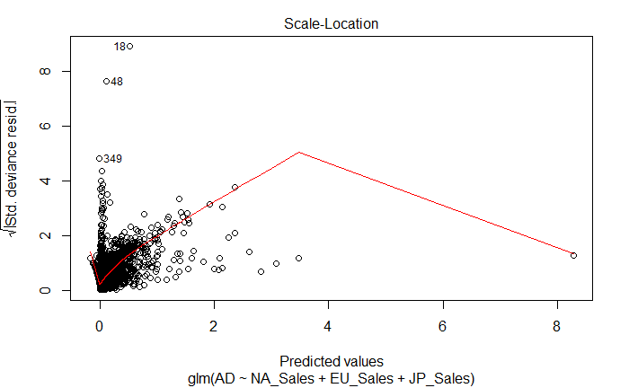

Slide 12


