Slide 1

WPT Mini Project
Topic- CDAC Placement portal web application
Presented By: Team 26
Team Member :
Urmila Pundlik Nagdive (230940520091)
Shwetal T (230940320111)
Lalit Liladhar Zope (230940520036)
Under guidance of:
Mr.Aditya Kansana &
Mr.Abhishek Purohit

Slide 2

INTRODUCTION
A placement portal is a web-based system that helps students and companies manage the recruitment and hiring process. It can also provide information on placement providers and placements.
In this mini project,we have develope placement portal website for CDAC, for recruiting student for the position in companies.This platform is easy to handle to both student and well as cell.
This platfrom done by using HTML,CSS Javascript and reactJs and for stroring data we have use MongoDB for easy and better understanding.

Slide 3
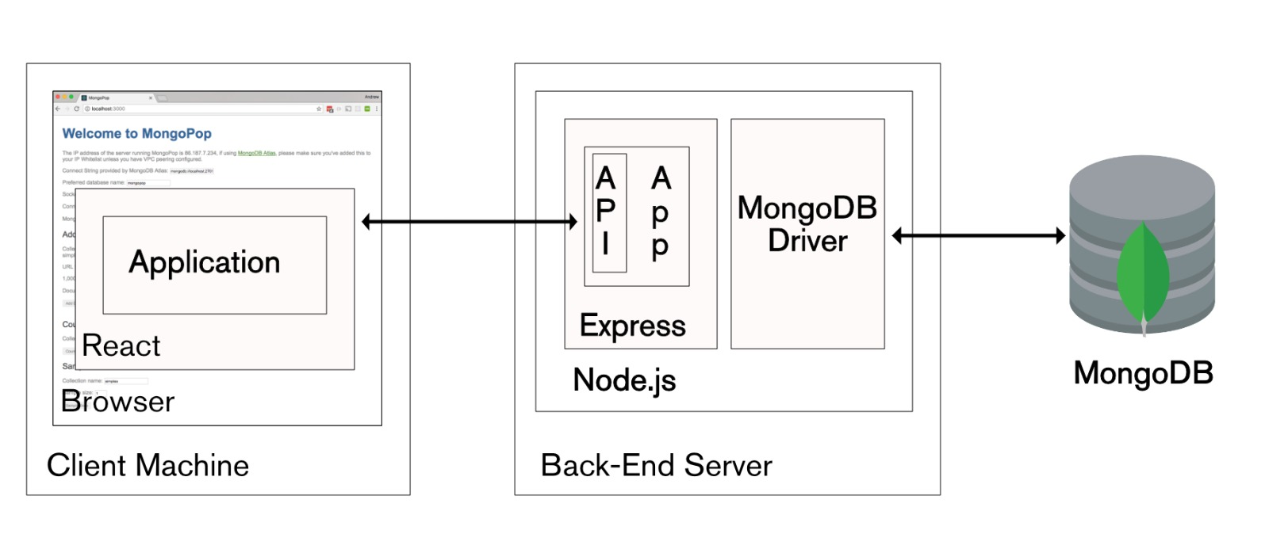
Technology Used:
For frontend we have use:
- Axios
- React JS
For Backend we have use:
- ExpressJS
- MongoDB

Slide 4
THANKYOU

