Slide 1

Health_Clinic_management C++
Fu & LI
05.12.23

Slide 2
Requirements
Register A Patient
Make An Appointment

Slide 3

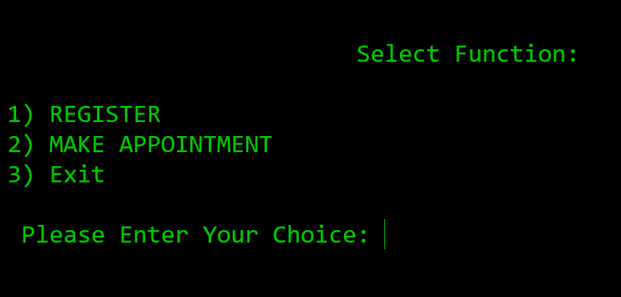
Terminal Version

Slide 4
Register Function
Patient Class
Check Input Validation
Register Function

Slide 5
Patient Class
int P_id{};
string P_name;
string P_address;
string P_history;

Slide 6
Check Input Validation
Check if the input is empty
Check if the input contain special character
Return “false” if yes
Return “true” if no

Slide 7
Register Function
Open "patients.txt", Create if not exist
Generate Patient ID
Loop to ask for input until get valid input
Write Patient Information to "patients.txt“
Output Message

Slide 8
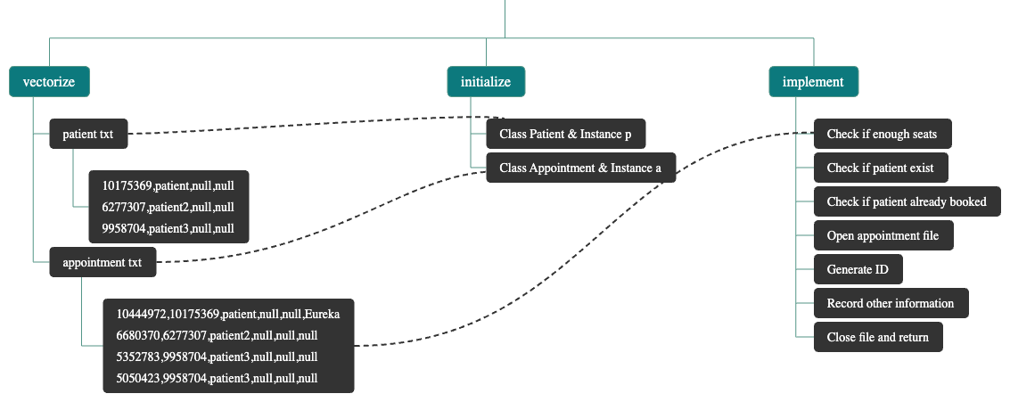
Appointment Function

Slide 9
Main Function
Generate Function Menu
Call Chosen Function
Go Back To Menu

Slide 10
Webserver
Crow
Register function well
Appointment can’t avoid double appointment to one seat

