Slide 1
Health_Clinic_MaNAGEMENT 2.2
FU & LI
2023-12-12

Slide 2
Requirements
Record prescriptions associated with a patient ID
Update medical records after each patient visit
Search to retrieve patient’s medical history

Slide 3
Webserver
s
Crow --> Http Requests
Sqlite3 --> Manage Data
Postman --> Test Functions

Slide 4
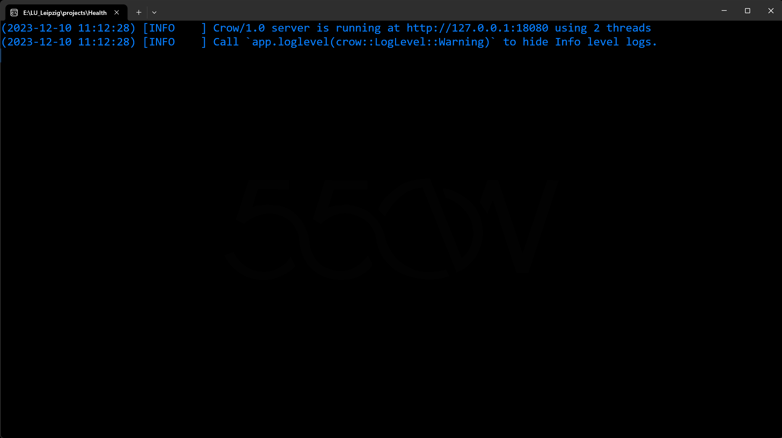

Slide 5
Data structure
MedicalHistory
patientId
doctorId
date
prescription
Patient
P_id
P_name
P_address
P_phone
Doctor
D_id
D_name
D_specialization
Appointment
patientId
doctorId
date
period

Slide 6
Data structure
Patient
P_id
P_name
P_address
P_phone
Appointment
patientId
doctorId
date
period
clinic.db
MedicalHistory
patientId
doctorId
date
prescription
Doctor
D_id
D_name
D_specialization

Slide 7
Register Patient
int Generate_id
bool isValidName
int getPatientId

Slide 8
Register Patient
int Generate_id
bool isValidName
int getPatientId
random
7 digits

Slide 9
Register Patient
bool isValidName
int Generate_id
int getPatientId
@#$
0123
length

Slide 10
Register Patient
int getPatientId
int Generate_id
bool isValidName
Check
phone existence
Retrieve ID

Slide 11
Register Patient
int getPatientId
int Generate_id
bool isValidName
Check
phone existence
Retrieve ID

Slide 12
Register Patient
int getPatientId
int Generate_id
bool isValidName
Check
phone existence
Retrieve ID

Slide 13
Register Patient
int getPatientId
int Generate_id
bool isValidName
Check
phone existence
Retrieve ID

Slide 14
Register Patient
int getPatientId
int Generate_id
bool isValidName
Check
phone existence
Retrieve ID
11 digits
Only Numbers

Slide 15
Register Patient
int Generate_id
bool isValidName
register_patient
int getPatientId

Slide 16
Make appointment
{
"patient_id": XXXXXXX,
"doctor_id": XXXXXXX,
"date":"YYYY-MM-DD",
"period":" choose from [9-11, 11-13, 13-15, 15-17] "
}

Slide 17
Make appointment
Check if patient_id exist
Already has an appointment
{
"patient_id": XXXXXXX,
"doctor_id": XXXXXXX,
"date":"YYYY-MM-DD",
"period":" choose from [9-11, 11-13, 13-15, 15-17] "
}

Slide 18
Make appointment
Check if doctor_id exist
Available or not
{
"patient_id": XXXXXXX,
"doctor_id": XXXXXXX,
"date":"YYYY-MM-DD",
"period":" choose from [9-11, 11-13, 13-15, 15-17] "
}

Slide 19
Make appointment
Check if format right
Check if date earlier than today
Check if date more than a year later
{
"patient_id": XXXXXXX,
"doctor_id": XXXXXXX,
"date":"YYYY-MM-DD",
"period":" choose from [9-11, 11-13, 13-15, 15-17] "
}

Slide 20
Make appointment
{
"patient_id": XXXXXXX,
"doctor_id": XXXXXXX,
"date":"YYYY-MM-DD",
"period":" choose from [9-11, 11-13, 13-15, 15-17] "
}
Check if format right

Slide 21
Make appointment
{
"period": "11-13",
"message": "Appointment Successfully Made",
"patient_id": 1015571,
"doctor_id": 1029250,
"date": "2024-11-17"
}

Slide 22
Other functions
print_patients
print_doctors
register_doctor
print_appointments

Slide 23
Record Medical history
Check if ids exist
Check if date valide
Pass values -> class -> database
{
"patient_id": XXXXXXX,
"doctor_id": XXXXXXX,
"date":"YYYY-MM-DD",
”prescription":”take medicine twice a day”
}

Slide 24
Retrieve Medical history
get request and id
use id -> database -> aggregate data from database TABLE medical_history
use data from database -> prepare data in the form of JSON to return

Slide 25
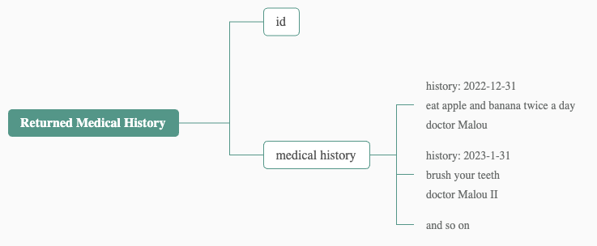
Retrieve Medical history

Slide 26
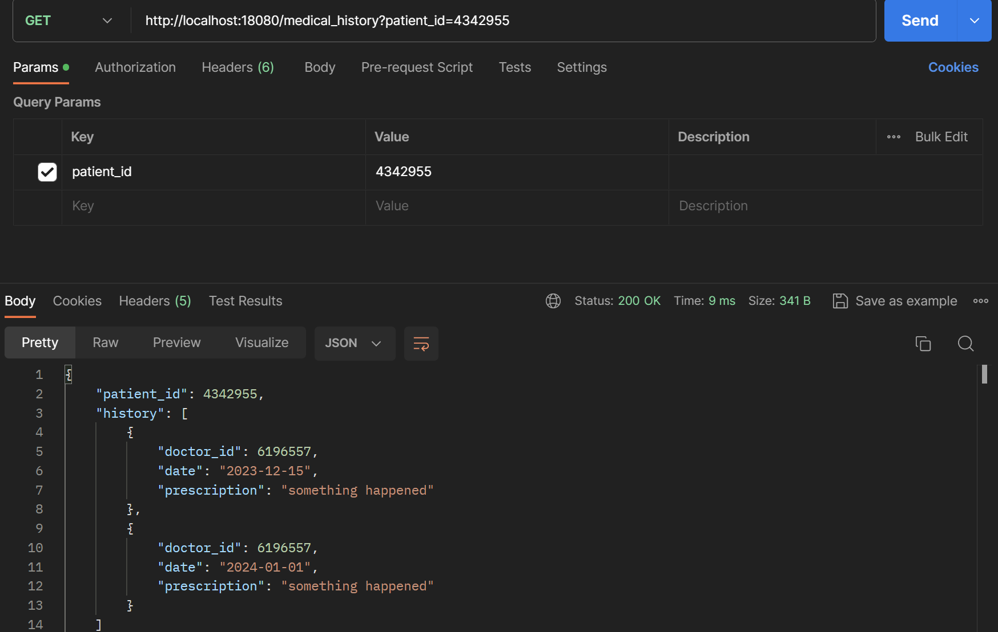
Retrieve Medical history

