Slide 1

Health_Clinic_MaNAGEMENT 2.4
FU & LI
2024-01-23

Slide 2
Requirements
Implement a procedure to record and update the quantity of medical supplies
Design a feature to alert staff when stock levels for a particular item are low

Slide 3
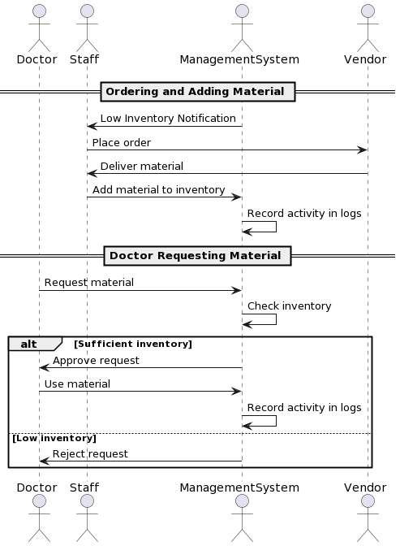
changes in inventory and record logs

Slide 4

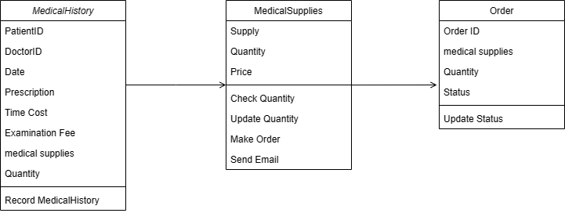
Make Order

Slide 5

Add supply

