Slide 1

Health_Clinic_MaNAGEMENT 3.0
FU & LI
2024-01-16

Slide 2
Implementing a procedure to generate bills based on services provided during the appointment
Adding a feature to file insurance claims for patients with insurance coverage
Requirements

Slide 3

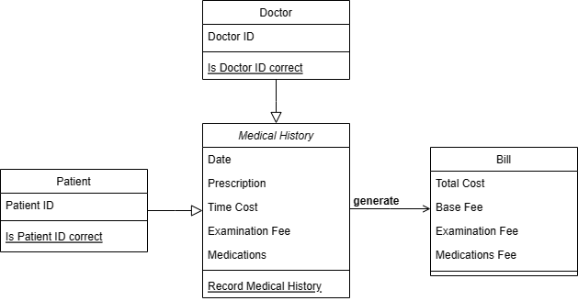
Bill gereration

Slide 4
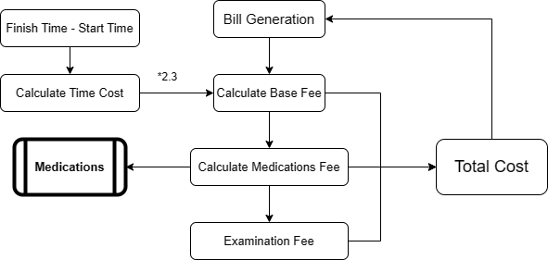
Bill gereration

Slide 5
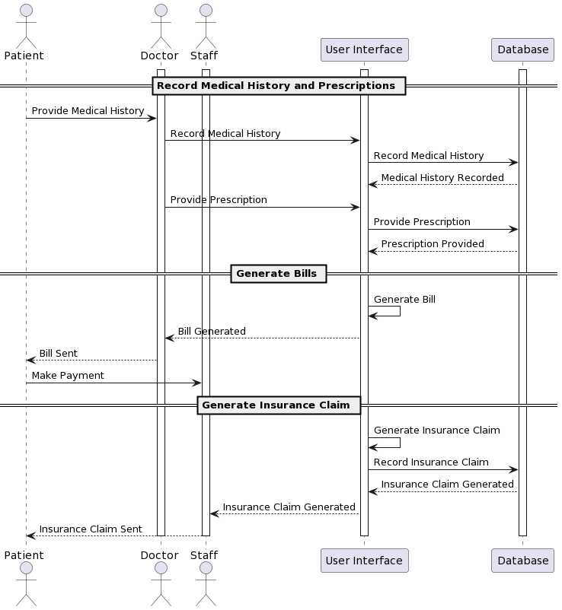
system Design

Slide 6
insurance system Design
Private vs Public
Coverage Scope
Reimbursement
Payment to Healthcare Providers

Slide 7

insurance system Design
Private medical insurance
The patient sends the bill to the insurance company, the insurance company transfers the reimbursement amount to the patient's bank account, and the patient pays the doctor himself/herself
Public health insurance
Insurance companies settle directly with clinics and hospitals
(reference from mawista)

