Slide 1

ReadersHaven_Project 2
Search that matches partial or full titles
Sort based on price (both ascending and descending) or title
By Karina & Li

Slide 2
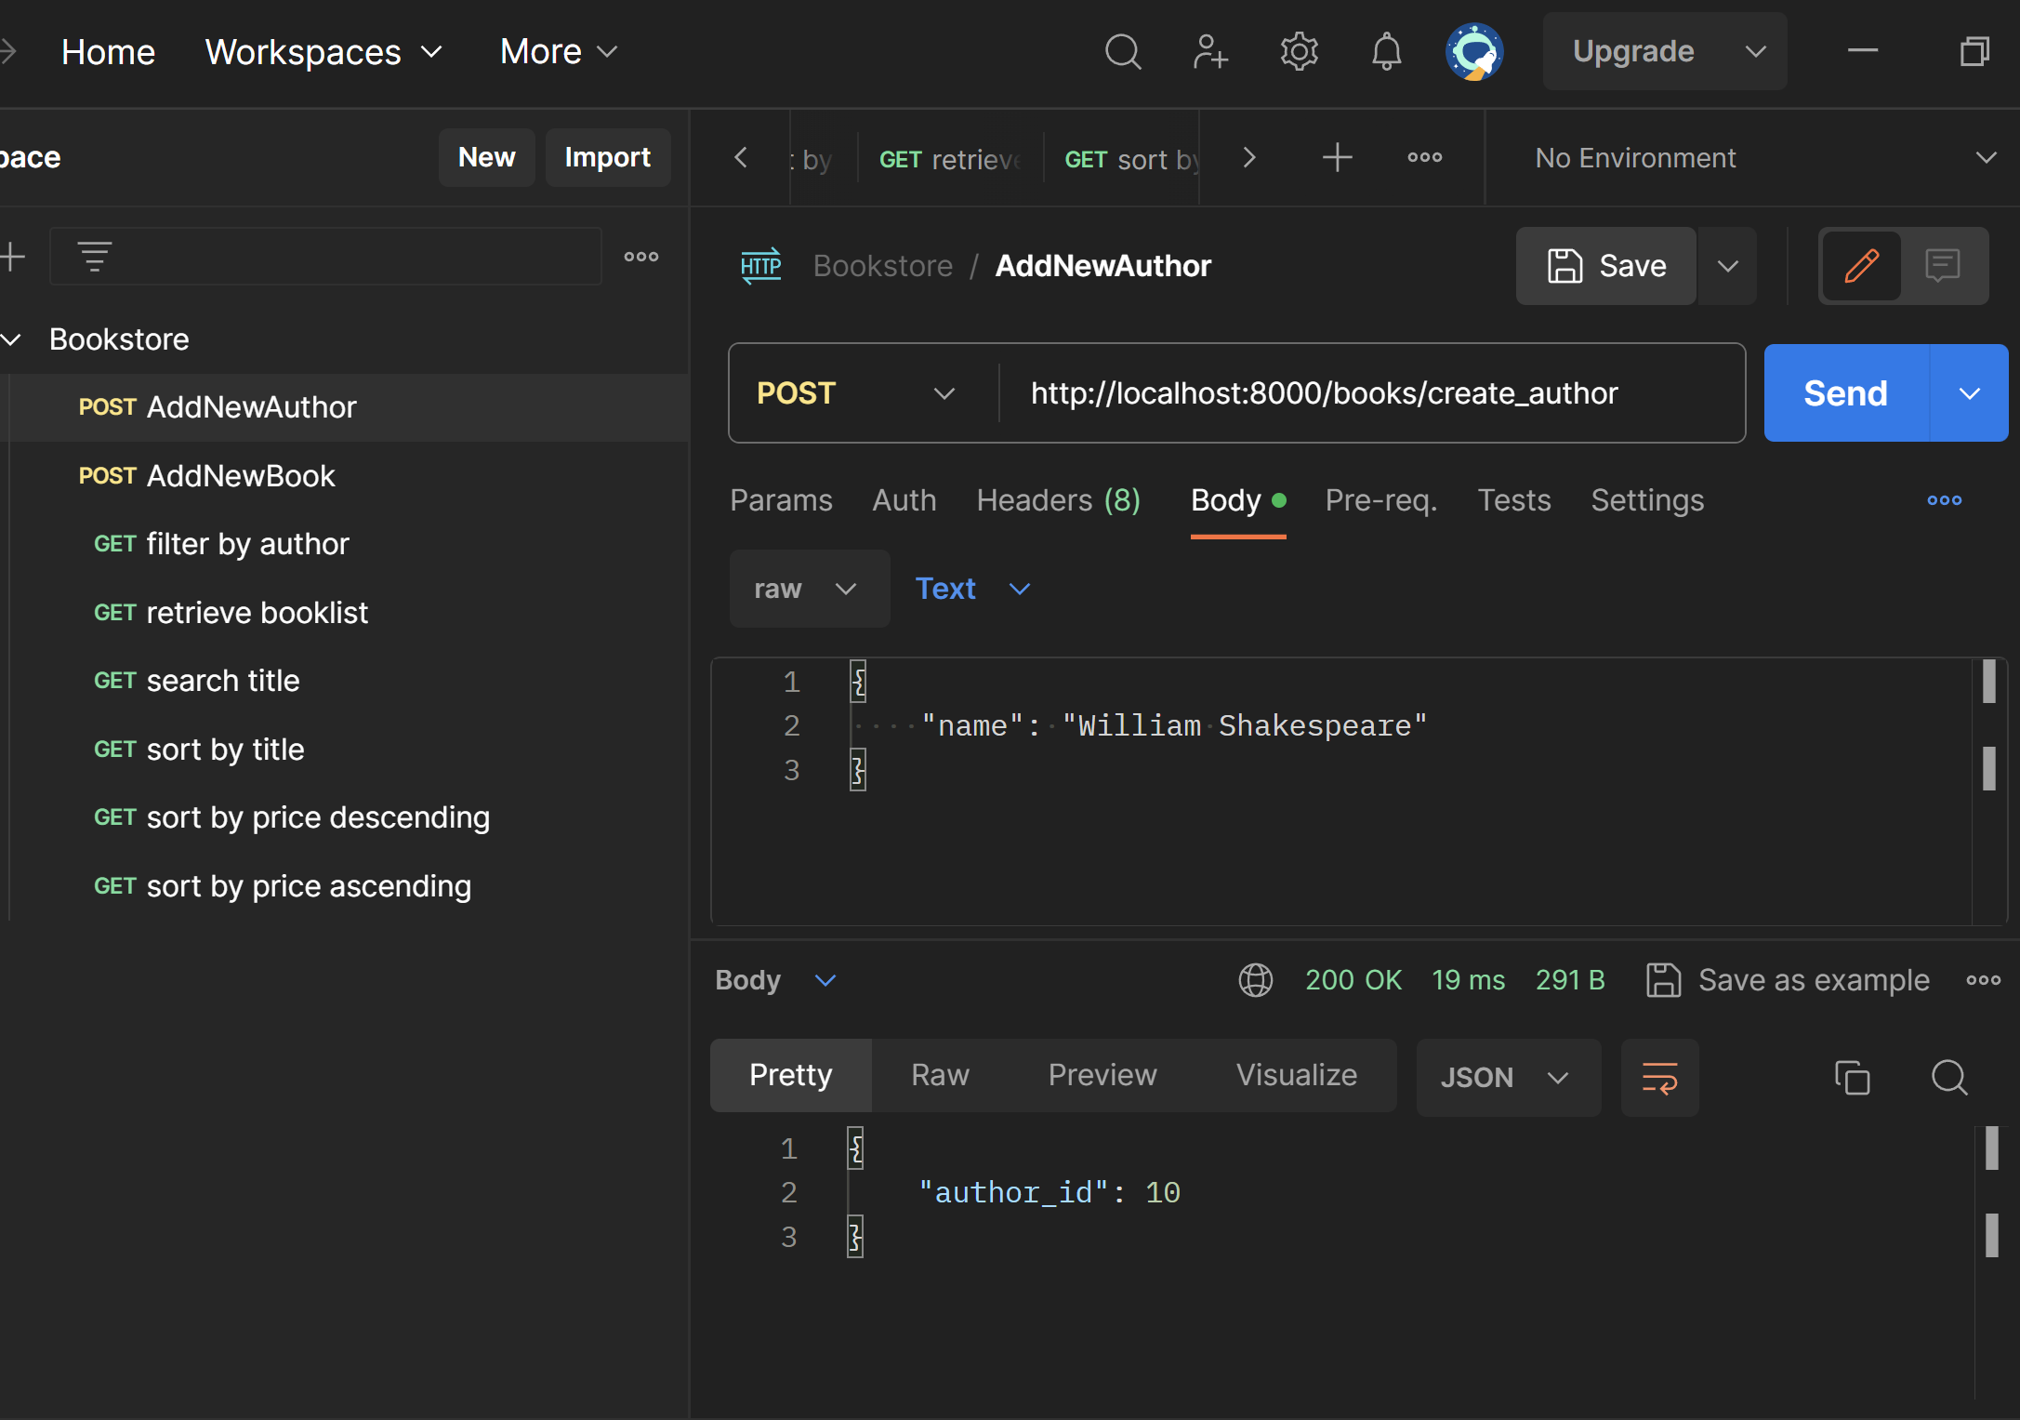
Create new author
from .models import Book, Author from django.http import JsonResponse from django.views.decorators.csrf import csrf_exempt import json
@csrf_exempt def create_author(request): if request.method == 'POST': try: data = json.loads(request.body.decode("utf-8")) author_name = data.get("name")
#…Error Processing…#
author = Author.objects.create(author_name = author_name) return JsonResponse({'author_id': author.id}) except Exception as e: return JsonResponse({'error': str(e)}, status = 400)

Slide 3
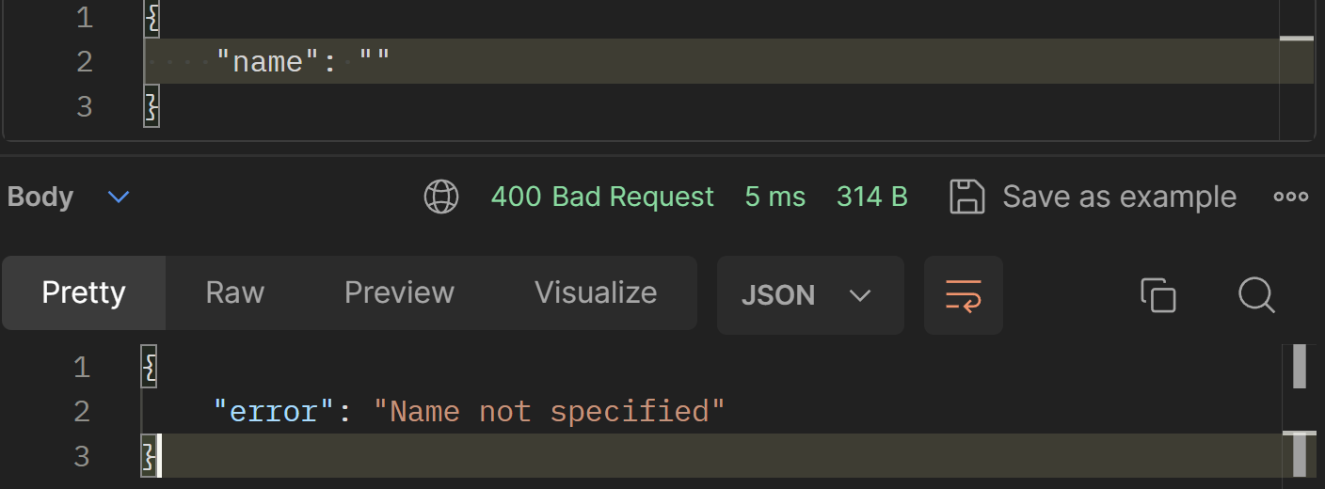
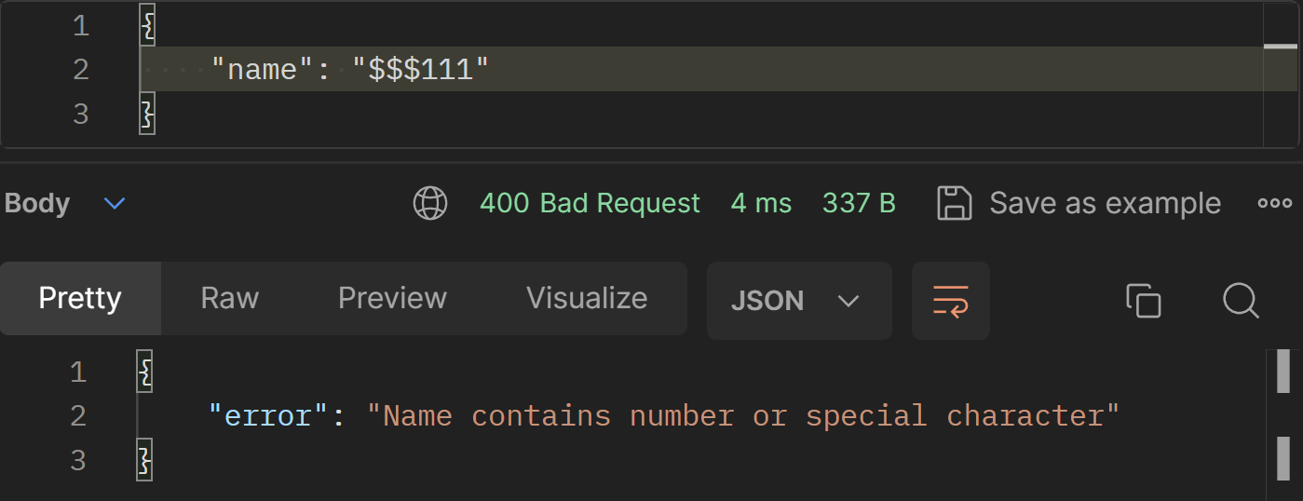
Error processing
if not author_name or author_name == "": return JsonResponse({'error': "Name not specified"}, status = 400) if not isinstance(author_name, str): return JsonResponse({'error': "Name should be string!"}, status = 400) sc_number = "[@_!#$%^&*()<>?/\|}{~:;']1234567890" for i in author_name: if i in sc_number: return JsonResponse({'error': "Name contains number or special character"}, status=400) exist_author = Author.objects.filter(author_name = author_name).first() if exist_author: return JsonResponse({'error': "Author is already exist!"}, status = 400)

Slide 4
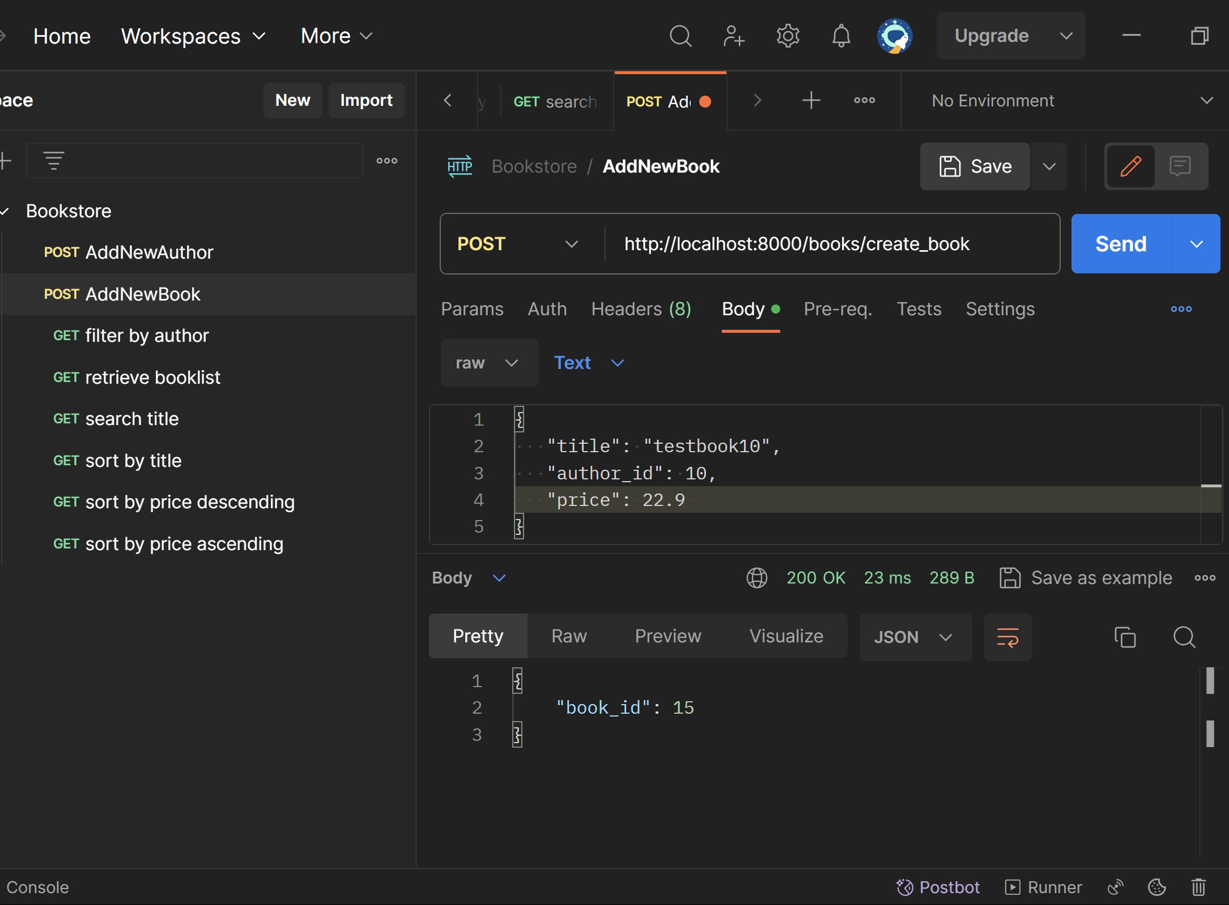
Create new book
@csrf_exempt def create_book(request): if request.method == 'POST': try: json_request = json.loads(request.body) title = json_request.get("title") author_id = json_request.get("author_id") price = json_request.get("price") author_name = json_request.get("author")
#…Error Processing…#
new_book = Book.objects.create(title = title, price = price, author = exist_author) return JsonResponse({'book_id': new_book.id}) except Exception as e: return JsonResponse({'error': str(e)}, status = 400)

Slide 5
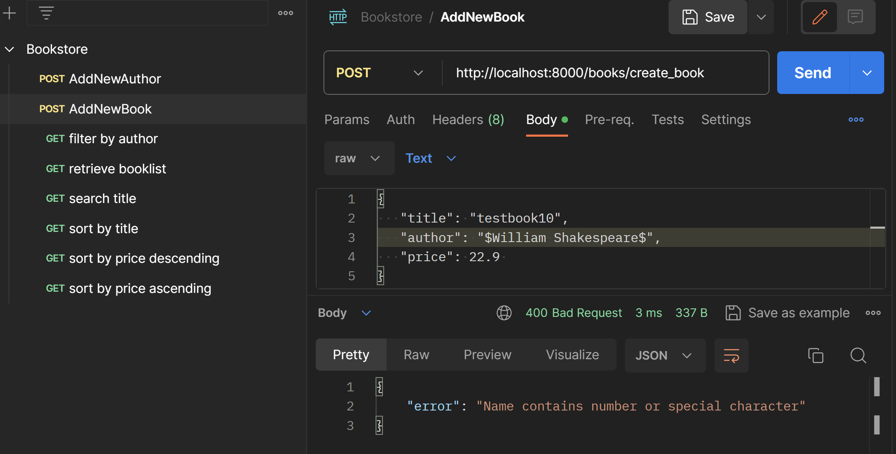
Create new book with author name
if author_name: sc_number = "[@_!#$%^&*()<>?/\|}{~:;']1234567890" for i in author_name: if i in sc_number: return JsonResponse({'error': "Name contains number or special character"}, status=400) exist_author = Author.objects.filter(author_name=author_name).first() if not exist_author: author = Author.objects.create(author_name=author_name) else: author = exist_author

Slide 6
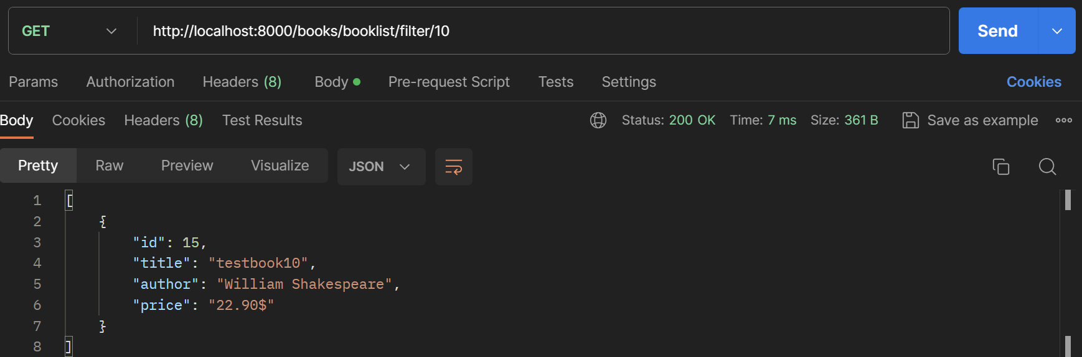
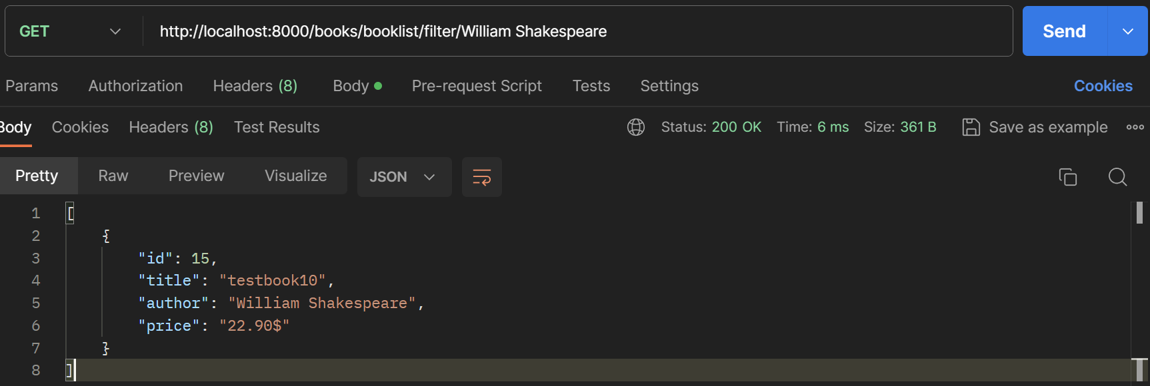
Filter by author id or name
def filter_books_by_author(request, author_id): try: author = Author.objects.filter(id = author_id).first() if not author: return JsonResponse({'error': "Author was not found"}, status = 400) books = Book.objects.filter(author = author) book_array = [{'id': book.id, 'title': book.title, 'author': book.author.author_name, 'price': str(book.price) + "$" } for book in books] return JsonResponse(book_array, safe = False) except Exception as e: return JsonResponse({'error': str(e)}, status = 400)

Slide 7
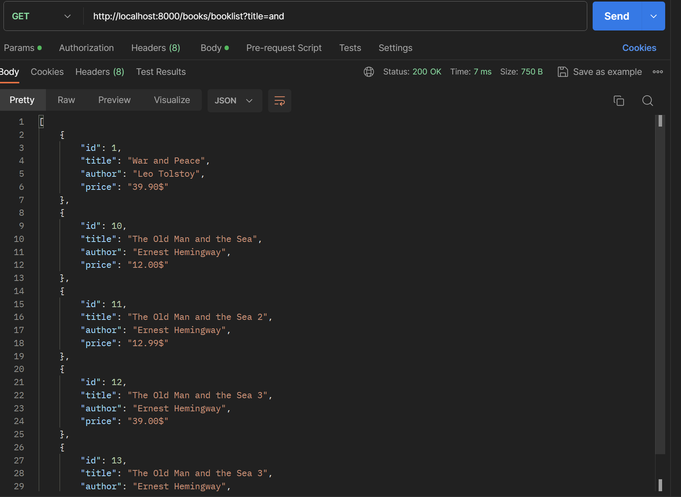
Retrieve and search booklist by title
def book_list(request): title = request.GET.get('title') books = Book.objects.all() if title: books = books.filter(title__icontains = title) book_array = [{'id': book.id, 'title': book.title, 'author': book.author.author_name, 'price': str(book.price) + "$" } for book in books] if book_array == []: return JsonResponse({'error': "Title was not found"}, status = 400) return JsonResponse(book_array, safe = False)

Slide 8
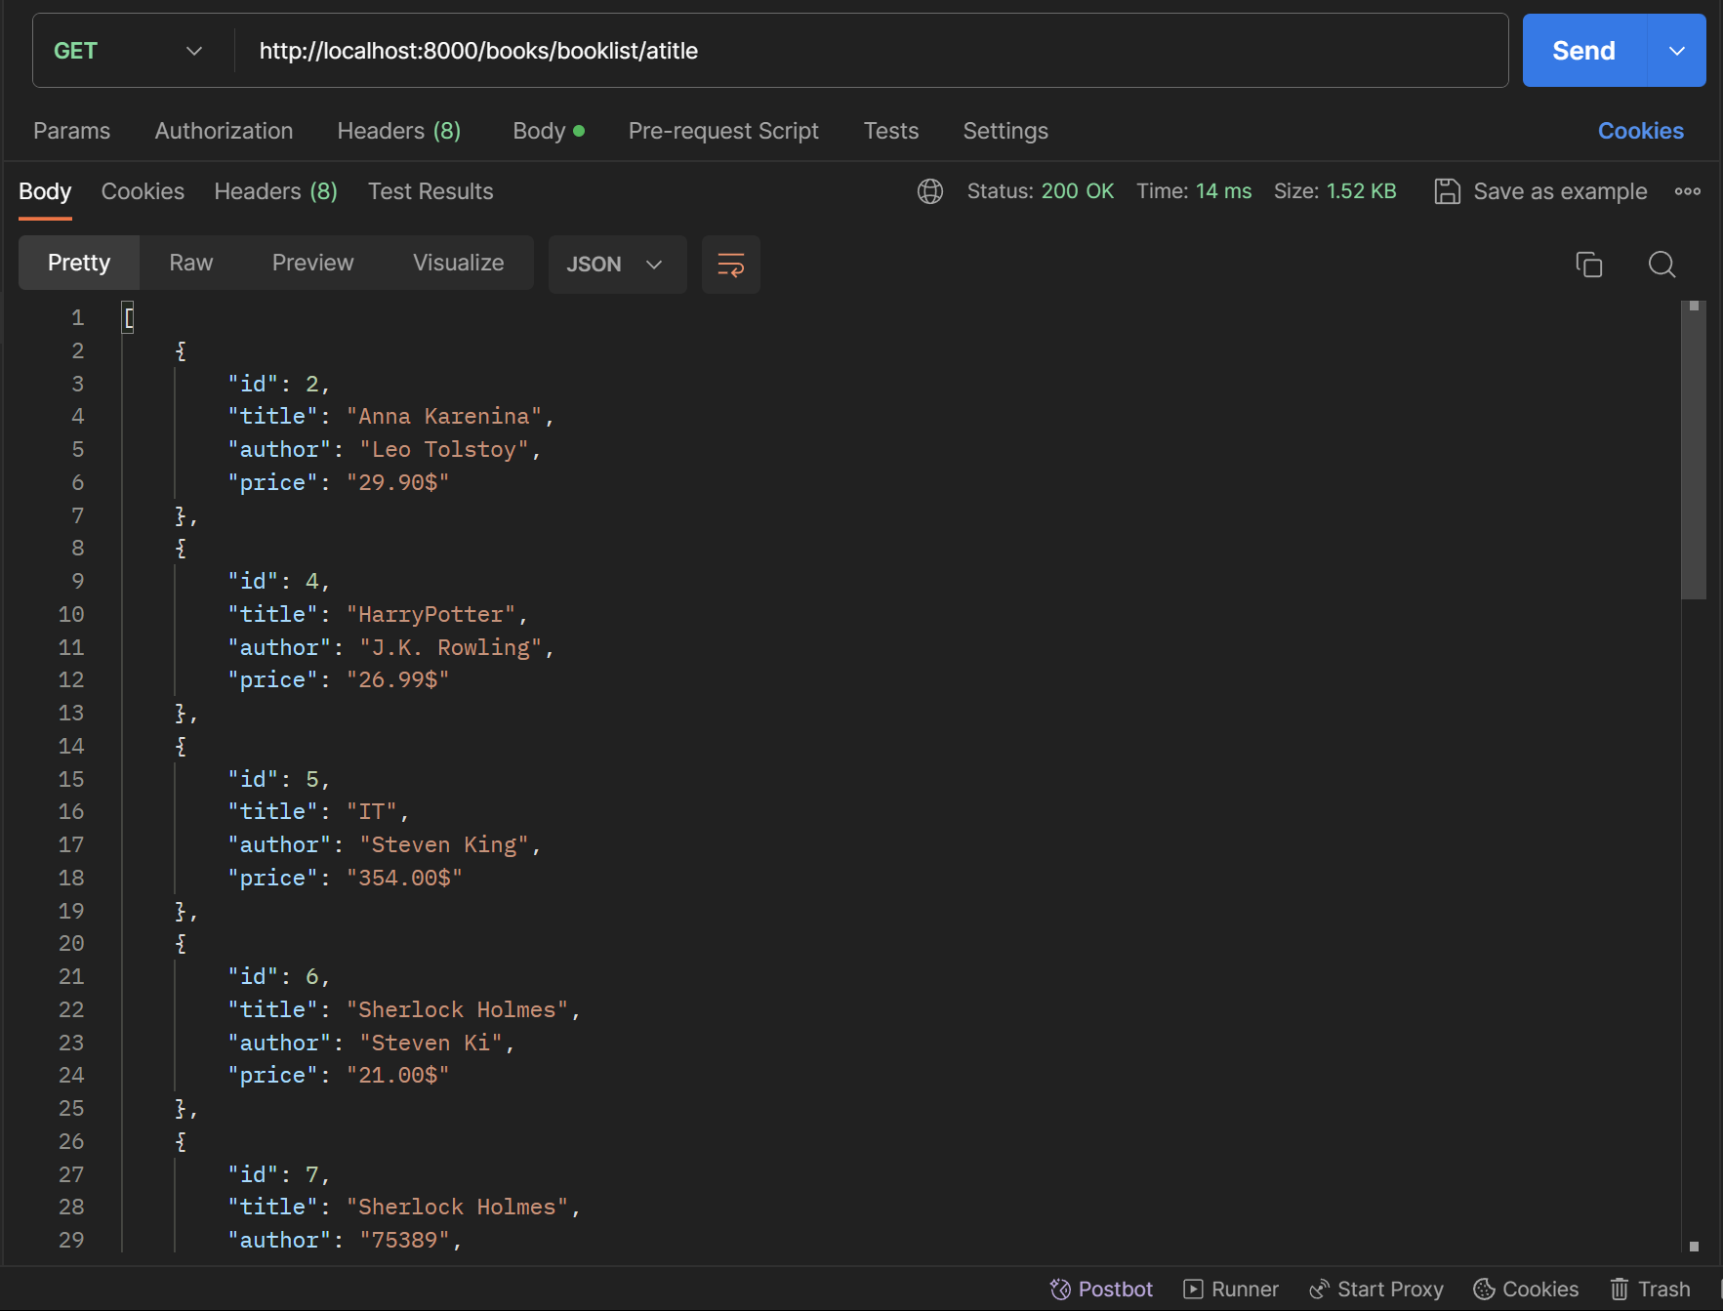
Sort by title alphabetically
def sort_books_by_title(request): books = Book.objects.all().order_by('title') book_sorted = [{'id': book.id, 'title': book.title, 'author': book.author.author_name, 'price': str(book.price) + "$" } for book in books] return JsonResponse(book_sorted, safe=False)

Slide 9
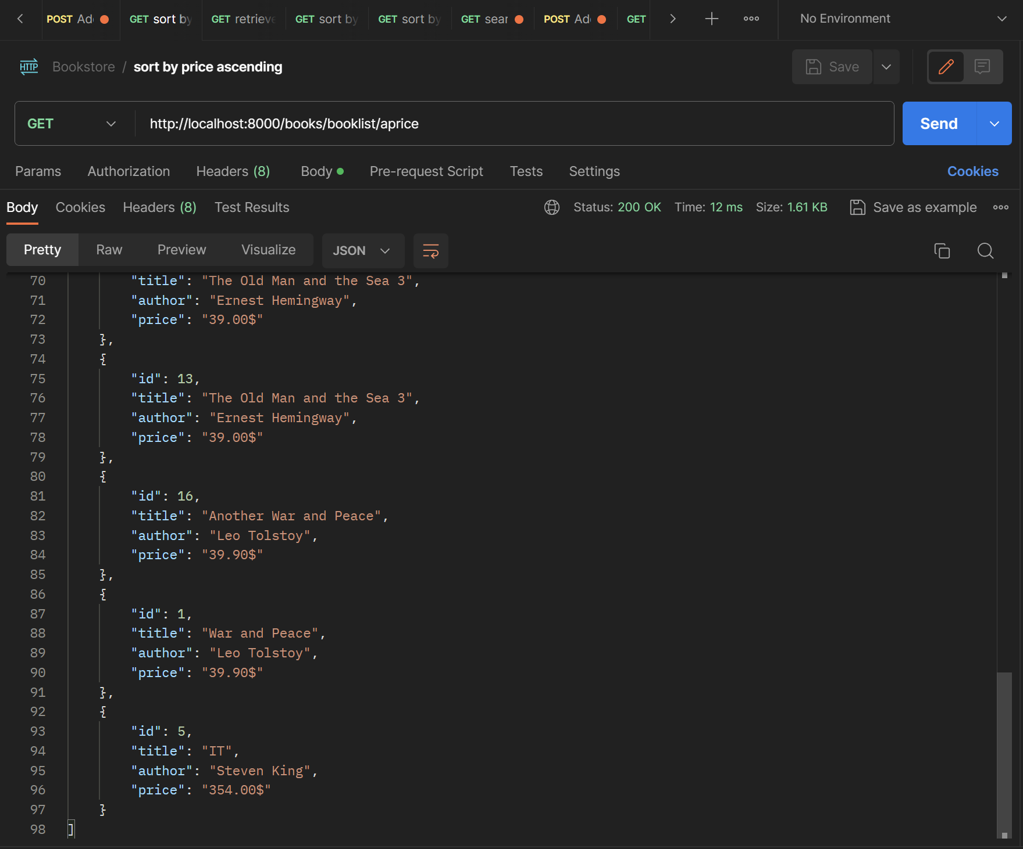
Sort by price ascending
def sort_books_by_price_ascending(request): books = Book.objects.all().order_by('price','title') book_sorted = [{'id': book.id, 'title': book.title, 'author': book.author.author_name, 'price': str(book.price) + "$" } for book in books] return JsonResponse(book_sorted, safe=False)

Slide 10
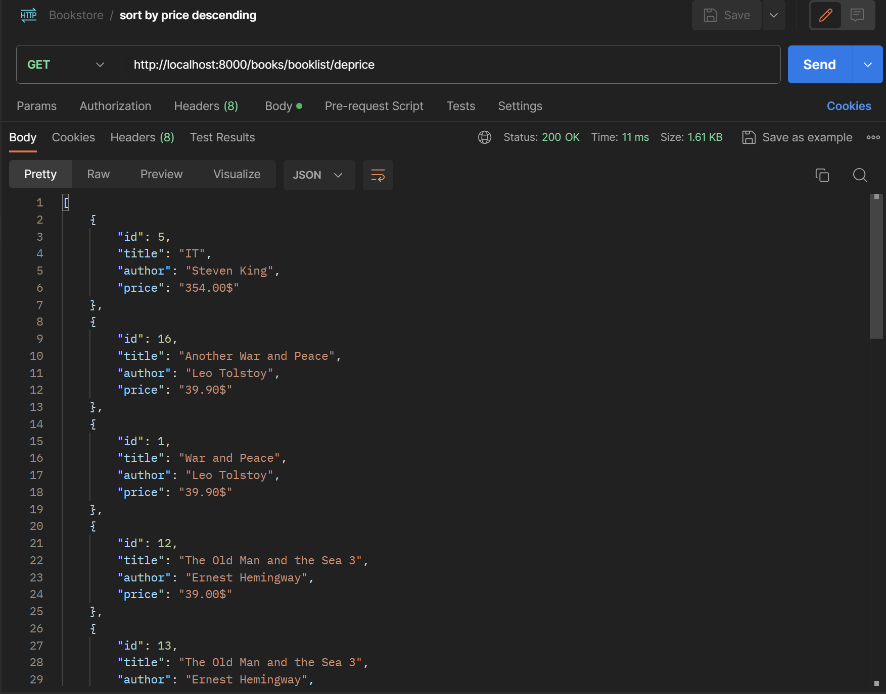
Sort by price descending
def sort_books_by_price_descending(request): books = Book.objects.all().order_by('-price','title') book_sorted = [{'id': book.id, 'title': book.title, 'author': book.author.author_name, 'price': str(book.price) + "$" } for book in books] return JsonResponse(book_sorted, safe=False)

