Slide 1
Traffic Management System 3.1
Fu and Karina

Slide 2
Content
Registering a new vehicle in the system
Recognizing and logging number plates at city junctions

Slide 3
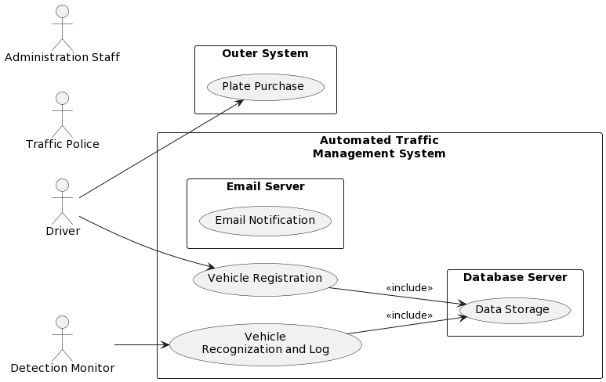

Slide 4
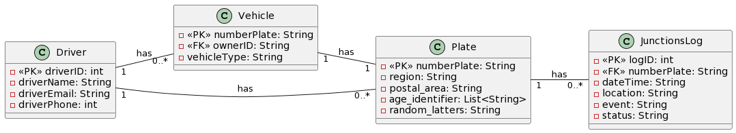

Slide 5
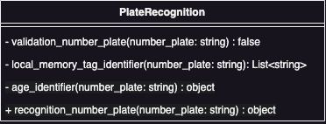

Slide 6
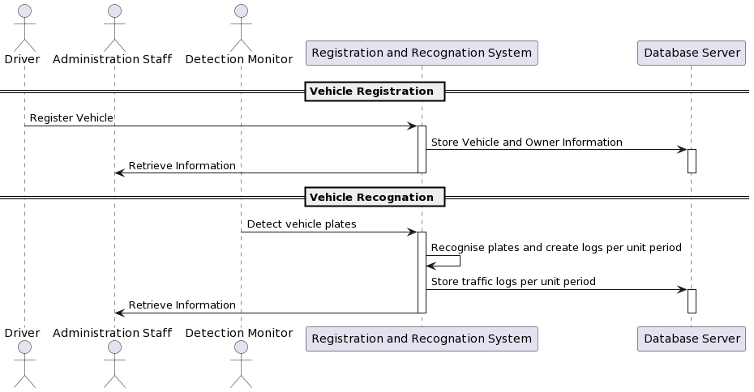

Slide 7
Demo
Register a vehicle
Detect and record junction situation on 24 hours

Slide 8
To be solved
Data validate
Initiate database -> input data set via mysql
Duplicate traffic record
Further logs record
Specific UML

