Slide 1
Traffic Management System 3.2
Fu and Karina

Slide 2
Content
Implementing procedures to detect different violations
Automatically issuing fines
Email notifying system

Slide 3
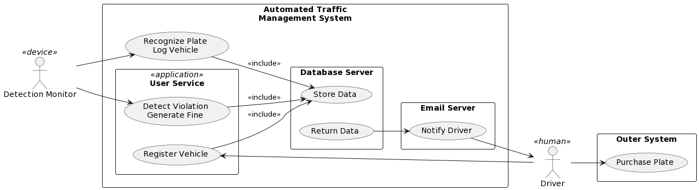

Slide 4
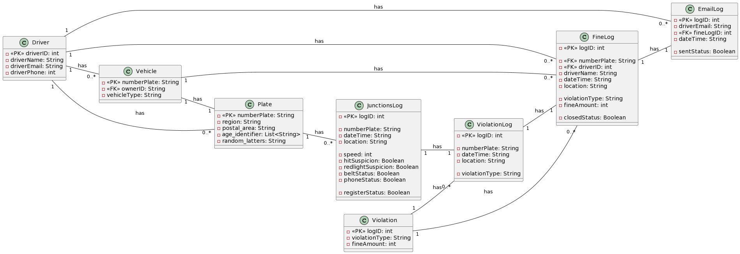

Slide 5
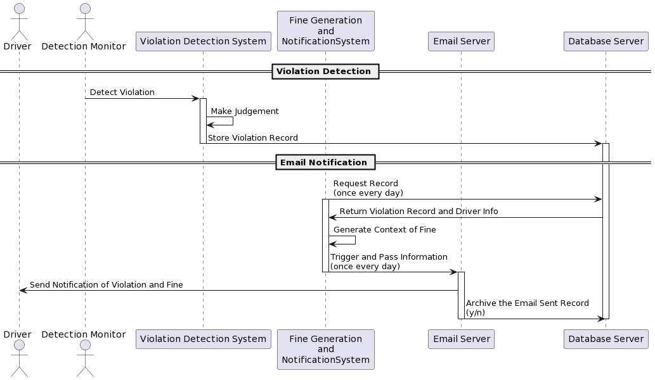

Slide 6
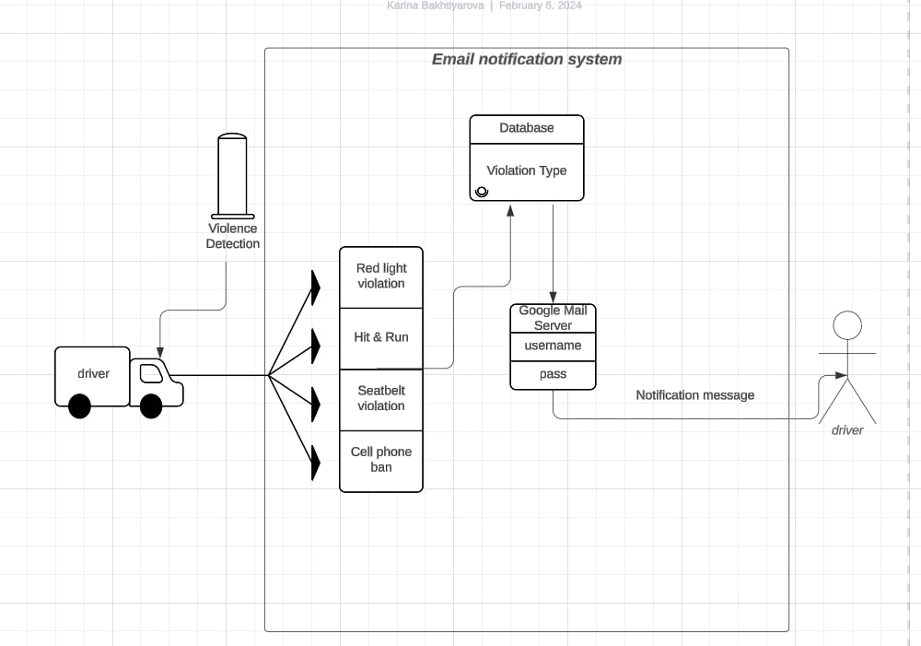

Slide 7
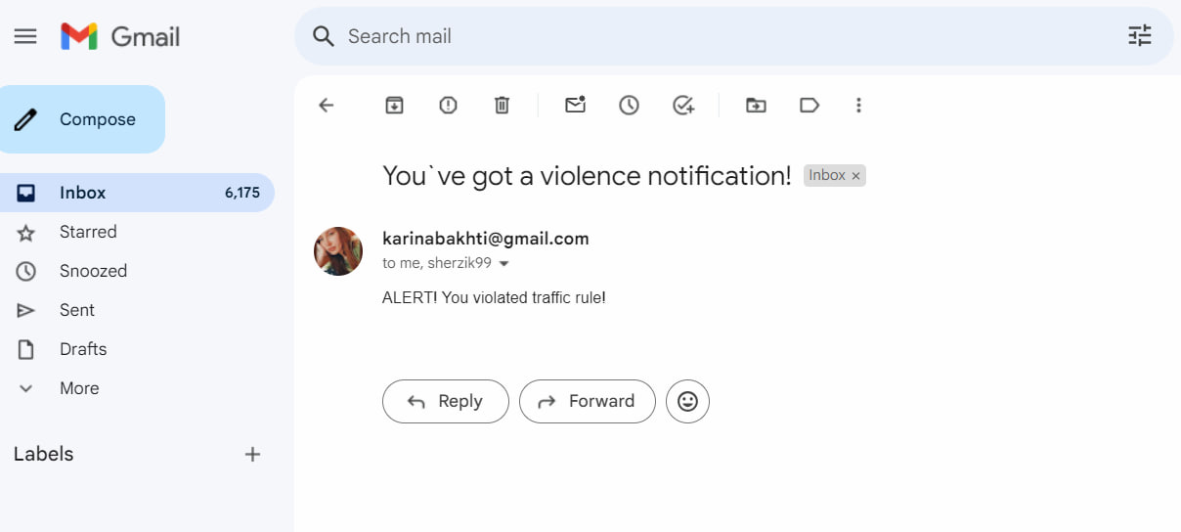

Slide 8
Demo
use detection monitor pro to get data
import data into junction logs
according to date and violation, generate violation log
get driver info accordingly, then generate fine

Slide 9
To be solved
notification system connect to different applications/endpoints

