Slide 1
Traffic Management System 3.3
Fu and Karina

Slide 2
Content
Implementing a feature to analyse the number of vehicles passing through city junctions at different times
improved detection simulator
prediction arithmetic
Identifying areas prone to congestion based on the traffic flow data
visualization according to analysis
notification of prediction result

Slide 3
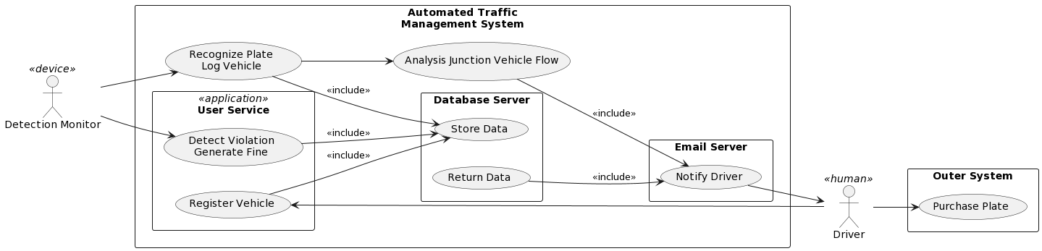

Slide 4
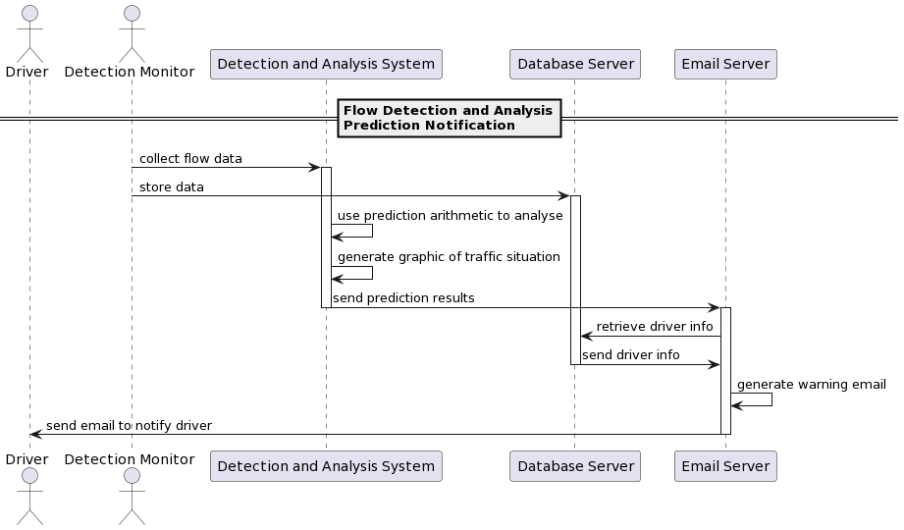

Slide 5
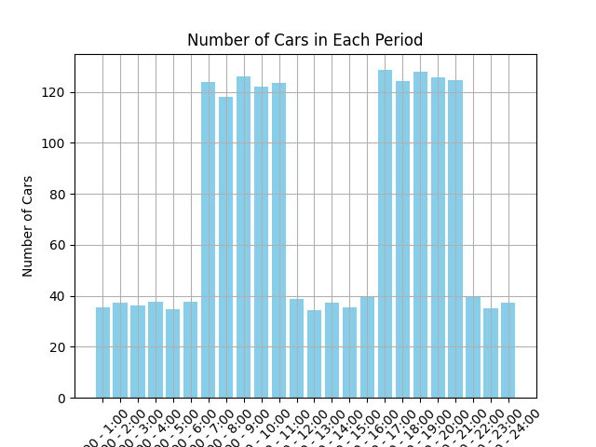

Slide 6
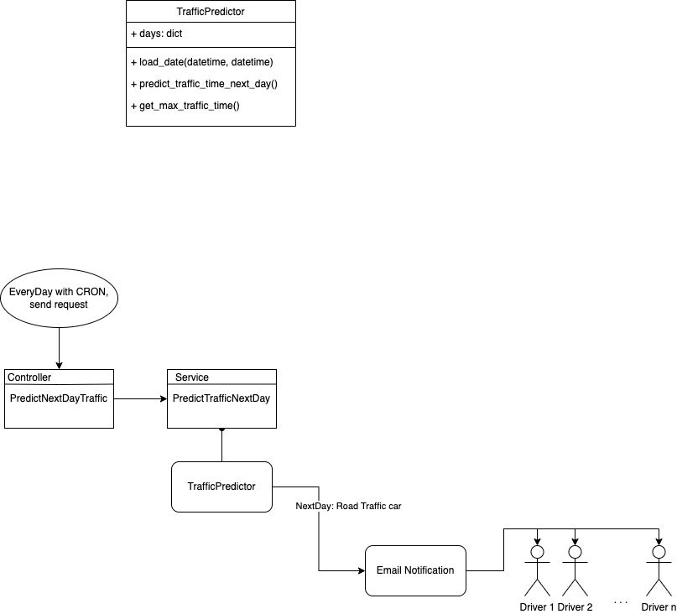

Slide 8
Demo

