Slide 1
Traffic Management System 3.4
Fu and Karina

Slide 2
Content
Implement a procedure to detect emergency vehicles at city junctions
Design a feature to send notifications to other drivers to give way

Slide 3
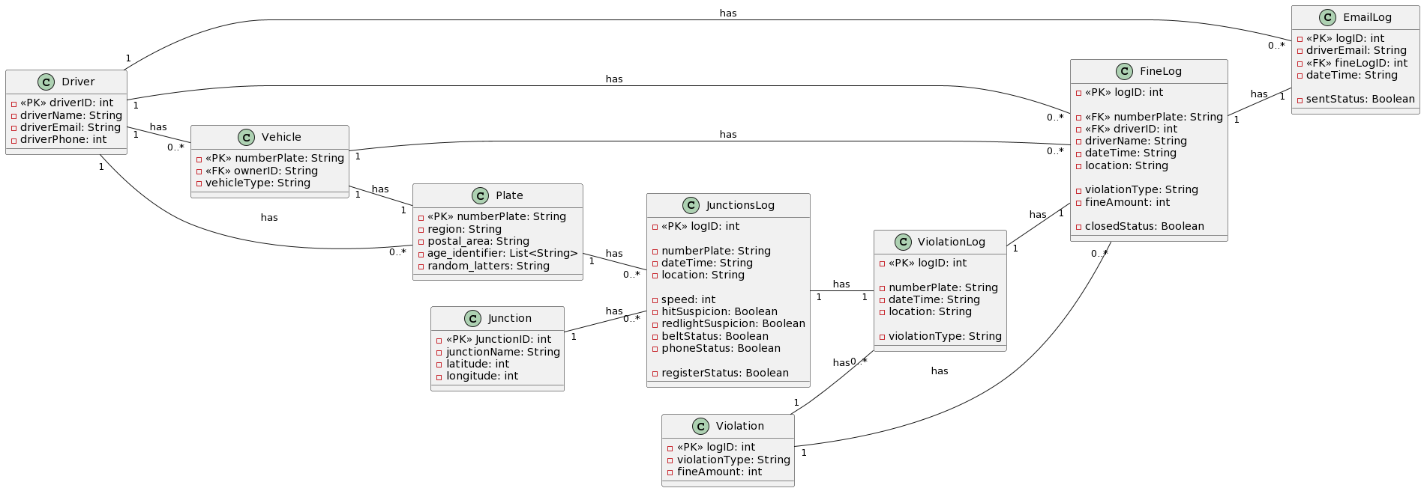

Slide 4
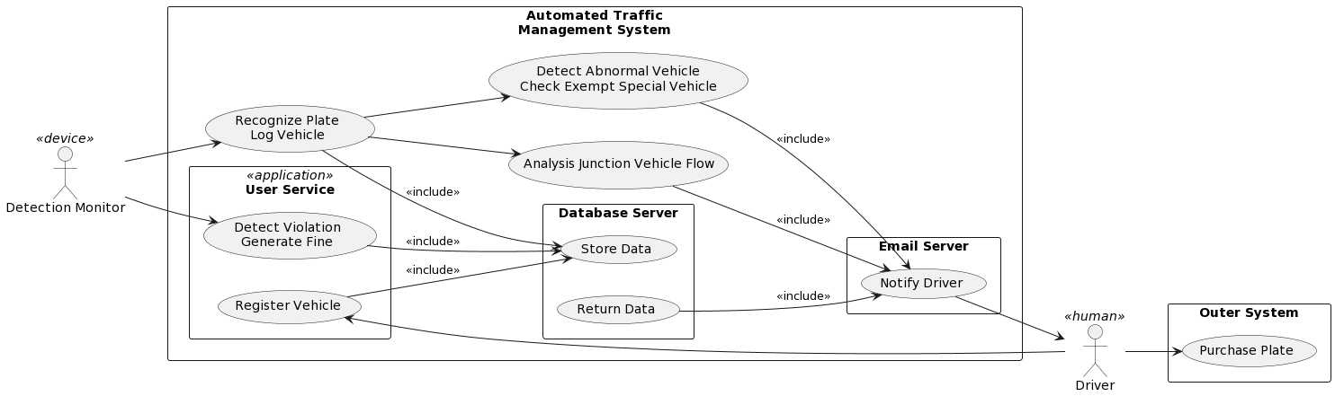

Slide 5
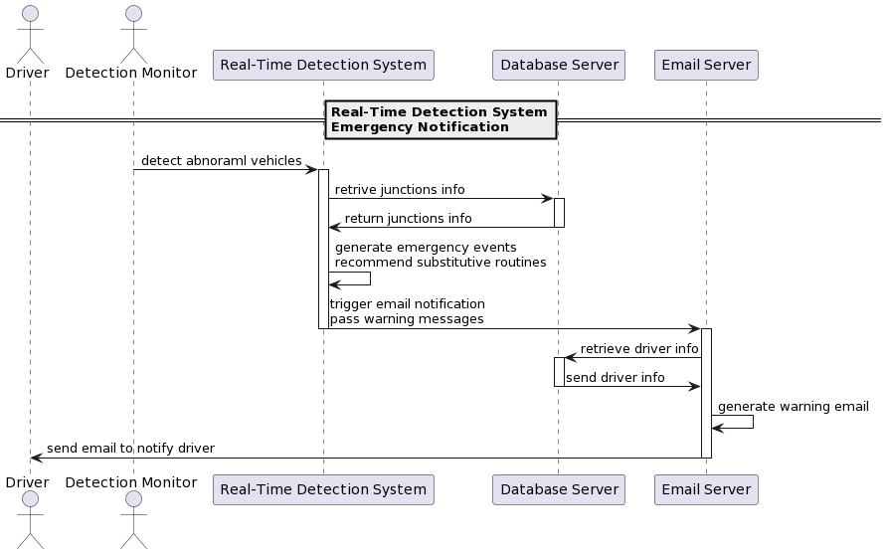

Slide 6
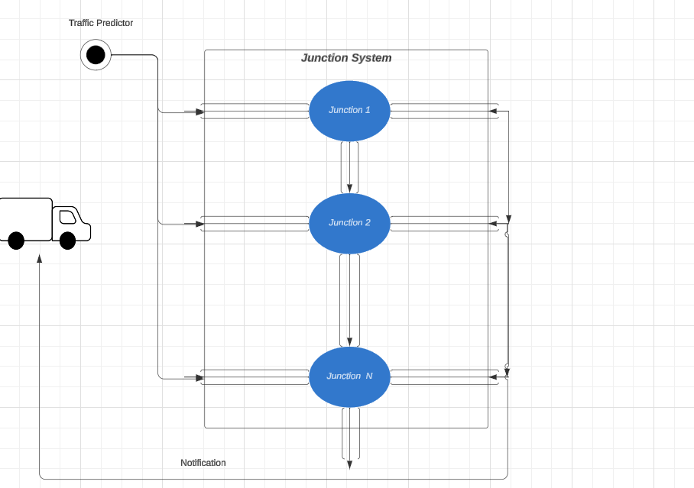

Slide 7
Demo

