Slide 1

eBid | Online Auction
FU & LI
04.23.2024

Slide 2
Content
Module Design
Function Design
Expected Effects
Diagrams

Slide 3
Module Design
Frontend
Next.js
Main Server
Boost.Asio
MySQL
Authentication Server
Django
PostgreSQL
Main
Server
MySQL
Client
Frontend
Auth
Server
PostgreSQL
Notes:
ASIO stands for "Asynchronous Input/Output”
Asynchronous means tasks can be processed parallelly

Slide 4
Functions Design
Business User
Manage inventory
Manage promotion/event
Customer User
Browser items
Take part in auctions
Rate and leave comments

Slide 5

Expected Effects

Slide 6
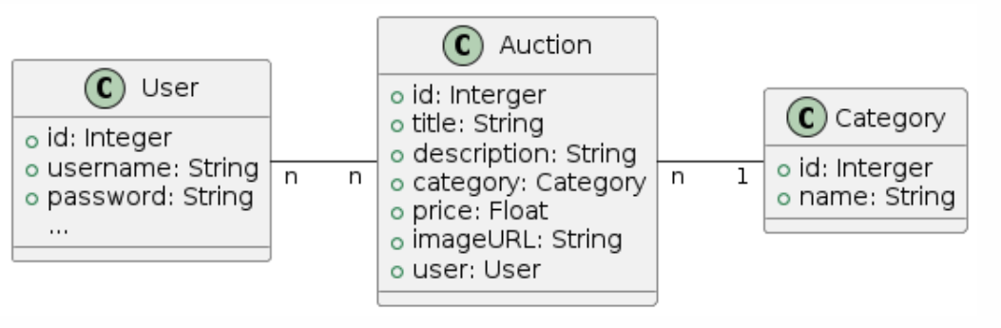
Class Diagram

Slide 7
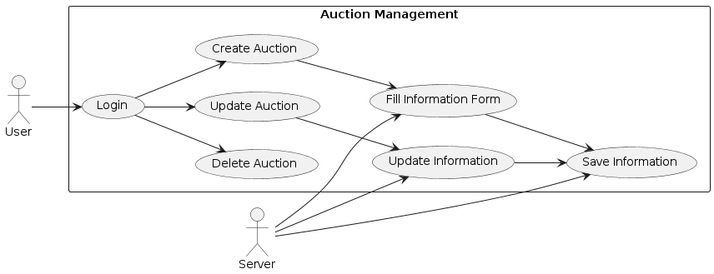
Auction Management Use Case Diagram

Slide 8
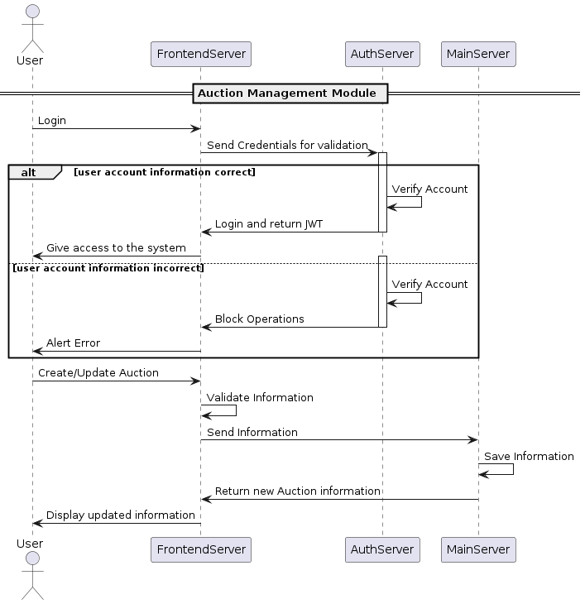
Auction Management Sequence Diagram

